Slide 1


STGS version 1.0
The “Soar Technology Goal System”
Sean Lisse
Software Engineer
lisse@soartech.com
Thinking…inside the box
3600 Green Court • Suite 600 • Ann Arbor, MI 48105
734-327-8000 • Fax: 734-913-8537 • www.soartech.com

Slide 2
STGS Overview
The STGS approach is:
  A declarative forest-of-goals programming methodology and supporting library of Soar productions
  Similar in idea to “Radical Randy”, The “Cambridge approach”
  Currently used as the basis of the agents in CIANC3 and ICF projects at Soar Technology

Slide 3
STGS Intellectual Debts
The STGS grew from the following conceptual roots:
  The Radical Randy Approach (Jones)
  The Cambridge Approach (Gratch)
  BDI Architectures (various)
  The “Phase System” (Lisse, 23rd SW)
  HLSR (Crossman, Wray, Lebiere)
  Help from Soar Tech employees
    Beard, Crossman especially

Slide 4
STGS Motivation
Engineering, not necessarily HBM
  Using Soar to develop intelligent agent systems vs. using Soar to model human behavior
Useful if not Plausible
  While not cognitively plausible to have large numbers of concurrent parallel goals, it is very useful for intelligent agents in real-time applications

Slide 5
STGS Motivation (2)
STGS helps with:
  Management of multiple interleaving goal stacks/threads of control
  Flexible/run-time configuration of goals
  Interagent communication about goals
  Encapsulation of goals and actions
Chunking is Expensive
  Although chunking should hypothetically reduce or eliminate the cost of regenerating a goal-stack that is blown away and rebuilt, in practice it is prohibitively expensive to develop agents that can use chunking in this way

Slide 6
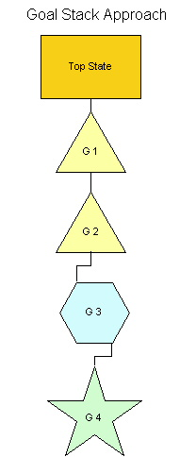
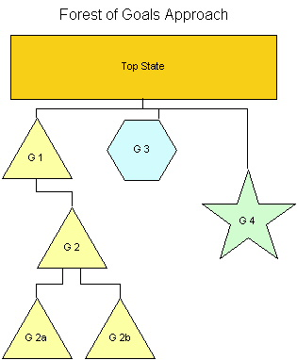
Goal Stacks vs. Forests

Slide 7
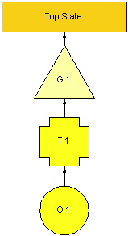
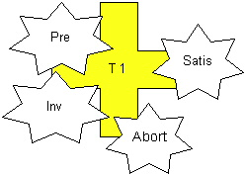
STGS Core Objects
“Goals”
“Transforms”
Operators
“Bind-Points”

Slide 8
STGS Core Objects:
“Goals”
Goals
  Represent something the agent wishes to accomplish
  Do not represent actions, but desired action outcomes
  Are not necessarily an external world state, but are at least derived from world states

Slide 9
STGS Core Objects: “Transforms”
Transforms
  “Declarative Operator proposals”
  Represent some action that the agent wishes to take
  Exist explicitly to separate goals from complex actions
  Existence is dependent upon goals

Slide 10
STGS Core Objects:
Operators
Operator proposal triggered by transform presence
Operator preferences
  Usually indifferent
  Can be set via standard preference mechanism
Operators feed results back to owning transform
Impasses only used for lack of knowledge or error cases

Slide 11
STGS Core Objects:
“Bind Points”
Bind Points
  Hang off of goals and transforms
  Are encapsulated and reified left-hand-side fragments
  Are used to control Goal and Transform activation, as:
    Preconditions
    Invariants
    Satisfaction conditions
    Abort conditions

Slide 12
Anatomy of a Goal or Transform
For ease of maintenance and reasoning, Goals and Transforms share a common structure.
Major G/T data structures:
  Type
  Parameters
  Bind-Points (pre,inv,sat,abort)
  Annotations

Slide 13
Example Goal
Goal
  Type: send-message
  Parameters: “Say Hi to Charlie”
  Bind-Points:
    Preconditions – after 5 pm today
    Invariants – Charlie’s listening
    Satisfaction conditions – “message sent” annotation
  Annotations:
    Half-built message

Slide 14
STGS Benefits:
Soar Language Theory
Impasses only used for errors or lack of knowledge
Goals and Operators not conflated
Increased agent introspection ability
No kernel mods necessary
  Still technically fits within Soar’s UTC framework
Past goal info can be retained for history

Slide 15
STGS Benefits:
Software Engineering Benefits
Multiple threads of control
  And processing of batches of like tasks
Robustness
  One miscoded operator can no longer immobilize entire agent, instead causes “thread impasse”
Explicit parameters facilitate:
  encapsulation
  code reuse
Explicit bind-points and goals help with soar debugging

Slide 16
STGS Benefits:
Complex Goal Processing
Reified goals may be treated as standard soar objects:
  Stored
  Laid out in “plans”
  Manipulated at run-time
  Sent to other agents
Declarative “plan” specification
  Allows pre-built plans to be given to agents
  Flexible levels of autonomy via plans with different levels of specificity
  Built from metagoals
Metagoals

Slide 17
STGS Benefits:
Metagoals
Metagoals standardize a set of mechanisms previously encoded in a combination of one-off proposal LHSs and top-state data
Metagoals developed so far:
  Periodic goal (repeating)
  Sequential goals (partial ordering)
Under development:
  Multiagent shared goals

Slide 18
Performance Costs
Coding time:
  Base STGS: 69 carefully-tuned productions
  Domain knowledge: Each operator must be split into Goal/Transform/Operator (~x2 code w/o counting reuse)
Run time costs:
  4-5 elaboration cycles per goal/transform instantiation (Pipelined)
  Fewer decision cycles overall due to infrequent operator no-change

Slide 19
Nuggets:
Useful Take-Away Concepts
Forest-of-Goals w/ multiple threads of execution
Introspectable and durable procedural artifacts
  (goals and transforms)
Composable and flexible LHS mods
  (bind points, metagoals)
Parameter structures for procedural data artifacts

Slide 20
Coal:
More threads of control means more complex interactions between threads
Lots of WME and elaboration activity
Lots of new things that live on top of soar architecture to learn
If goal forest is very busy, it can be difficult to track
Less use of the goal stack means chunking comes into play less often
  Though this can be used to “choose your chunks”

Slide 21
Looking Forward:
(STGS 2.0?)
Additional ease-of-use advancements
Goal Priorities + preferences
If LTM system available, store inactive historical goals in LTM
Soar Kernel modifications?
  Volunteers?

Slide 22
Questions?
Ask away

Slide 23
Sponsors
This presentation was prepared under a Department of the Army Small Business Innovation Research Program 2000.2 contract for topic A02-024 (contract #DASW01-03-c-0019).
We gratefully acknowledge the sponsorship of this research by the United States Army Research Institute and thank ARI Program Manager Carl Lickteig for his guidance and support.

Slide 24
Thanks
Special thanks are owed to:
The HLSR project
Dr. Randy Jones
Jon Beard

Slide 25
Additional Slides
Resource allocation and tracking

Slide 26
Goal/Transform
Activation Stages
Goals and Transforms can be:
  Created – goal is desired
  Potential – goal is considered
  Active – goal is pursued
  Achieved – goal is completed
  Aborted – goal was considered, found unachievable
  When Achieved/Aborted, no longer Potential
  Must be Potential to be Active

Slide 27
Anatomy of a Goal or Transform (2)
Type
  Fixed string
  Like operator names - namespacing
Parameters
  Main source of input info to the Goal or Transform
  Like the parameters to a function in a procedural language

Slide 28
Anatomy of a Goal or Transform (3)
Bind-Points
  Control G/T activation level
  Fed by domain-specific elaborations
Annotations
  Localized “working space”
  Used to keep notes on progress of G/T
  Used to accept messages from other G/Ts
  Vanish when G/T is deactivated

