Slide 1

Soar as a Story Director
Brian Magerko
University of Michigan

Slide 2
Interactive Drama
A drama that includes the human player as an important actor in a virtual space.
The resulting story is dependent both on the system presenting the drama and the player’s interactions with that system

Slide 3
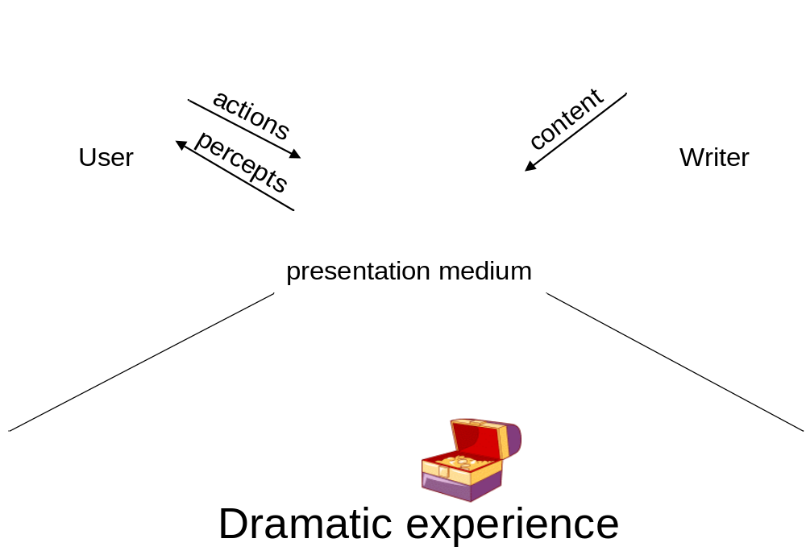
Generic Interactive Drama

Slide 4
Our View of Interactive Drama
Author communicates a particular artistic vision
  Specific temporal structure
  Humans are great storytellers
  “I want control from beginning to end.”
The User is a character in the story
  Behavior may be positive or negative to the story
  “I want to act how I want in the story.”
How do we balance the tension between author and User desires?
Novel approach to Interactive Drama,
using existing AI techniques
Notes:
From Soar 2003 talk

Slide 5
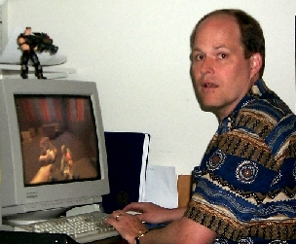
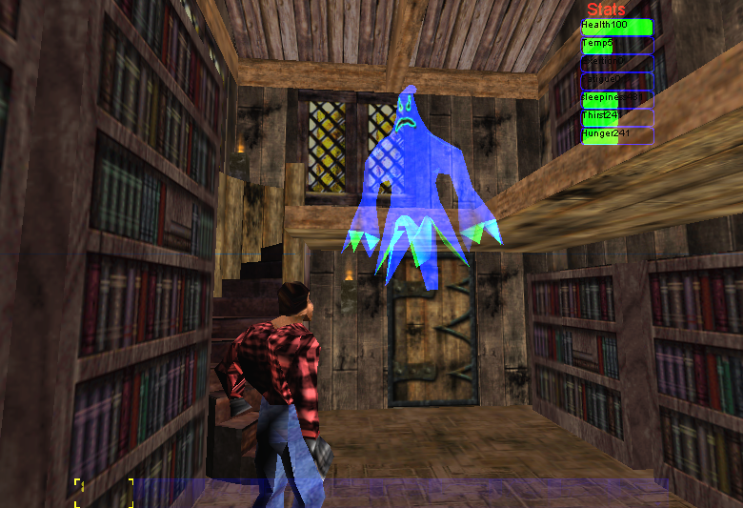



Haunt 2
Human player
percepts
user actions
AI
Actor
direction
abstract plot
Human
Writer
Built in Unreal Tournament
AI Director
Interactive game, populated by human-like AI characters with an AI
director that dynamically controls an unfolding story.

Slide 6
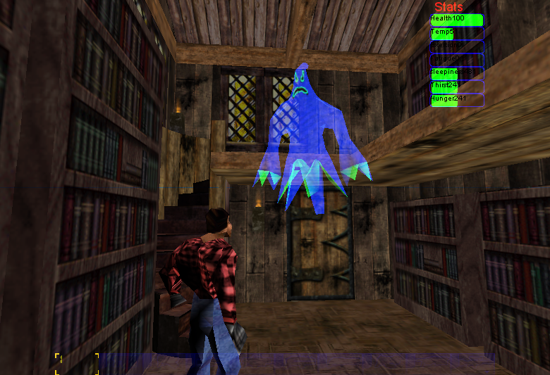
Haunt 2
Soar
Unreal
Tournament
Soar/UT
Interface
long-term memory
skills, doctrine, tactics
encoded as rules
SGIO
SGIO
Perceptual
models
Motor control
language
Physiological
model
Physics
input
input
movement physics perception terrain
animations buildings
graphics sounds
networking
short-term memory
Perception, situation, goals
output
output
Perceive
Decide
Act

Slide 7
Soar as Actors
Goal-based behavior
  Soar agents
  Basic world knowledge (navigation, item use, communication)
Individualized personality
  Physiology
  Emotion modeling (Bob Mariner)
Directable (Mazin Assanie)

Slide 8
An Example Scene
The Innkeeper and John, the professor, are in the lounge. They have a conversation about the building, including the Innkeeper mentioning several rooms that may be of interest to the User. John mentions the turbulent relationship he’s had in the past with another guest here, Sally. The User should be nearby to learn this information.

Slide 9
Story Representation
Plot points created as WME’s by human author
Preconditions match to world state
Actions are the associated actor performances, to be executed once all preconditions are matched
Timing constraints describe pacing in the world
Plot points connected to each other via a partial-ordering
“Active” if all of its parents have been performed
At(Lounge, John)
At(Lounge, Innkeeper)
Proximity(User, John, 1)
Begin: 10 sec.
End: 120 sec.
Talk(John, Innkeeper,house_conv)
preconditions
actions

Slide 10
Soar as a Story Director
Hypothesizes both actor and user knowledge / state
Directs actors to perform according to the plot (e.g. “perform conversation” or “go to lounge”)
Directs actors / the environment in response to errant user behavior
Employs a predictive model of user behavior for preemptive story direction

Slide 11
Errant User Behavior
Errant behavior is any set of actions (including inaction) that keep an active plot point’s preconditions from being fulfilled
  E.g. the user stays away from the lounge and the timing constraints are violated
The Director may execute “attract user to lounge” or “go to user to have conversation” in response

Slide 12
Director Execution Cycle
Haunt 2 environment
execute direction
predicted behavior threatens an active plot point
precondition for active plot point only involves agents
observable game features
timing constraint violated
all preconditions for an active plot point are true
knowledge maintenance
knowledge
set appropriate descriptors as true / false
plot monitoring
new plot-revelant fact
model player
new plot point has been set as active
hypothesize entity knowledge
keep track of world state
mark plot points as active / done
At(Lounge, John)
At(Lounge, Innkeeper)
Proximity(User, John, 1)
Begin: 10 sec.
End: 120 sec.
Talk(John, Innkeeper,house_conv)

Slide 13
Domain Dependence / Independence
Haunt 2 environment
execute direction
predicted behavior threatens an active plot point
precondition for active plot point only involves agents
observable game features
timing constraint violated
all preconditions for an active plot point are true
knowledge maintenance
knowledge
set appropriate descriptors as true / false
plot monitoring
new plot-revelant fact
model player
new plot point has been set as active
hypothesize entity knowledge
keep track of world state
mark plot points as active / done
domain dependent
domain independent

Slide 14
Operator Hierarchy
record-entity
update-entity
check-preconds
execute direction
model user
conversation
knowledge
drink
location
physiology
proximity

Slide 15
Direction Choice
Director action choice is based on an authored mapping of predicates of preconditions to one of a set of strategy types
A set of different actions may fall under a single strategy type
sp {direction*location*propose*actor-to-area
(state <s> ^name execute-direction
^descriptor <d>
^top-state. command <com>)
(<d> ^type location
^area <area>
-^entity.name |User|)
(<com> ^type move
^area <area>
^phrase <phrase>)
-->
(<s> ^operator <o> + =)
(<o> ^name actor-to-area
^type direction
^descriptor <d>
^command <com>)
}
execute direction
location

Slide 16
User Prediction
Creates an internal copy of the world state
  Includes hypothesized user knowledge
  Creates a fake ^top-state and ^io
User model (for now) is a subset of the HauntBot agent that runs
Director actions for meeting preconditions can be executed in modeling world
All actions cost some fixed amount of time
Modeling success depends on whether or not preconditions are fulfilled before the modeled time clock passes the plot point’s end timing constraint

Slide 17
Knowledge Taxonomy
attraction
world
knowledge
Relationships*
repulsion
long-term
rules
knowledge
short-term
items
story goals
entities
Mental
actor goals
areas
goals
model goals
Emotional*
?
Taxonomy of knowledge used in Haunt director and actors
temperature
inventory
thirst
Physical
physiology
fatigue

Slide 18
Near future Work
Finishing the details for a demo this summer
  Resolving issues with partial-ordering of plot
  Authoring plot content
View user modeling and direction probabilistically
  How likely is the user to fulfill the active plot points’ preconditions given his history and how much time has passed?
  How likely is a given direction going to succeed in guiding the user to fulfill the preconditions?
Heuristic choice of direction actions
  Subtlety
  Believability
  Effectiveness
  …?

Slide 19
Nuggets and Coal
Nuggets
  The system actually works now. A complete story can be told
  Can start working on the interesting questions concerning user modeling in an interactive drama
  Soar has proven to be more than suitable for the domain
Coal
  Still don’t have a useful user model
  Partial-ordering of plot is hard without explicit choice points
  Interactions in Haunt 2 are severely limited

