Slide 1

A New Soar Debugger in Java
Douglas Pearson
ThreePenny Software
douglas.pearson@threepenny.net

Slide 2
Goals
Re-examine what we’d like in a debugger
  Address limitations in the current tools
  Provide some new useful capabilities
  Define an approach for debuggers in general
Develop a “Debugger Framework”
  Everything modular and extensible
  User configurable
  Not just “our view” of what’s good in a debugger
Define how debuggers should connect to Soar
  Embed new capabilities in (or near) the kernel so available to all debuggers / utilities
  Text based equivalents for all debugger commands

Slide 3
Debugger Framework
Debugger is assembled out of a collection of modules
Each module
  Manages a window
  Can issue commands to other windows/modules
  Can post events for other windows/modules
  Maintains its own persistent storage
  Offers its own settings and options
  Can be written by the user community (eventually)

Slide 4
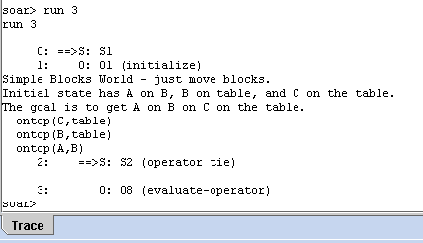
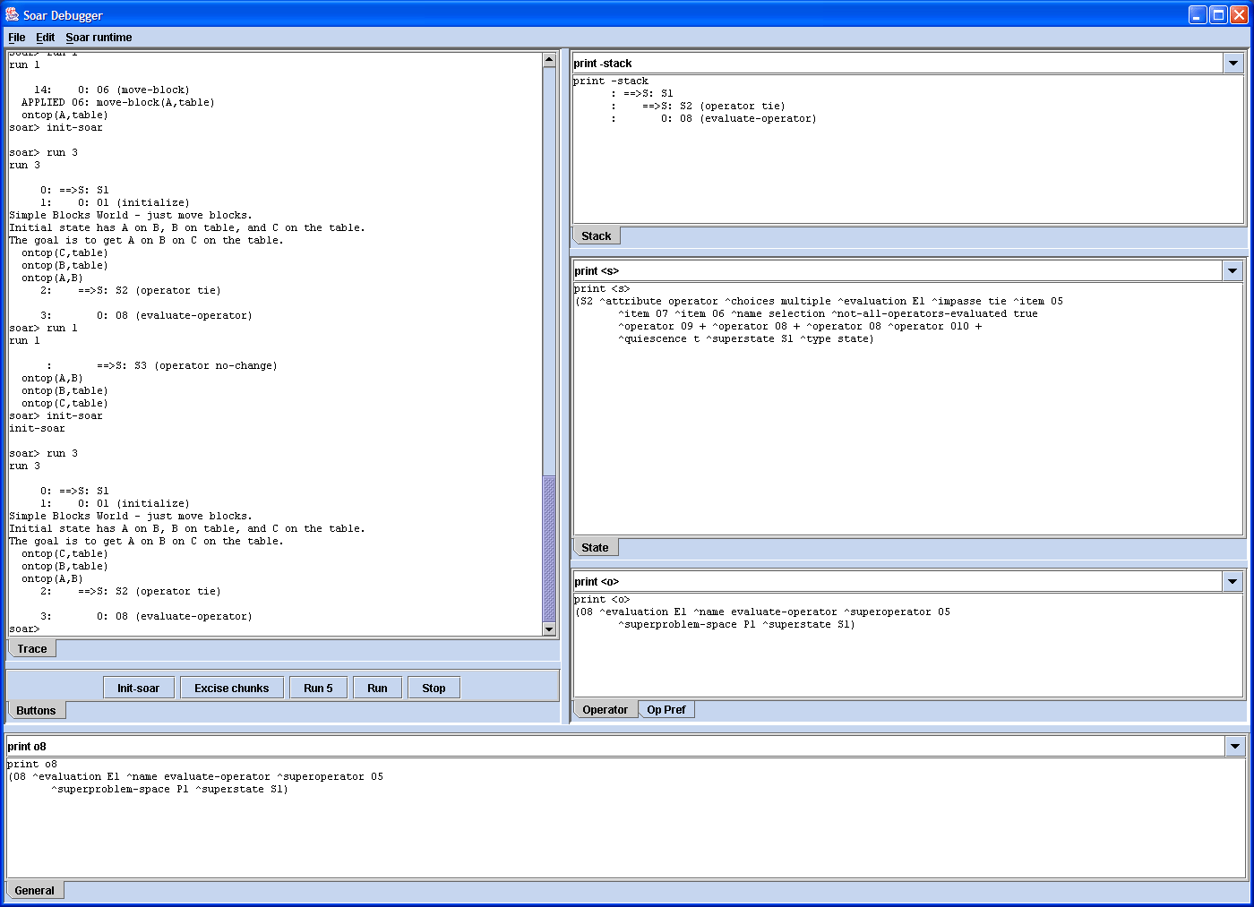
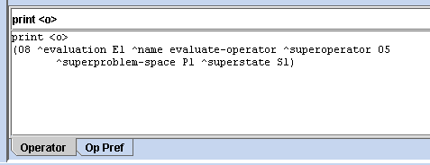
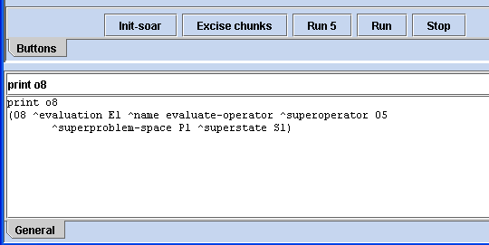
User Defined Behavior

Slide 5
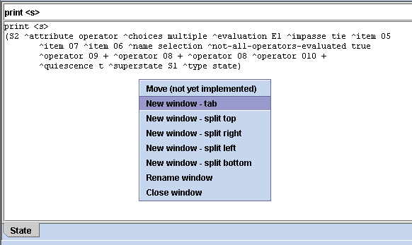
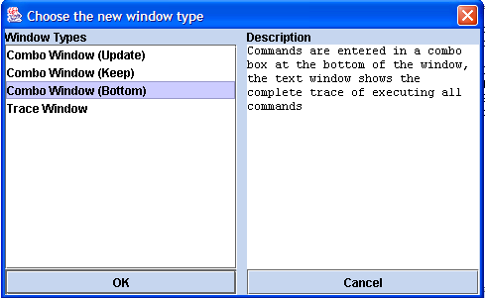
User Controlled Layout
Add or Remove windows
Selecting from the list of modules
Save and Load layouts

Slide 6
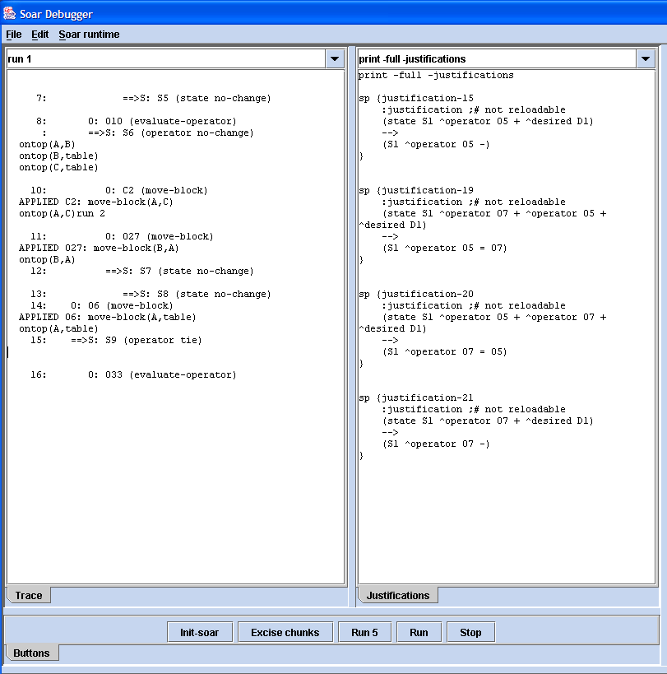
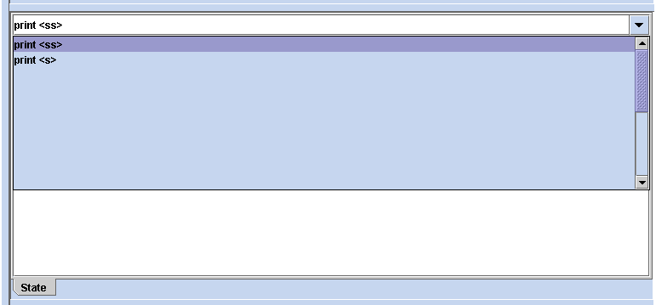
Speed and Convenience is Vital
Store command histories
Store window positions
  Save/Load different layouts for different contexts

Slide 7
Connecting to Soar
Connection point into Soar: gSKI or not?
  Soar Consortium
Existing tools rely on sending strings and parsing strings
  Any change in output format breaks tools
Alternative is to send and receive XML
  Provides logical description of commands and output
    Plus usual XML benefits (nesting, lots of tools, transparent…)
  Makes logging easy
  Makes remote access easy
  Embedded is still efficient
Remote
XML
File
XML
File
XML
Object
XML
Object
Soar
(gSKI)
XML
Object
XML
Object
Soar
(gSKI)
XML
Object
XML
Stream
Soar
(gSKI)
Soar
(gSKI)
XML
Object
XML
Object
XML
File
Tool
(Debugger)
Tool
(Debugger)
Tool
(Debugger)
Tool
(Debugger)

Slide 8
XML Communication
Debugger and Soar as separate processes
Soar logs to file; review later in Debugger
Tool
(Debugger)
XML
Object
XML
Stream
XML
Object
Soar
(gSKI)
Tool
(Debugger)
XML
Object
XML
File
XML
Object
Soar
(gSKI)

Slide 9
XML Communication
Debugger and Soar as Remote processes
Debugger with Embedded Soar
Remote
Tool
(Debugger)
XML
Object
XML
File
XML
File
XML
Object
Soar
(gSKI)
Tool
(Debugger)
XML
Object
Soar
(gSKI)

Slide 10
Multi-Level Traces (via XML)
Log traces at higher detail levels than displayed
  Go back and review
0: ==>S: S1
+1: O: O1 (initialize)
+2: ==>S: S2 (operator tie)
+3: O: O10 (evaluate-operator)
0: ==>S: S1
- 1: O: O1 (initialize)
--- Application Phase ---
--- Firing Productions (PE) ---
Firing blocks-world*apply*initialize
--- Change Working Memory (PE) ---
--- Application Phase ---
--- Firing Productions (IE) ---
Firing blocks-world*monitor*world-state
Firing blocks-world*monitor*world-state
Firing blocks-world*monitor*world-state
Firing blocks-world*elaborate*state*clear-table
Firing blocks-world*elaborate*state*clear
Firing blocks-world*elaborate*state*clear
Retracting blocks-world*propose*initialize
--- Change Working Memory (IE) ---
+2: ==>S: S2 (operator tie)
+3: O: O10 (evaluate-operator)

Slide 11
Debugger Environment
Run debugger with embedded Soar instance
  Visual Studio parallel
Run debugger with separate Soar process
  Remote debugging or Soar embedded in environment
Run Soar and then attach debugger later
  Useful when have many agents, one with problems
Run Soar and log output, review in debugger later
  Maximum performance or customer problems
Run debugger inside Eclipse (part of full IDE)
  Vision for the future perhaps; SWT?

Slide 12
Nuggets and Coal
Early days
Large scale progress
  How to connect Debugger to Soar
  How to connect to future versions of Soar
Vision for the future
  Lots of cool features
    Multi-level watch; macros; connect WMEs to rule (via match)…
  Modular design, user controlled vision of debugger
Can’t deploy anything yet
  Still building infrastructure

