Slide 1


SOAR Processing with
Field Programmable Gate Arrays
Presented by
Matthew Scarpino
Hoplite Systems LLC

Slide 2
Introduction
Technical focus: applications of reconfigurable computing
Selected for initial funding by DARPA
  “Cognitive Processing Hardware Elements”
RAISE – Reconfigurable Architecture for Improved Soar Execution

Slide 3
What is Reconfigurable Computing?
Altering architecture and content to meet the behavioral requirements
CPU
  Changing content, fixed architecture
  Optimized for general-purpose applications
FPGA
  Content/architecture dynamically configurable
  Can be optimized for a specific application

Slide 4
Virtex-II FPGA Structure
4
FG
FF
C
A
R
R
Y
MEM
4
FG
FF

Slide 5
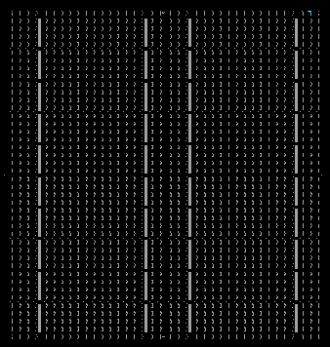

Virtex-II FPGA Structure

Slide 6
Virtex-II Configuration
Similar to compilation/assembly in CPU
Sends a bitstream into the FPGA
Traditional process:
  Verilog, VHDL
  Hardware design synthesized into netlist
  Netlist implemented onto specific device

Slide 7
Virtex-II Configuration
Non-traditional: Low-level design
  Configure each FPGA resource separately
  Used for designs with repeated structures
  Allows for partial reconfiguration
    Configure individual columns of an FPGA
    Vital for reconfigurable computing

Slide 8
Challenge of Embedded Soar: Rete
TOP NODE
ALPHA1
JOIN
BETA
ALPHA2
JOIN
WMEs
BETA
ALPHA3
JOIN
JOIN
BETA
ALPHA4
JOIN
JOIN
PRODUCTIONS

Slide 9
Challenge of Embedded Soar: Rete
Structure depends on production rules
  Net re-arranges with changing conditions
Requirement: Dynamic Memory Allocation
  Needed for linked-lists, pointers
  Interacts with Memory Management Unit
  Difficult on an embedded, distributed system

Slide 10
RAISE Structure
Dynamic memory allocation is not an option
  FPGAs and OS-less embedded processors
Fixed amount of memory for each object
  Advance knowledge of object attributes
    Determined by input or goal context experience
  Each attribute stored in particular order
  Each attribute takes a single value

Slide 11
RAISE Structure
Object Memory
Switching
Logic
Production
Output
WMEs
Operators

Slide 12
RAISE Structure
Simplification and Compression
  Keep memory requirements to a minimum
  Remove unnecessary data structures
  Examples: WMEs and Preferences
Scalability
  Concurrent FPGA processing
  Greater efficiency than SMP
  Division of labor

Slide 13
RAISE Structure
FPGA
FPGA
  Contains object memory (WMEs)
  Performs combinational logic
Configuration Device
  Activates operators
  Configures FPGA
Configuration
Device
(CD)

Slide 14
RAISE Operation
PERCEPTION/
SYMBOL
GENERATION
ALPHA MEMORY
BUFFER
CONFIGURATION
DEVICE
ACTUATION/
CONTROL
FPGA

Slide 15
Conclusion
Design still in planning stage
  Will evolve as work progresses
Structural analogue for cognitive processing
  Distributed memory and processing
  Combination of small computational elements
  Behavior controls structure

