Slide 1


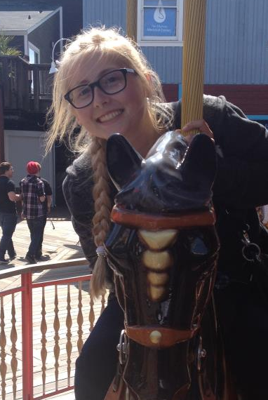


Efficient Episode Recall and Consolidation
Allison Seibert & Alexandra Warlen
Emilia Vanderwerf & Robert Stiles
Notes:
UP logo
Pictures of us
Allie

Slide 2
Task: Hashing Episodes
(Wallace, et.al. 2013)
(S1 ^epmem E1)
(E1 ^command C1)
(E1 ^present-id 1)
(E1 ^result R2)
(S1 ^io I1)
(I1 ^input-link I2)
(I2 ^eater E2)
(E2 ^name red)
(E2 ^score 0)
(E2 ^x 13)
Hash Fn
0 | 1 | 1 | 0 | … | 1
Recognition without Recall (Wallace, et.al. 2013)
Hash Function Requirements:
Fast
Repeatable
General
Constant time
Notes:
Hashcode (n bits)
Show animation of how hashing works based on episodes/WMEs
Give background of tests (data: number of WMEs, # of episodes, slowly changing data sets)
Alex
mention that data is completely undefined - could be not in english, size of episode could vary, could be pictures, words etc. All we know is the structure would be in the format of WMEs

Slide 3
Motivation: Feature Importance
New Requirement: similar episodes generate similar hash values
Encoding – do I need to encode this?
Storage – is it ok to forget this?
Retrieval – what is the best match for this cue?

Slide 4
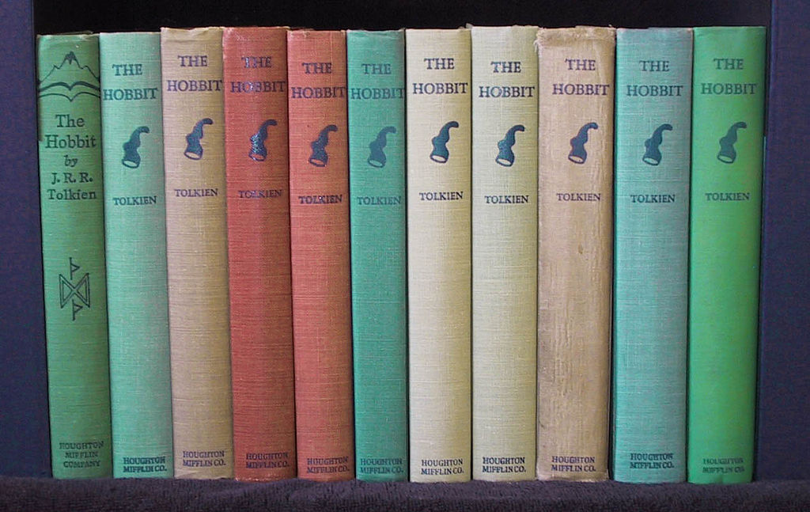
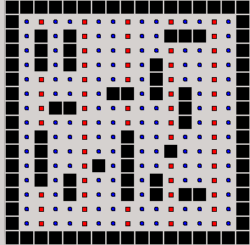
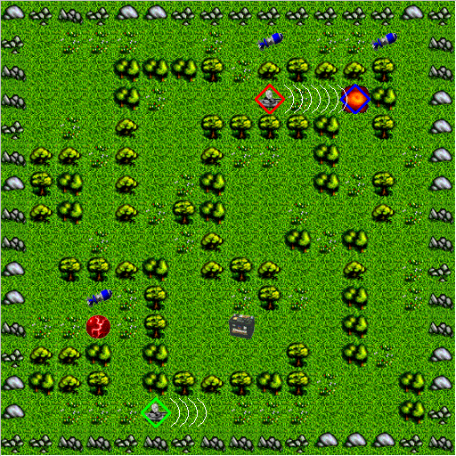
Environment
Notes:
General problem – hashing episodes to be represented in an ‘n’ bit hashcode
Talk briefly about what data was used (eaters, tank soar, Siddhartha)
UML maybe just main classes (WME, Main, and hashFn/SweetSpot)
Value of this: face value, finding what is important info for encoding storage retrieval, effective hash fn can be used for recall too
eaters - 580 and something episodes 150 wme’s per ep
tanksoar - 640 average of 100
Allie
replace siddhartha with something
replace UML with tank soar
remove credits from eaters

Slide 5
CURRENT EPISODE
(S1 ^epmem E1)
(E1 ^command C1)
(E1 ^present-id 1)
(E1 ^result R2)
(S1 ^io I1)
(I1 ^input-link I2)
(I2 ^eater E2)
(E2 ^name red)
(E2 ^score 0)
(E2 ^x 13)
Hash Formula
0: epmem E1
1: input-link I2
2: north E4
3: score 0
4: content bonusfood
Hash Code Size: 5
0 1 2 3 4
epmem E1 | input-link I2 | north E4 | score 0 | content bonusfood
1
1
0
1
0
Notes:
Will add animation so down-arrow moves along hash code
preface this slide - “one approach is…”
Emphasize that this is not the only way to create a hashcode

Slide 6
Genetic Algorithm Hashing
(Holland 1992)
Generation I
Generation II
1: Parents
2: Children
3: Mutations
4: Find the two best children
5: Rinse and Repeat
Notes:
Citation!
-→ lead into Sweet Spot
Allie
GREAT ANIMATION! Except!!! One mutation SOMETIMES! (Your choice to change) O.o
Soar people are too good for this slide - keep it for thursday though
This is CHEATING (to be used as a benchmark)

Slide 7
Folding Hash Function
(Bloom 1970)
Never gonna give you up
Never gonna let you down
1
1
1
1
1
0
never
gonna
give
you
up
Notes:
General idea behind how it works and why it was a good idea
Show some simple examples
Allie
VERY GOOD SLIDE!!! Allie is awesome!
Inspired by looking at bloom filters (reference it!)
AND CITE IT
Put bobby and emilias faces here!! Let them know that this was their algorithm

Slide 8
Folding Hash Function
(Bloom 1970)
Never gonna give you up
Never gonna let you down
1
1
0
1
0
1
never
down
gonna
give
you
up
let
Notes:
General idea behind how it works and why it was a good idea
Show some simple examples
Allie

Slide 9
Folding Hash Function
(Bloom 1970)
Never gonna give you up
Never gonna let you down
Never gonna run around and desert you
Never gonna make you cry
Never gonna say goodbye
Never gonna tell a lie and hurt you
1
1
1
0
1
1
never
down
make
lie
gonna
run
cry
and
give
around
say
hurt
you
and
goodbye
up
desert
tell
let
make
a
Notes:
General idea behind how it works and why it was a good idea
Show some simple examples
Allie

Slide 10
Folding Hash Function
(Bloom 1970)
Never gonna give you up
Never gonna let you down
Never gonna run around and desert you
Never gonna make you cry
Never gonna say goodbye
Never gonna tell a lie and hurt you
1
1
0
1
0
1
never
down
make
lie
gonna
run
cry
and
give
around
say
hurt
you
and
goodbye
up
desert
tell
let
make
a
Notes:
General idea behind how it works and why it was a good idea
Show some simple examples
Allie

Slide 11


Locality Sensitive Hashing
(Indyk, etl.al. 1998)
≈
Dictionary
Hash Formula - Code Size 5
epmem E1
input-link I2
south N3
north E5
score 0
content wall
content eater
content eater
score 0
north E5
input-link I2
epmem E1
content wall
south N3
Notes:
Acknowledge that its an existing algorithm
cite it!!
take off numbers
when introducing slide:
Different parts of the hashcode are hashed independently
2 images are considered “similar” if any one of the subsections is the same
Problem: presumes previous knowledge of data type

Slide 12

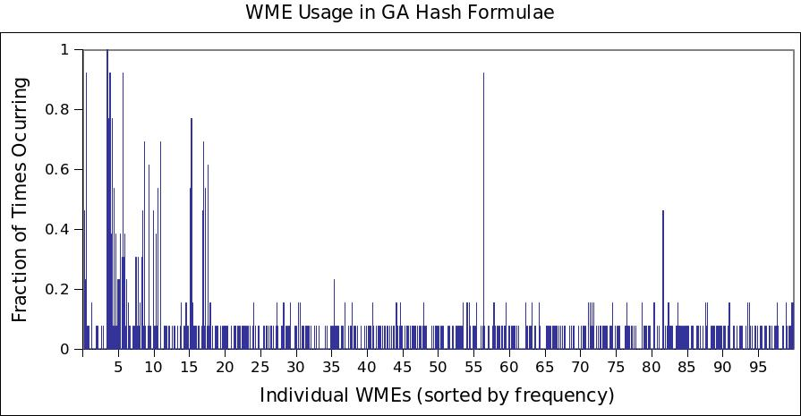
Sweet Spot Hash Function
GA is selecting WMEs with moderate frequency of use.
Notes:
preface with: “This is our attempt at mimicking GA…”

Slide 13
Sweet Spot Hash Permutations
Replacing Hash Formula
never
gonna
give
we’re
no
and
rules
in
love
you
know
the
so
i
strangers
you
up
let
down
run
around
{
{
never
gonna
give
we’re
no
and
rules
in
love
you
know
the
so
i
strangers
you
up
let
down
run
around
give
we’re
no
and
rules
we’re
in
no
and
rules
in
Notes:
mention that dictionary is sorted in order of frequency.

Slide 14
Folding Sweet Spot Hash Function
VS
Never Gonna You
And
Never gonna give you up
Never gonna let you down
Never gonna run around and desert you
Never gonna make you cry
Never gonna say goodbye
Never gonna tell a lie and hurt you
Let Give Desert
Cry Goodbye
111
111
111
111
110
111
010
100
001
100
010
000
Notes:
wanted hash function that resisted change
any change to the hash formula would ruin many previous hashcodes
decided to look into folding since it never got rid of any WMEs
but still liked the idea of having a sweet spot
combined folding and sweetspot to get rid of both function’s problems
found that cutting off top 98% of the dictionary yielded best results - better than reg folding since it uses much more obscure words, meaning less episodes will hash to the same hashcode (better unique)

Slide 15
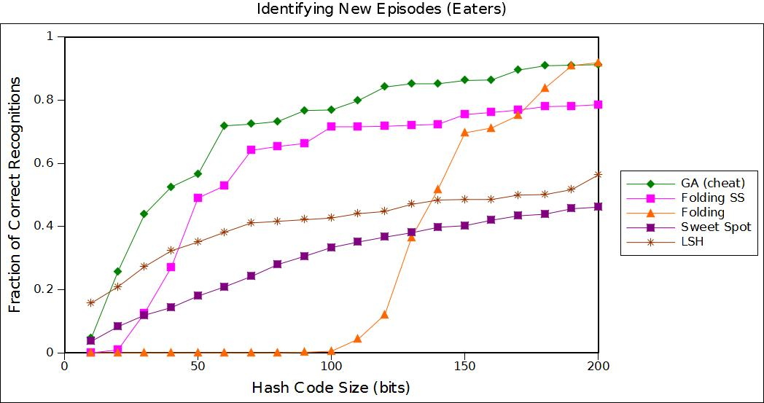

Slide 16
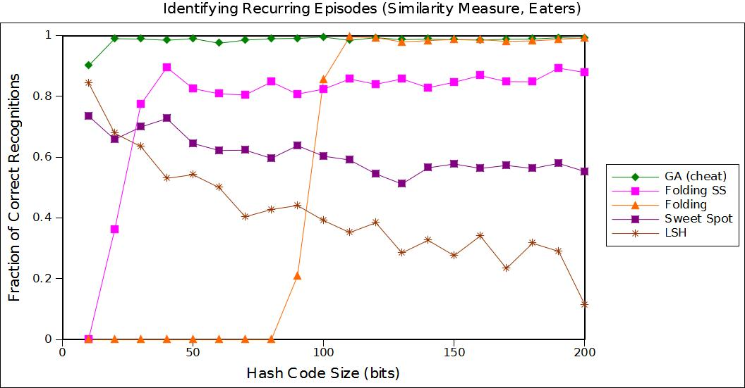

Slide 17
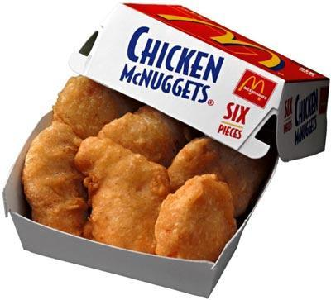
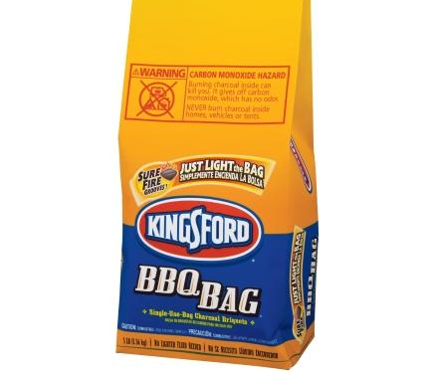
Nuggets and Coal
Folding SS was able to reproduce GA results with smaller hashcode size
Folding SS relies upon having a dictionary of known features (potentially grows forever)
Notes:
Good and bad of the project
Alex
Allie, feel free to add anything that I miss though
Add references after this slide!
Add tank soar data too for reference with questions

Slide 18
Citations
Bloom, Burton H. (1970), "Space/Time Trade-offs in Hash Coding with Allowable Errors", Communications of the ACM 13 (7): 422–426.
Holland, John (1992). Adaptation in Natural and Artificial Systems. Cambridge, MA: MIT Press. ISBN 978-0262581110.
Indyk, Piotr.; Motwani, Rajeev. (1998). , "Approximate Nearest Neighbors: Towards Removing the Curse of Dimensionality.". Proceedings of 30th Symposium on Theory of Computing.
Wallace, Scott, Dickinson, Evan and Nuxoll, Andrew (2013) Hashing for Lightweight Episodic Recall.;In Proceedings of AAAI Spring Symposium: Lifelong Machine Learning. 2013.

