Slide 1
Learning Tasks through Situated Interactive Instruction
James Kirk, John Laird
jrkirk@umich.edu
Soar Workshop 2014

Slide 2
Motivation
How can agents accomplish novel tasks?
Manually programmed offline
Specified in formalized syntax
Observe other agents perform the task
Natural language instruction
Interactive Task Learning agents
Dynamically extend tasks that can be performed
Interact with a human teacher in a shared environment
Accumulate knowledge over many different tasks
Ex: service robots, computer assistants, virtual agents

Slide 3
Interactive Task Learning
Learns the problem formulation or definition
Defining the objects, actions, goals, failure conditions
Not learning task policy
Mohan, S. and Laird, J. 2014. Learning Goal-Oriented Hierarchical Tasks from Situated Interactive Instruction. Proceedings of the Twenty-Eight AAAI Conference on Artiﬁcial Intelligence, Quebec City, Canada.
Acquires a Task Concept Network using learned knowledge about
Verbs (move)
Spatial prepositions (on, right of)
Object attributes (red, rectangle)
Can learn games that are
Fully observable, deterministic, turn-based
Playable with discrete actions

Slide 4
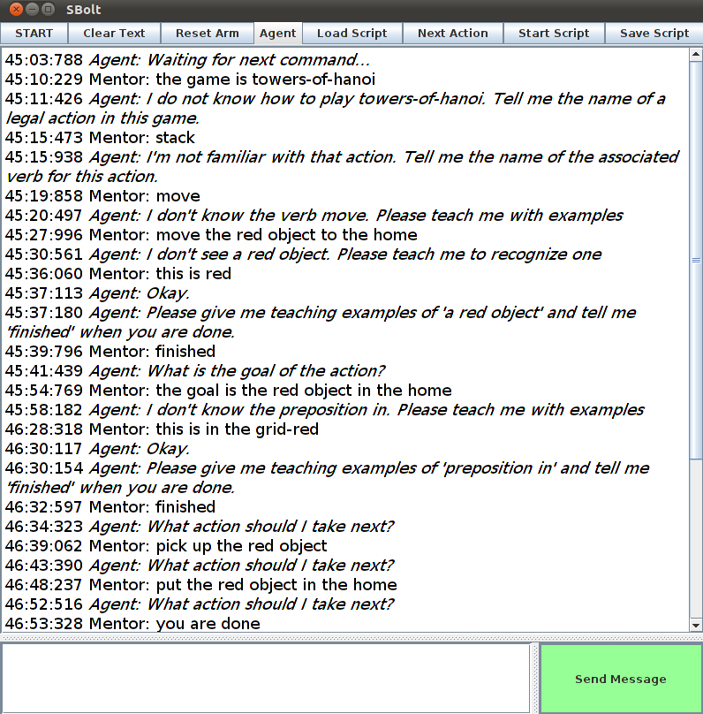
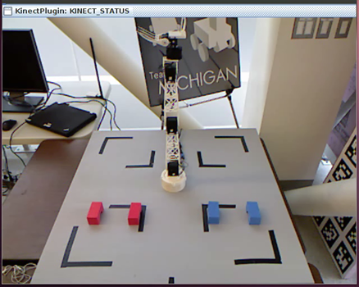
Agent Overview
Acquire task description via language
Construct internal task representation
Game
Extract internal representation of objects in the world
A1
Tic-Tac-Toe
P1
place
move
C1
Reason over objects, relationships to determine available actions
block
location
C11
C12
Search for solution by internally simulating actions
Manipulate environment based on discovered solution

Slide 5
Procedural Memory
Semantic Memory
Action Knowledge
Word – Category
Mapping
Verb – Operator Mapping
Prep Learning
Noun/Adjective – Perceptual Symbol Mapping
Task Concept Network
Noun Learning
Verb Learning
Preposition – Spatial Relation Mapping
Primitive Verbs
Task Learning
Locations
Soar Architecture
Indexing
Interaction
Episodic Memory
Agent’s Experiences
TCN Interpretation
Working Memory
Action
Perception
Spatial Visual System
Spatial Primitives

Slide 6
Representing Tic-Tac-Toe
Distinguish pieces
Object colors red and blue
Detect relationships
Prepositions on, under, and linear
Recognize legal actions
Place your piece (red) on an empty location
Must not already be in play
Detect Goal
Three of your pieces are on the board in a line

Slide 7
Acquisition of Task Concept Network
Game
M: The name of the game is tic-tac-toe.
A: What is the name of an action, goal, or failure?
M: The name of an action is place
A: Describe an object or condition for this action.
M: a red block
A: Describe another condition or object.
M: the block is not on a location
A: Describe another condition or object
M: a location
A: Describe another condition or object
M: the location is not under a block
A: Describe another condition or object
M: finished
A: What is a verb associated with this action?
M: move the block on to the location
action
name
A1
Tic-Tac-Toe
parameters
name
verb
constraints
P1
place
move
C1
1
2
1
2
block
location
C11
C12
spatial
attribute
spatial
S1
red
S2
prep
with
not
prep
with
not
on
location
true
under
block
true

Slide 8
Instantiating Actions
Find potential objects for each parameter
Parameter 1
Parameter 2
Apply object attribute constraints
Apply spatial constraints
Construct full match sets

Slide 9
Internally Simulating Tic-Tac-Toe
External Environment
Internal representation
Goal Not Detected
Goal Detected!

Slide 10
Desiderata
D1. Competent
D2. General
D3. Continuous, Accumulative Learning
D4. Efficient Communication

Slide 11
Competent
Video links
Towers of Hanoi: https://www.youtube.com/watch?v=j2r0AVobhlE
Tic-Tac-Toe: https://www.youtube.com/watch?v=fK2SnaO_qt0
Peg Solitaire: https://www.youtube.com/watch?v=e7ywonNMcXc
Frog and Toad puzzle: https://www.youtube.com/watch?v=3CJdBKS24Ho
Sokoban: https://www.youtube.com/watch?v=ekl60_nVDIA

Slide 12
General
Game | Spatial Concepts | Actions | Goal | Failure
Tic-Tac-Toe | on, under, linear | place | 3-in-a-row
Connect-3 | on, under, linear, near | stack-place | 3-in-a-row
Towers of Hanoi | on, under, smaller | smaller-stack | stacked
5 puzzle | on, under, near, diagonal | slide | matching-location
Frogs and Toads | left, right, on, under | slide-l, slide-r, jump-l, jump-r | side-swap
4 Queens | on, under, linear | place | all-placed | no-attack
Blocks world | on, under | stack | order-stacked
Sokoban | on, under, linear, diagonal | push, slide | blocks-in
Peg solitaire | on, under, linear | jump-remove | one-left
Knight’s tour | on, under, L-vertical, L-horizontal | knight-a, knight-b | all-placed
River crossing | Left, right, aligned | move-l, move-r, carry-l, carry-r | Right-bank | Fox-goose, Goose-beans

Slide 13
Continuous, Accumulative Learning
Experiment: Three games taught separately and sequentially

Slide 14
Efficient Communication

Slide 15
Future Work
Increase generality by extending types of games and concepts
Hexapawn, 3-Mens Morris
Missionaries and Cannibals, Othello, Backgammon
Teaching by demonstration
“This is the goal”
Ability to give additional information via interactive instruction
Advice, heuristics, subgoals, state evaluation metrics
Improve “naturalness” and flexibility of language

Slide 16
Nuggets and Coals
Nuggets
Can learn and play many different games/puzzles
Learns new concepts and complex conditions online in real time
Operates in multiple environments, including the real world
Knowledge transfers between games to reduce interactions
Coals
Language syntax and task acquisition process is restrictive, unnatural
Issues scaling to larger games with more pieces, relationships
Uses simple Iterative deepening search- insufficient for handling some games/puzzles

Slide 17
Questions?

