Slide 1
A Modular Agent For a Naval Decision-Making Simulation

Slide 2
Project Background
Pre-existing Navy simulator for experimentation: NSS (Naval Simulation System)
Modeled command and tactical decision-making using simple, parameterized scripts
Navy requirement arose to add serious simulation of decision making
SBIR Phase I served as a “competition” to select the team that would join the NSS prime contractor
Soar Technology was selected, with Soar as the cognitive engine to be integrated into NSS

Slide 3
Project Results
Soar is now an integrated component of a commercial Navy simulator used for experimentation
New system is called WISDM (Warfighting Impact of Simulated Decision Makers)
Navy customer is helping us look for additional projects to extend and apply the work

Slide 4
Technical Approach
Integration of Soar with NSS accomplished via message-level API
After receiving a message, NSS expects a response (no time limit)
Soar agent is not to do any work in between messages (after a response has been delivered and before receiving a new message)
But agent is allowed to send additional “Query Messages” before sending the ultimate “Response Message”
Command-level agent (not actually operating any equipment)
Messages to agent represent sensed tracks and engagement results
Messages from agent represent information-gathering and tactical commands
A number of prototype agents developed to demonstrate the integration

Slide 5
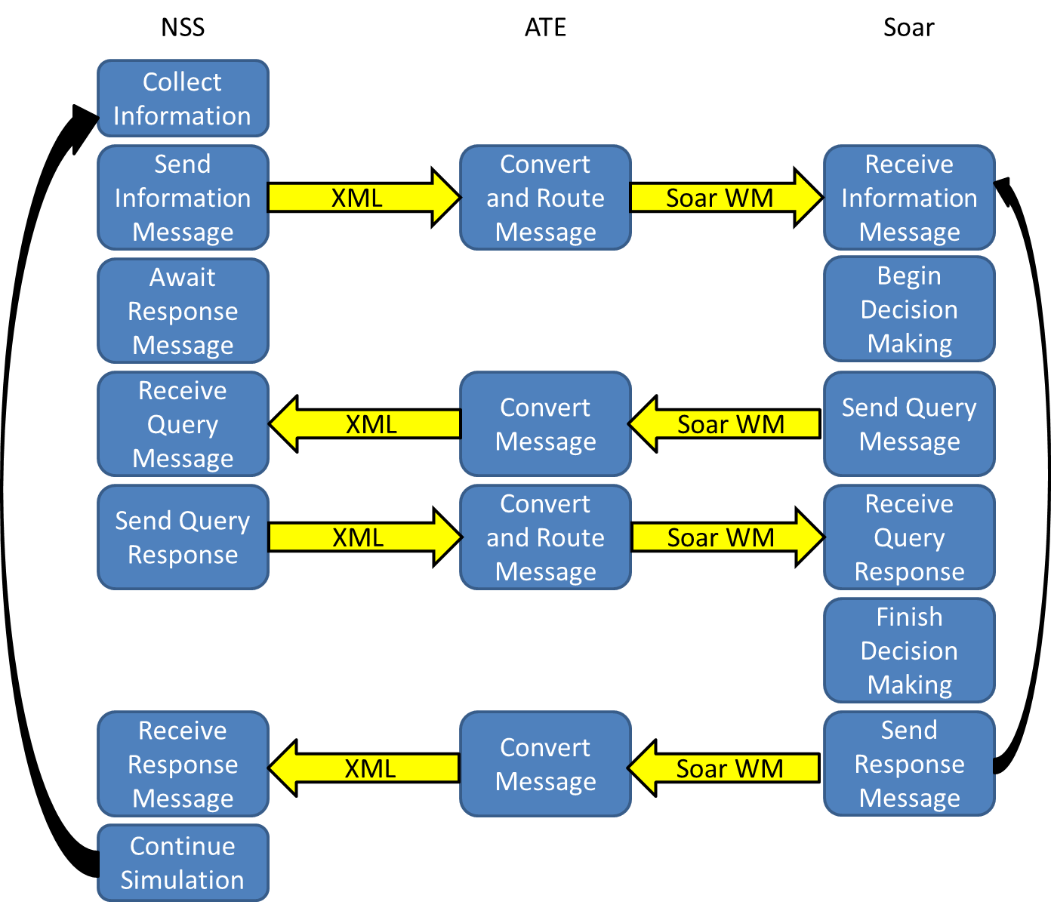
Interaction Schematic

Slide 6
Soar Agent Design Approach
Prototype agent goals:
Demonstrate the integration of NSS with Soar
Demonstrate some simple forms of decision-making models
Demonstrate a non-engineering user interface for composing and parameterizing behaviors
Approach:
Identify several decision-making use cases
Identify separable “behavior modules” to support the use cases
Implement and document the modules with “clean” interfaces, so they are composable
NSS-based user interface for selecting and composing behavior modules
Includes modules that use Soar’s reinforcement learning, semantic memory, and a “deliberative” form of reinforcement learning

Slide 7
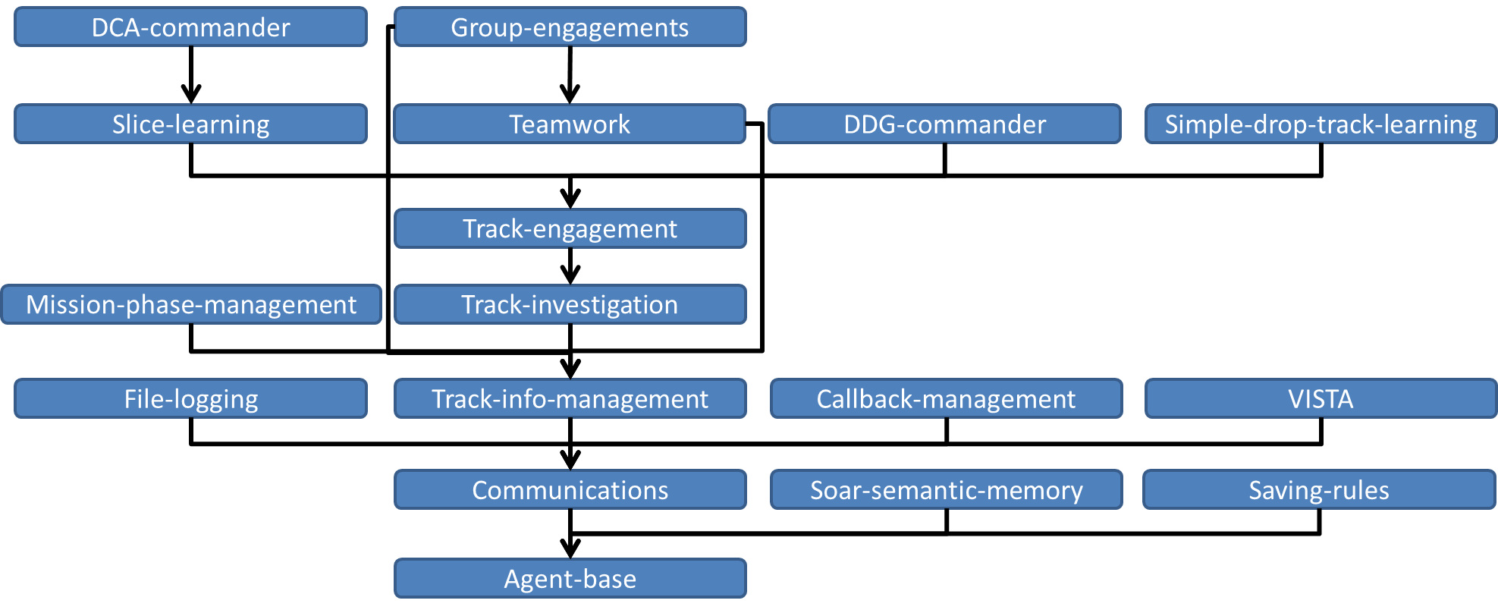
Module Dependency Hierarchy

Slide 8
Module Example
Track-investigation
Summary
The track-investigation module provides basic decision-making logic for an agent to choose to investigate an incoming track.
Dependencies
The track-investigation module requires the track-info-management module.
Files
Investigate-track-goal.soar
Operators
Investigate-track.soar
Stop-investigating-track.soar

Slide 9
Sample Composed Agent
Simple learning agent
Required modules
Simple-drop-track-learning, Saving-rules
Response type
ASSET_RESPONSE_TACTIC with SELF_VECTOR_RESPONSE
Agent parameters
Response
LOITER_DURATION (default 0.066667)
STANDOFF_PAUSE (default 0.083330)
STANDOFF_ALTITUDE (default 0)
STANDOFF_RANGE (default 0)
Commit criteria
Engage-all-tracks (default true)
Learning
Initial-fake-track-value (default -5)
Initial-unknown-track-value (default 3.2)
Lost-track-penalty (default -10)
Fake-track-reward (default 0.1)

Slide 10
Summary
Nuggets
Soar is integrated into a commercial simulation engine
Customer is happy and looking for further extensions
Significant steps toward a framework for “real” composable behavior modules
Lumps
Still only a prototype

