Slide 1
Soar-ing Network Reticulation: early conceptualization
Alex Yahja, Marshall Scott Poole, & Steven Corman
National Center for Supercomputing Applications, U of Illinois at Urbana-Champaign, & U of Arizona

Slide 2
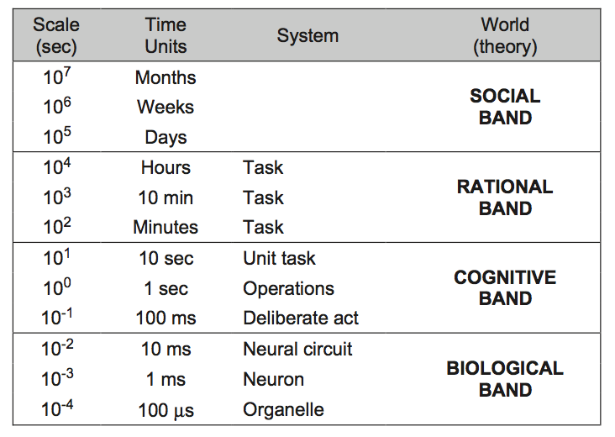
Newell’s Human Action Timescale

Slide 3
Social Band’s Networking Theories*
Self-Interest: creating ties to advance personal desires
Mutual interest & collective action: mutual advance
Contagion: ideas & beliefs spread through networks
“Cognitive” theories: meaning & perception shaping networks
Homophily & proximity: similarity & closeness
Balance: transitive ties (friending a friend of friend)
Coevolution: fitness of communities
* by Monge and Contractor (2003)

Slide 4
Some Perspectives of Groups in the Social Band*
Functional perspective: functions that groups and group members perform
Psychodynamic perspective: relationship between emotional & subconscious with rational & conscious interpersonal interaction
Social identity (Identification): a sense of belonging to groups
Conflict-power-status perspective: power, status, hierarchy, resource contention, ego & alter
Symbolic-interpretive perspective: language, symbol, interpretation
* By Poole and Hollingshead (2005)

Slide 5
Research Statement
One Social Band’s theory → Network Reticulation*:
How human social memory, coding convention (language), communication, identity, and networking originated
Some empirical & statistical evidence, but at Social Band
Soar in the Newell’s timescale of human action:
Rational Band
Cognitive Band
What underlies the Social Band’s behaviors modeled by Network Reticulation Theory (NRT)?
What Soar’s components can be adapted with the consideration of social behaviors?
* by Corman and Scott (1994)

Slide 6
Network Reticulation Theory (NRT)
Network Reticulation Theory (NRT) describes how social drivers & interactions in shared activities generate human groups/networks:
activation and activity foci
reticulation (communication & network structuration) and
enactment of events & coding conventions
>represented as multi-agents and (planned) Soar agents

Slide 7
Network Reticulation for Each Agent
Enactment for each agent: triggering events such as scheduled meetings or shared locations.
Once events are ongoing, the agent activities rise, which is part of activation.
To execute activities, agents communicate and interact with each other in the form of communication instances, which is part of reticulation.

Slide 8
Structural Manifestation of Agent Communications and Activities
Communication instances give rise to perceived network.
Activities give rise to activity foci and vice versa.
Triggering events in enactment give rise to coding conventions, in which shared symbols or meanings emerge.

Slide 9
Network Reticulation and Performance
identification
Performance
Enactment
Activation
Reticulation
Environment
systemic phenomena:
triggering
events
activities
communication
instances
action results
action effects
structural properties:
coding
conventions
activity
foci
perceived
network
reputation
network
changes
in environment

Slide 10
NRT’s and Soar’s Analogies
NRT (at the Social Band) | Soar (at the Cognitive & Rational Bands)
Activation (over people and tasks) | Spreading Activation (over rules)
Enactment | Subgoaling and operator selection
Reticulation | Symbolic Long-term Memories
Coding convention | Semantic Memory
Communications | Rule firings
Identification | Memories about Self

Slide 11
Software Factory Dataset
Recording 79 participants (employees and clients) of a software firm over 3 years
Participants attached a digital recorder and lapel microphone, and logged in to a server which placed a time stamp on the recording.
Weekly staff meeting recordings
Organizational records.
Weekly sociometric surveys about how much they had communicated with other Software Factory participants etc.
Bi-weekly interviews about events and activities at Software Factory and in its projects.

Slide 12
Evaluation
Nuggets:
Melding together systems and theories from the Social, Rational and Cognitive Bands
Greater involvement of the Social Band
Coal:
Early research
12

Slide 13


Acknowledgment

Slide 14
Agents for Red-Blue Game
Each agent has its own goal, events, activation, and reticulation processes influenced by other agents (and commanders)
Agent type: commander, convoy, uav_patrol, elderA, elderB, bombmaker, digger, financier
3 sides: friendly (blue), enemy (red), neutral

Slide 15
Trace
Time Tick: 0 elderA: WaitforAid << enactment elderA to commander: WhereisAid >> reticulation elderB: WaitforAid << enactment ------------------------------------------------------- Time Tick: 1 commander to elderA: WillGiveAid << enactment commander to commandpatrol: PatrolAlphaRoute << enactment commander to convoy: GotoVillageA << enactment commander to convoy: ProvideAidtoVillageA << enactment commander to uavpatrol: PatrolGammaRoute << enactment convoy: GotoVillageA << activation elderA: WaitforAid << enactment elderB: WaitforAid << enactment ------------------------------------------------------- Time Tick: 2 uavpatrol: PatrolGammaRoute << activation uavpatrol to convoy: GammaRouteDangerous >> reticulation commandpatrol: PatrolAlphaRoute << activation elderA: WaitforAid << enactment elderB: WaitforAid << enactment

Slide 16
Time Tick: 3 convoy: TakeAlphaRoute << activation uavpatrol: PatrolGammaRoute << activation uavpatrol to convoy: GammaRouteDangerous >> reticulation commandpatrol: PatrolAlphaRoute << activation commandpatrol to convoy: AlphaRouteClear >> reticulation elderA: WaitforAid << enactment elderB: WaitforAid << enactment elderB to commander: WhereisAid >> reticulation financier: FundBombs << enactment ------------------------------------------------------- Time Tick: 4 convoy: TakeAlphaRoute << activation uavpatrol: PatrolGammaRoute << activation uavpatrol to convoy: GammaRouteDangerous >> reticulation commandpatrol: PatrolAlphaRoute << activation commandpatrol to convoy: AlphaRouteClear >> reticulation elderA: WaitforAid << enactment elderB: WaitforAid << enactment financier to insurgentbank: GetMoney << activation insurgentbank to financier: ProvideMoney >> reticulation -------------------------------------------------------

Slide 17
Time Tick: 5 convoy: TakeAlphaRoute << activation uavpatrol: PatrolGammaRoute << activation uavpatrol to convoy: GammaRouteDangerous >> reticulation commandpatrol: PatrolAlphaRoute << activation commandpatrol to convoy: AlphaRouteClear >> reticulation elderA: WaitforAid << enactment elderB: WaitforAid << enactment financier to smuggler: ProvideMoney << activation financier to bombmaker: ProvideMoney << activation
------------------------------------------------------- Time Tick: 6 convoy to elderA: AidHere >> reticulation uavpatrol: PatrolGammaRoute << activation uavpatrol to convoy: GammaRouteDangerous >> reticulation elderA to smuggler: WhereisMoney >> reticulation elderB: WaitforAid << enactment

Slide 18
Time Tick: 7 uavpatrol: PatrolGammaRoute << activation uavpatrol to convoy: GammaRouteDangerous >> reticulation elderB: WaitforAid << enactment elderB to bombmaker: WhereisMoney >> reticulation smuggler to elderA: ProvideMoney >> reticulation smuggler to bombmaker: ProvideParts >> reticulation bombmaker to elderB: ProvideMoney >> reticulation bombmaker to smuggler: GetParts >> reticulation ------------------------------------------------------- Time Tick: 8 uavpatrol: PatrolGammaRoute << activation uavpatrol to convoy: GammaRouteDangerous >> reticulation elderB: WaitforAid << enactment bombmaker to digger: ProvideBomb >> reticulation digger to bombmaker: GetBomb >> reticulation -------------------------------------------------------

Slide 19
Time Tick: 9 uavpatrol: PatrolGammaRoute << activation uavpatrol to convoy: GammaRouteDangerous >> reticulation elderB: WaitforAid << enactment digger: MovetoBetaRoute << activation ------------------------------------------------------- Time Tick: 10 uavpatrol: PatrolGammaRoute << activation uavpatrol to convoy: GammaRouteDangerous >> reticulation elderB: WaitforAid << enactment digger: PlantBomb << activation

