Slide 1
Ideas for Modeling Language Acquisition
Peter Lindes
University of Michigan
plindes@umich.edu
Soar Workshop
14 June 2021

Slide 2
Human Language Acquisition
Acquisition is a social process
First year preparation
From-meaning mappings learned incrementally
Stages of development/critical periods

Slide 3
Embodied
Comprehension
Comprehension Engine
Action Module
Messages
Language Knowledge
Grounding
World Knowledge

Slide 4
How do we learn this processing?
How do we learn this knowledge?

Slide 5
A Three-Stage Theory
Stage 1: Interpret Experiences
Use situational knowledge to guess form to meaning
One small increment of knowledge at a time
Remember a series of episodes
Stage 2: Generalize Constructions
Cluster individual hypotheses from experiences
Form generalizations from those clusters
Generalizations saved as declarative knowledge
Stage 3: Acquire Skill
Use deliberate reasoning with declarative knowledge
Learn procedural knowledge from this processing
Epmem
Smem
Rules

Slide 6
Stage 1: Interpret Experiences
Krashen’s theory:
We acquire language in only one way: when we understand messages;
that is,
when we obtain “comprehensible input.”
Krashen, Stephen D. (20034). Explorations in Language Acquisition and Use: The Taipei Lectures. Heinemann, Portsmouth, NH.

Slide 7
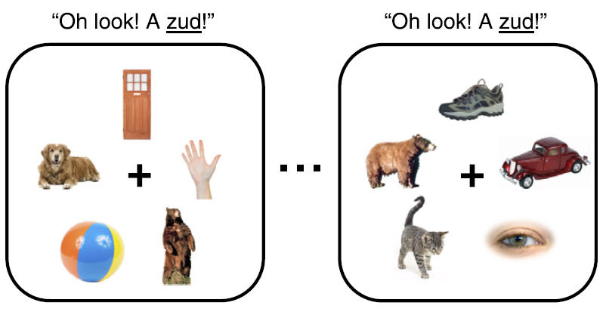
Stage 1: Interpret Experiences
Propose but verify:
Previous theory: “a statistical-associative learning mechanism to gradually converge” [e.g., Yu, C., & Smith, L. B. (2007).”
Propose but verify: “a one-trial procedure … – more a ‘fast mapping’ procedure than a gradual statistical one.”
Trueswell, John C., Medina, Tamara Nicol, Hafri, Alon, and Gleitman, Lila (2013). Propose but verify: Fast mapping meets cross-situational word learning. Cognitive Psychology 66, 126-156.

Slide 8
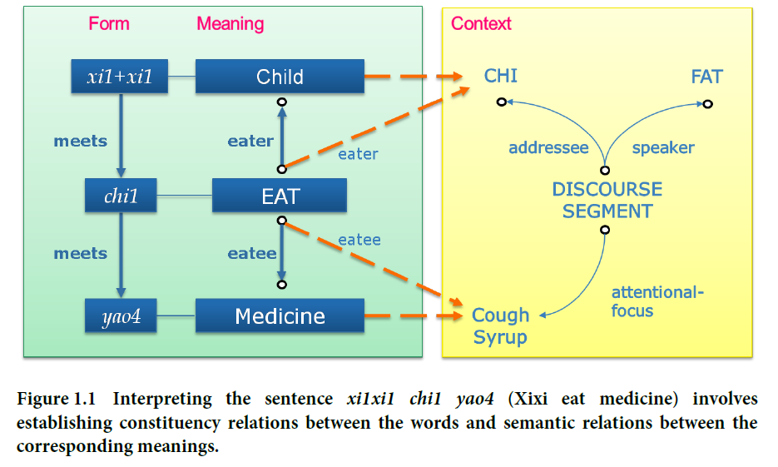
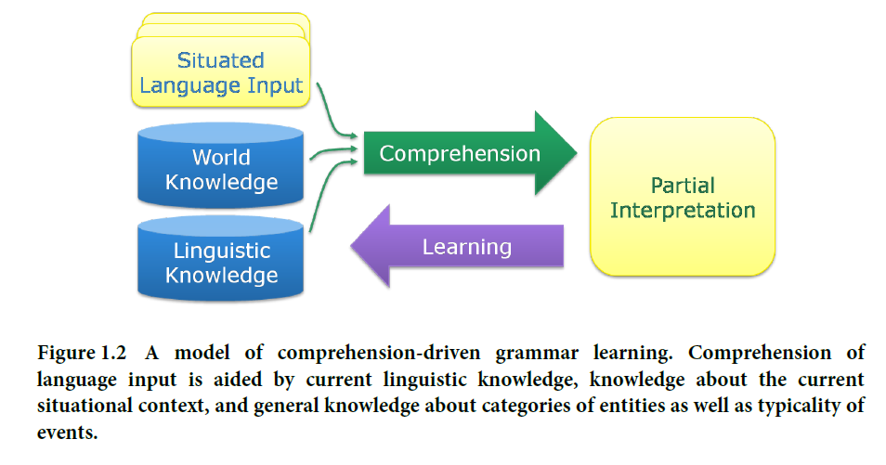
Stage 1: Interpret Experiences
ECG theory:
Uses CHILDES corpus in Mandarin
Mok, Eva H. (2008). Contextual Bootstrapping for Grammar Learning. PhD Dissertation, UC Berkeley.

Slide 9
Stage 2: Generalize Constructions
Goldberg’s theory:
Remember episodes
Clusters emerge
Clusters become constructions
Strengthened with new instances
Entrenchment
Novel expressions are possible when covered
Goldberg, Adele E. (2019). Explain Me This: Creativity, Competition, and the Partial Productivity of Constructions. Princeton University Press, p. 72.

Slide 10
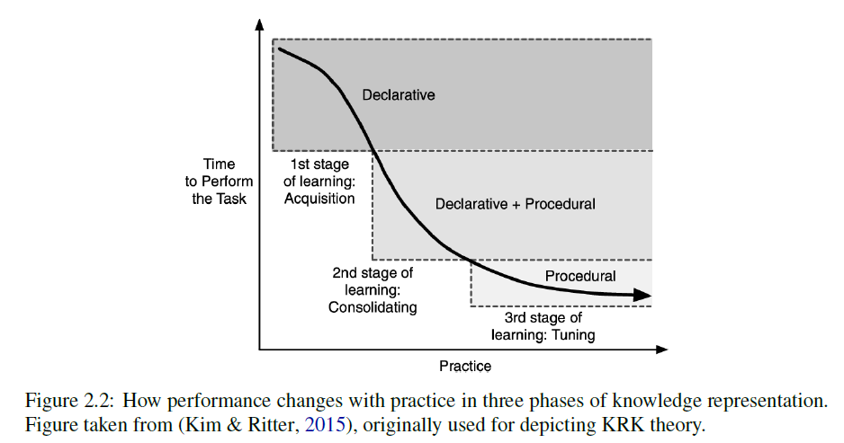
Stage 3: Acquire Skill
Stearns, Bryan (2021). A Comprehensive Computational Model of PRIMs Theory for Task-Independent Procedural Learning. PhD Dissertation, University of Michigan, p. 14.

Slide 11
Stage 3: Acquire Skill
One of my experiments:
Pick up the green block on the stove.
First time:
Second time:
89: O: O121 (cxn-query)
Build a TransitiveCommand construction.
90: O: O124 (build-cxn)
91: ==>S: S16 (operator no-change)
92: O: O127 (subcase-of-query)
93: O: O128 (generalize-cxn)
94: ==>S: S17 (operator no-change)
95: O: O130 (subcase-of-query)
96: O: O131 (generalize-cxn)
97: O: O132 (ground-cxn)
98: O: O133 (cxn-done)
138: O: O191 (cxn-query)
Build a TransitiveCommand construction.
139: O: O194 (build-cxn)
140: O: O197 (ground-cxn)
141: O: O198 (cxn-done)
7x reduction

Slide 12
3 Stages
of
Acquisition
Situations
Episodes
Declarative Knowledge
Procedural Knowledge
Stage 1:
Interpret Experiences
Stage 2:
Generalize Constructions
Stage 3:
Acquire Skill

Slide 13
A 3-way Path
to Comprehension
Interpret Experiences
Deliberate Reasoning
Declarative Knowledge
Knowledge
Situation
Message
Skill
Procedural Knowledge
Applying Procedures

Slide 14
Elements of an Implementation
Environment
Teaching agent
Simulated physical world
Corpus of mother-child speech
Learning agent
Prior knowledge
Experiment setup
Evaluation

Slide 15


Nuggets and Coal
Three-stage theory
Correspondence to Soar memories
Some success with skill learning
Need algorithm for Stage 1
Need algorithm for Stage 2
Need funding

Slide 16
Human Language Acquisition
Acquisition is a social process
Shared attention, Motherese
First year preparation
Social communication
Sound processing
Acting in the world
From-meaning mappings learned incrementally
Krashen’s input hypothesis
Stages of development/critical periods
Pre-production
Words, 2-words, Sentences
Abstraction

Slide 17
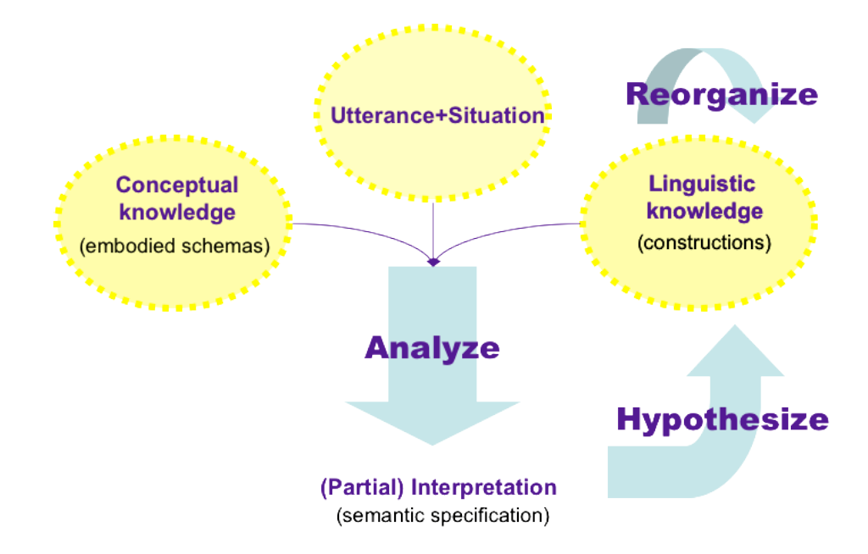
Stage 1: Interpret Experiences
ECG theory:
Chang, Nancy (2004). A computational model of comprehension-based construction acquisition. http://www.icsi.berkeley.edu/pubs/ai/CFN-NCPW04. pdf

Slide 18
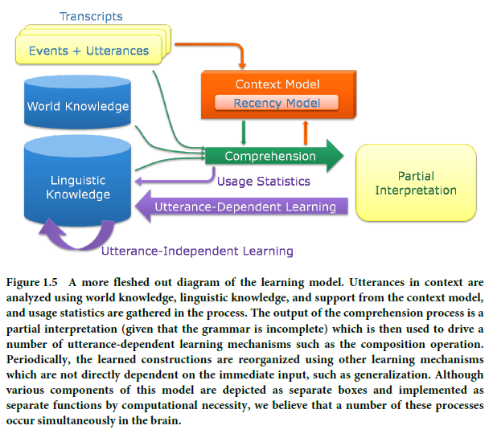
Stage 2: Generalize Constructions
ECG theory:
Mok, Eva H. (2008). Contextual Bootstrapping for Grammar Learning. PhD Dissertation, UC Berkeley.

Slide 19
Stage 2: Generalize Constructions
Adele E. Goldberg:
Surely it is premature to give up hope that humans, with our rich cognitive abilities, complex social skills, predilection to imitate, and 100-billion neuron brains, can learn language from available input.
Goldberg, Adele E. (2006). Constructions at Work: The Nature of Generalization in Language. Oxford University Press, p. 69.

