Slide 1
20 Questions Revisited: Narrowing the Search Space for Models of Human Cognition
Bryan Stearns
University of Michigan
June 2021

Slide 2

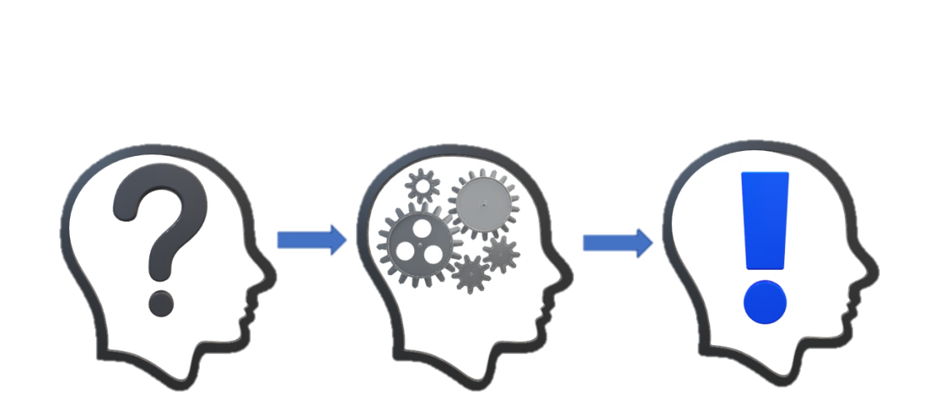
Context
Cognitive Modeling research
Just defended my dissertation
Lessons learned from PhD project

Slide 3

Dissertation Problem
My project:
Cognitive model of human procedural learning
Apply PRIMs theory (Taatgen, 2013) in Soar
Meta problem:
How to know a cognitive model
is an accurate model?
Taatgen, N. A. (2013). The nature and transfer of cognitive skills. Psychological Review, 120(3), 439–471.

Slide 4
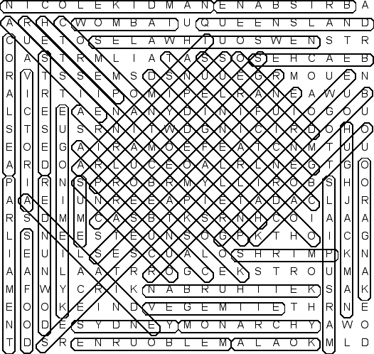
Identifiability Problems
Discovery Problem:
Space of possible solutions is vast
Little guidance for finding correct one
Uniqueness Problem:
Many computational approaches produce equivalent external behavior
Anderson, J. R. (1993). Rules of the mind. L. Erlbaum Associates.

Slide 5

My Task
Compare ACT-R model of PRIMs theory
Actransfer (Taatgen, 2013)
With my Soar model of PRIMs theory
PROPs (Stearns & Laird, 2020)
ACT-R
Actransfer
PRIMs
PROPs
Taatgen, N. A. (2013). The nature and transfer of cognitive skills. Psychological Review, 120(3), 439–471.
Stearns, B., & Laird, J. E. (2020). Toward unifying cognitive architecture and neural task set theories.
Proceedings of the Forty-second Annual Conference of the Cognitive Science Society.

Slide 6
My Problem
Soar allows general computation
Multiple ways to implement? (Discovery Problem)
Actransfer/PROPs both implement same high-level theory
Expect same overall behavior (Uniqueness Problem)
Different internal computation
How to evaluate?
ACT-R
Actransfer
>?
PRIMs
PROPs

Slide 7
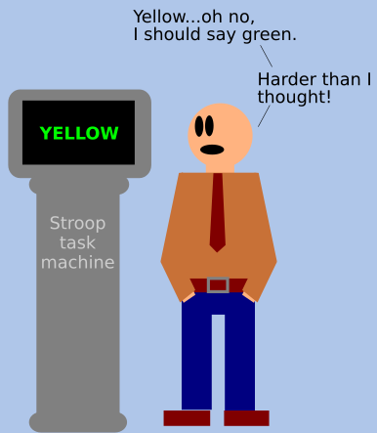
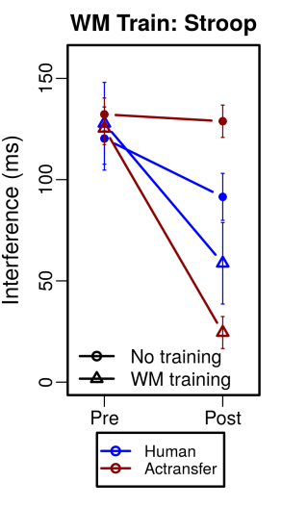
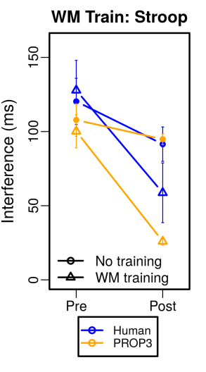
Example
Stroop task
Answer the color of the text
Actransfer model
Lower activation with incongruent perception
Slower retrieval time
PROPs model
Extra retrievals required for incongruent response
More cycles
Which model is accurate? Either?

Slide 8
“Can’t Play 20 Questions”
Allen Newell’s (1973) “20 Questions” paper
“You can’t play 20 questions with nature and win.”
Too complex to look at small pieces alone
Need better approaches for cognitive modeling
Proposed three paradigms to address problem
Newell, A. (1973). You can’t play 20 questions with nature and win: Projective comments on the papers of this symposium. Visual information processing (pp. 283–308). Elsevier Inc.

Slide 9
Newell’s Paradigms
“Construct complete processing models rather than the partial ones we now do. [...] Too much is left unspecified and unconstrained.”
“Accept a single complex task and do all of it. The current experimental style is to design specific small experiments to attempt to settle specific small questions.”
“Stay with the diverse collection of small experimental tasks, as now, but […] construct a single system to perform them all.”
Newell, A. (1973). You can’t play 20 questions with nature and win: Projective comments on the papers of this symposium. Visual information processing (pp. 283–308). Elsevier Inc.

Slide 10
This Talk
Revisit Newell’s advice
How I applied it for my work
Can apply with today’s architectures in general
Reduce search space for human model
Constraining approaches of possible models
Increasing model complexity

Slide 11
Newell’s Paradigms
(Emphasis mine)
“Construct complete processing models rather than the partial ones we now do. [...] Too much is left unspecified and unconstrained.”
“Accept a single complex task and do all of it. The current experimental style is to design specific small experiments to attempt to settle specific small questions.”
“Stay with the diverse collection of small experimental tasks, as now, but […] construct a single system to perform them all.”
Newell, A. (1973). You can’t play 20 questions with nature and win: Projective comments on the papers of this symposium. Visual information processing (pp. 283–308). Elsevier Inc.

Slide 12
Newell’s Paradigms
(Emphasis mine)
“Construct complete processing models rather than the partial ones we now do. [...] Too much is left unspecified and unconstrained.”
“Accept a single complex task and do all of it. The current experimental style is to design specific small experiments to attempt to settle specific small questions.”
“Stay with the diverse collection of small experimental tasks, as now, but […] construct a single system to perform them all.”
Comprehensive
Model every part of the theory
Include support processes
Newell, A. (1973). You can’t play 20 questions with nature and win: Projective comments on the papers of this symposium. Visual information processing (pp. 283–308). Elsevier Inc.

Slide 13
Newell’s Paradigms
(Emphasis mine)
“Construct complete processing models rather than the partial ones we now do. [...] Too much is left unspecified and unconstrained.”
“Accept a single complex task and do all of it. The current experimental style is to design specific small experiments to attempt to settle specific small questions.”
“Stay with the diverse collection of small experimental tasks, as now, but […] construct a single system to perform them all.”
Do all of the task
Do each kind of processing
Use each part of architecture
Consistently with each other
Consistent with architecture design
Consistent
Newell, A. (1973). You can’t play 20 questions with nature and win: Projective comments on the papers of this symposium. Visual information processing (pp. 283–308). Elsevier Inc.

Slide 14
Newell’s Paradigms
(Emphasis mine)
“Construct complete processing models rather than the partial ones we now do. [...] Too much is left unspecified and unconstrained.”
“Accept a single complex task and do all of it. The current experimental style is to design specific small experiments to attempt to settle specific small questions.”
“Stay with the diverse collection of small experimental tasks, as now, but […] construct a single system to perform them all.”
Task-independent
Single system for many tasks
No over-fitting one task
No tailoring model for just external results
Newell, A. (1973). You can’t play 20 questions with nature and win: Projective comments on the papers of this symposium. Visual information processing (pp. 283–308). Elsevier Inc.

Slide 15
Desiderata for Models
Apply these to my PROPs model
Comprehensive
Consistent
Task-independent

Slide 16
Desiderata for Models
Comprehensive
Consistent
Task-independent

Slide 17
1. Comprehensive
Comprehensive
Consistent
Task-independent
Theory can need multiple support processes
Decision making
Declarative retrieval
Planning
Etc.
Not needed to test standalone idea
Could just assume they work
But support processes can add constraint
Can shape the rest of the theory
A
??
C
A
B
C

Slide 18
Constrains Theory
Comprehensive
Consistent
Task-independent
Defining support processes can constrain
Knowledge representation
System communication
Processing time
Makes concrete
A
B
C

Slide 19
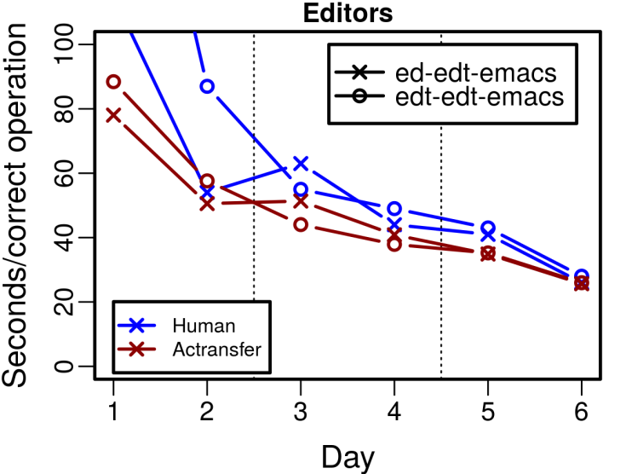
Example
Comprehensive
Consistent
Task-independent
PRIMs
Actransfer
Actransfer
Learns rules after executing retrieved instruction
Assumes agent retrieves correct instruction first
ACT-R
Evaluate
Init
Retrieve
Execute
Learn
Assumed

Slide 20

Example
Comprehensive
Consistent
Task-independent
PRIMs
PROPs
Learn links to SMEM for spreading activation
Activation leads agent to retrieve correct result
PROPs
Evaluate
Init
Retrieve
Execute
Learn
Defined

Slide 21
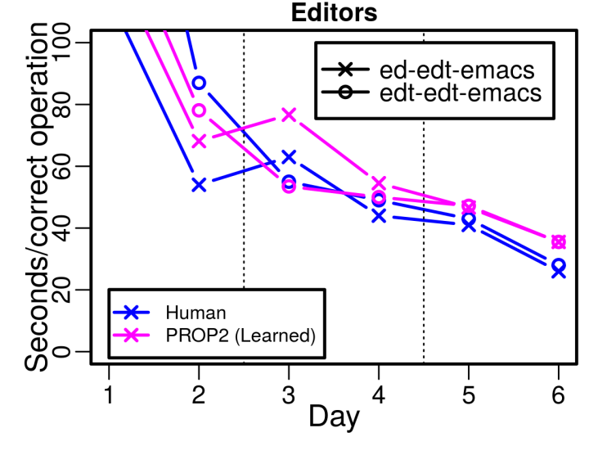
Example
Comprehensive
Consistent
Task-independent
Changes learning curve!
Agent learns retrieval while practicing instruction
Test
Init
Retrieve
Execute
Learn
Defined

Slide 22
2. Consistent
Comprehensive
Consistent
Task-independent
Internal consistency
“Do all of the task”
Use all relevant architecture parts coherently
“Listen to the architecture”
Use parts in manner supported by prior research
External consistency
What is known about human processing

Slide 23
Example
Comprehensive
Consistent
Task-independent
Actransfer
Actransfer
Retrieve single most-activated instruction
Then do instruction
Retrieval effectively replaces decision making
Inconsistent!
Declarative Memory
Retrieve
Decision Making
Do-A
Working Memory
Do-B
Do-C
Do-B

Slide 24
Example
Comprehensive
Consistent
Task-independent
PROPs
Retrieve multiple choices
Let decision making select
PROPs
Declarative Memory
Retrieve
Select
Decision Making
Do-A
Working Memory
Do-B
Do-B
Do-C
Do-C

Slide 25
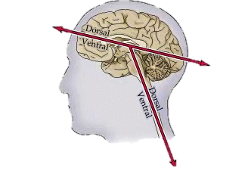
Example
Comprehensive
Consistent
Task-independent
Led to new data structure
Soar problem spaces as declarative instruction format
Connection with Task Set theory
(Sakai, 2008)
Declarative Memory
Retrieve
Select
Decision Making
D
B
E
Working Memory
Image from (Purves et al., 2001)
A
F
D
C
G
B
E
Cognitive
Sensory
Purves D, Augustine GJ, Fitzpatrick D, et al., editors. Neuroscience. 2nd edition. Sunderland (MA): Sinauer Associates; 2001. Some Anatomical Terminology.
Sakai, K. (2008). Task set and prefrontal cortex. Annual Review of Neuroscience, 31(1), 219-245.

Slide 26


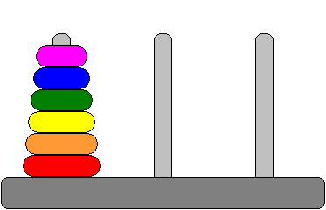

3. Task-Independent
Comprehensive
Consistent
Task-independent
BIG constraint!
Not just architecture, but main agent rules too
Whole system
Same model of cognition for all tasks
Vary task instructions/strategy only
Anything learned

Slide 27
Fewer Solutions
Comprehensive
Consistent
Task-independent
Many ways to model mental arithmetic
Many ways to model Stroop task
Fewer that can do both
Even fewer can also do Towers of Hanoi
Each additional task constrains solutions

Slide 28
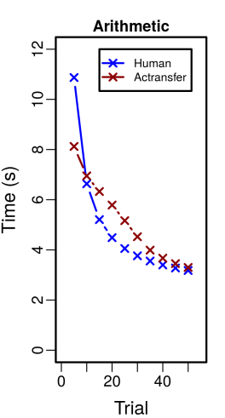

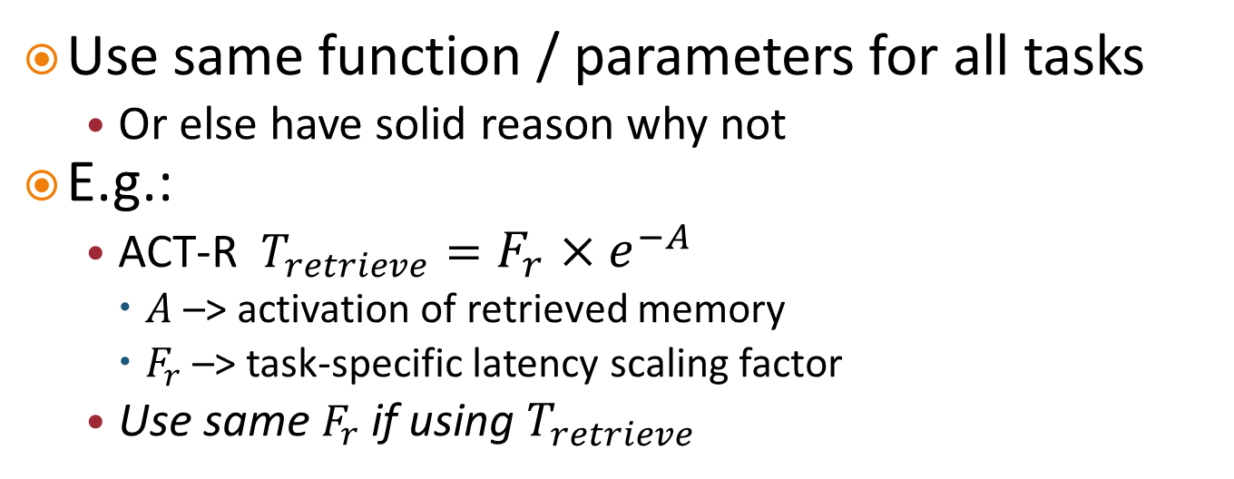


Constrains Timing
Comprehensive
Consistent
Task-independent
Use same function / parameters for all tasks
Or else have solid reason why not
E.g.:
ACT-R $T_{retrieve}=F_{r}×e^{−A}$
$A$ –> activation of retrieved memory
$F_{r}$ –> task-specific latency scaling factor
Use same $F_{r}$ if using $T_{retrieve}$
$$F_{r}=.15$$
$$F_{r}=1.5$$

Slide 29

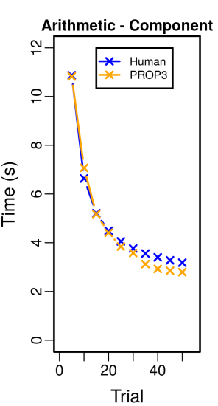
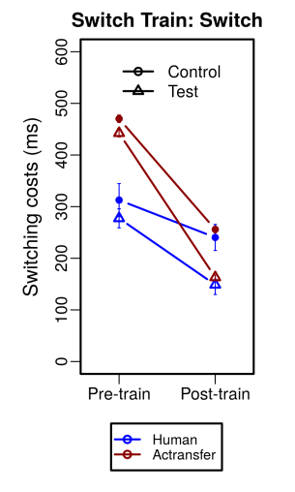
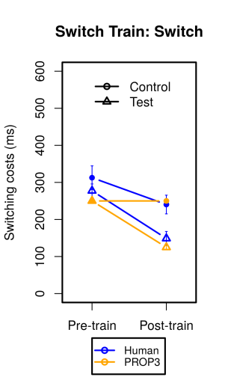
Example
Comprehensive
Consistent
Task-independent
Model of learning arithmetic task
Use same system for task-switching task
Add constraint of same timing function
New timing model
Fewer variables
More explanatory power

Slide 30
Summary
Smaller space of models that are:
Comprehensive
Consistent
Task-independent
Increased constraint focuses model design
Can lead to improved model!

Slide 31
Reducing Identifiability Problems
Increased complexity reduces behavior similarity
Reduced Uniqueness Problem
+ More rigorous constraints reduce number of possible models
Reduced Discovery Problem

Slide 32
We Need to Step Up!
More rigorous modeling
Requires more planning
Requires more development work
But result is powerful
Single system can do many tasks
Apply to AI?
I believe the field is ripe for this

Slide 33


Conclusion
Nuggets
Specified computation Offers more precise theory comparison
Ability to model more tasks
Results in more constrained search for human model
Coal
Bigger systems, more effort
Identifiability problem still out there, even if reduced

Slide 34
20 Questions Revisited
Bryan Stearns
Thank you

