Slide 1

Towards a Unified Model of Deep Cognition
John Sustersic
6/15/2021
Approved for Public Release

Slide 2
Purpose
Lay a theory-guided foundation to a path forward for robust autonomy.
Provide a (very) brief background in cognitive architectures, experiences using Soar in autonomy, and how it relates to the standard model of unified cognition.
Identify key limitations of existing architectural approaches.
Discuss possible ways forward.
Approved for Public Release

Slide 3
Cognitive Architecture
What is a cognitive architecture?
Model (theoretical and/or computational) of the mind.
Many models evolved over the past 5-6 decades.
Soar, ACT-R, Epic, and many others.
Models are often better for certain purposes than others.
Turing-complete: Can do anything in any architecture, however certain algorithms are *much* simpler to implement in one or other
Approved for Public Release

Slide 4
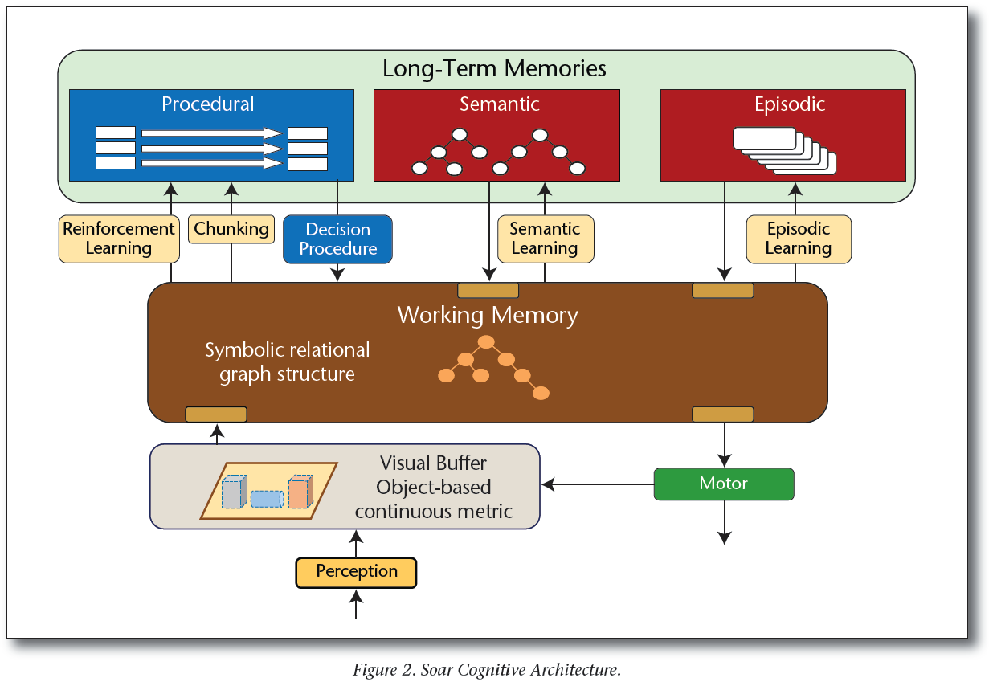
Soar Cognitive Architecture
Laird, J. E., Lebiere, C., & Rosenbloom, P. S. (2017). A Standard Model of the Mind: Toward a Common Computational Framework across Artificial Intelligence, Cognitive Science, Neuroscience, and Robotics. AI Magazine, 38(4), 13-26. https://doi.org/10.1609/aimag.v38i4.2744

Slide 5
Cognitive Architectures
Nuggets
Coal
Able to model particular aspects of cognition quantifiably better than other computational models.
Principled way to express concisely algorithms that may not express as cleanly in other programming languages.
E.g. Dijkstra’s algorithm is trivial in Soar, but counting is anything but...
Represents a Structured AI
Esoteric, hard to learn – especially for experienced programmers in other languages.
Do not often incorporate the latest computer science advances.
Typing in Soar, e.g., is limited by today’s standards.
Architectures ‘bake in’ assumptions that may or not apply generally or to particular use cases.
Difficult to compare results from different architectures.
Ultimately, the computer is operating on bits/bytes as directed by si
Approved for Public Release

Slide 6
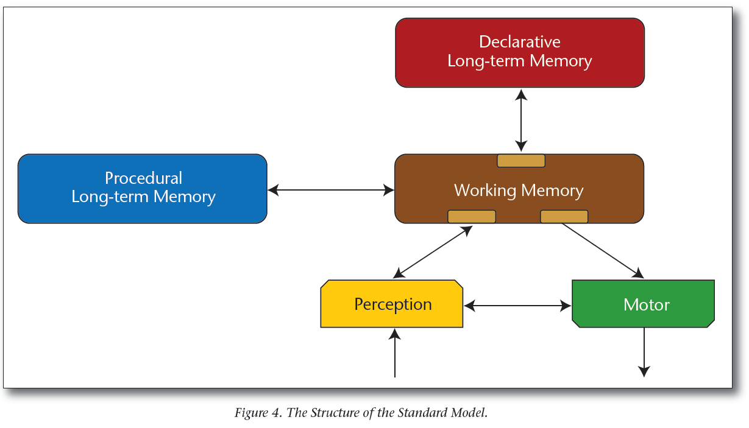
The Standard Model
Laird, J. E., Lebiere, C., & Rosenbloom, P. S. (2017). A Standard Model of the Mind: Toward a Common Computational Framework across Artificial Intelligence, Cognitive Science, Neuroscience, and Robotics. AI Magazine, 38(4), 13-26. https://doi.org/10.1609/aimag.v38i4.2744

Slide 7
Role-based Cognitive Autonomy
Role based AI agents using a coarse Soar and C++ co-design software architecture of
“It depends” rules map to Soar decision layer.
Partially order decision forest, where partial orders depend on context and shift relatively over time.
Computational layer levered open-source heavily – CGAL, Eigen, boost, C++ 11, openCV, etc…
Impedance mismatch at the Soar-C++ boundary was significant.
Attentional mechanism is essential.
A MANTA Agent
(Multi-agent Architecture for Natural and Trusted Autonomy)
Cognitive
(Soar)
Computational
Decision Aids
Communication
ROS-like using ZMQ
M. Rothgeb and J. P. Sustersic, "The Coming Revolution in Cognitive Autonomous Undersea Vehicles," Undersea Warfare, vol. 63, 2017.
M. Rothgeb and J. P. Sustersic, "Applying Submarine Tactical Center Knowledge to UUV," ONR Innovation Special Edition on Artificial Intelligence, vol. 11, 2014.
R. Thome, C. Fedor, J. Sustersic and U. Ukah, "Non-linear Decision Making for Robust Navigation in Role Based Autonomy," in Proceedings of IEEE Oceans, Washington, 2015.
How to be efficient designing and encoding (and maintaining) complex, heterogeneous software systems?
Approved for Public Release

Slide 8
Role-based Functional Decomposition
Allows agents to work at different time scales appropriate for their roles
Command Duty Officer
Responsible for real-time execution of CoA which serves as context to bound real-time trades for contact management, executing tasks, and reacting to dynamic situation.
Cognitive
(Decisions)
Commander
Decides and delegates tasking and constraints, balances stealth/risk/task trades, monitors and intervenes to assure performance
1
Computational
Decision Aids
Communication
ROS-like using ZMQ
Cognitive
(Decisions)
Cognitive
(Decisions)
Pilot
Platform maneuver specialist. Responsible for choosing and monitoring control tasks that satisfy assigned tasks, assuring platform performance and adapting as needed to conditions.
2
Computational
Decision Aids
Computational
Decision Aids
3
Navigator
Develops Courses of Actions (CoAs) based on Commander’s constraints and tasking, assures CoAs meet requirements, monitors and intervenes to assure performance
Communication
ROS-like using ZMQ
Communication
ROS-like using ZMQ
Cognitive
(Soar)
Cognitive
(Soar)
Cognitive
(Decisions)
Cognitive
(Decisions)
Computational
Decision Aids
4
Computational
Decision Aids
Computational
Decision Aids
Computational
Decision Aids
Communication
ROS-like using ZMQ
Communication
ROS-like using ZMQ
Communication
ROS-like using ZMQ
Communication
ROS-like using ZMQ
Macroscopic distribution of cognitive tasks for interaction at time scales on order of second or slower.
Supports Explainable AI, MUM-T and high assurance autonomy.
Approved for Public Release

Slide 9
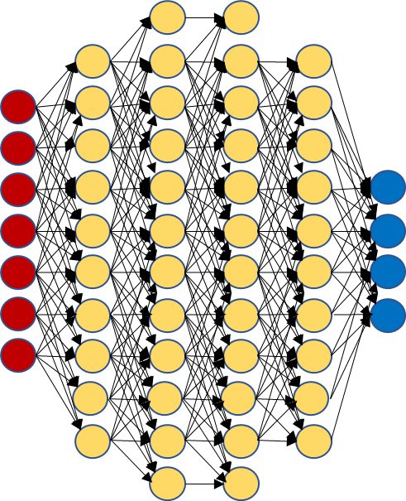
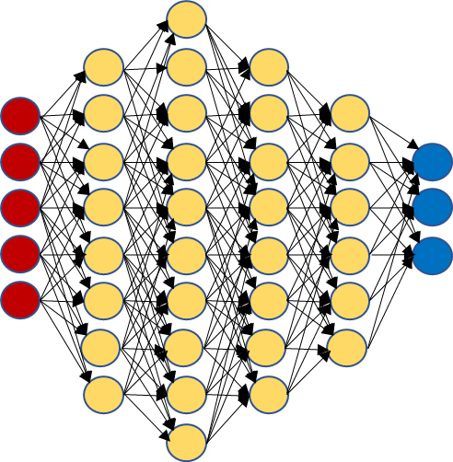
A Deep Cognitive Architecture
Procedural Memory
(Procedural, Control)
Working Memory
Declarative Memory
(Semantic, Episodic)
Increasing Abstraction, increasing time constants
…
…
…
Procedural Memory
(Procedural, Control)
Working Memory
Declarative Memory
(Semantic, Episodic)
Procedural Memory
(Procedural, Control)
Working Memory
Declarative Memory
(Semantic, Episodic)
Perception
Motor
A Deep Cognitive Architecture in terms of the standard model. Perceptual and Motor systems are not prescriptive, but rather allow for an ensemble of techniques and methods appropriate for particular sensors or actuators. Policy driven reinforcement learning modulated by cognitive layers for complex control applications.
Control Primitives
Perceptual and State Data
…
…
…
…
(nonlinear) Control Systems
Sensor Data
Active
Sensor Data
Open-loop Motor Control
Closed-loop Motor Control

Slide 10
Informing the way forward…
Desiderata
Considerations
Nonessentials
Support quick and efficient exploration of complex design spaces.
PyTorch and/or Tensorflow compatibility.
Cognitive layers that each might encapsulate different architectural paradigms.
E.g. support use of ACT-R at lower levels, Soar at higher levels.
Intrinsic attentional functionality.
Modern CS capabilities – scope, namespaces, OOP
Modular, composable software architecture.
Scalable software, suitable for us from FPGA through Cloud deployment to meet application requirements.
Focus on algorithms, not implementation.
May need new, general way to express production rules that can be parameterized to realize instances with Soar, Act-R, etc. functionality.
Fixed architecture that requires a priori knowledge or assumptions on numbers / states/ classes / etc.
“Another” cognitive stand-alone cognitive architecture.
Lossy impedance mismatches at the interfaces between layers.
Esoteric syntax.
Develop for cognitive architectures what PyTorch and TensorFlow is to deep learning – and integrate.
Approved for Public Release

Slide 11
A Short Detour Into A Rabbit Hole…
No Free Lunch Theorem and Complexity Theory
Cognitive Architecture Development as Optimization driven Search Algorithm
On average, over all problems all optimization algorithms are equivalent.
Allows for locally superior performance.
Occam’s razor → lower Kolmogorov complexity more probably → some algorithms like cross-validation can perform better on average for practical problems.
Lots of similar meta-findings to date.
Hard to normalize performance for level of investment.
Not possible/practical to have standard datasets for apples-to-apples comparisons.
Simplest implementations of algorithms most likely to be right.
Better assurance of correctness.
Lower cost to develop/maintain.
Wolpert, D.H., Macready, W.G. (1997), "No Free Lunch Theorems for Optimization", IEEE Transactions on Evolutionary Computation 1, 67.
Lattimore, Tor, and Marcus Hutter. "No free lunch versus Occam’s razor in supervised learning." In Algorithmic Probability and Friends. Bayesian Prediction and Artificial Intelligence, pp. 223–235. Springer, Berlin, Heidelberg, 2013
Theory suggests that making it easy to combine heterogeneous methods will lead to best value propositionmike
Approved for Public Release

Slide 12
Key Questions
What does the interface to cognitive layers?
Separate for different memory classes?
(sparse) tensors, or (sub-)graphs, or something else?
How to modulate input to layer?
Do we need inhibitory mechanism?
General activation function?
Synchronization?
Clock-crossing logic from FPGA/hardware applications?
Answering these questions well is key to success
Approved for Public Release

Slide 13
Discussion

Slide 14
Thank You.
Approved for Public Release

