Slide 1
Eight-QueenS Problem: Fuzzy Constraint Satisfaction Problem Using Soar. Neha Rajan 2018

Slide 2
Constraint Satisfaction Problem
Classical Constraint Satisfaction Problem consider a set of hard constraints that every solution must satisfy.
Drawbacks:-
Some problems are too constrained and have no solutions.
Time Consuming.
Other problems lead to a large set of equally possible solutions.
CSP procedures can pick random solution.
Notes:
In classical Constraint Satisfaction Problem(CSPs) knowledge is embedded in a set of hard constraints, each one restricting the possible values of a set of variables.
However constraints in real world problems are seldom hard, and CSP's are often idealizations that do not account for the preference among feasible solutions.

Slide 3
How to overcome with these problems…?
Fuzzy Constraint encompasses both preference relations among instantiations and priorities among constraints.
Fuzzy Constraints are flexible.

Slide 4
FCSP provides two flexible ways such as:-
Soft Constraints - which directly express preferences among solutions.
(This is ranking of instantiations/attributes which are more or less acceptable for the satisfaction of a soft constraints).
Prioritized Constraints – The flexibility lies in the ability to discard constraints involved in inconsistencies, provided that they are not too important.
Generally, weight is associated with each constraints and the request is to minimize the greatest priority levels of the violated constraints.

Slide 5
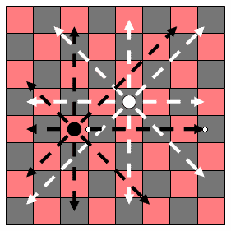
Problem Statement
Place 8 Queens on 8X8 chess board such that no queen can attack one another.
We have:-
Variables: Q_{i} (i is the row)
Domains: D_{i} = {1,2,3,4,5,6,7,8} columns
Constraints: Q_{i} =! Q_{j} cannot be in same column.
| Q_{i} – Q_{j} | =! | I - j | cannot be in same diagonal.

Slide 6
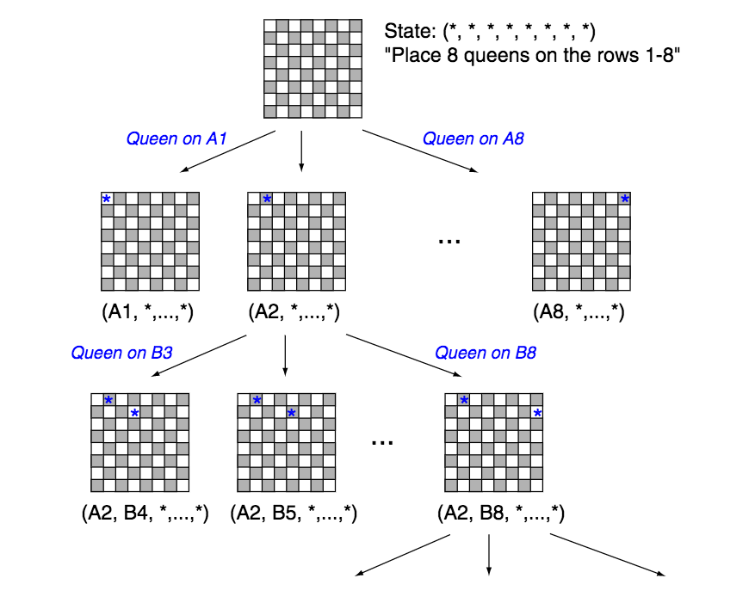
State space Tree for 8-queens
We have large search spaces depending on classical CSP which can be shortened by providing flexible constraints i.e. Prioritized Constraints.

Slide 7
Design approach in Soar
Operator Proposal
Constraint-Checking Substate
Constraints
No other Queen can place in same row.
No other Queen can place in same column
Evaluation Substate
No other Queen can place in same diagonal
Move, only with higher priority
Operator Selection

Slide 8
Operators are proposed for initializing chess board of 8*8
Operator Proposal
Operators are proposed to move location from one to another
Constraint-Checking Substate
Operators are rejected because they do not figure out which next operator to get selected
Evaluation Substate
Resulting operator no-change impasse leads to constraint-checking substate
Operator Selection

Slide 9
Operator Proposal
Operator check that no queen is placed in same row.
Constraint-Checking Substate
Operator check that no queen is placed in same column.
Evaluation Substate
Operator check that no queen is placed in same diagonal.
Operator Selection
This will leads to evaluation substate

Slide 10
For each location where next queen is placed, compare the priority
Operator Proposal
Constraint-Checking Substate
If higher priority is selected then place queen else backtrack
Record Outcome
•Success if constraints weren’t violated
•Failure if constraints were violated
•Partial failure if outcome was unknown
Evaluation Substate
Operator Selection

Slide 11
Operator Proposal
Constraint-Checking Substate
Evaluation Substate
Agent selects among operators that do not violate constraints
Operator Selection

Slide 12
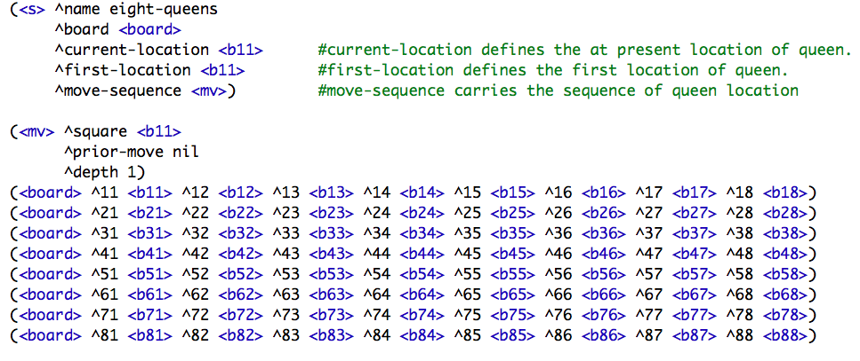
8-queens in Soar
Representation of chess board in SOAR

Slide 13
How Fuzzy Logic will Help to make flexible constraints..?
Fuzzy logic is a form of many-valued logic in which the truth values of variables may be any real number between 0 and 1.
Fuzzy constraint Satisfaction provides the flexible way in Soar to decide :-
What is the most preferred actions? Why do you prefer this action over other actions?
These questions/ideas will help to provide more logics in constraints.

Slide 14
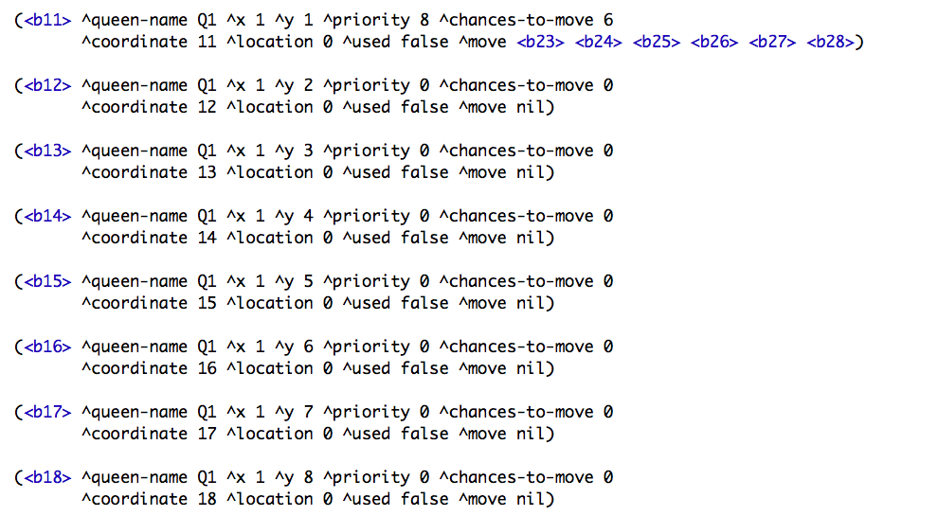
Constraints becoming flexible by providing priority so that next queen can identify which location is goal oriented.
^priority 8 represents that queen can choose to locate at this priority location.
^location 0/1 elaborates the concept of fuzzy. That means either queen be placed(true, value will be 1) or queen cannot be placed(false, value will be 0).
^move nil represents that next queen will not be placed in the same row.

Slide 15
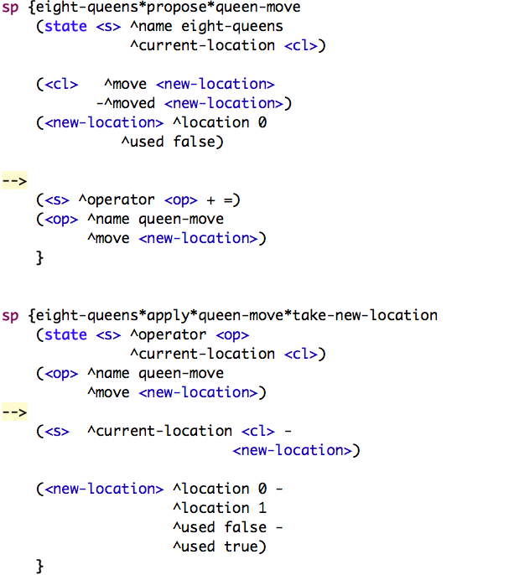
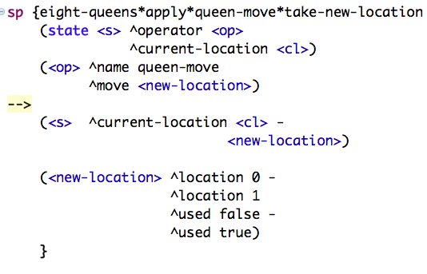
In this code queen is moving from current location to new location

Slide 16
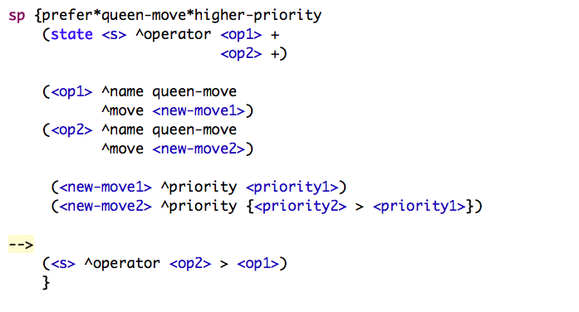
Flexible preference to move queen from one location to another by comparing the higher priority.

Slide 17
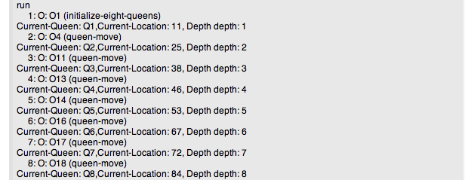
Result

Slide 18
Future Work
To build more flexible constraints.
Allow queen to pick random location to begin with.
Will use Reinforcement Learning and expand the size of the problem .
Will implement episodic memory and semantic memory.

Slide 19

