Slide 1
Games (and concepts) Learnable by Rosie
James Kirk
Soar Workshop 2018

Slide 2
Recent Improvements
Additional Pre-encoded Knowledge
New action remove (removes objects from the environment)
New function for generating subsets from “two of the X” to X choose 2
Concept same (“objects X have the same color”)
In a set
In when not a spatial relation can refer to members of set
Ex: “in a line”, “in a group”
Improved handling of learning predicates with sets
Ex: a term that describes a set can be defined as a test on single object or a set (captured vs. matching)
Use context of usage (helpful in ambiguous learning scenarios)
New Automated(elaborated) Assumption
object inherit the relationships of locations that they are on
Also unary attributes related to position (x,y coordinates)
These improvements have
improved the language the can be used to teach concepts
expanded the set of learnable games (Shuffle, etc.)

Slide 3
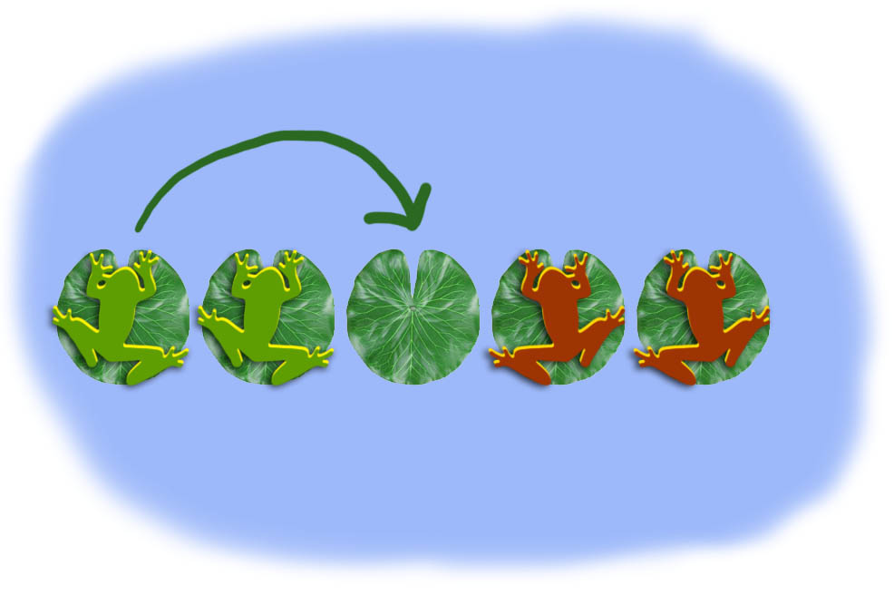
Frogs and Toads
Previous version language
“If a location below a toad is to the left of a location below a frog and the second location is to the left of a clear location then you can move the toad onto the clear location.”
New supported language
“If a toad is to the left of a frog and the frog is to the left of a clear location then you can move the toad onto the clear location.”

Slide 4
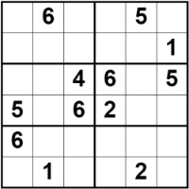
Sudoku
Previous version language
“If the row of a location is the row of another location and the value of the former location is the value of the latter location then you lose.”
New supported language
“If two of the locations are matching and they have the same row then you lose.”
Rosie: I don't know the concept matching.
“If the locations have the same value then they are matching.”

Slide 5
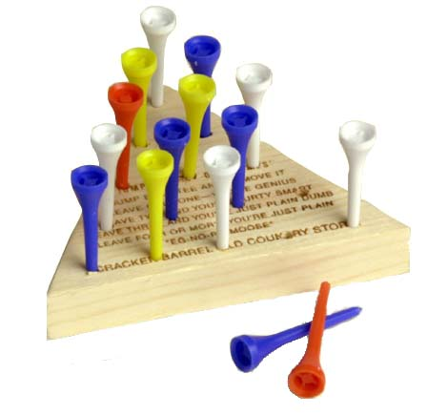
Peg Solitaire
Previous version language
“If the location below a block is between a clear location and a covered location then you can move the block onto a garbage plus move a block on the covered location onto the clear location.”
New supported language
“If a peg is between a clear location and a block then you can remove the peg plus move the block onto the clear location.”

Slide 6
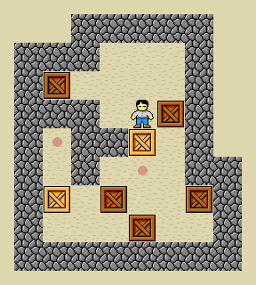
Sokoban
Previous version language
“If a covered location is between a clear location and an occupied location then you can move a block on the covered location onto the clear location plus move a block on the occupied location onto the covered location.”
New supported language
“If a block is between the agent and a clear location then you can move the block onto the clear location plus move the agent onto the location that was below the block.”

Slide 7
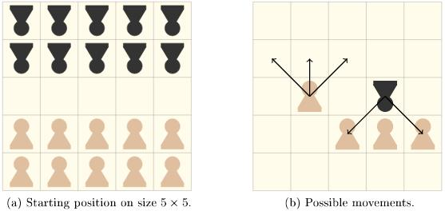
Breakthrough [pawn game]
Previous version language
“If an occupied location is movable from a captured location then you can move a block on the occupied location onto a garbage and move another block on the captured location onto the occupied location.”
New supported language
“If an occupied location is attacked by a red block then you can remove a block on the occupied location and move the red block onto the occupied location.”

Slide 8
Tic-Tac-Toe
Previous version language
“The goal is that three linear locations are captured.”
Rosie: I don’t know the concept captured.
“If a location is below a red piece that is yours then the location is captured.”
equals
3
count
“3”
(1,4,7)
(1,4,7)
below
captured
(1,2,3);…
10-12
(1,2,3); …(3,5,7)
input1
yours
Legend
Primitive concepts
Learned concepts
Input Arguments
linear
10-15
15
1-9
piece
locations
12
Objects 1-9: category=location
Objects 10-12: color=red, category=block
Objects 13-15: color=blue, category=block
On: (10,1); (11,4); (12,7); (13,5); (14,6)
Linear: (1,2,3); (4,5,6); (7,8,9); (1,4,7); (2,5,8);
(3,6,9); (1,5,9); (3,5,7)
7
8
9
11
13
14
4
5
6
10
1
2
3

Slide 9
Tic-Tac-Toe
New supported language
“The goal is that three of the captured locations are in a line.”
Rosie: I don’t know the concept line.
“If the locations are linear then they are in a line.”
(1,4,7)
(1,4,7)
linear
line
(1,4,7);…
(1,4,7);.. (4,7,9);
input1
choose 3
Legend
Primitive concepts
Learned concepts
Input Arguments
(1,4,7,9)
captured
1-9
locations
12
13
7
8
9
Objects 1-9: category=location
Objects 10-13: color=red, category=block
Objects 14-16: color=blue, category=block
On: (10,1); (11,4); (12,7); (13,9); (14,6); (15,5); (16,2)
Linear: (1,2,3); (4,5,6); (7,8,9); (1,4,7); (2,5,8);
(3,6,9); (1,5,9); (3,5,7)
11
15
14
4
5
6
10
16
1
2
3

Slide 10
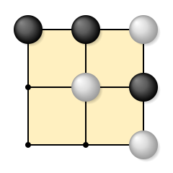
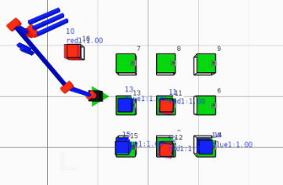
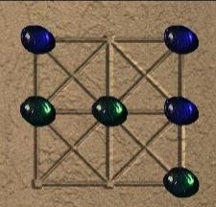
Board Games
3x3 games
Tic-Tac-Toe, 3 Men’s Morris, Picaria, Nine Holes
Breakthrough
Connect 4
Simplified Risk
Othello

Slide 11
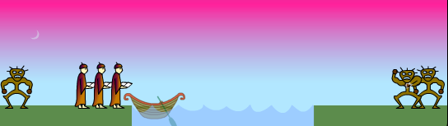
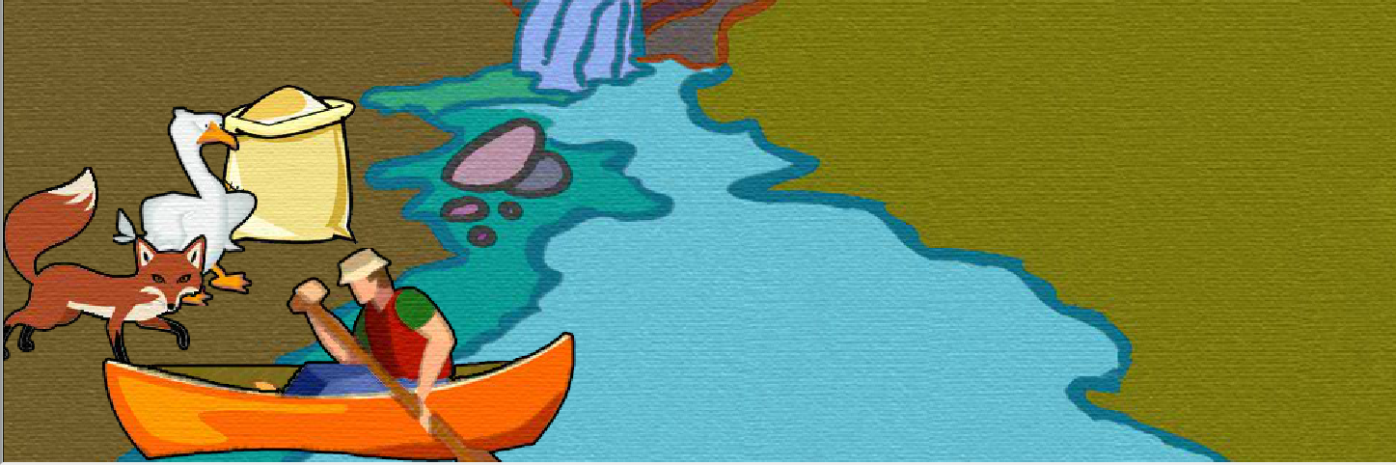
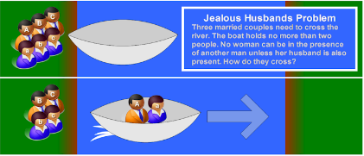
River Crossing Puzzles
Missionaries and Cannibals
Family River crossing
Fox, Goose, & Beans
Jealous Husbands problem
Manager-Actor River Crossing

Slide 12
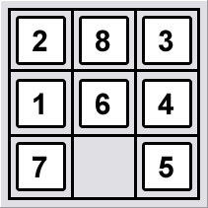
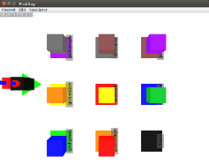
Grid Puzzles
5/8/15 puzzle
Sokoban
Knight’s tour
Maze
Pushing maze

Slide 13
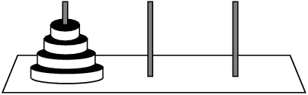
Block puzzles
Tower of Hanoi (3 ,4, & 5 Blocks)
Various Blocks World puzzles
Frog and toads puzzle
Stacking frogs puzzle
King/Lazy Stacking frogs
Sorting

Slide 14
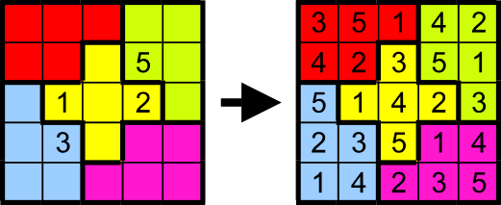
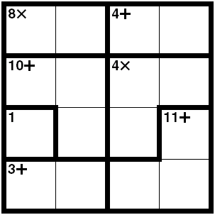
Marking/Logic puzzles
Sudoku/ Killer Sudoku
Jigsawdoku
KenKen
Logi-5
Shuffle
Map coloring

Slide 15
Solitaires & Card Games
Mahjong
Peg Solitaire
Crazy Eights
President

Slide 16
Classification of the new learnable terms
From a basic set of primitives Rosie is able to learn, through complex hierarchical composition, a large number of new terms
Based on what the available primitive knowledge is
Color, shape, size, names, volume, weight, value
Prepositions (on, behind, under, below, left of)
Numerical functions (number of, sum of, subset, …)
Comparitors (less than, more than)
Types of Learnable concepts are an extension of the types of the supported primitives: the building blocks of new knowledge
Learning the correct meaning (how to recognize and operationalize) depends on the context:
The usage of the word (in initial use and in its definition)
The state of the world
The state of the agent’s current knowledge
The task element being defined
Notes:
Initial structure is stored in semantic memory

Slide 17
Learning the meaning of nouns
“If an object is a block and the object is red then it is a frog.”
“If an object is a blue block then it is a toad.”
“If an object is a medium brown rectangle then the object is a box.”
“If an object is a red block and the object is on a bank then it is a missionary.”
“If an object is a blue block and the object is on a bank then it is a cannibal.”
“If an object is a large yellow sphere and the object is in the kitchen then the object is a grapefruit.”
will not always be applicable (context-specific)

Slide 18
Learnable the meaning of functions
“If a block is on a boat then the block is a passenger of the boat.”
“If the last-name of a woman is the last-name of a man then the man is the husband of the woman.”
“If the last-name of a man is the last-name of a woman then the woman is the wife of the man.”
“If a block is on a location then the block is an occupant of the location.”
“If a location is below a block then the location is the position of the block.”
“If a location is adjacent to another location then the former location is a neighbor of the later location.”

Slide 19
Learning the meaning of state verbs
“If a location is under an object and the location is diagonal with the object then the object is attackable by the location.”
“If an occupied location is above a clear location then the clear location is capturable by a block on the occupied location.”
“If a location is below a block and the block is blue then the location is occupied by the block.”
“If an occupied location is above a clear location then the clear location is conquerable by a block on the occupied location.”
“If the color of a block is the color of an object then the block is matched by the object. “

Slide 20
Learning the meaning of adjectives
“If a location is below an object then it is covered.”
“If a block is not on a location then it is free.”
“If a location is not below an object then it is clear.”
“If a bank is below the boat then it is the current bank.”
“If a block is red then it is your block.”
“If a block is large then it is huge.”
“if a location is below a red block then the location is frog-covered.”
“if a location is below a blue block then the location is toad-covered.”
“If the color of a location is the color of the block that is on the location then the location is matched.”
“If a location is below a blue block then it is occupied.”
“If the color of an object is absent then the object is colorless.”
“If the shape of an object is absent then the object is shapeless.”
“If the number of covered locations near a clear location is eight then the clear location is surrounded.”
“If the number of captured locations near a clear location is more than one then the location is a fork location.”

Slide 21
Learning the meaning of comparative adjectives
“If the volume of a block is less than the volume of an object then the block is smaller than the object.”
“If the temperature of a block is less than the temperature of an object then the block is colder than the object.”
“If the weight of an object is more than the weight of another object then the former object is heavier than the latter object.”
“If the value of a card is more than the value of an object then the card is higher than the object.”
“If the value of a card is less than the value of an object then the card is lower than the object.”
“If the number of blocks on a location is less than the number of blocks on an object then the location is weaker than the object.”
“If the number of blocks on a location is more than the number of blocks on an object then the location is stronger than the object.”

Slide 22
Learning the meaning of superlative adjectives
“If an object is not hotter than any block then the former object is coldest.”
“If an object is not colder than any block then the former object is hottest.”
“If an object is not smaller than a block then the former object is largest.”
“If a block is not larger than any object then the block is smallest.”
“If an object is not lower than any card then the former object is highest.”
“If an object is not higher than any card then the former object is lowest.”
“If a card is on a deck and it is not below another card then it is a top card.”
“If a card is on a deck and it is not on another card then it is a bottom card.”

Slide 23
Learning the meaning of prepositions
“If a location is next to an object but it is not diagonal with the object then it is adjacent to the object.”
“If a block is on an object then the object is below the block.”
“If a location is above an object then the object is under the location.”
“If the blocks have the same row then they are in a line.”
“If a block is blue and the column of the block is the column of a location then
the block is below the location.”

Slide 24
“Warmer”
The required understanding of terms like warmer can differ widely based on the context
“If the temperature of a block is more than the temperature of an object than the block is warmer than the object.”
“If the temperature of an object is more than room temperature than the object is a warmer object.”
“If the kelvin-value of a block is more than the kelvin-value of an object than the block is warmer than the object.”
“A red object is warmer than a blue object.”
“A jacket is warmer than a t-shirt.”

Slide 25
“Captured”
Also has many meanings dependent on context, domain, usage
“If a location is below a red block then the location is captured.”
“If a location is below a blue block then it is a captured location.”
“If a location is below a red block then the location is captured by the block.”
“If a blue block is on a location then the location is captured by the opponent.”
“If the value of a location is X then the location is captured.”
Notes:
Initial structure is stored in semantic memory

Slide 26
From these primitives…
STATE VERBS
PREPOSITONS
ADJECTIVES
NOUNS
write
on
red
location(s)
move
near
blue
object(s)
is
above
green
block(s)
has
left
yellow
card(s)
linear
orange
1,2,3…
in front
purple
volume
spades
diagonal
black
shape
hearts
between
white
category
diamonds
of
brown
color
clubs
by
more than
value
king
from
less than
size
queen
suit
rook
row
bishop
column
knight
section
pawn
man
sphere
woman
boat
last-name
garbage
child
adult
sum
product
number

Slide 27
we can learn these new terms
STATE VERBS
PREPOSITONS
ADJECTIVES
NOUNS
write
covered
covered by
on
below
red
ruby
your*
middle
center
empty
location(s)
piece
move
captured
captured by
near
far
blue
aqua
their*
weak
edge
colorless
object(s)
tile
is
occupied
occupied by
above
under
green
clear
free
strong
corner
shapeless
block(s)
face
has
matched
matched by
left
right
yellow
low
high
wild
movable
filled
card(s)
cannibal
defended
defended from
linear
close
orange
big
little
dark
defendable
fork
1,2,3…
missionary
supported
supported by
in front
behind
purple
small
medium
top
supportable
volume
spades
frog
surrounded
surrounded by
diagonal
adjacent
black
large
larger
bottom
capturable
shape
hearts
toad
attacked
attacked by
between
around
white
heavier
lighter
bright
attackable
category
diamonds
fox
marked
of
beside
color
clubs
goose
supporting
brown
heavy
light
dim
jumpable
defending
by
more than
larger than
largest
movable from
value
king
bean
from
less than
smaller than
smallest
defendable by
size
queen
theirs*
supportable from
suit
rook
yours*
heavier than
heaviest
capturable by
row
bishop
mine
lighter than
lightest
attackable from
column
knight
box
higher than
highest
section
pawn
grape
lower than
lowest
jumpable by
man
sphere
stronger than
strongest
woman
boat
weaker than
weakest
last-name
wife of
brighter than
brightest
garbage
husband of
dimmer than
dimmest
child
position of
adult
occupant of
sum
neighbor of
product
score of
number
owner of

Slide 28
Nuggets and Coals
Nuggets
Can learn an infinite number of new task-specific terms (with overloading of terms)
Can learn a large number of tasks, with transfer between tasks at multiple levels
Coals
How to we formally define the space of learnable concepts (games and task-specific concepts)
Not completed evaluations on new games and concepts

Slide 29
BONUS SLIDES

Slide 30
Other classifications of Learnable Terms
Synonynms
Antonyms
Homonyms
If a block is large then it is huge.
If an object is below a block then it is covered. (vs clear)
If the value of a location is the value of the tile that is on the location then the location is matched.
If the color of a location is the color of the block that is on the location then the location is matched.

Slide 31
Predicates for Mobile/robotic
If the value of an office is 3844 then it is the soar office.
If an object is in the pantry then the object is stored.
If an object is brown and the object is a large rectangle then the object is a box.
If the color of a steak is red then the steak is raw.
If the color of a steak is brown then the steak is cooked.
If the temperature of a steak is more than 150 and the steak is brown then the steak is well-done.
If an object is a large yellow sphere and the object is in the kitchen then the object is a grapefruit.
If an object is a small purple sphere and the object is near other small purple spheres then the object is a grape.*
Consider using “..then it might be a grape.” (possibly this is always what is implied for nouns)
Not always be true but useful/correct in the current situation without using large training examples

Slide 32
Supports many new Heuristics
Prefer attacking a location over attacking an object that is stronger than the location.
Prefer attacking a weak location.
prefer moving the smallest block.
prefer moving a small block.
prefer playing a held card that is highest.
prefer playing a held card that is lowest.
prefer playing a low card.
prefer playing the highest held card.
prefer playing a card over playing an object that is lower than the card.
prefer writing a number onto a location over writing a number onto an object that is higher than the location.
prefer moving a block onto a defendable location over moving a block onto a location that is not defendable.
prefer moving a block onto a surrounded location over moving a block onto a location that is not surrounded.

Slide 33
Task Specific Features
Tic-tac-Toe
If the number of locations diagonal with another location is one then the location is a corner location.
If the number of locations diagonal with another location is two then the location is a edge location.
If the number of locations diagonal with another location is four then the location is a center location.
If the number of captured locations near a clear location is more than one then the location is a fork location.
Cards
If a card is on a deck and it is not below another card then it is the top card.
If the value of a card is eight then the card is wild.
If the value of a card is two then it is a trump card.
if a hand is not below any card then it is empty.
River crossing
if a bank is not below a boat then it is the opposite bank.
if a bank is below a boat then it is the current bank.
Frogs and Toads (with blocks)
if a block is blue then it is a toad.
if a block is red then it is a frog.

