Slide 1
A Task-General Learning Model
Part 1: Power-law learning with gradual chunking
Bryan Stearns
University of Michigan
Soar Workshop - May 2018

Slide 2

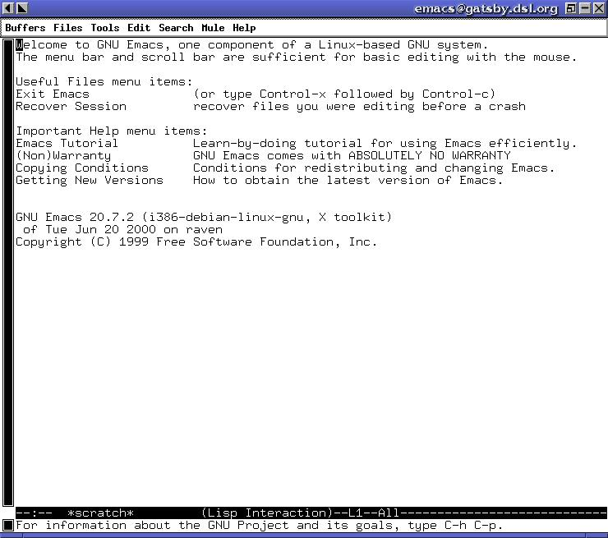

Cognitive Modeling
You have the Soar cognitive architecture
Task-general theory of cognition
You want a task-general model of human learning
Ex: Text Editor
Ex: Arithmetic

Slide 3
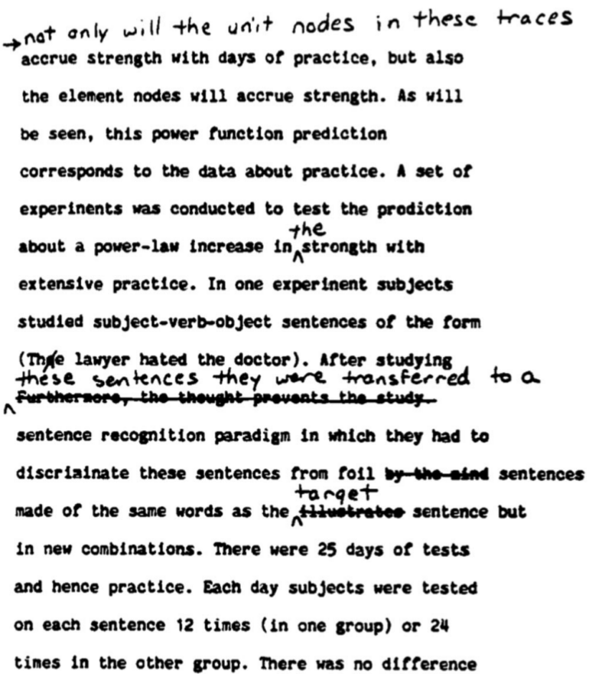
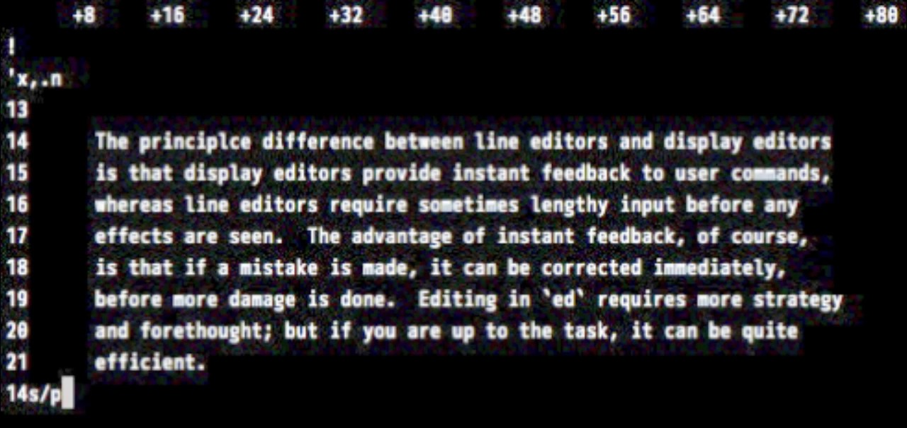
Editors Task (Singley and Anderson, 1985)
Human typists
Written edit directions
3 unfamiliar text editors:
ED, EDT (line editors)
EMACS (display editor)

Slide 4
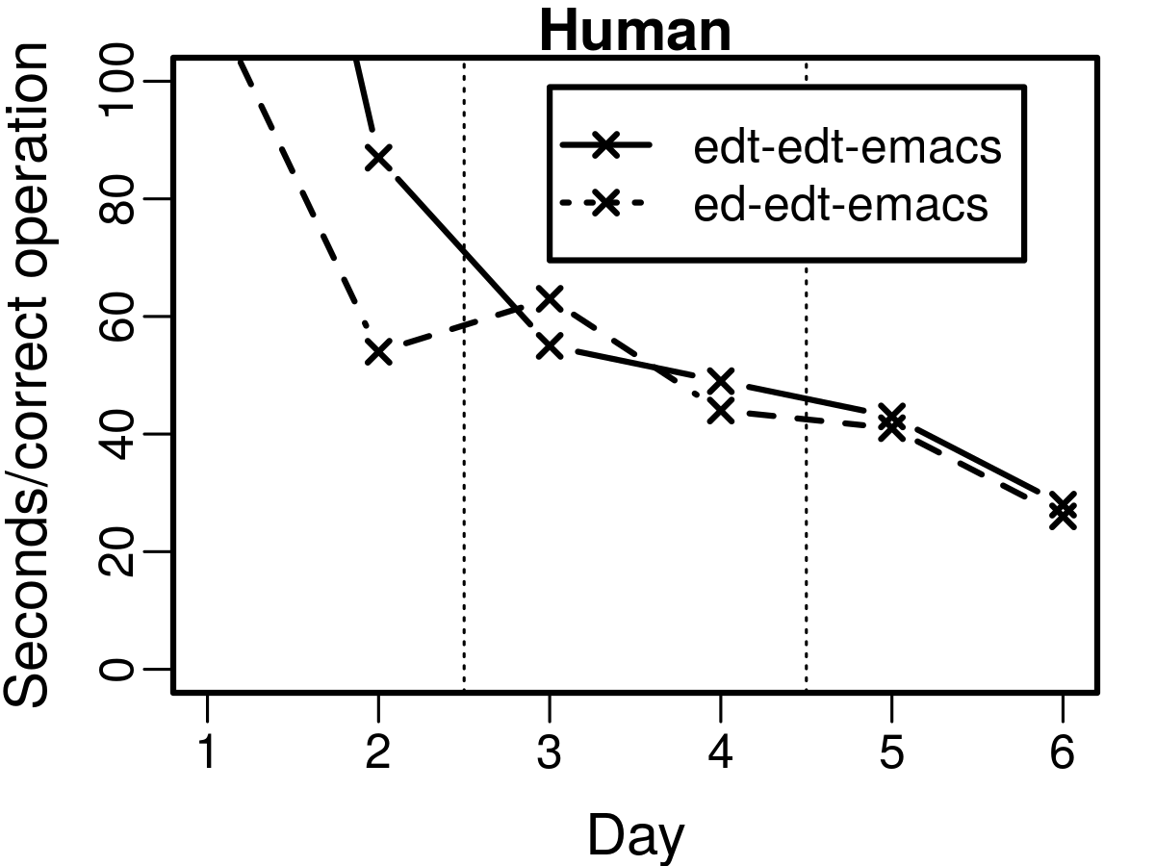
Editors Task (Singley and Anderson, 1985)
Human typists
Written edit directions
EDT w/o practice
3 unfamiliar text editors:
ED, EDT (line editors)
EMACS (display editor)
Subjects transferred among editors over 6 days
Seconds per operation
EDT after
practice
Speed increased with practice
High transfer between editors
ED
or
EDT
EDT
EMACS

Slide 5

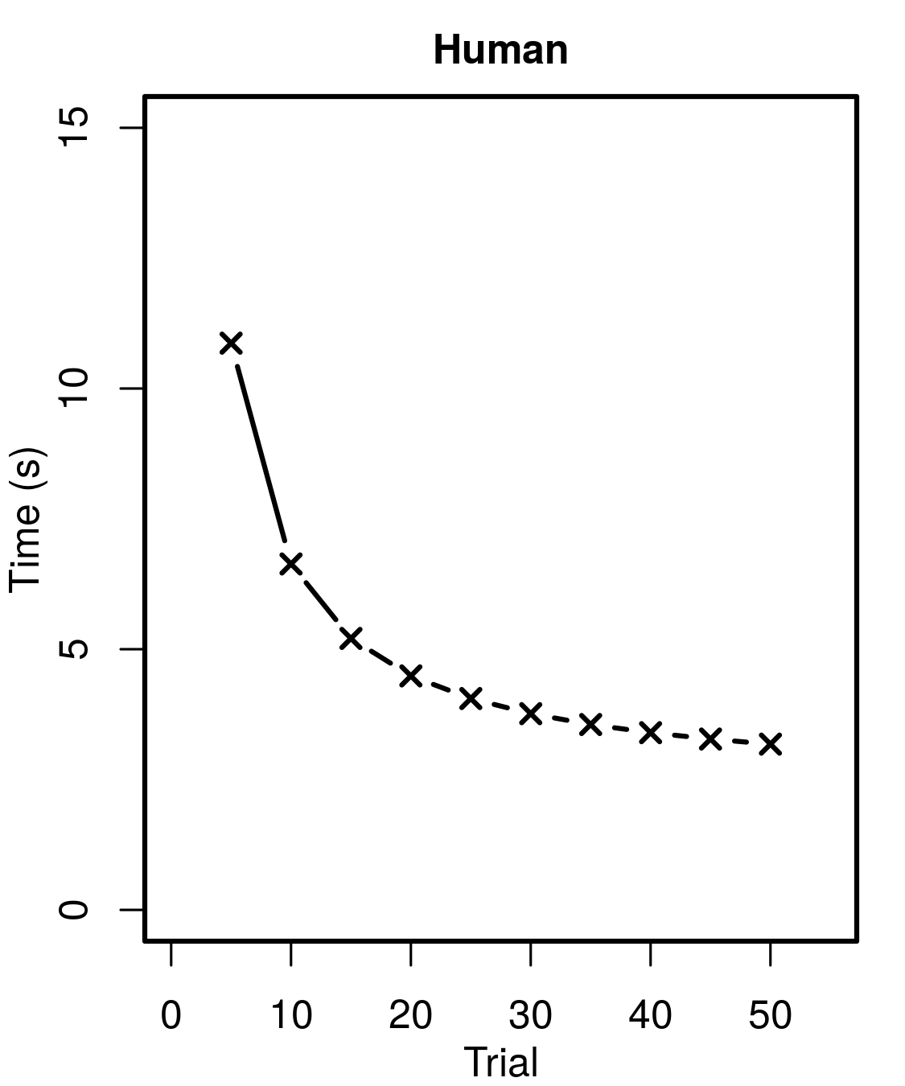
Arithmetic Task (Elio, 1986)
Human Latency
Human subjects
Memorized algorithm
Applied algorithm for 50 trials
Variable input given on screen
Speed increased with practice
Power-law learning
Var1 <- input1 * (input2 - input3)
Var2 <- max(input4 / 2, input5 / 3)
result <- Var1 + Var2

Slide 6
A Task-General Learning Model
A Soar model that
Learns tasks by practice
As task-general as architecture
Does not hard-code task constraints
Human Latency
ED
or
EDT
EDT
EMACS

Slide 7
What it learns:
Read Direction
Read Screen
Type Letter
Task operations:
“What to do”
Individual operations
Task order:
“When to do it”
How to sequence operations
Press Enter
Read Direction
Read Screen
Type Letter
Press Enter

Slide 8
Hard-coded knowledge
Read Direction
Read Screen
Type Letter
Press Enter
If not general, can hard-code task:
Task operations:
Operator rules
WME semantics
Read Direction
Read Screen
Type Letter
Press Enter
Task order:
Proposal conditions
Preferences
If general, can’t assume operations or order

Slide 9
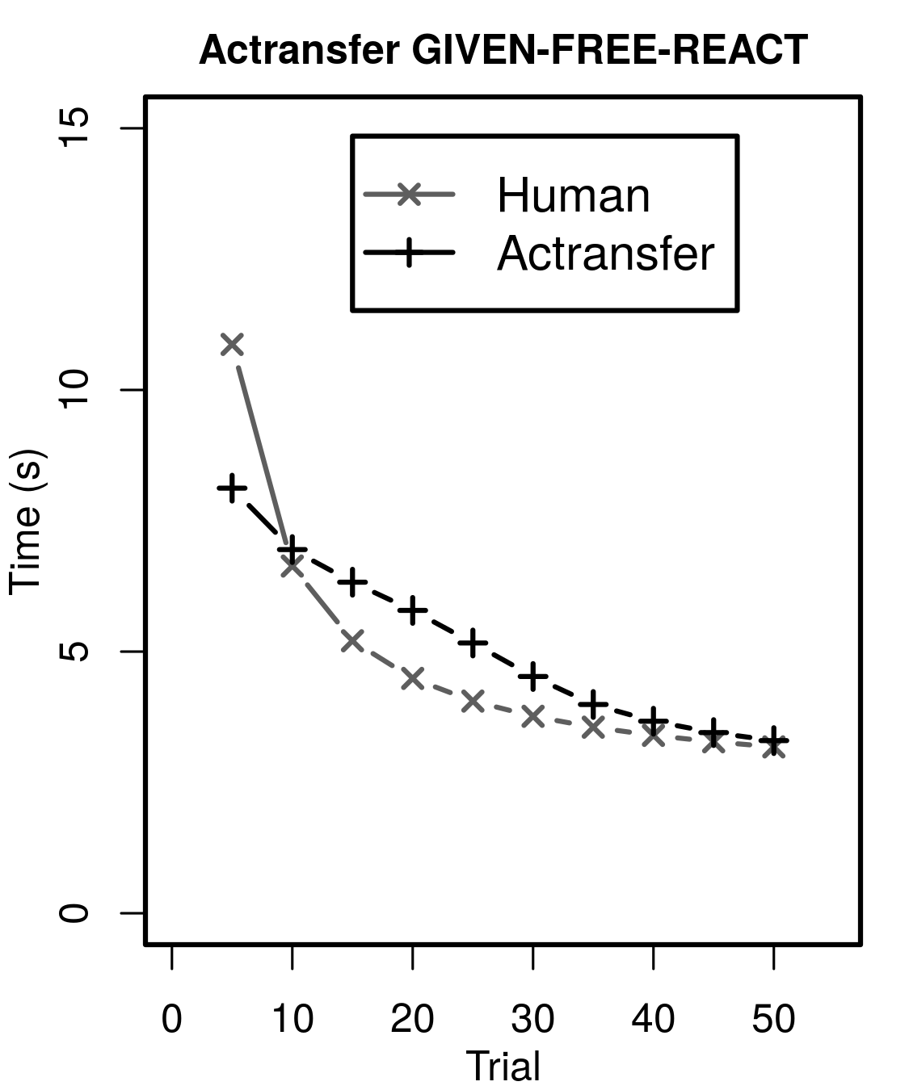
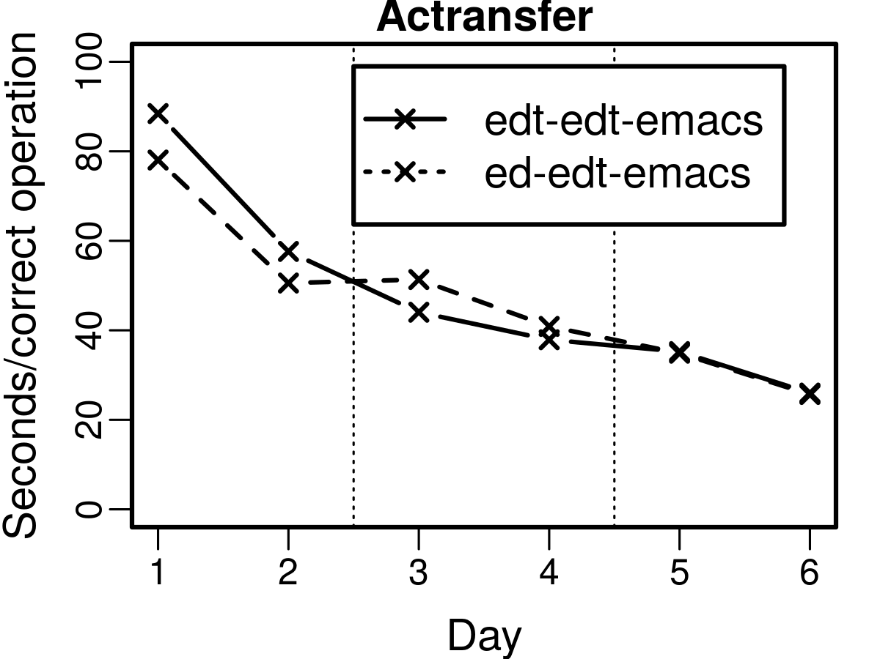
Related Work
Human/Actransfer
Primitive Elements Theory (Taatgen, 2013)
Actransfer architecture (ACT-R derivative)
Learns task operations
Learn rules by instruction
Assumes operation order
ED
or
EDT
ED
or
EDT
EDT
EMACS
EDT
EMACS
Notes:
We’ll similarly compare with human behavior

Slide 10
My model: Fetch and Execute
Like computer architecture model:
Fetch: Retrieve operation instructions from SMEM
Execute: Apply fetched instructions in fetched order
Read Direction
Read Direction
Read Screen
Read Screen
Type Letter
Press Enter
Preserves generality:
SMEM content is task-specific
Content can change
Fetch/execute is task-general
Okay to hard-code
SMEM
Read Direction
Read Screen
Type Letter
Press Enter

Slide 11
Fetch and Execute in Soar
SMEM
Press Enter
Type Letter
Task operations == Soar operators
Propose rules
Apply rules
SMEM instructions describe rules
Conditions & actions
Any valid Soar rule
Instructions →
I1
^condition
^action
^action
P1
P2
P3
Select task operation by selecting instructions
Perform task by following instructions

Slide 12
Learning Fetch and Execute
SMEM
Press Enter
Type Letter
THIS TALK
Learning operators:
Chunk instructions into rules
Using gradual chunking
Learning instruction order:
Chunk spreading activation network
Instructions →
I1
^condition
^action
^action
P1
P2
P3
NEXT TALK
Read Direction
Read Screen
Type Letter
Press Enter

Slide 13
Types of Operators
Read Direction
Read Screen
Type Text
Type Text
Press Enter
Sequential operators
“Temporally-extended” actions
Must be separate
Type Letter
Type Letter
Type Letter
Type Letter
2. Compilable operators
“Simultaneous” operations
Could be parallel
Can chunk into single rule
Test if not end of text
Type next letter
Increment text pos
Assume all instructions are compilable
Fetch order covers the rest
Test if not end of text
-->
Type next letter
Increment text position

Slide 14
Learning Operators
SMEM
Press Enter
Type Letter
Instructed conditions and actions evaluated in substate
Chunked into rule
Instructions →
I1
^condition
^action
^action
P1
P2
P3
CHUNK:
Test if not done typing
Test direction is “type”
-->
Type next letter
P1:
Test if not done typing
P2:
Test direction is “type”
Substate:
P3:
Type next letter
Test if done
Type dir: “type”
Type next letter

Slide 15
Learning Operators
SMEM
Press Enter
Press Enter
Type Letter
If idle: Fetch instructions in substate
idle == impasse
Fetch randomly! (for now)
Test if done typing
Test direction is “type”
Press Enter

Slide 16
Learning Operators
SMEM
Press Enter
Type Letter
If idle: Fetch instructions in substate
Evaluate conditions
Test if done typing
Test if done typing
Test direction is “type”
Test direction is “type”
Press Enter
Press Enter

Slide 17
Learning Operators
SMEM
Press Enter
Type Letter
Type Letter
If idle: Fetch instructions in substate
Evaluate conditions
If false: Fetch again
Test if not done typing
Test direction is “type”
Type next letter

Slide 18
Learning Operators
SMEM
Press Enter
Type Letter
If idle: Fetch instructions in substate
Evaluate conditions
If false: Fetch again
If true: Do actions
Test if not done typing
Test direction is “type”
Type next letter

Slide 19
Learning Operators
SMEM
Press Enter
Type Letter
If idle: Fetch instructions in substate
Evaluate conditions
If false: Fetch again
If true: Do actions
Chunk operations together
Test if not done typing
Test direction is “type”
Type next letter
“Type Letter” chunk:
Test if not done typing
Test direction is “type”
-->
Type next letter
Substate:
Test if done
Test dir: “type”
Type next letter

Slide 20
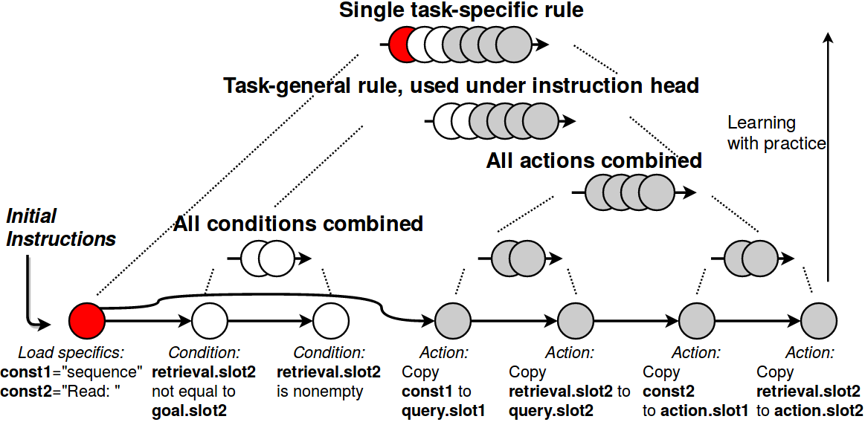
Chunking Operations Together
Prior work: (Taatgen, 2013)
Chunk instructions hierarchically
Intermediate compositions transfer
“Type Letter” chunk:
Test if not done typing Test direction is “type”
-->
Type next letter
Intermediate chunks:
Test if done
Test dir: “type”
Type next letter
Initial instructions:
Test if done
Test dir: “type”
Type next letter
(Stearns et al., 2017)

Slide 21
Chunks Override Fetch
SMEM
Press Enter
Type Letter
Fetch only if agent idle
After impasse
Chunked task rules fire without fetching
Same as hard-coded version
No more fetching required
Test if not done typing
Test direction is “type”
Type next letter
“Type Letter” chunk:
Test if not done typing
Test direction is “type”
-->
Type next letter
Substate:
Test if done
Test dir: “done”
Type next letter

Slide 22
SMEM Retrieval Order
SMEM
Read Direction
Read Screen
Type Letter
Press Enter
We fetch randomly from SMEM
Could search all SMEM…
Assume order is instructed too
(for now)
Follow a linked-list of what to fetch
Requires fixed sequence ahead of time
Read Direction
Read Screen
Type Letter
Press Enter

Slide 23
Are we done?
ED
or
EDT
We have fetch & execute
Task-general model
Learn operators from instructions
Does it model human learning?
“Problem”:
Chunking is one-shot learning
EDT
EMACS
Human Latency

Slide 24
Gradual Learning
ED
or
EDT
Gradual chunking can provide:
High transfer
Power-law learning
(Stearns et al., 2017)
Humans show:
High transfer
Power-law learning
I added gradual chunking to Soar...
EDT
EMACS
Human Latency

Slide 25
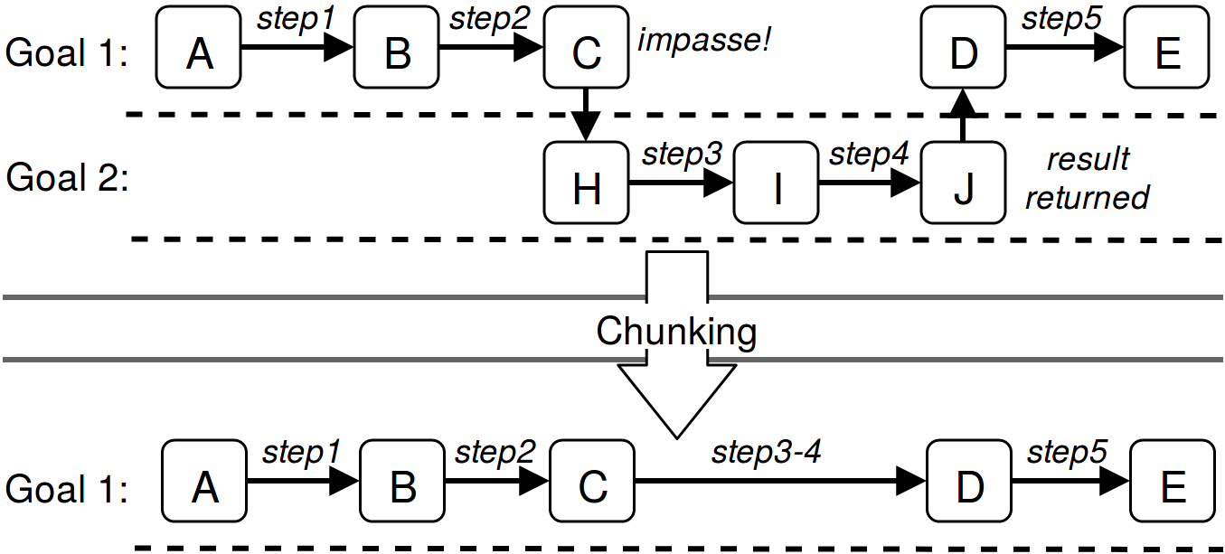
Chunking
Impasse leads to substate
Substate rules return results to superstate
Soar creates rules (chunks) for each result
Chunk preempts later impasses and substates

Slide 26
Chunking
Impasse leads to substate
Substate rules return results to superstate
Soar creates rules (chunks) for each result
Chunk preempts later impasses and substates

Slide 27
Chunking
Impasse leads to substate
Substate rules return results to superstate
Soar creates rules (chunks) for each result
Chunk preempts later impasses and substates

Slide 28
Chunking
Impasse leads to substate
Substate rules return results to superstate
Soar creates rules (chunks) for each result
Chunk preempts later impasses and substates

Slide 29
Chunking
Impasse leads to substate
Substate rules return results to superstate
Soar creates rules (chunks) for each result
Chunk preempts later impasses and substates

Slide 30
Gradual Chunking
Require multiple chunking attempts before storing the chunk
Soar parameter: Chunking Threshold
# Attempts

Slide 31
Gradual Chunking
Impasse leads to substate
Substate rules return results to superstate
Soar creates a rule for each result
Soar counts how many times this rule has been created
Soar chunks the rule if that count passes a threshold
Chunk preempts later impasses and substates

Slide 32
Gradual Chunking
Impasse leads to substate
Substate rules return results to superstate
Soar creates a rule for each result
Soar counts how many times this rule has been created
Soar chunks the rule if that count passes a threshold
Chunk preempts later impasses and substates
Threshold: 3
Count=0

Slide 33
Gradual Chunking
Impasse leads to substate
Substate rules return results to superstate
Soar creates a rule for each result
Soar counts how many times this rule has been created
Soar chunks the rule if that count passes a threshold
Chunk preempts later impasses and substates
+1
Threshold: 3
Count=1

Slide 34
Gradual Chunking
Impasse leads to substate
Substate rules return results to superstate
Soar creates a rule for each result
Soar counts how many times this rule has been created
Soar chunks the rule if that count passes a threshold
Chunk preempts later impasses and substates
+1
Threshold: 3
Count=2

Slide 35
Gradual Chunking
Impasse leads to substate
Substate rules return results to superstate
Soar creates a rule for each result
Soar counts how many times this rule has been created
Soar chunks the rule if that count passes a threshold
Chunk preempts later impasses and substates
+1
Threshold: 3
Count=3

Slide 36
Gradual Chunking
Impasse leads to substate
Substate rules return results to superstate
Soar creates a rule for each result
Soar counts how many times this rule has been created
Soar chunks the rule if that count passes a threshold
Chunk preempts later impasses and substates
Threshold: 3
Count=3

Slide 37
Gradual Chunking
Impasse leads to substate
Substate rules return results to superstate
Soar creates a rule for each result
Soar counts how many times this rule has been created
Soar chunks the rule if that count passes a threshold
Chunk preempts later impasses and substates
Threshold: 3
Count=3
If Threshold == 1:
Same as normal chunking

Slide 38
Gradual Chunking Benefits
Don’t save chunk unless commonly used
Reduce memory bloat
If multiple valid results, chunk what’s shared by other subgoals
More transferrable
(Stearns et al., 2017)

Slide 39
Are we done?
ED
or
EDT
We have task-general fetch & execute
We have gradual learning
Let’s try it
EDT
EMACS
Human Latency

Slide 40
Experimentation
ED
or
EDT
EDT
EMACS
Test gradual chunking thresholds
Both domains
Compare with human learning
Human Latency

Slide 41
Soar Model Measurements
Instructions crafted for task
Initialized into SMEM
Simple string I/O environment
Simulated time
50 msec / decision cycle
Activation-based time* for SMEM retrievals
Additional time for motor actions + vision
Measure time to perform task operations
* Borrowed from ACT-R model

Slide 42
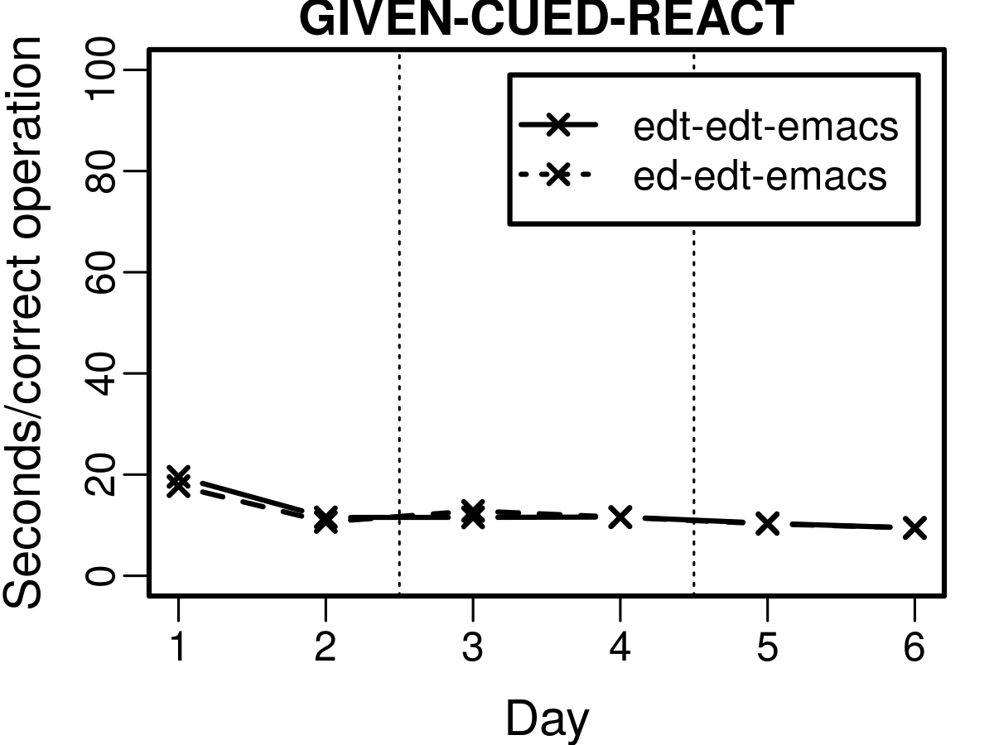
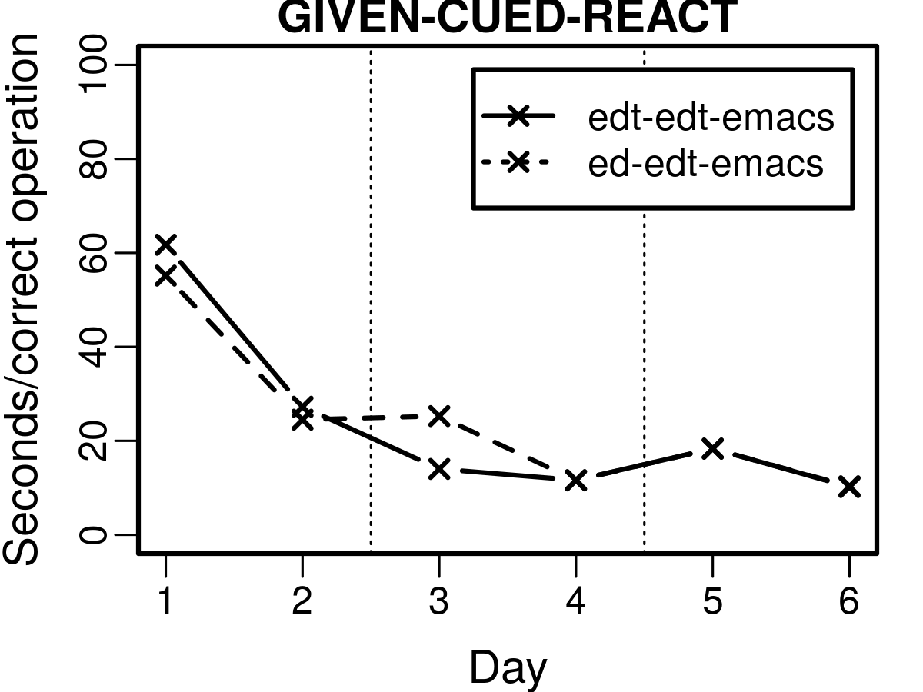
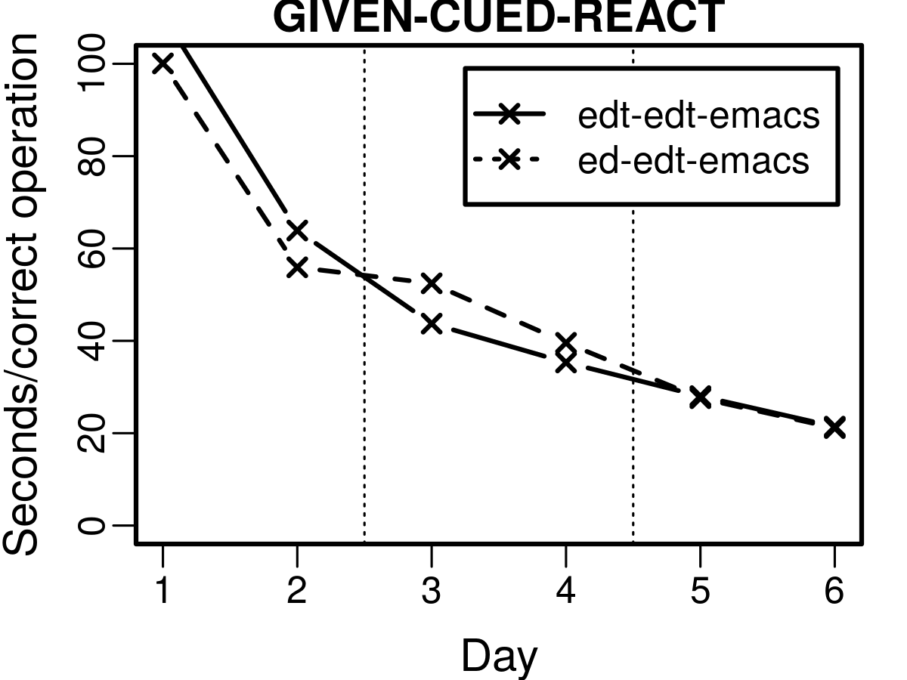
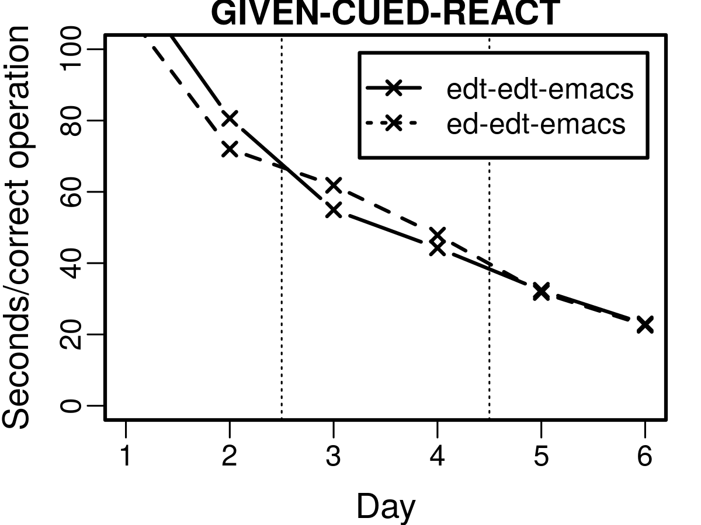
Text Editors Model Results
Threshold = 1
Threshold = 10
Threshold 48+ is close
> 48 too linear
Too fast in days 1-2
Threshold = 48
Threshold = 192

Slide 43
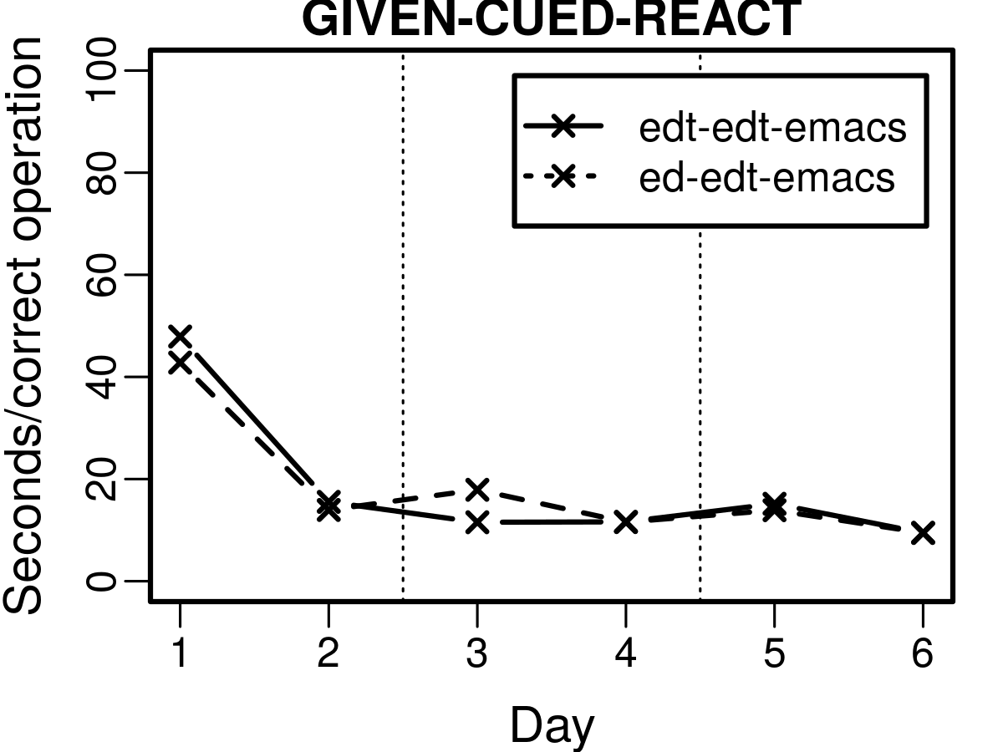
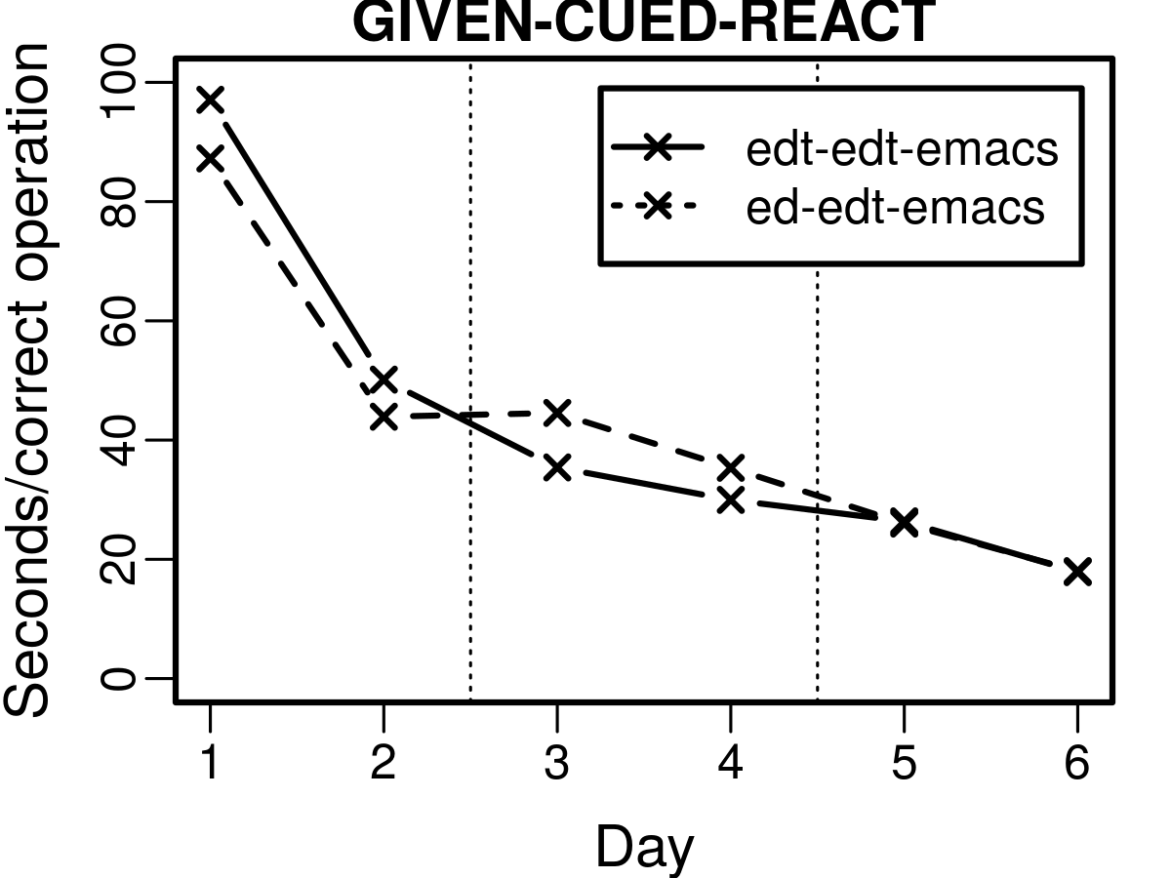
Text Editors Model Results - Extra Data
Threshold = 1
Threshold = 5
Threshold = 10
Threshold = 15
Threshold = 48
Threshold = 192

Slide 44
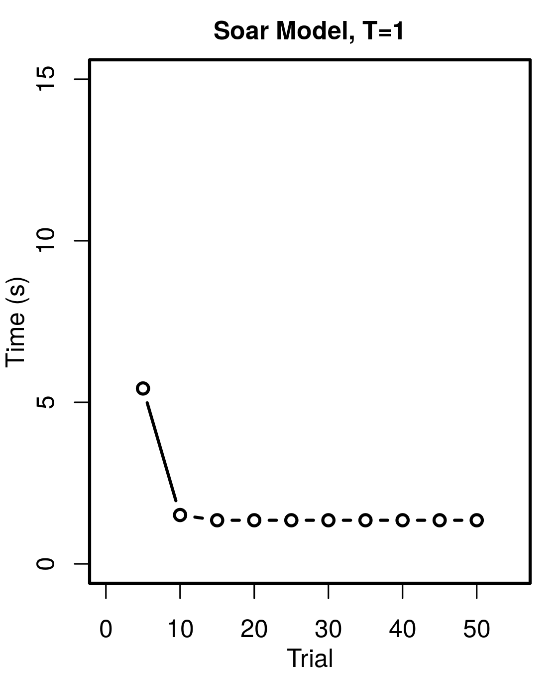
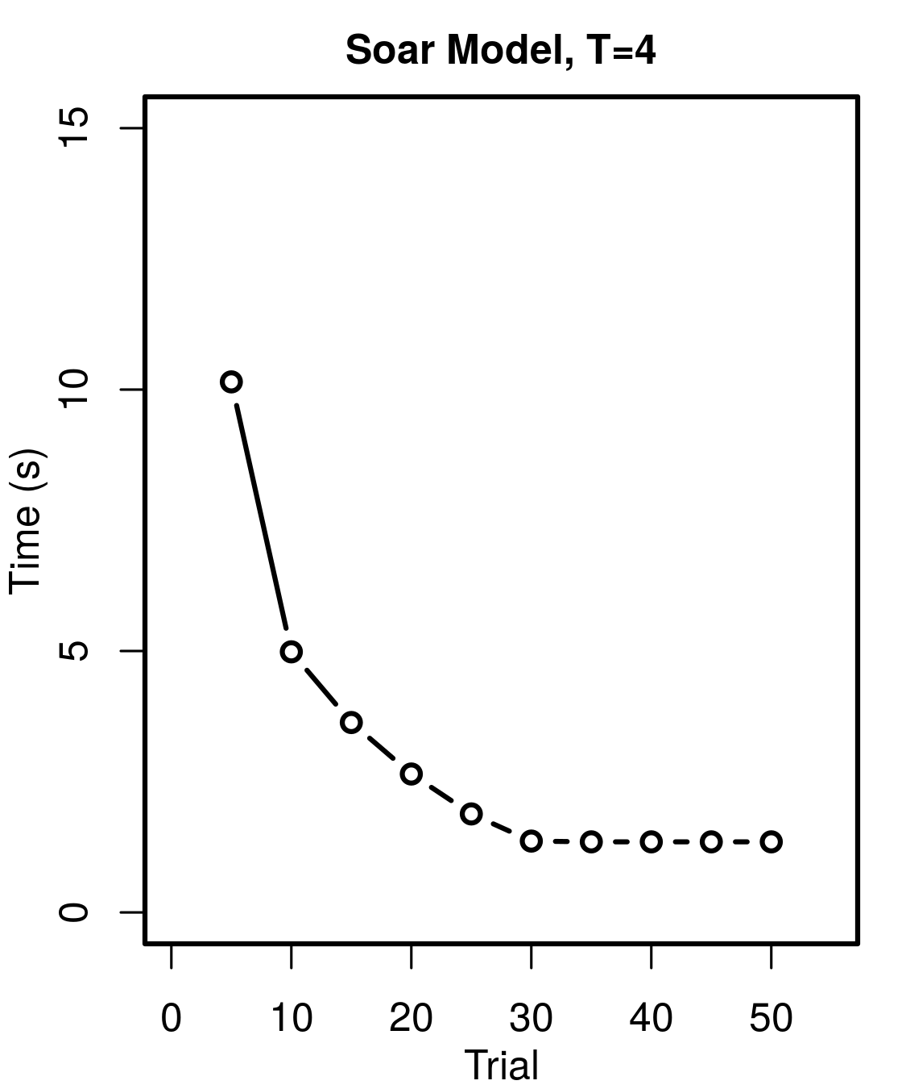
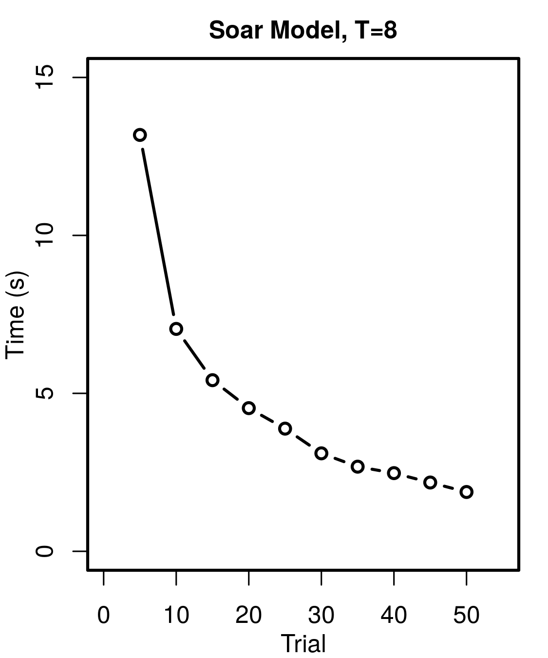
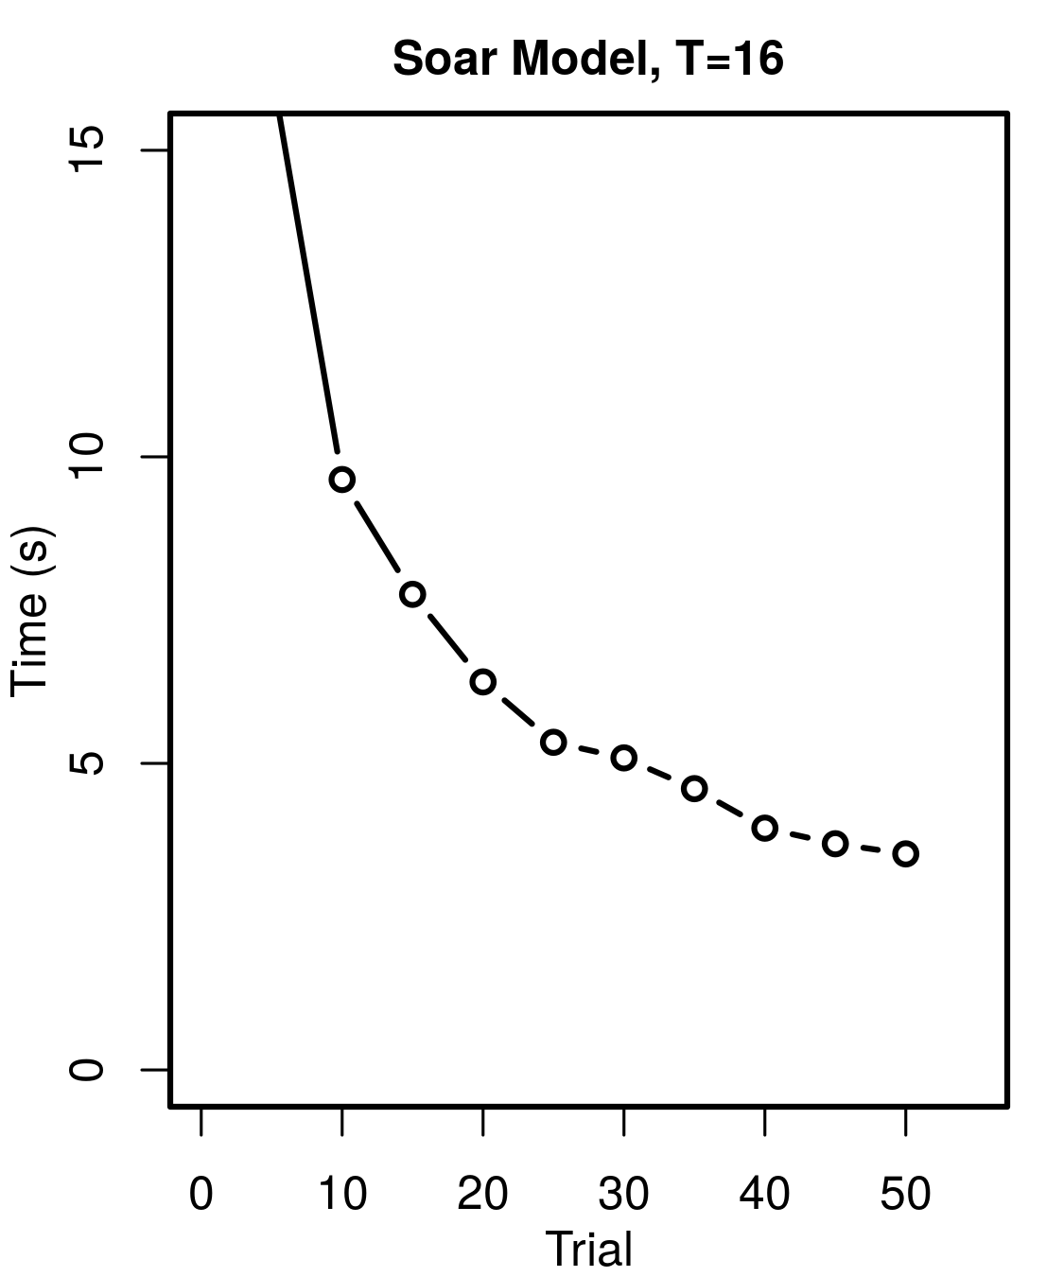
Arithmetic Model Results
Threshold = 1
Threshold = 4
Same general learning model
Different SMEM instructions
Human Latency
Threshold = 8
Threshold = 16
Threshold of 8 close
Power-law
Too fast by trial 50
Humans not optimal

Slide 45


Summary
Questions
Working fetch and execute model
Task general
Learns rules from SMEM instructions
Gradual chunking
Small architectural modification
Human-like operator learning
Still assumes operation order
Requires fixed task sequence
Not great as human model
Too fast at start in Editors
Too fast at end in Arithmetic
Soar Model
Human
Soar Model

Slide 46
Bibliography
Elio, R. (1986). Representation of similar well-learned cognitive procedures. Cognitive Science, 10(1), 41 - 73.
Singley, M. K., & Anderson, J. R. (1985). The transfer of text-editing skill. International Journal of Man-Machine Studies, 22(4), 403 - 423.
Stearns, B., Assanie, M., & Laird, J. E. (2017). Applying primitive elements theory for procedural transfer in soar. In International conference on cognitive modeling.
Taatgen, N. A. (2013). The nature and transfer of cognitive skills. Psychological Review, 120(3), 439–471.

