Slide 1
Towards Solving Visual Puzzles using Visual Knowledge Representations in Soar
James Boggs
University of Michigan

Slide 2
Introduction

Slide 3
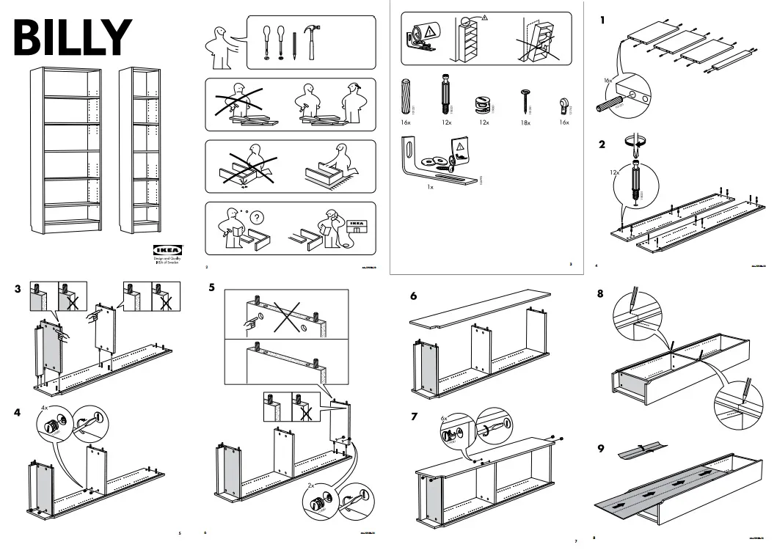

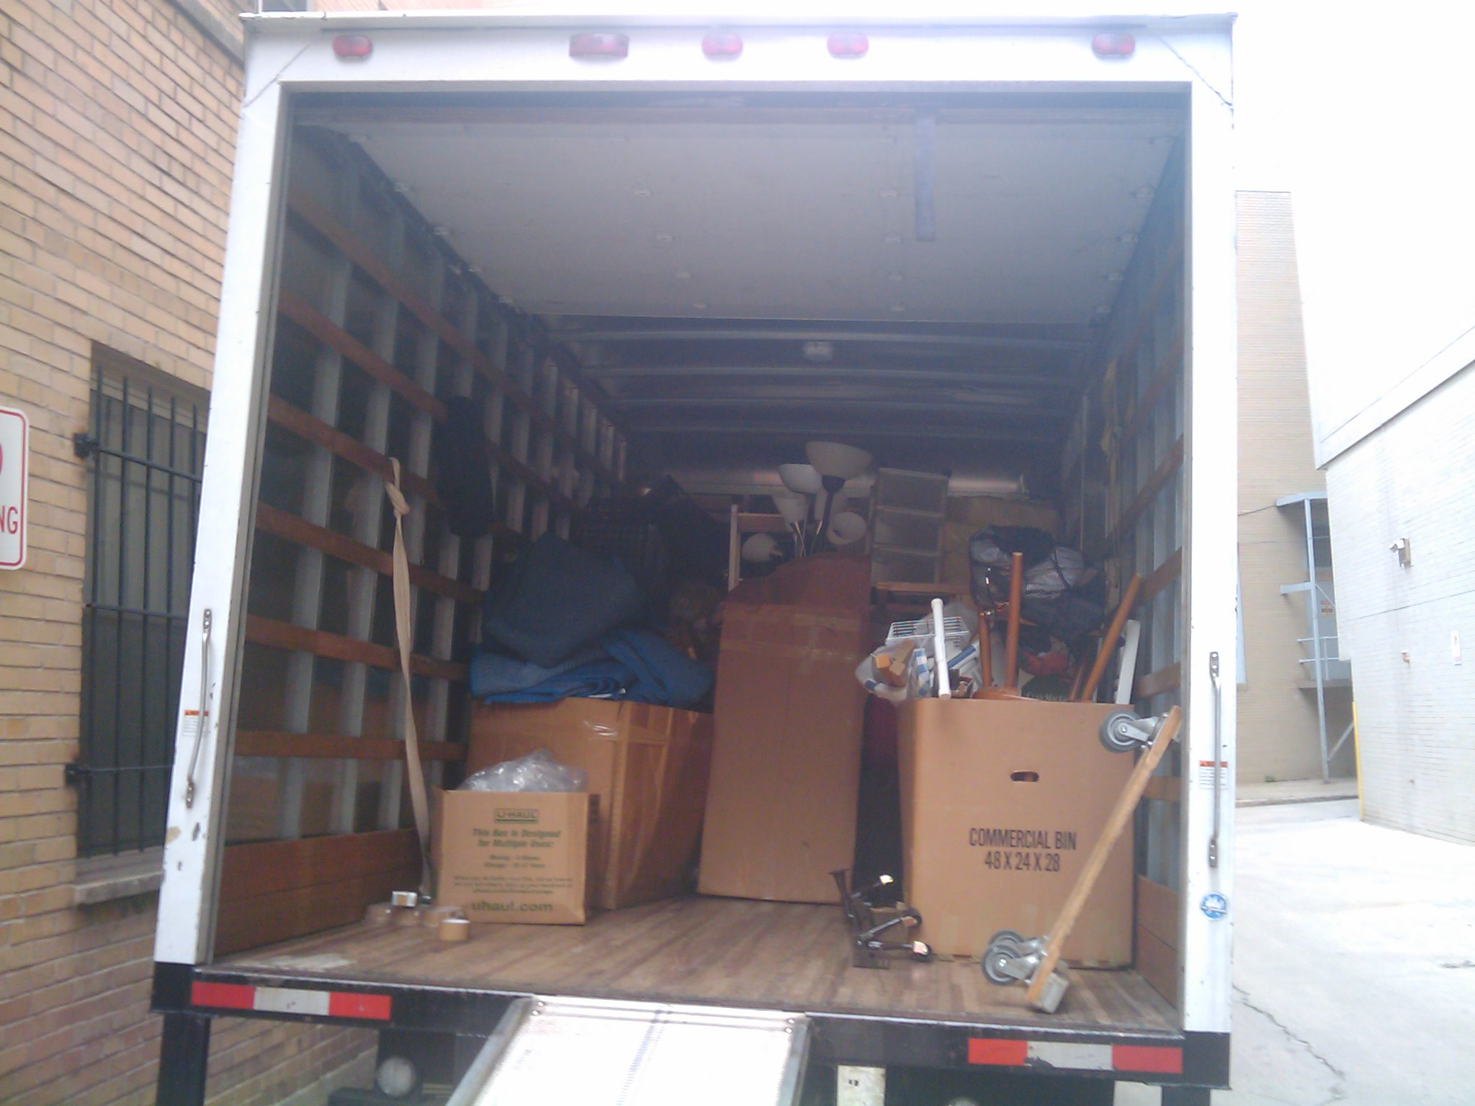
Motivation
Many tasks in the real world benefit from or even require visual reasoning

Slide 4
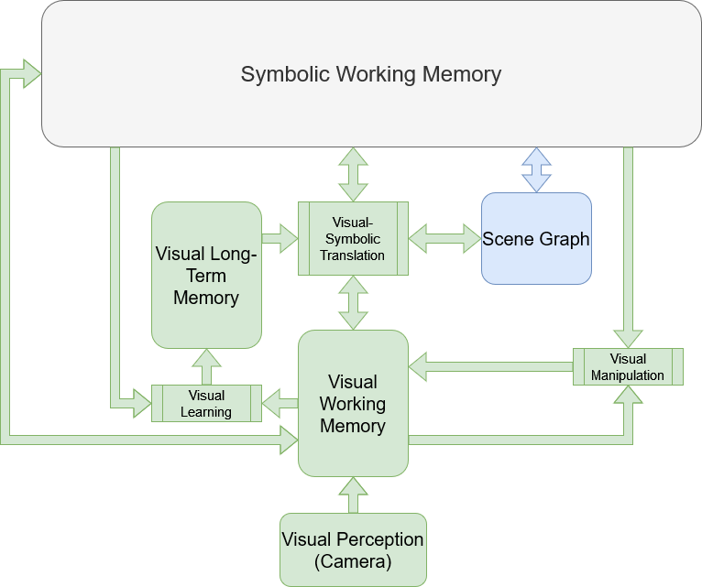
General Research Focus
Extend Soar to include visual knowledge and reasoning by creating new visual memories and associated reasoning operations

Slide 5
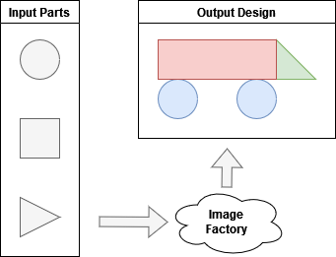
Overview of Current Work
Proof-of-concept agent in simple domain: “Image Factory”
Fundamental task: Create output design by modifying and combining input parts
New visual-symbolic object representation in SVS

Slide 6
Background

Slide 7
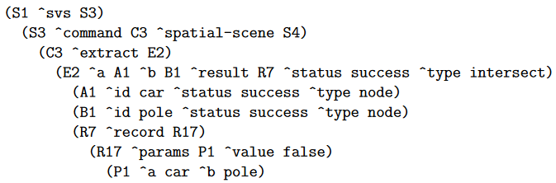
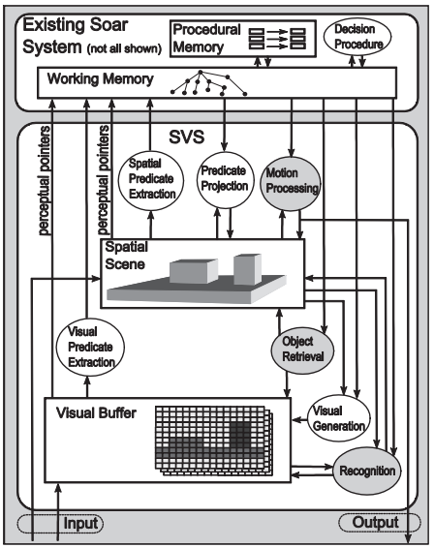
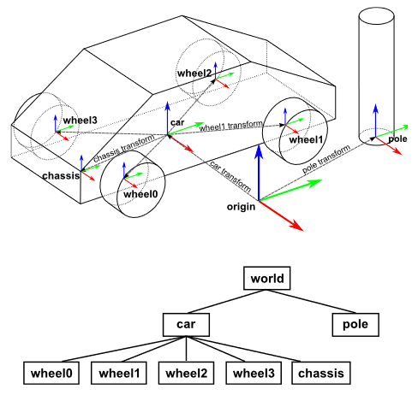
Current Spatial-Visual System
Laird 2012, “The Soar Cognitive Architecture”

Slide 8
Structure of SVS2
Three new visual memories:
Visual Working Memory: holds task-specific visual knowledge and reasoning operations
Visual Long-Term Memory: holds task-independent, long-term visual knowledge
Visual Input Buffer: very short term memory storing most recent raw visual percepts

Slide 9
Visual Working Memory
Maintains current state of visual reasoning
Graph of visual operations (VOps) which can generate & manipulate visual knowledge
VOps + their inputs & outputs connected to symbolic WM
Symbolic Working Memory
get-visual-input
rotate
get-visual-input
union
45
Visual Working Memory
get-visual-input
rotate 45
get-visual-input
union

Slide 10
Current Work

Slide 11
Image Factory Domain
Objective: given input parts, design a factory which uses machines to assemble the inputs into a specified output product
Parts & product are both given as images
Machines can:
Generate an input part
Scale or rotate an input part
Stack two input parts with a relative translation
Solution should be given as a graph indicating how machines should be connected

Slide 12
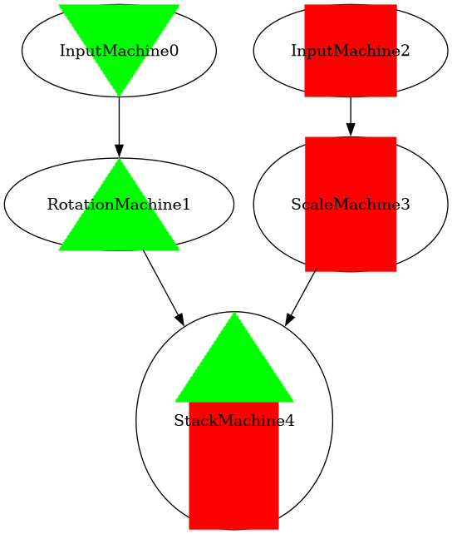
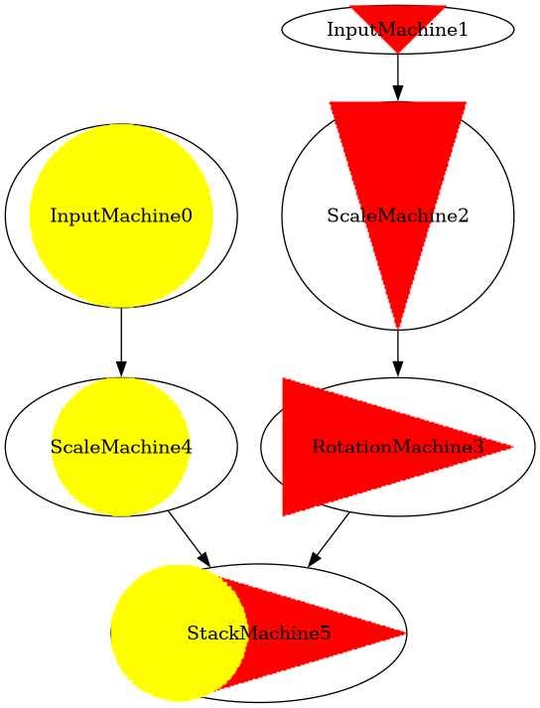
Image Factory: Some Simplifications
Image Factory domain as described is extremely complex, so some simplifications were made for this work:
Only two input images
Unique shapes and colors
No color changing machine
Limited factory size
Limited values for scaling and rotation

Slide 13
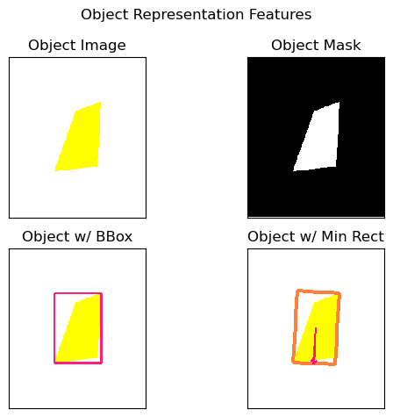
Object Representation
Fundamental to the domain is objectness:
there are multiple discrete components which should be treated separately
Must be able to represent objects in addition to images
Object representation is visual-symbolic: should maintain both visual-spatial & symbolicized features
Currently, uses hand-crafted feature set, including:
Image, mask, height, width, location in original image, color, number of sides, angle of minimal rectangle
Median Object Color:
(0.0, 255.0, 255.0)
Object Size (h,w):
(98, 66)
Object Angle:
93.63 deg
Num Edges:
4

Slide 14



Image Factory Agent
Get input parts and desired product
Input 1
Product
Input 2

Slide 15


Image Factory Agent
Get input parts and desired product
Segment product image by color to get individual objects
Segment 1
Product
Segment 2

Slide 16
Image Factory Agent
Get input parts and desired product
Segment product image by color
Since there’s no color changing, pair same-colored inputs and segments together
Input 1
Segment 1
Input 2
Segment 2

Slide 17
Image Factory Agent
Input 1
Segment 1
Get input parts and desired product
Segment product image by color
Pair inputs and segments
Compare input and segment in a pair to get difference in angles and height & weight ratios
∆ Angle:
-90 deg
H-ratio:
1.0
W-ratio:
1.0
Object Angle:
180 deg
Object Size:
(141, 134)
Object Angle:
90 deg
Object Size:
(135, 138)

Slide 18
Image Factory Agent
Input 1
New Part
Get input parts and desired product
Segment product image by color
Pair inputs and segments
Compare input and segment
Attempt a scaling or rotation operation on input part, guided by results of comparison
∆ Angle:
-90 deg

Slide 19


Image Factory Agent
New Part
Segment 1
Get input parts and desired product
Segment product image by color
Pair inputs and segments
Compare input and segment
Attempt a scaling or rotation operation
Compare results with segment and product to detect matches
Accounts for and detects obscuration, which it stores to remember which part goes on top in final product
coverage=1.0
Product
coverage=1.0

Slide 20
Image Factory Agent
Input 1
Match 1
Get input parts and desired product
Segment product image by color
Pair inputs and segments
Compare input and segment
Attempt a scaling or rotation operation
Detect matches
Build factory design by following chain of operations which led from an input part to a matching part
Rotate
-90 deg
Input 2
Match 2
Scale
H: 0.5
W: 1.5

Slide 21
Results & Discussion

Slide 22
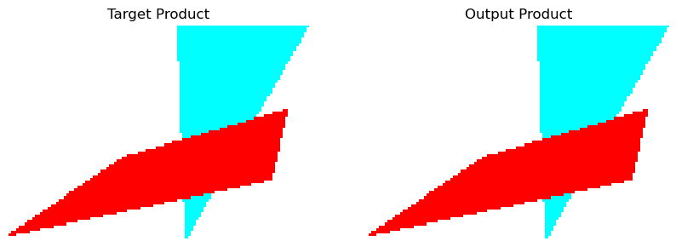
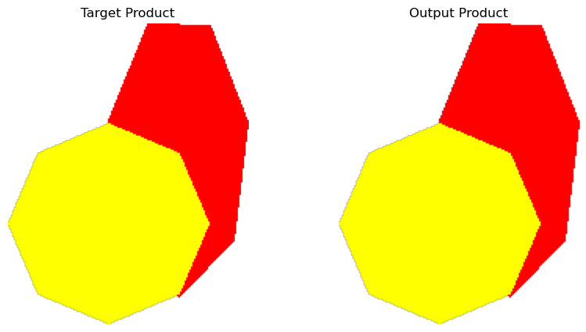
Initial Results
So far, tested on 16 randomly-generated factories
10 agent-generated images were visually identical to goal images
5 were within a small margin of error (unnoticeable to humans)
1 factory couldn’t be completed in reasonable timeframe

Slide 23
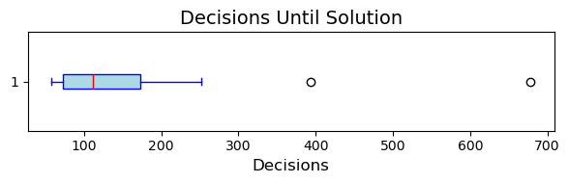
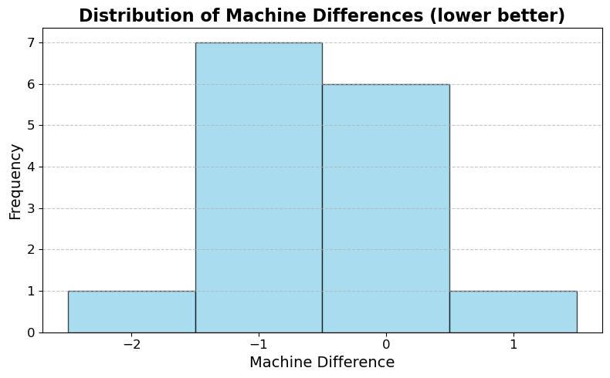
Initial Results
15/16 factories were completed in a reasonable amount of time
Min decisions: 58
Max decisions: 678
Longest wall time was 35s
Incomplete factory took >2000 decisions
Agent solutions were almost entirely (14/15) as good or better than original factory
Only 1 added an unnecessary machine

Slide 24
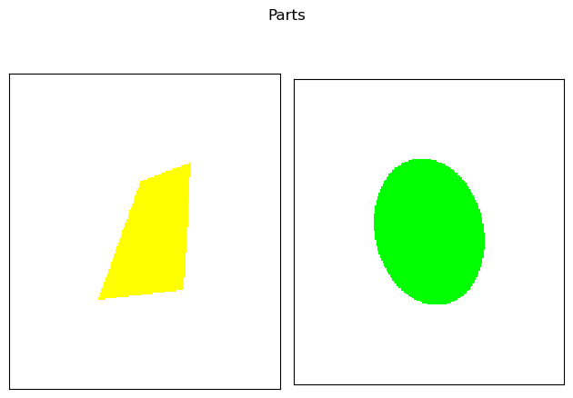
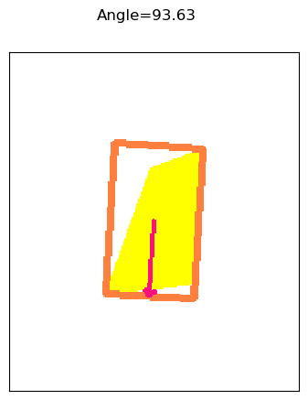
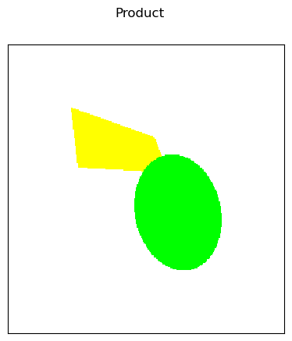
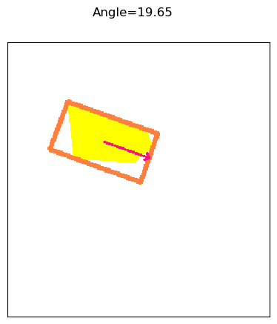
Analysis: Failure Case
Incomplete factory took >2000 decisions
Ended up crashing before finding solution (too much memory usage?)
Possible reason: factory has an obscured, irregular polygon
Problem: search is guided by:
bounding box height & width ratios for scaling
minimal rectangle angle for rotation
Bounding box ratio thrown off by obscuration
Angle thrown off by obscuration + irregularity
OpenCV minimal rectangles are finicky!
Result: resorts to exhaustive search

Slide 25
Future Work & ConclusioN

Slide 26
Future Work: Two Directions
Better Soar Code
Improve Object Representations
Significant room for optimization to prevent slow-down and crashing
Improve search guidance rules by:
adjusting heuristic weights
baking in more geometric knowledge
probably lots of other little tricks
Add more information to hand-crafted representation
Too painstaking and too fragile!
Learn object representations via deep learning
regress affine transform between input and product part representations
predict complete product part from obscured segment

Slide 27
Nuggets and Coal
Nuggets
Coal
Mostly successful proof-of-concept for visual reasoning with SVS2
Extends Soar to include images and image manipulation, might be helpful to some
Hopefully enough to finish my dissertation!?
Hand-crafted object representations are too fragile
Fragility bleeds over into Soar code: no way to handle noisiness/fuzziness
e.g., slight pixel misalignments can throw everything off
Bonus coal: using PyTorch in Soar is tricky due to namespace collision

Slide 28
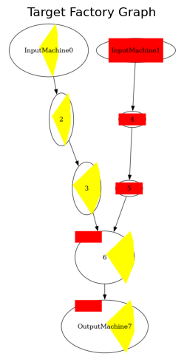
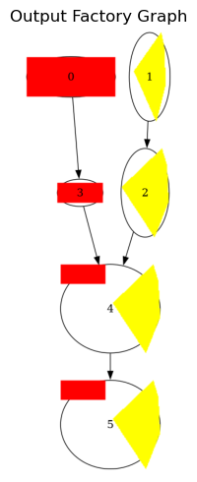
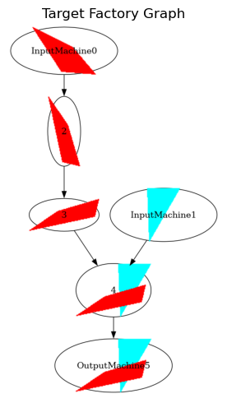
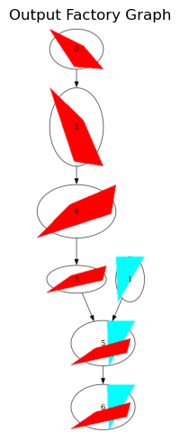
Analysis: Machine Differences
Best: Saved 2 Machines
Worst: Added 1 Machine

Slide 29
Outline
Introduction
Motivation
General Research Focus
Specific Work
Background & Prior Work
SVS: Spatial Scene
SVS 2: Visual Memories
Methodology
Image Factory Domain
Object Representations
Image Factory Agent
Evaluations & Analysis
Initial Results
Analysis of Hand-crafted Approach
Future Work
Agent Code Improvements
DL-Based Representations
Conclusion

