Slide 1
Artificial Intelligence in Drug Discovery: Problems and Prospects
A case study in predictive modeling and virtual screening for acetylcholinesterase inhibition
Md Abu Sadat Soash, Sajib Mia
Department of Genetic Engineering and Biotechnology
Shahjalal University of Science and Technology, Sylhet, Bangladesh

Slide 2
Why this question
AI now touches every stage of discovery, from target identification to trial design.
A 2026 Nature Reviews Drug Discovery perspective finds clinical impact still limited after a decade of investment.
Two problems surfaced in our own work: the cost of data curation, and telling rediscovery from novelty.
Open resources such as ChEMBL and COCONUT make large-scale screening possible outside industry.
Target
Human acetylcholinesterase (AChE), the target of every approved symptomatic Alzheimer's therapy.
2

Slide 3
Approach
ChEMBL 37
Curate
Model
Validate
Screen
7,826 raw IC50 records for CHEMBL220
6,268 unique compounds, median pIC50
Random Forest on 1024-bit Morgan fingerprints
Cross-validation, y-randomization, Gini bit mapping
738,823 COCONUT natural products
Random Forest was chosen for data fit at this scale, direct interpretability, and to spend effort on validation rather than architecture. Docking is left as a next step.
3

Slide 4
Data curation took most of the effort
Exact IC50 relations in nM only; pIC50 computed per record.
Multiple assays per compound collapsed by the median in log space.
19 compounds had pIC50 above 11.8. 17 came from one assay, a likely unit-parsing artifact, and were removed.
2,877
active (pIC50 > 6)
1,595
inactive (pIC50 < 5)
1,796
intermediate, excluded from classifier
4

Slide 5
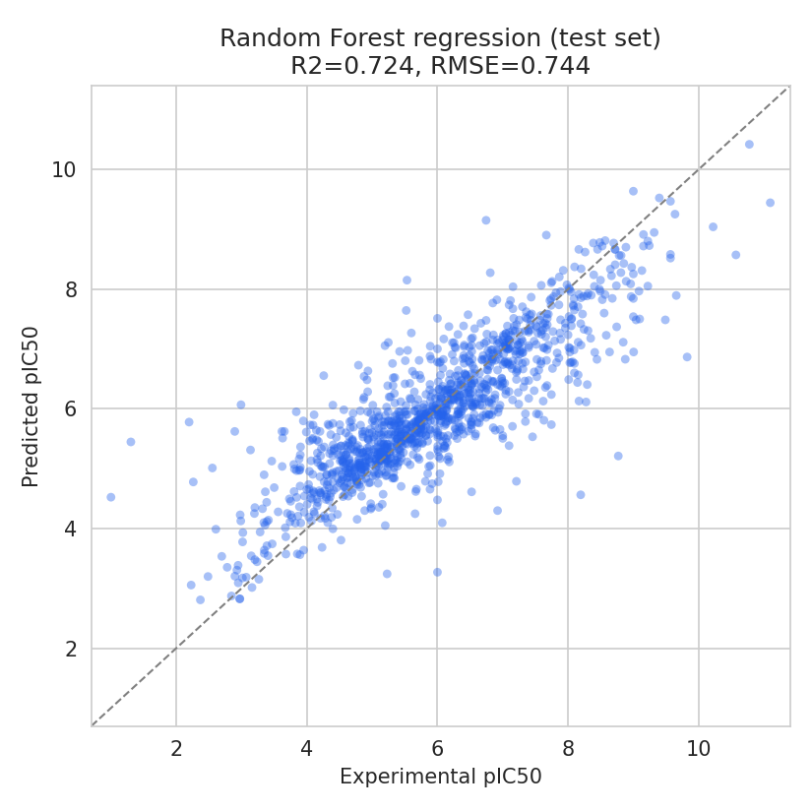
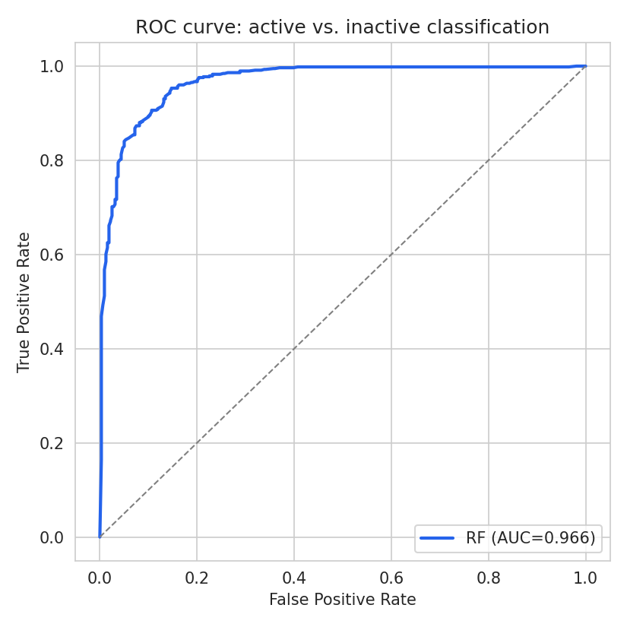
Predictive performance
 | Regression (pIC50) | Classification
Test set | R² 0.72, RMSE 0.74 | AUC 0.966, accuracy 91.3%
3-fold CV | R² 0.69 ± 0.03 | AUC 0.960 ± 0.005
Y-randomization | R² -0.19 ± 0.02 | AUC 0.50 ± 0.01
5

Slide 6
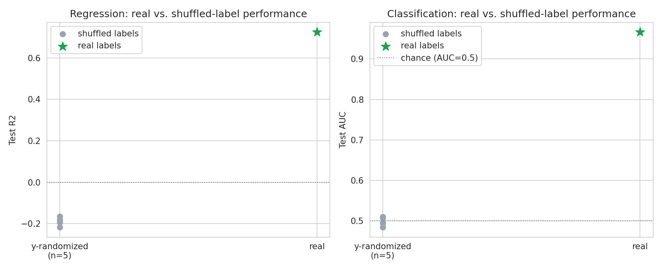
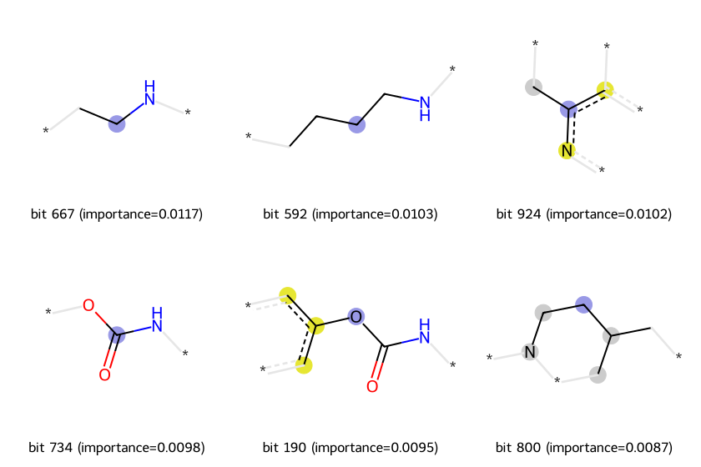
Controls and interpretation
Shuffled labels drop performance to chance, which rules out leakage.
The top fingerprint bit is the O-C(=O)-NH carbamate group found in physostigmine, rivastigmine and neostigmine.
6

Slide 7
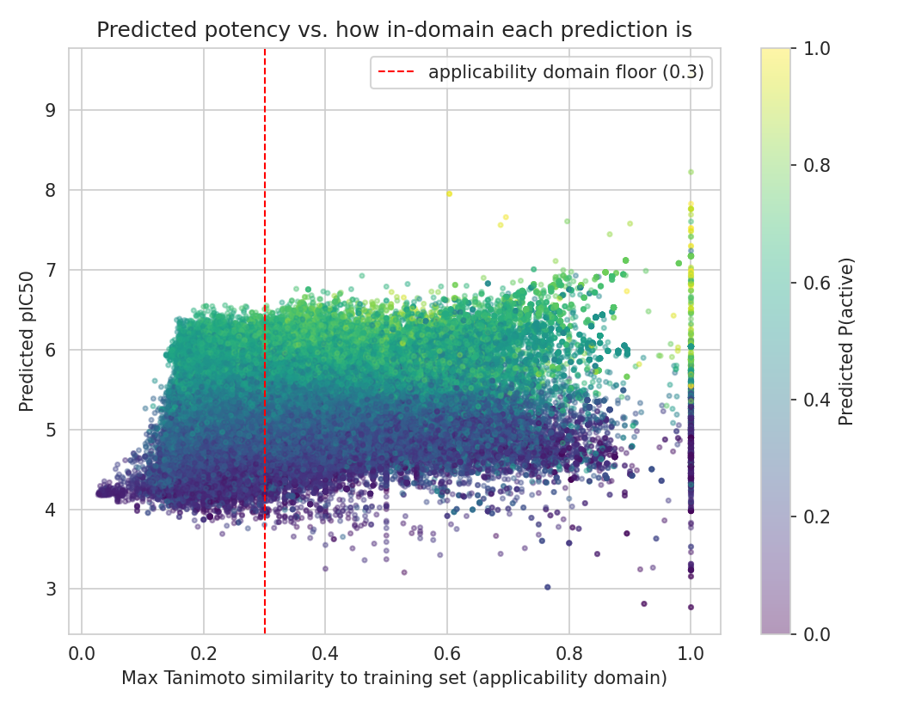
Virtual screening of COCONUT
188,855 compounds (25.6%) predicted active; 46.1% inside the applicability domain.
Huperzine A predicted at pIC50 6.82, inside its reported range. Galantamine scored borderline (P = 0.57).
Top hits with similarity 1.0 were donepezil, tacrine and the physostigmine family. These are duplicates of training data.
Similarity 0.30 to 0.95 surfaced diazaspirononanones from the irbesartan intermediate, an AChE chemotype reported in prior assays.
7

Slide 8
Limitations, next steps, conclusion
Limitations
Next steps
No external or temporal test set.
Nearest-neighbor Tanimoto is a simple domain measure.
One algorithm and one fingerprint.
No hit tested experimentally.
Docking against a resolved AChE structure, then molecular dynamics.
Candidates: irbesartan, the non-duplicate diazaspiro analogue, two coumarin-carbamate hybrids.
Ellman assay for confirmation.
AI in drug discovery is useful but demands rigor. The model found real signal, and it re-derived known leads rather than discovering new ones.
8

