Slide 1
Detecting Credit Card Fraud with Machine Learning
Vaughan Cordell

Slide 2
Overview
“The datasets contains transactions made by credit cards in September 2013 by European cardholders. This dataset present transactions that occurred in two days, where we have 492 frauds out of 284,807 transactions. The dataset is highly unbalanced, the positive class (frauds) account for 0.172% of all transactions..”
Why is this Important?
“Identity fraudsters bilked $16 billion from 12.7 million U.S. consumers in 2014. As alarming as that statistic is, it's actually an improvement over the year before, when fraudsters stole $18 billion from 13.1 million victims.”
Why machine learning?
Sheer size of dataset
Machine learning allows us to process through data much more quickly
Unbalanced nature of the data

Slide 3
What is important?
Precision vs. Recall
Precision : Given a positive prediction, how likely is it to be correct?
Recall: Given a positive example, will our classifier detect it?
In fraud, detection will always be more important
We would much rather false positives than false negatives

Slide 4
Input & Output
Input:
Consists of real credit card transactions made over the course of two days in September of 2013
284,807 total transactions, with 492 classified as fraudulent
Features run through a Principal Component Analysis(PCA) transformation
Classification labels of 28/30 features unknown,
“Unfortunately, due to confidentiality issues, we cannot provide the original features and more background information about the data.”
Only non-transformed data consists of Time (seconds) and Amount (euros)
Output:
Classification of transaction as fraudulent or not fraudulent

Slide 5
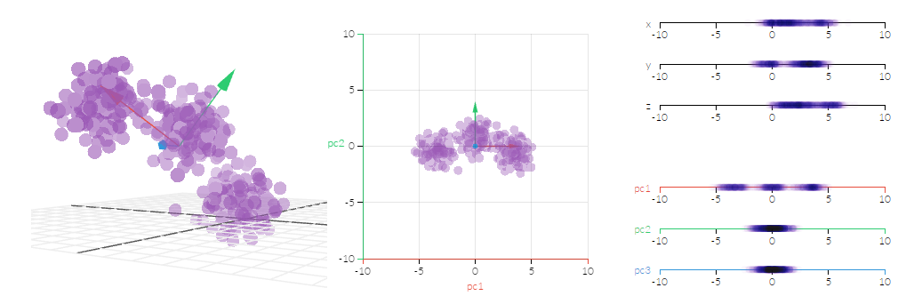
What is PCA?
Principal Component Analysis:
A technique used to emphasize variation and bring out strong patterns in a dataset, often used to make data easier to explore and visualize. We convert a set of observations of possibly correlated variables into a set of values of linearly uncorrelated variables, called principal components.
Can be used for a large number of k-dimensional inputs, from 2D onward
Uses the concept of principal components to find the best possible fit

Slide 6
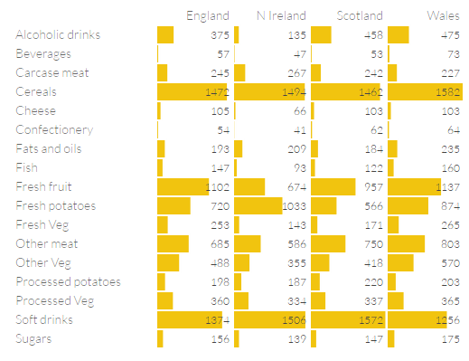
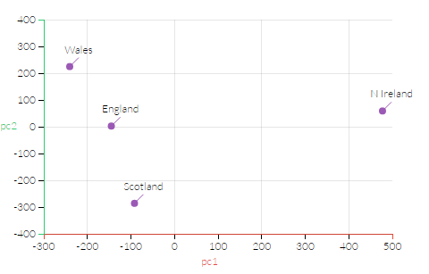
PCA, continued

Slide 7
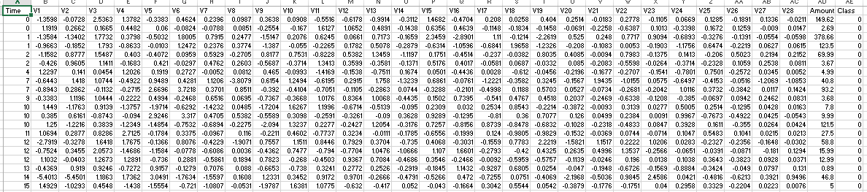
What does this mean for our data?
Labels of the input features of the data are unknown, but none were removed post-PCA
Without knowing the labels ourselves, removing potential noise features in the data becomes problematic
Protection of privacy is an industry standard, so it is important for real world application to be able to produce results from data like this

Slide 8
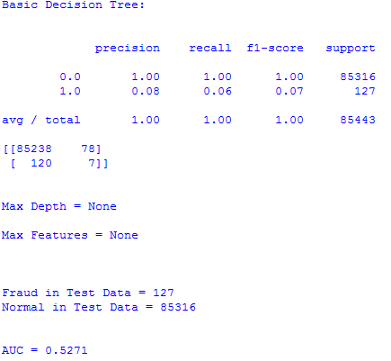
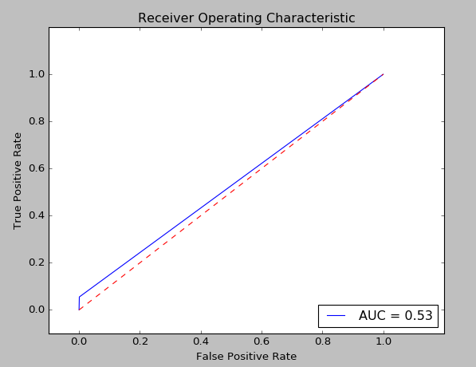
Methods Used

Slide 9
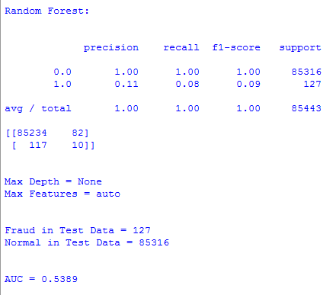
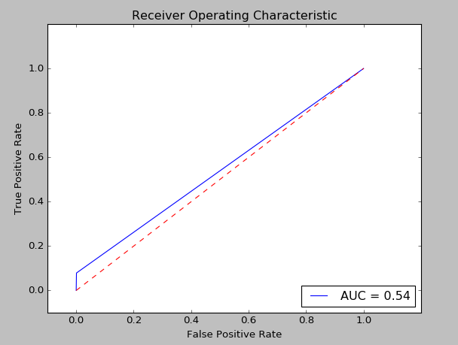
Methods Used

Slide 10
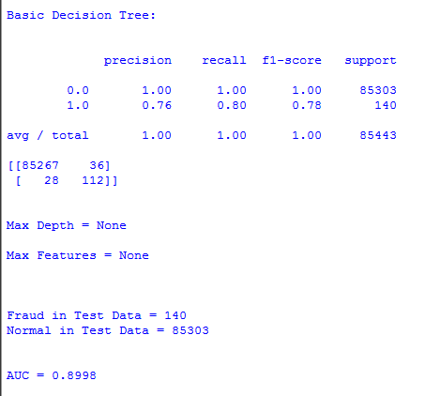
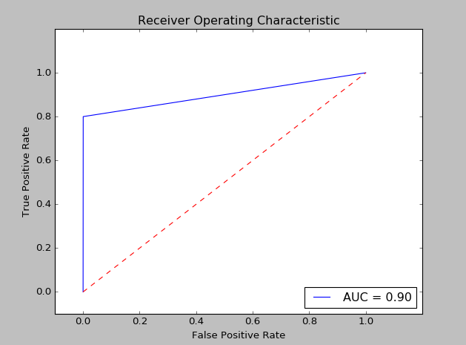
Methods Used

Slide 11
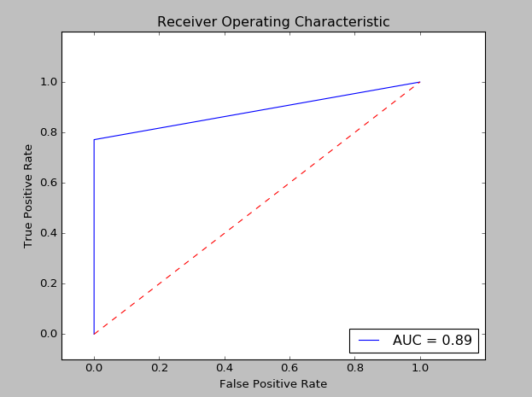
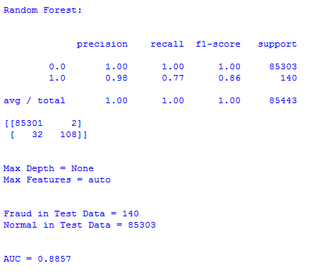
Methods Used

Slide 12
Conclusions
The results of this project are very promising for the future
However, the recall could definitely be improved
Decision Tree and Random Forest Algorithms worked well, but other algorithms may work better, further development and testing is needed
Features could also all be individually removed per run to check for potential noise within data, but this is a time-consuming process

Slide 13
Sources
Dataset source: Andrea Dal Pozzolo, Olivier Caelen, Reid A. Johnson and Gianluca Bontempi. Calibrating Probability with Undersampling for Unbalanced Classification. In Symposium on Computational Intelligence and Data Mining (CIDM), IEEE, 2015
Statistics on Fraud: http://www.nasdaq.com/article/credit-card-fraud-and-id-theft-statistics-cm520388

