Slide 1
بِسْمِ اللهِ الرَّحْمٰنِ الرَّحِيْمِ

Slide 2
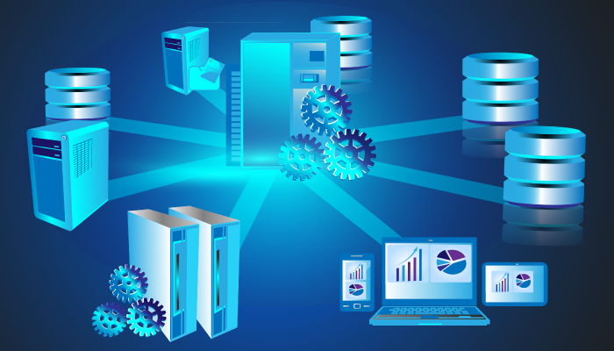
DIGITAL WALLET
Soban Ahmed
Awais Anwar
DBMS using MYSQL and FASTAPI

Slide 3
Agenda
Data base Architecture And Design
Introduction
Timeline Procedure
Scope And Objective
Key Functionalities
Data Tables
And Relations
Future Enhancement and scalability
Conclusion
Presentation Title

Slide 4
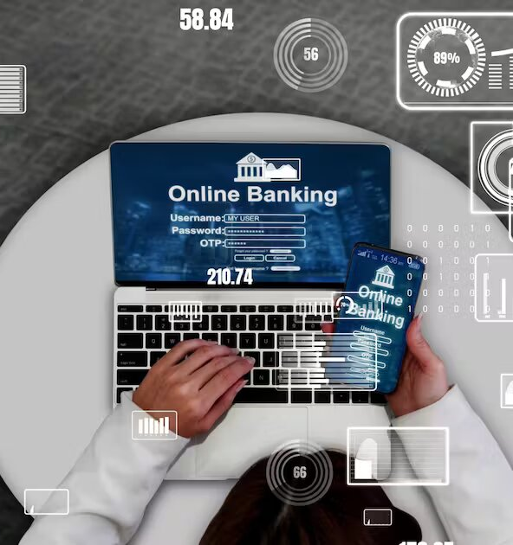
Introduction
Overview of the Digital wallet
Importance of a Well-Designed Database

Slide 5
Timeline Procedure
Step II
Step V
Normalized Database
Documentation
Step I
Created ERD of Database
Step III
STEP IV
Created API’s for CRUD operations and Authentication system
Querrying the database

Slide 6
Database Architecture and Design
Overview of the Relational Database Architecture
Entity-Relationship (ER) Diagram
Database Normalization

Slide 7
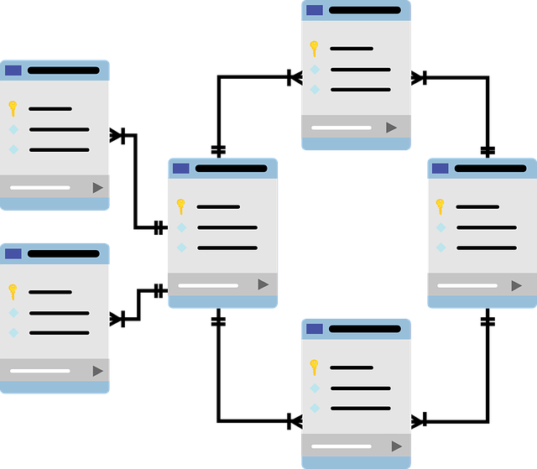
Relational Data base

Slide 8
Relations And Associations
One-to-One, One-to-Many, and Many-to-Many Relationships
Relationship between User and Member Models
Relationship between Member and Country Info Models
Relationship between Member and Currency Supported Models
Relationship between Member and Withdrawal Models
Relationship between Member and Deposit Models
Relationship between Deposit and Gateway Models
Relationship between Deposit and Deposit Status Models
Relationship between Member and Transaction Log Models

Slide 9
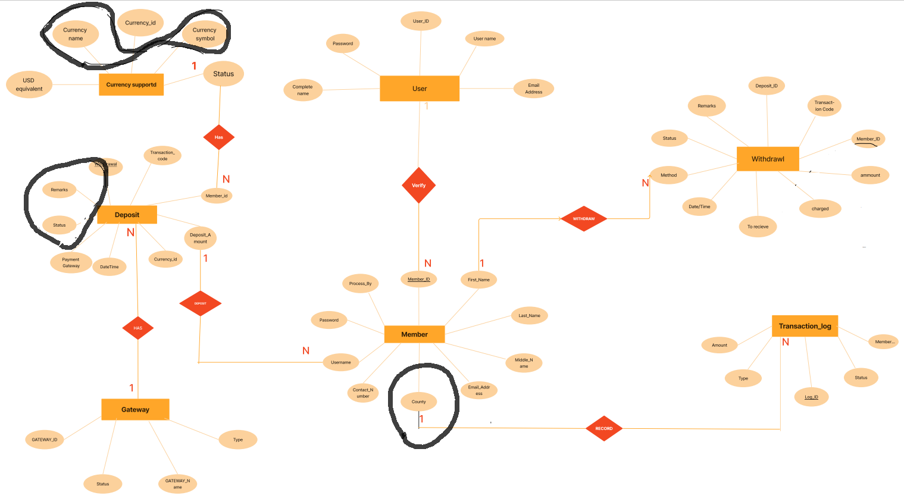
ERD before Normalization

Slide 10
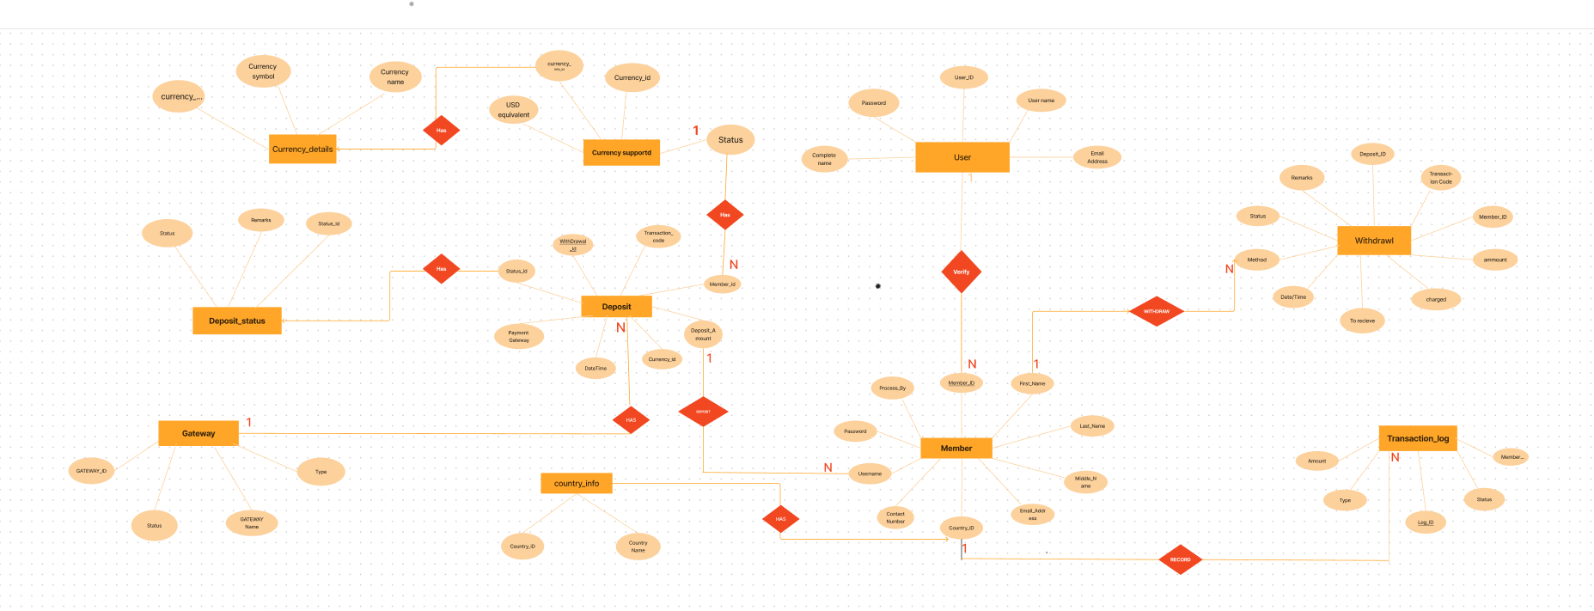
ERD After Normalization

Slide 11
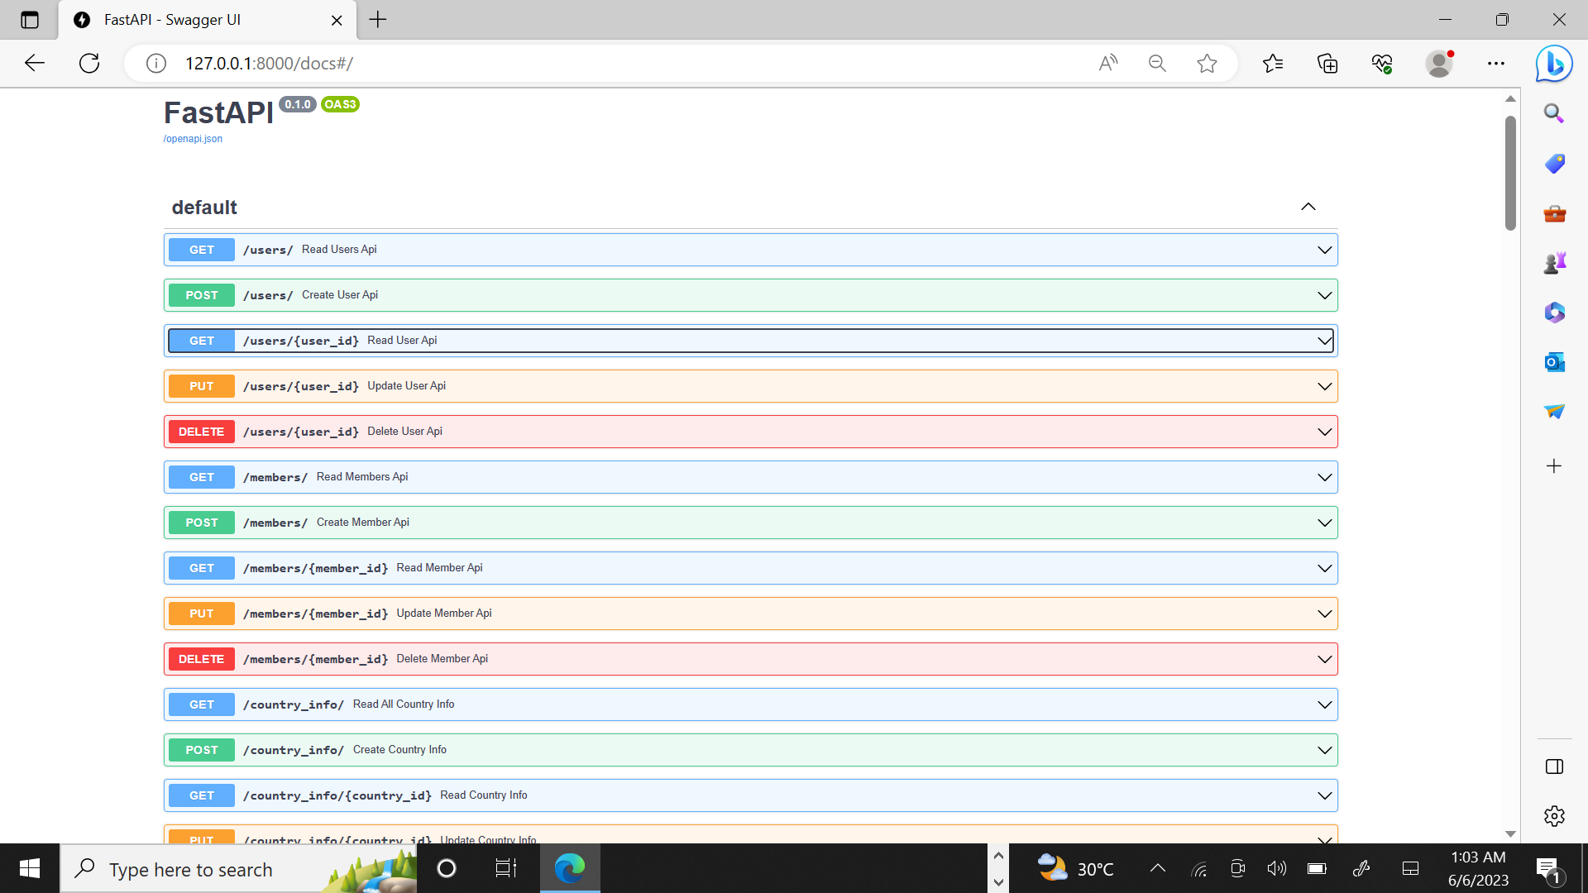
API’s

Slide 12
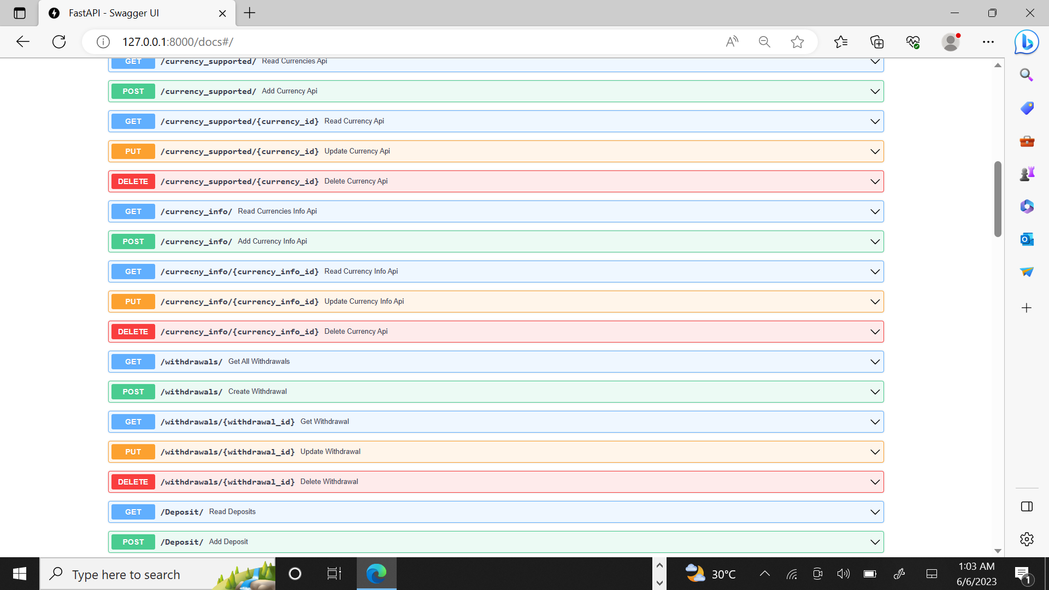

Slide 13
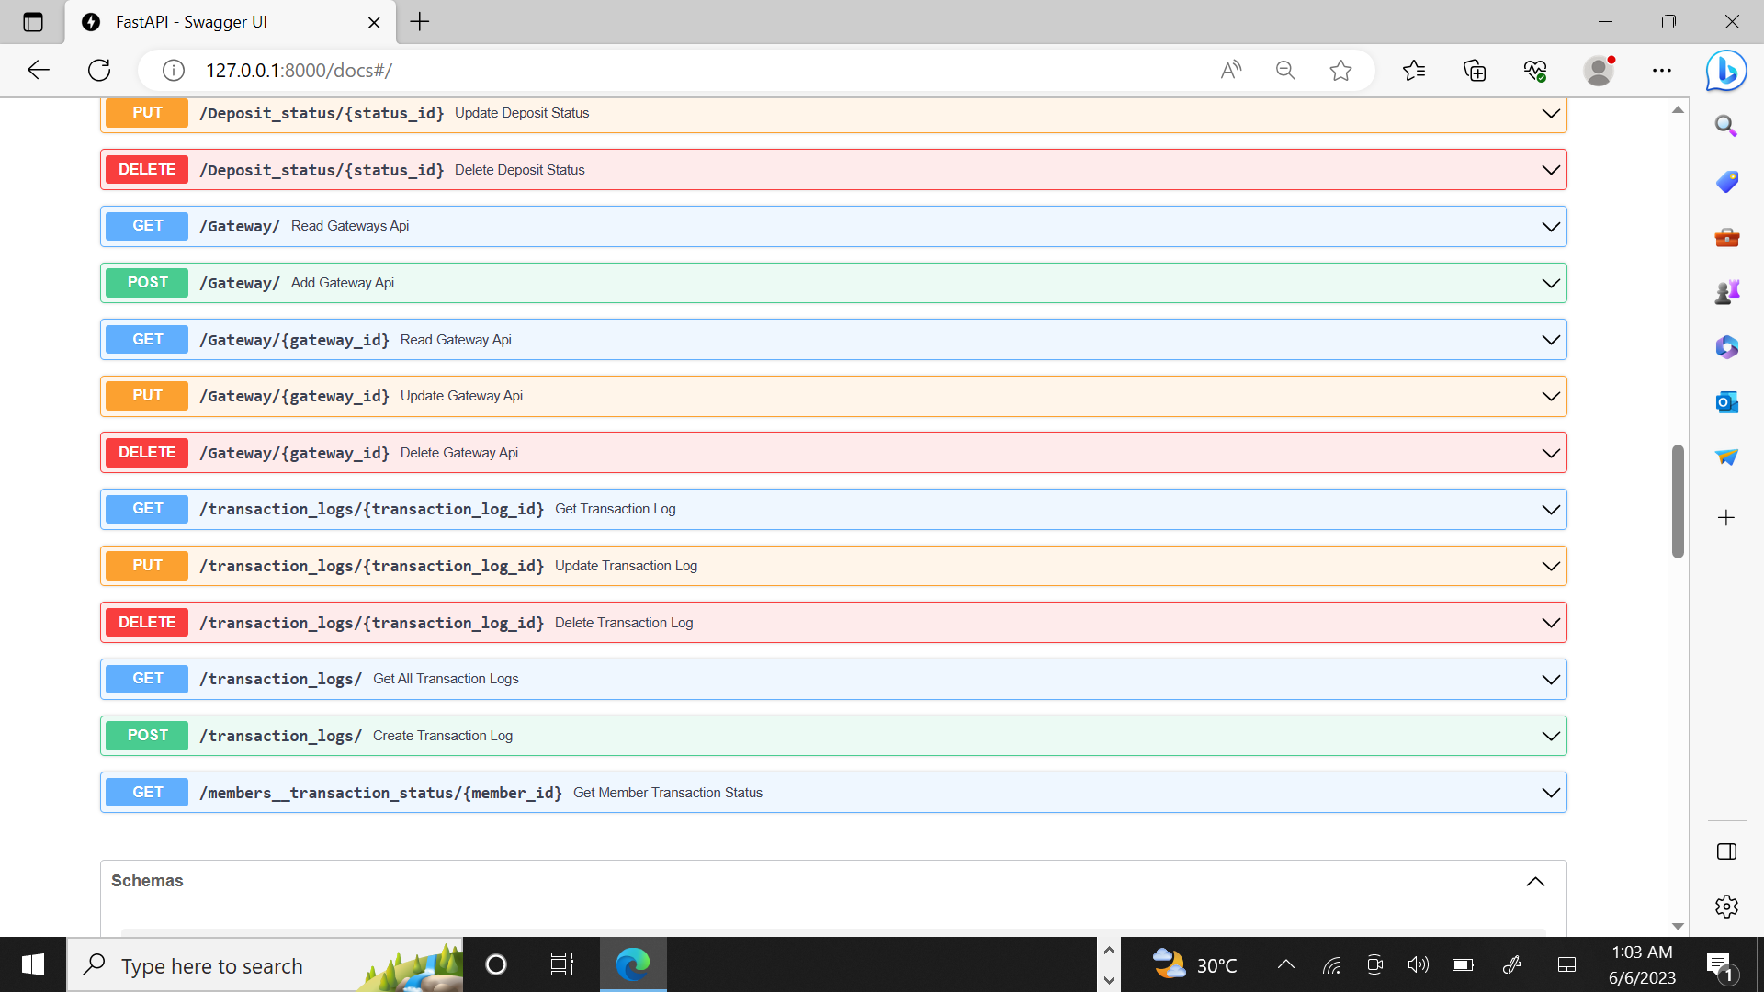

Slide 14
Scope And objectives
Purpose of the Database System
Target Users and Stakeholders

Slide 15
“Business opportunities are like buses. There’s always another one coming.”
Richard Branson

Slide 16
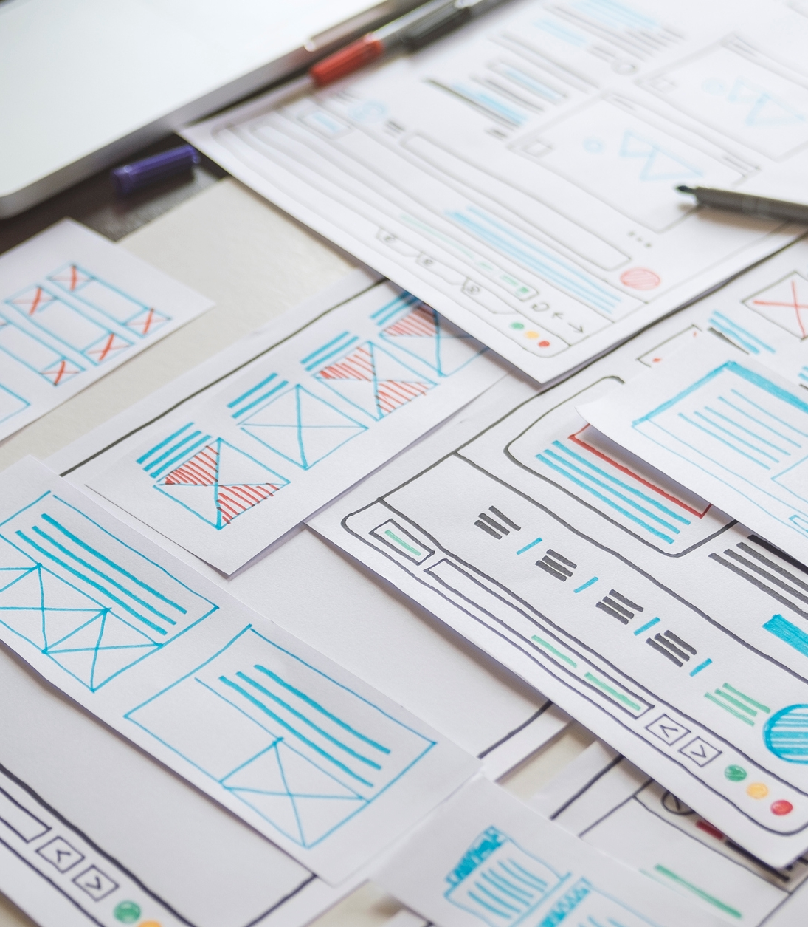
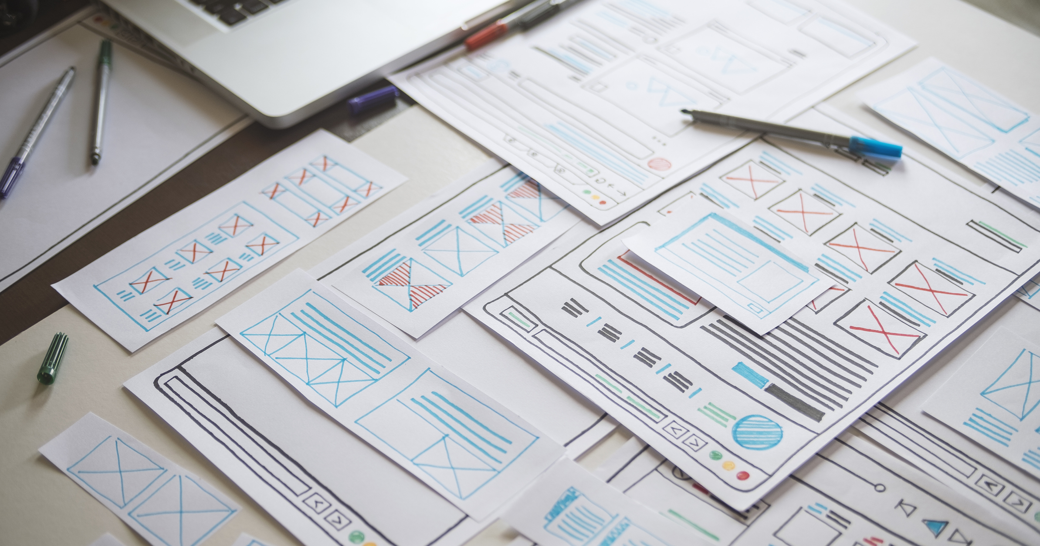
Primary goals
Provide secure and easy transactions

Slide 17
Key Functionalities
User Management
Member Management and Registration
Deposit and Withdrawal Operations
Transaction Logging and Tracking

Slide 18
Future Enhancements and Scalability
Scalability Considerations
Potential Improvements and Features
Database Maintenance and Optimization

Slide 19
CONCLUSION
Summary of key points
Importance of a Well-Structured Database
Potential Impact and Benefit

Slide 20

May we add some good value, BEST OF LUCK !

