Slide 1
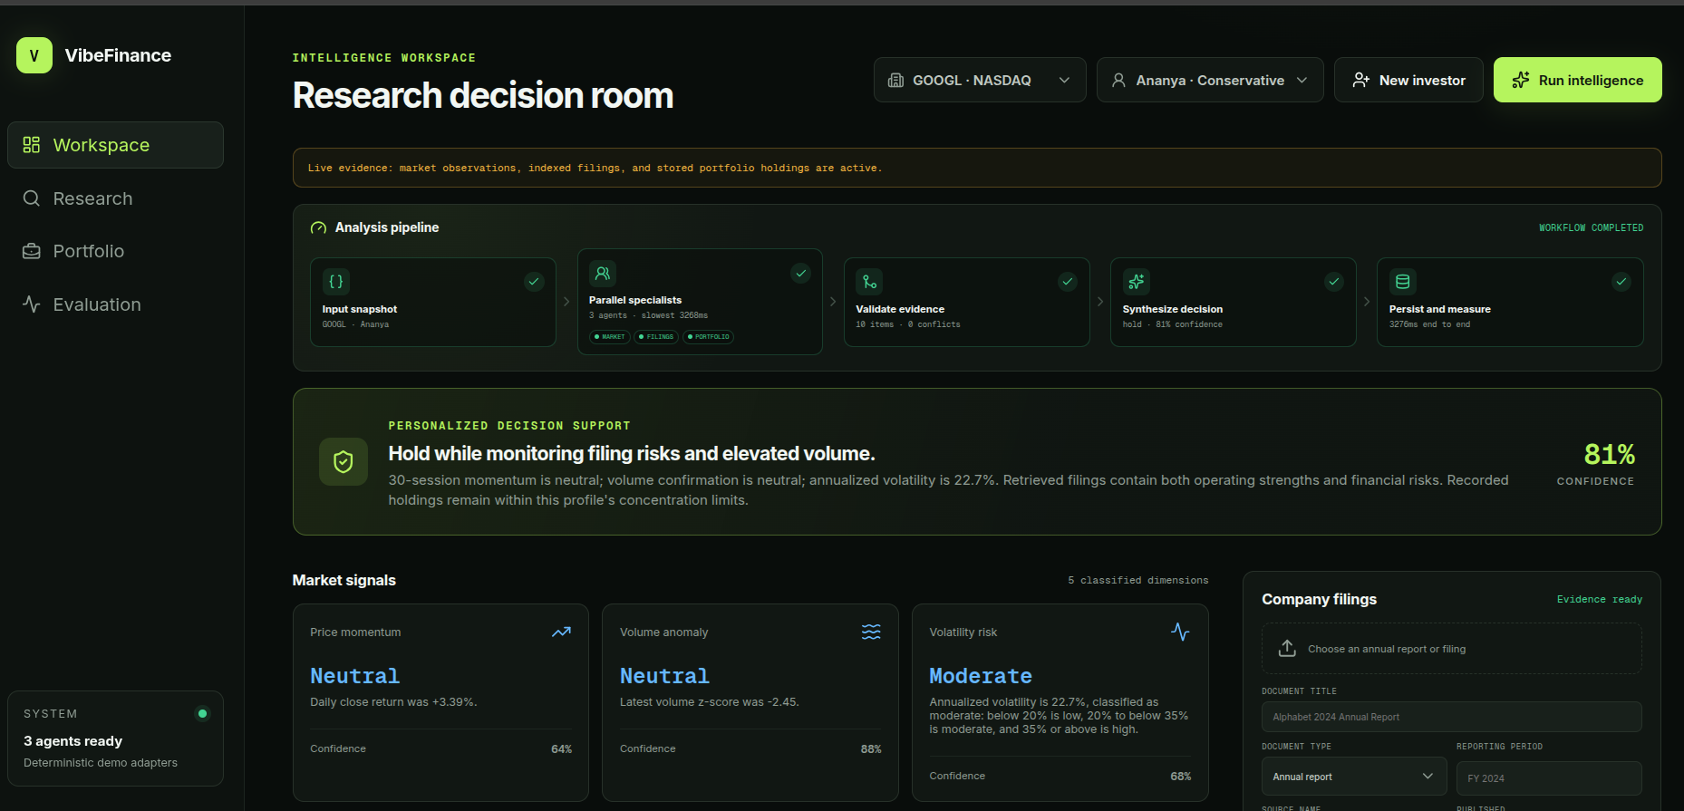
EVIDENCE-FIRST FINANCIAL INTELLIGENCE
VibeFinance
Multi-agent decision support that turns live market observations, cited filings, and portfolio context into personalized investor intelligence.
LIVE MARKET SIGNALS
CITED RAG
PERSONALIZED
One workflow. Three specialists. Every decision traceable.
Built for retail investors who need context—not another stream of disconnected data.
V
VibeFinance
WILD BUGS HACKATHON • 2026
01
Notes:
Open with the promise: VibeFinance coordinates evidence and personal risk context so a retail investor can understand why a conclusion was reached.

Slide 2
THE GAP
02
Retail investors have data. They lack coordinated reasoning.
Prices, filings, and portfolio risk live in separate tools—so the burden of synthesis falls on the investor.
1
Market data without context
2
Filings without retrieval
3
Advice without personalization
Screeners surface momentum and volume, but rarely connect the signal with business fundamentals.
Annual reports are authoritative but dense. Relevant risks are difficult to find at decision time.
The same view is shown to investors with different holdings, horizons, and concentration limits.
DESIGN QUESTION
How can we turn independent evidence into one transparent decision—without letting an LLM invent the numerical truth?
V
VibeFinance
WILD BUGS HACKATHON • 2026
02
Notes:
Frame the problem as orchestration, not data scarcity. Existing tools solve isolated tasks; the missing layer is evidence-aware synthesis that changes with the investor.

Slide 3
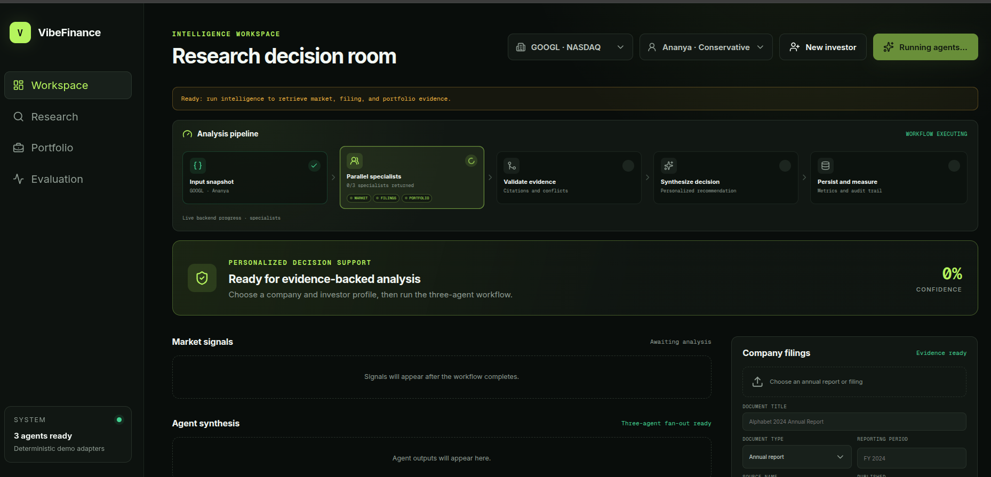
PRODUCT
03
From raw evidence to a saved, personalized decision
The interface exposes every stage of the workflow instead of hiding analysis behind a spinner.
1
Select context
2
Acquire evidence
3
Run specialists
4
Validate
5
Synthesize
6
Persist
Company + investor
Market + filings
Parallel fan-out
Citations + conflicts
Personalized result
Metrics + audit trail
LIVE PROGRESS • RESPONSIVE BACKGROUND JOB
V
VibeFinance
WILD BUGS HACKATHON • 2026
03
Notes:
Walk left to right. The API accepts the analysis immediately, specialists execute in parallel, and the completed result is validated and persisted.

Slide 4
ARCHITECTURE
04
A hybrid system: computation for truth, LLMs for interpretation
LangGraph coordinates three typed specialists in parallel, followed by validation, conflict detection, and synthesis.
PYTHON + STATISTICS
RAG + LLM
PORTFOLIO MATHEMATICS
LLM SYNTHESIS
MARKET SIGNAL AGENT
FILING RESEARCH AGENT
PORTFOLIO RISK AGENT
ONE
DECISION
Momentum
Volume anomaly
Annualized volatility
Query expansion
pgvector retrieval
Evidence-bound interpretation
Position exposure
Sector concentration
Profile limit checks
Validated citations
Explicit conflicts
Confidence ceiling
Provider-independent LLM layer
CHATANTHROPIC
CHATOPENAI
temperature 0 • structured output • deterministic fallback
V
VibeFinance
WILD BUGS HACKATHON • 2026
04
Notes:
Stress that numerical truth comes from validated computation. The LLM is constrained to document interpretation and final explanation.

Slide 5
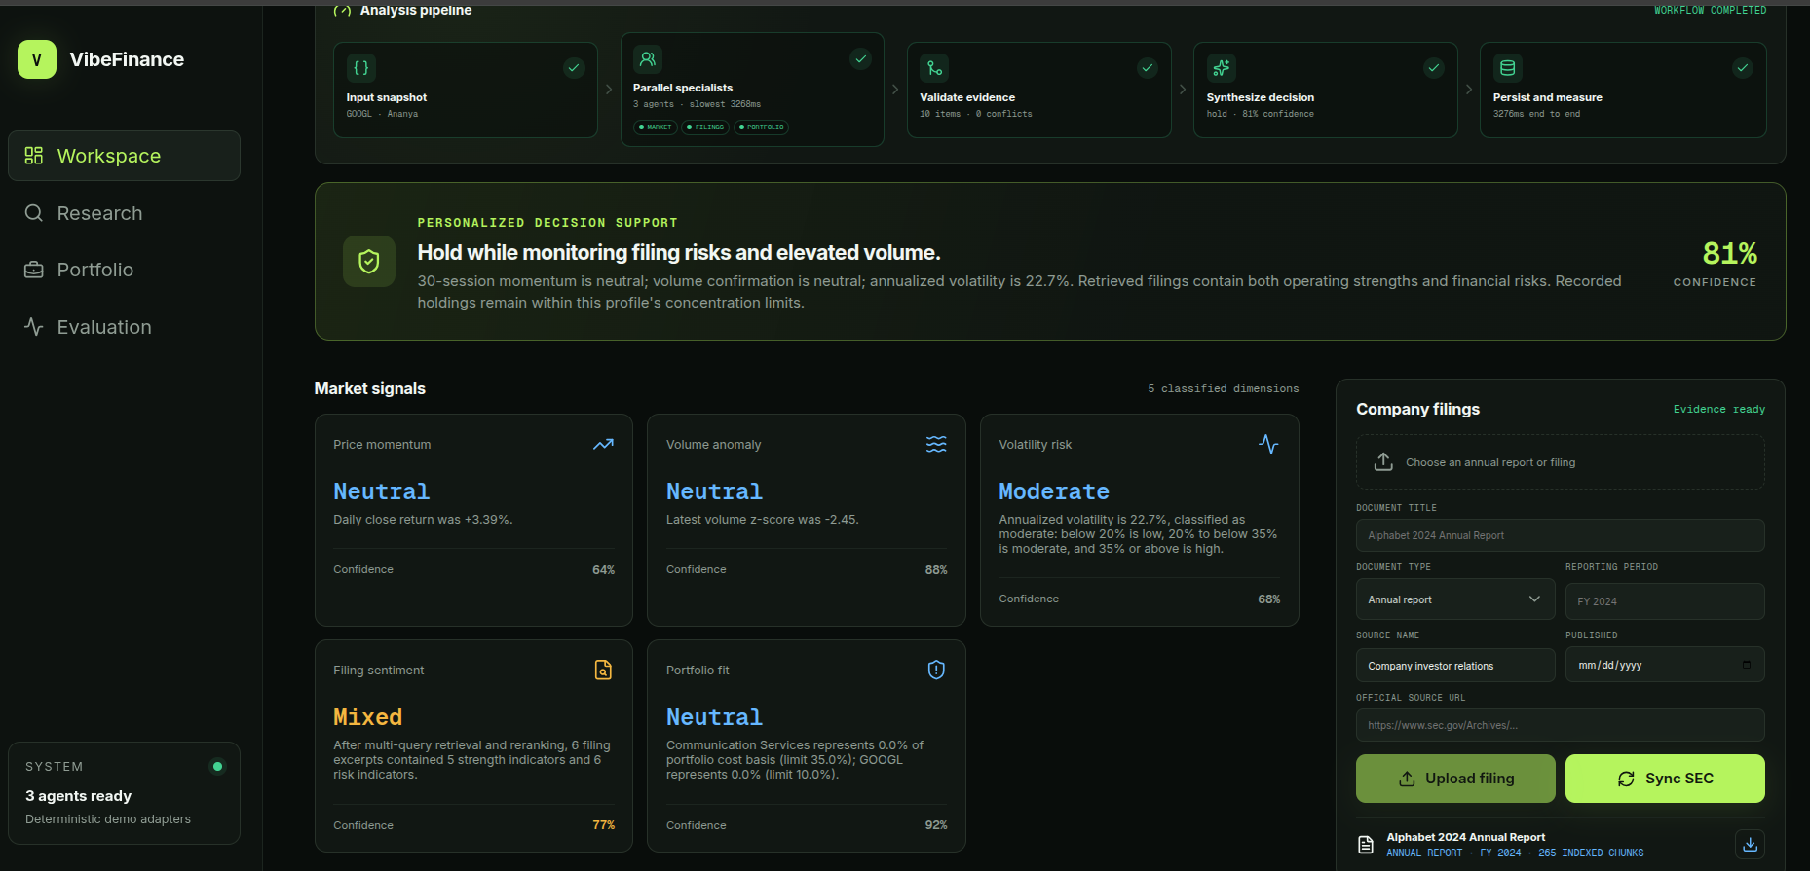
EVIDENCE
05
Five classified dimensions, grounded in live and indexed sources
The dashboard exposes labels, confidence, rationale, filing status, and the underlying document.
Deterministic market signals
30-session momentum, 20-session volume anomaly, and annualized volatility are calculated—not guessed.
Semantic filing retrieval
SEC or uploaded filings are chunked, embedded with BGE-small, and searched in Supabase pgvector.
Verifiable attribution
Every filing claim retains the document, page/chunk identity, source URL, and supporting evidence ID.
V
VibeFinance
WILD BUGS HACKATHON • 2026
05
Notes:
Point out five visible dimensions, the indexed annual report, and its download action. This demo filing contains 265 indexed chunks.

Slide 6
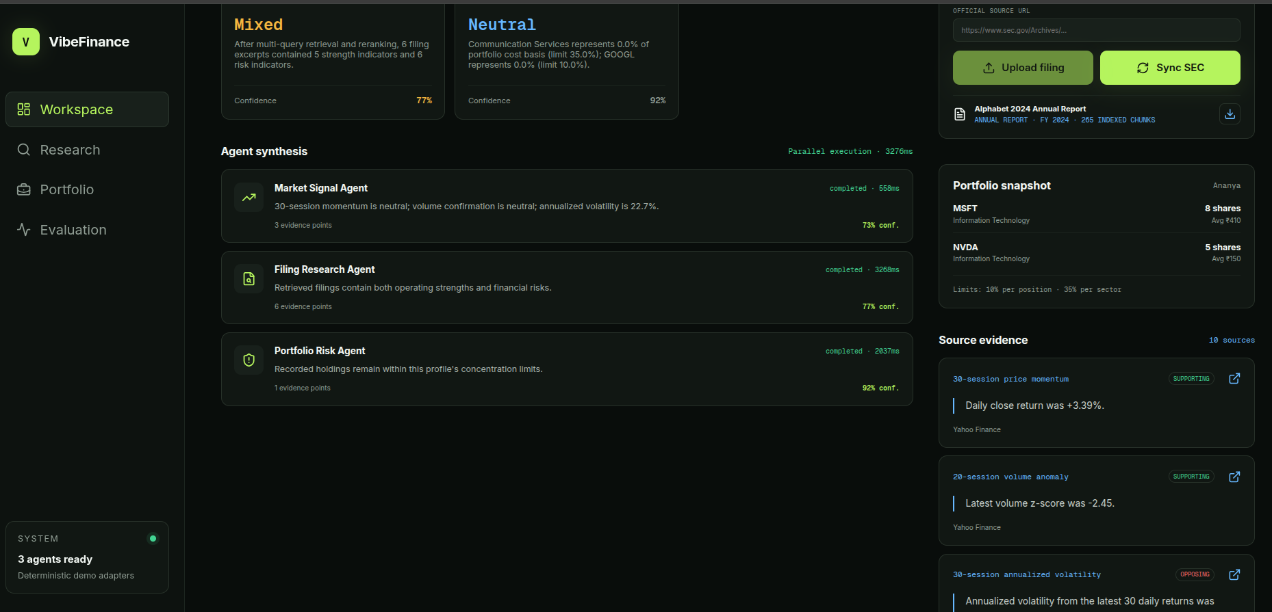
MULTI-AGENT PROOF
06
Parallel specialists produce structured, independently cited outputs
Each agent exposes its own summary, evidence count, confidence, completion state, and latency.
MARKET 558ms • FILING 3268ms • PORTFOLIO 2037ms • 10 SOURCES
V
VibeFinance
WILD BUGS HACKATHON • 2026
06
Notes:
This is the core judging proof: three specialized agents, parallel execution, structured contracts, visible sources, and supporting versus opposing evidence.

Slide 7
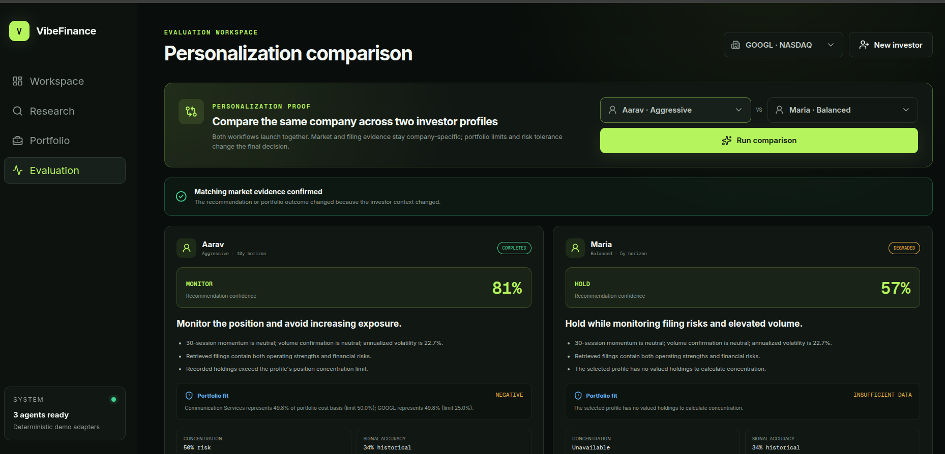
PERSONALIZATION
07
Same company evidence. Different investor context. Different outcome.
Portfolio state and risk policy affect the decision; market and filing evidence remain company-specific.
CONTROLLED COMPARISON
MATCHING
MARKET EVIDENCE
Only investor context changes.
PROFILE STATE
Risk tolerance
Investment horizon
Position limits
Sector limits
Recorded holdings
V
VibeFinance
WILD BUGS HACKATHON • 2026
07
Notes:
The proof banner confirms matching market evidence. Aarav receives MONITOR because concentration is near the limit. Maria has insufficient portfolio data, so the system degrades confidence instead of pretending certainty.

Slide 8
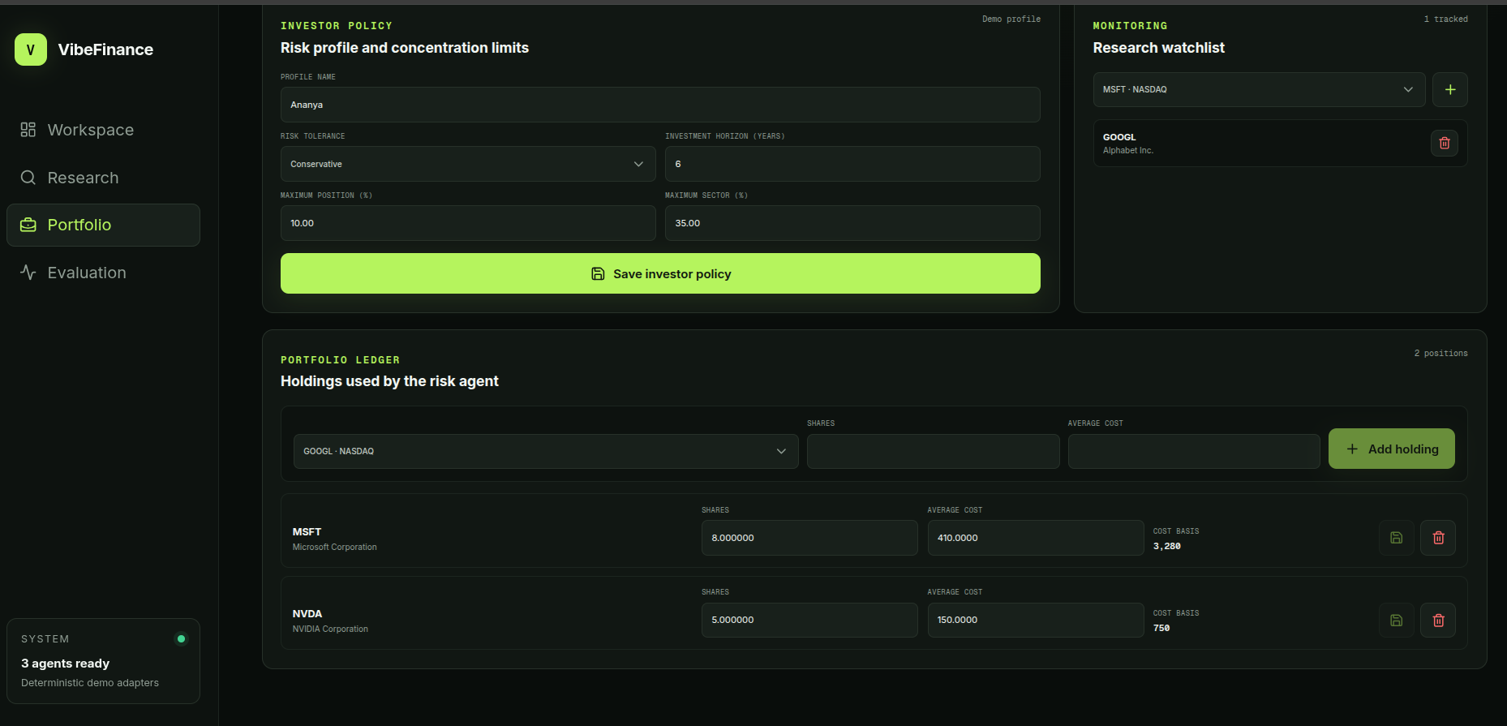
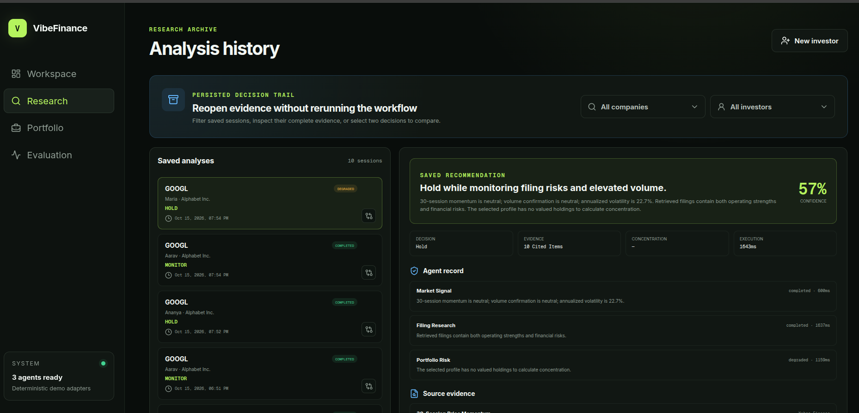
STATE AND AUDITABILITY
08
The recommendation is backed by durable investor and decision state
Profiles, holdings, watchlists, filings, vectors, sessions, agent runs, and citations persist in Supabase.
PORTFOLIO STATE
PERSISTED DECISION TRAIL
V
VibeFinance
WILD BUGS HACKATHON • 2026
08
Notes:
The risk agent reads actual holdings and stored limits. Completed sessions reopen without rerunning, preserving recommendation, evidence, agent records, and latency.

Slide 9
RELIABILITY AND EVALUATION
09
Measured, bounded, and honest about uncertainty
Every session records performance and evidence metrics; unreliable inputs reduce confidence instead of breaking the workflow.
3.28s
10
0
3
Example end-to-end latency
Cited evidence items
Conflicts in shown run
Per-agent latency records
Graceful degradation
Citation validation
Missing filing, market, or portfolio data returns a degraded result—never fabricated evidence.
Unsupported evidence IDs are rejected before synthesis and persistence.
Confidence ceilings
Transparent evaluation
Missing agents, validation errors, and conflicts constrain final confidence.
Momentum accuracy, concentration, evidence count, conflicts, and latency are stored.
V
VibeFinance
WILD BUGS HACKATHON • 2026
09
Notes:
Use the degraded Maria result as evidence of graceful handling. Historical momentum accuracy is a diagnostic, not a forecast claim, and Yahoo Finance is a public adapter rather than an exchange feed.

Slide 10
WHY VIBEFINANCE
Decision support that earns trust through evidence.
DEMO PATH
01
Inspect indexed filing
A production-shaped hackathon MVP with a clear path from individual research to a scalable intelligence platform.
02
Run intelligence
03
Follow parallel agents
1
For investors
Personalized context, clear risk boundaries, and cited reasoning.
04
Verify citations
2
For fintechs
05
Compare investor profiles
Provider-neutral agents and APIs for existing research workflows.
06
Reopen saved decision
3
Roadmap
NSE/SEBI adapters, alerts, backtesting, and durable distributed jobs.
VibeFinance
Evidence first. Personalized always.
V
VibeFinance
WILD BUGS HACKATHON • 2026
10
Notes:
Close by moving directly into the live demo. The six-step route mirrors the mandatory MVP and keeps the demonstration focused on proof rather than navigation.

