Slide 1
EDES 301 PCB Project
Clay Goldsmith
Due 05/05/2025 @ 11:59pm

Slide 2
Background Information
For this project, I’d like to create a piece of art that is responsive to changes in rotation by showing different ‘slices’ of a 360 degree image. This is inspired by a cool build I saw of this Fluid Simulation Pendant that swishes the fluid around given detected movements by the IMU.
I will need a tool to turn a 360 degree image into a 2d ‘slice’ given my detected IMU angle (which should be reasonably simple, something I can code myself) and a tool to turn an image into a 32x32 LED matrix output (can use this tool? or this tool? to experiment. along with some hardware interface). Probably going to use some sort of dithering / data compression technique (ideally, the change as the device is moved around will give the viewer the ability to infer greater resolution of the image than the actual 32 x 32 pixel matrix would normally permit)

Slide 3
System Block Diagram
Adafruit
Model 607
32 x 32 LED Matrix
GPIO Pins
1 - 13
GPIO Pins 14-18
x4 Buttons
HCW-KC1206 Buzzer
3.3v - 5v
Level Shifter
GPIO Pin 14
PocketBeagle
GY-521 MPU6050
IMU Module
I2C(3.3V)

Slide 4
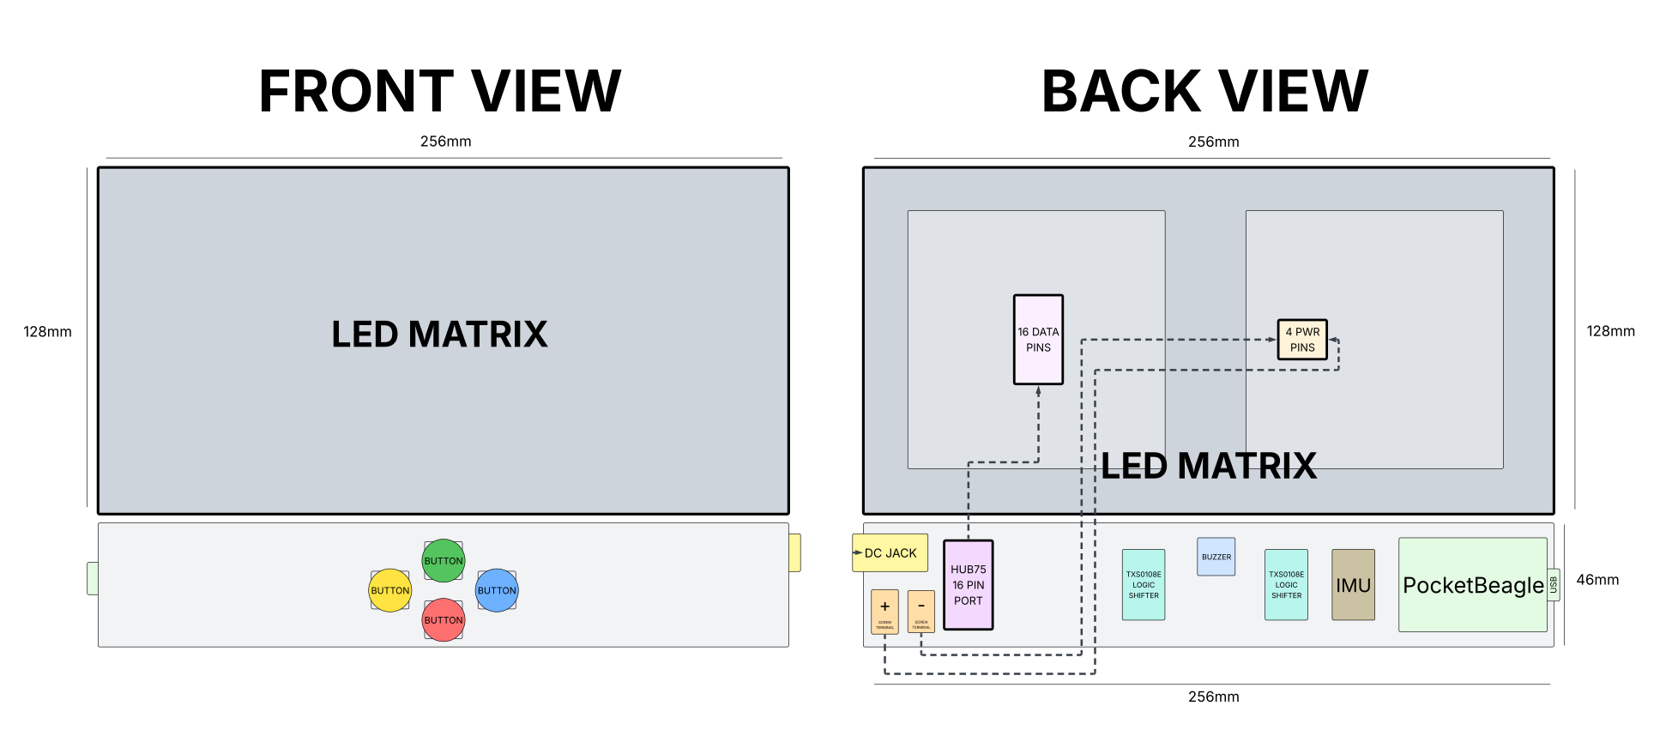
Mechanical Drawing
Complete For Project 2
See next slide for an example
FRONT
BACK

