Slide 1
COMP 472 — Project 2
Deus Ex Machina
Sobhan Mehrpour Kevishahi - 40122438

Slide 2
Heuristics

Slide 3
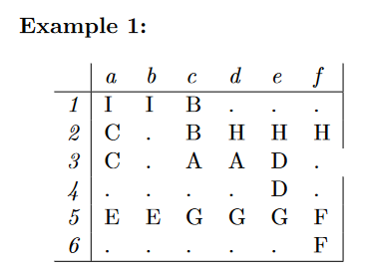
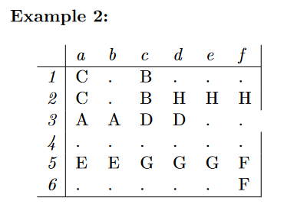
Heuristic 4
Description: Counts the number of blocks between A and the exit block. Then divides it by 4
Pros:
Incentivizes moving to the exit block once there are no cars.
Is admissible.
Is only 0 at the goal state.
Cons:
Does not help remove blocking cars.
h(Example 1)=2/4=0.5
h(Example 2)=4/4=1

Slide 4
Heuristic 5
Description: Counts the number of blocking cars and adds it to heuristic 4 (number of positions from A divided by 4).
Pros:
Incentivizes moving to the exit block once there are no cars.
Incentivizes moving blocked cars out of the way which has more weight than moving to the exit.
Is admissible.
Is only 0 at the goal state.
Cons:
Takes longer to compute.
h(Example 1)=1 + 2/4=1.5
h(Example 2)=1 + 4/4=2

Slide 5
Analysis

Slide 6
Solution Time Analysis
Uniform Cost Search: Tends to be one of the most time-consuming algorithms because it methodically searches for the solution. It often has large spikes.
Algorithm A/A*: Also tends to be very time-consuming, because the admissible heuristics try to find the optimal solution.
Greedy Best First Search: Tends to be the least time-consuming algorithm, because it doesn’t care about the optimal solution.

Slide 7
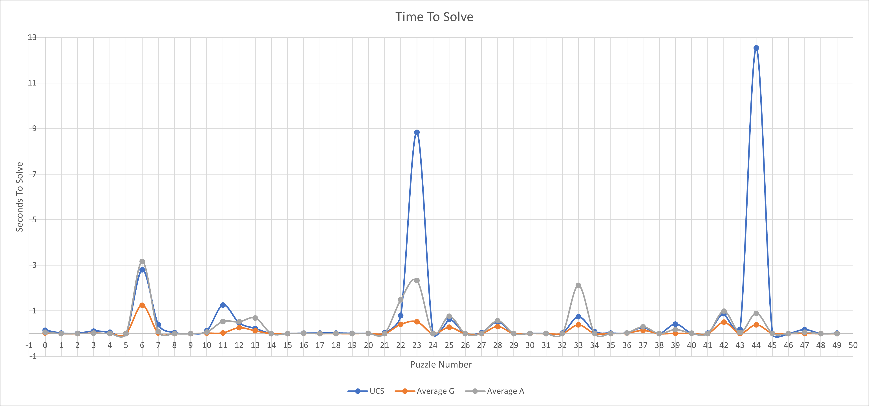
Average Solution Times - 1

Slide 8
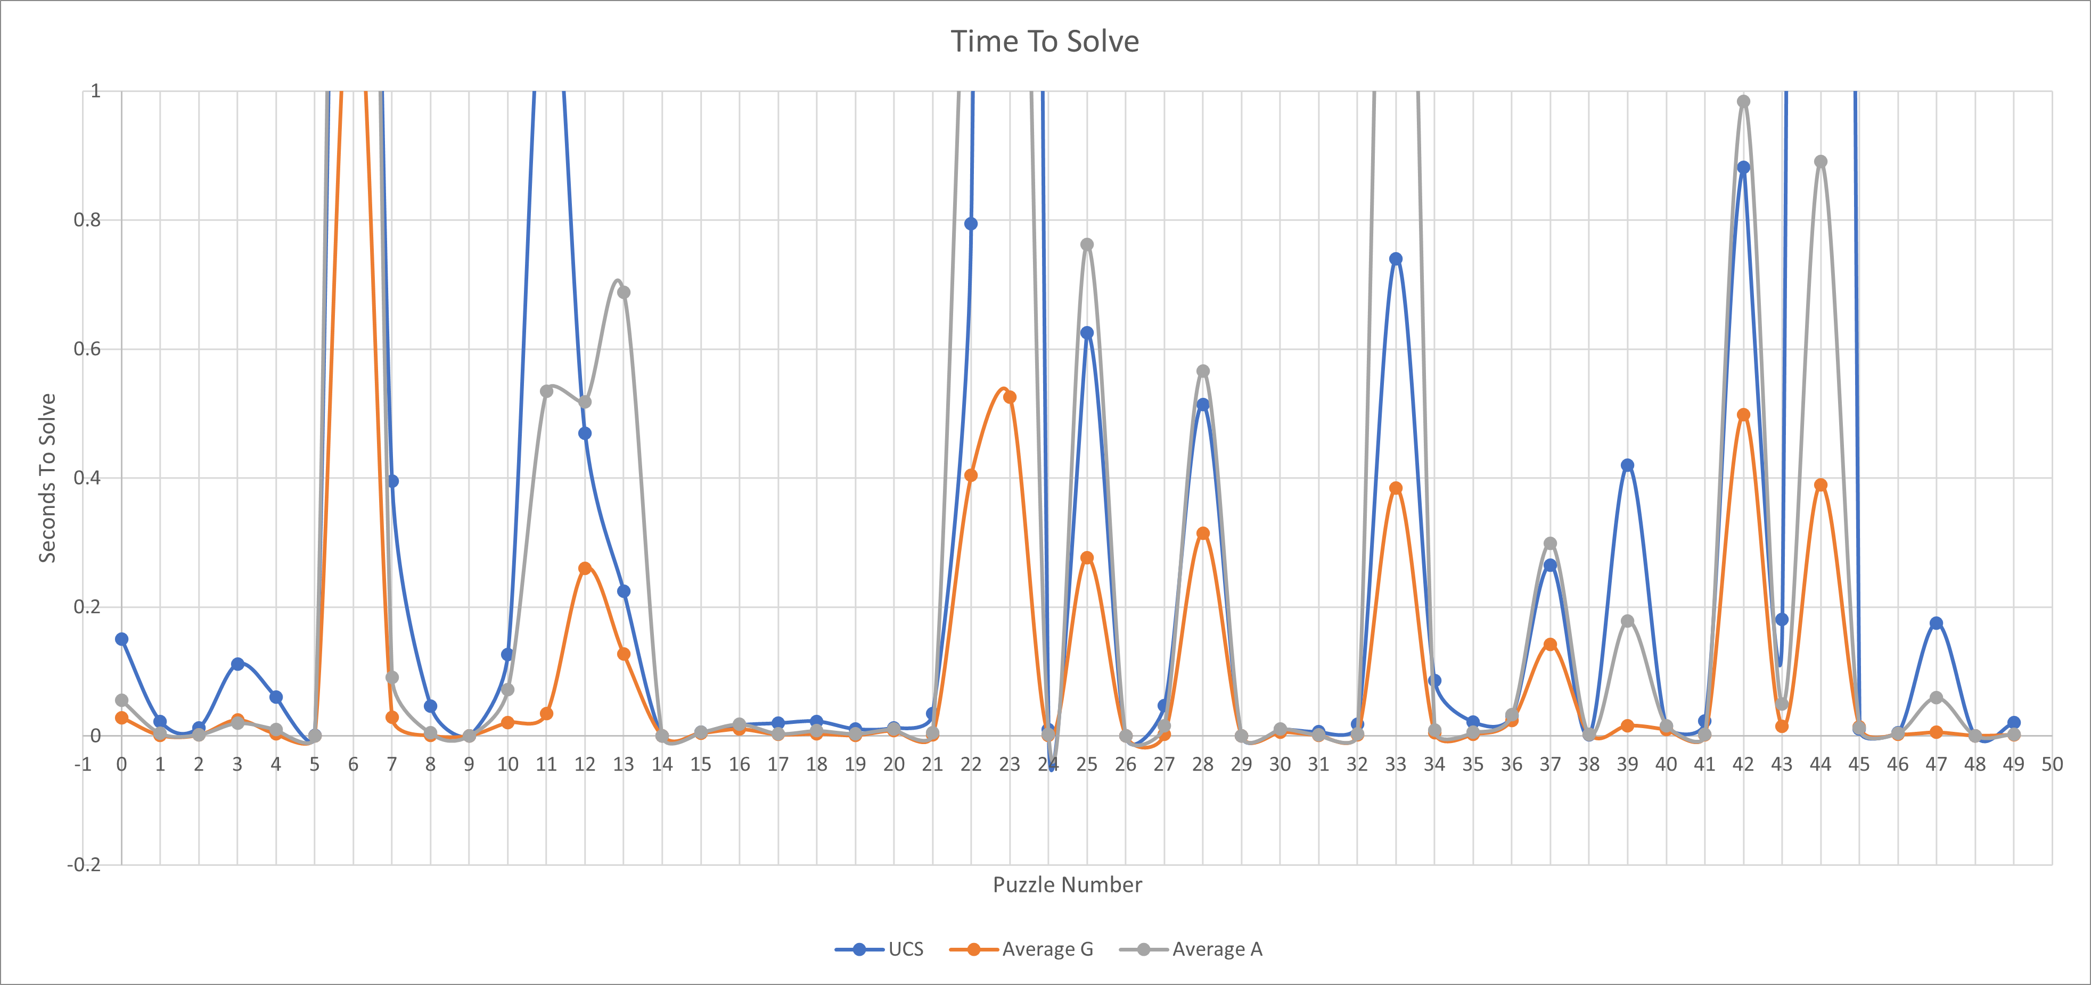
Average Solution Times - 2

Slide 9
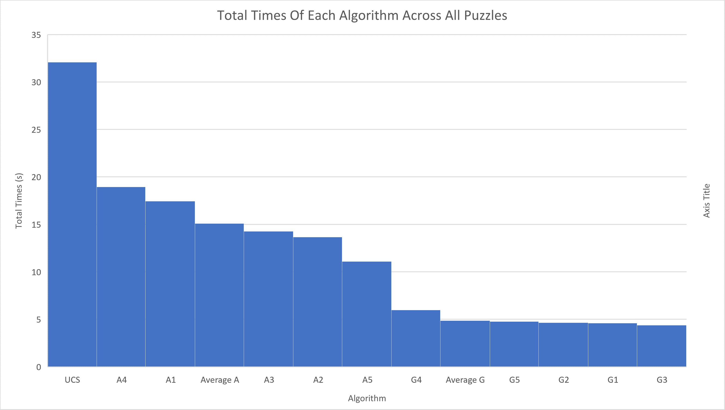
Total Solution Times

Slide 10
Search Path Analysis
Uniform Cost Search: Tends to search the most nodes when finding a solution, as this is a very meticulous algorithm.
Greedy Best First Search: Tends to search the least nodes, as this doesn’t strive to find the optimal solution.
Algorithm A/A*: Tends to be somewhere in the middle.

Slide 11
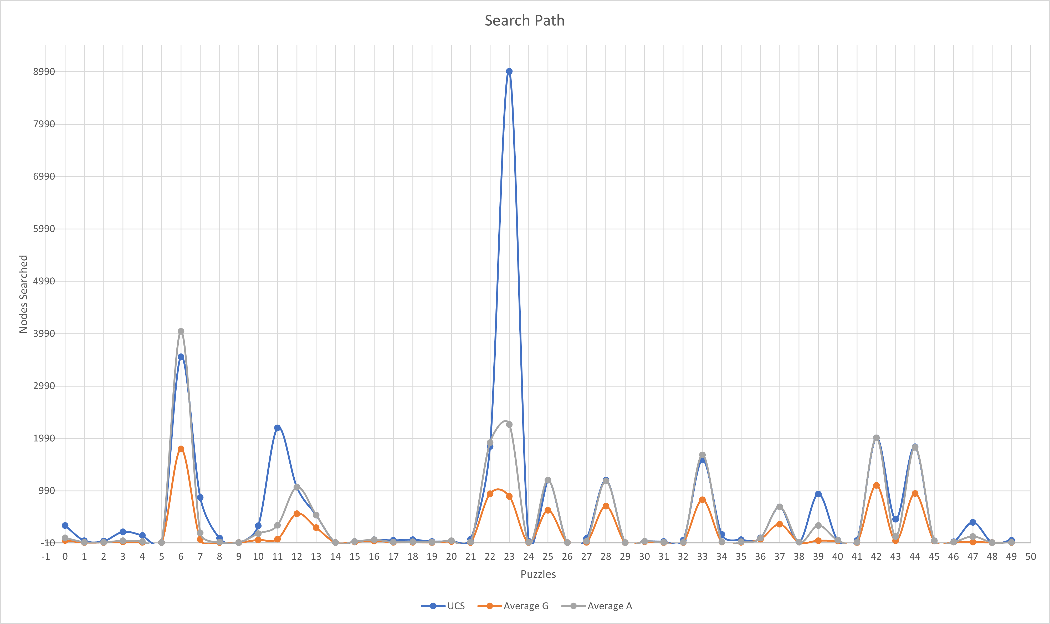
Search Paths

Slide 12
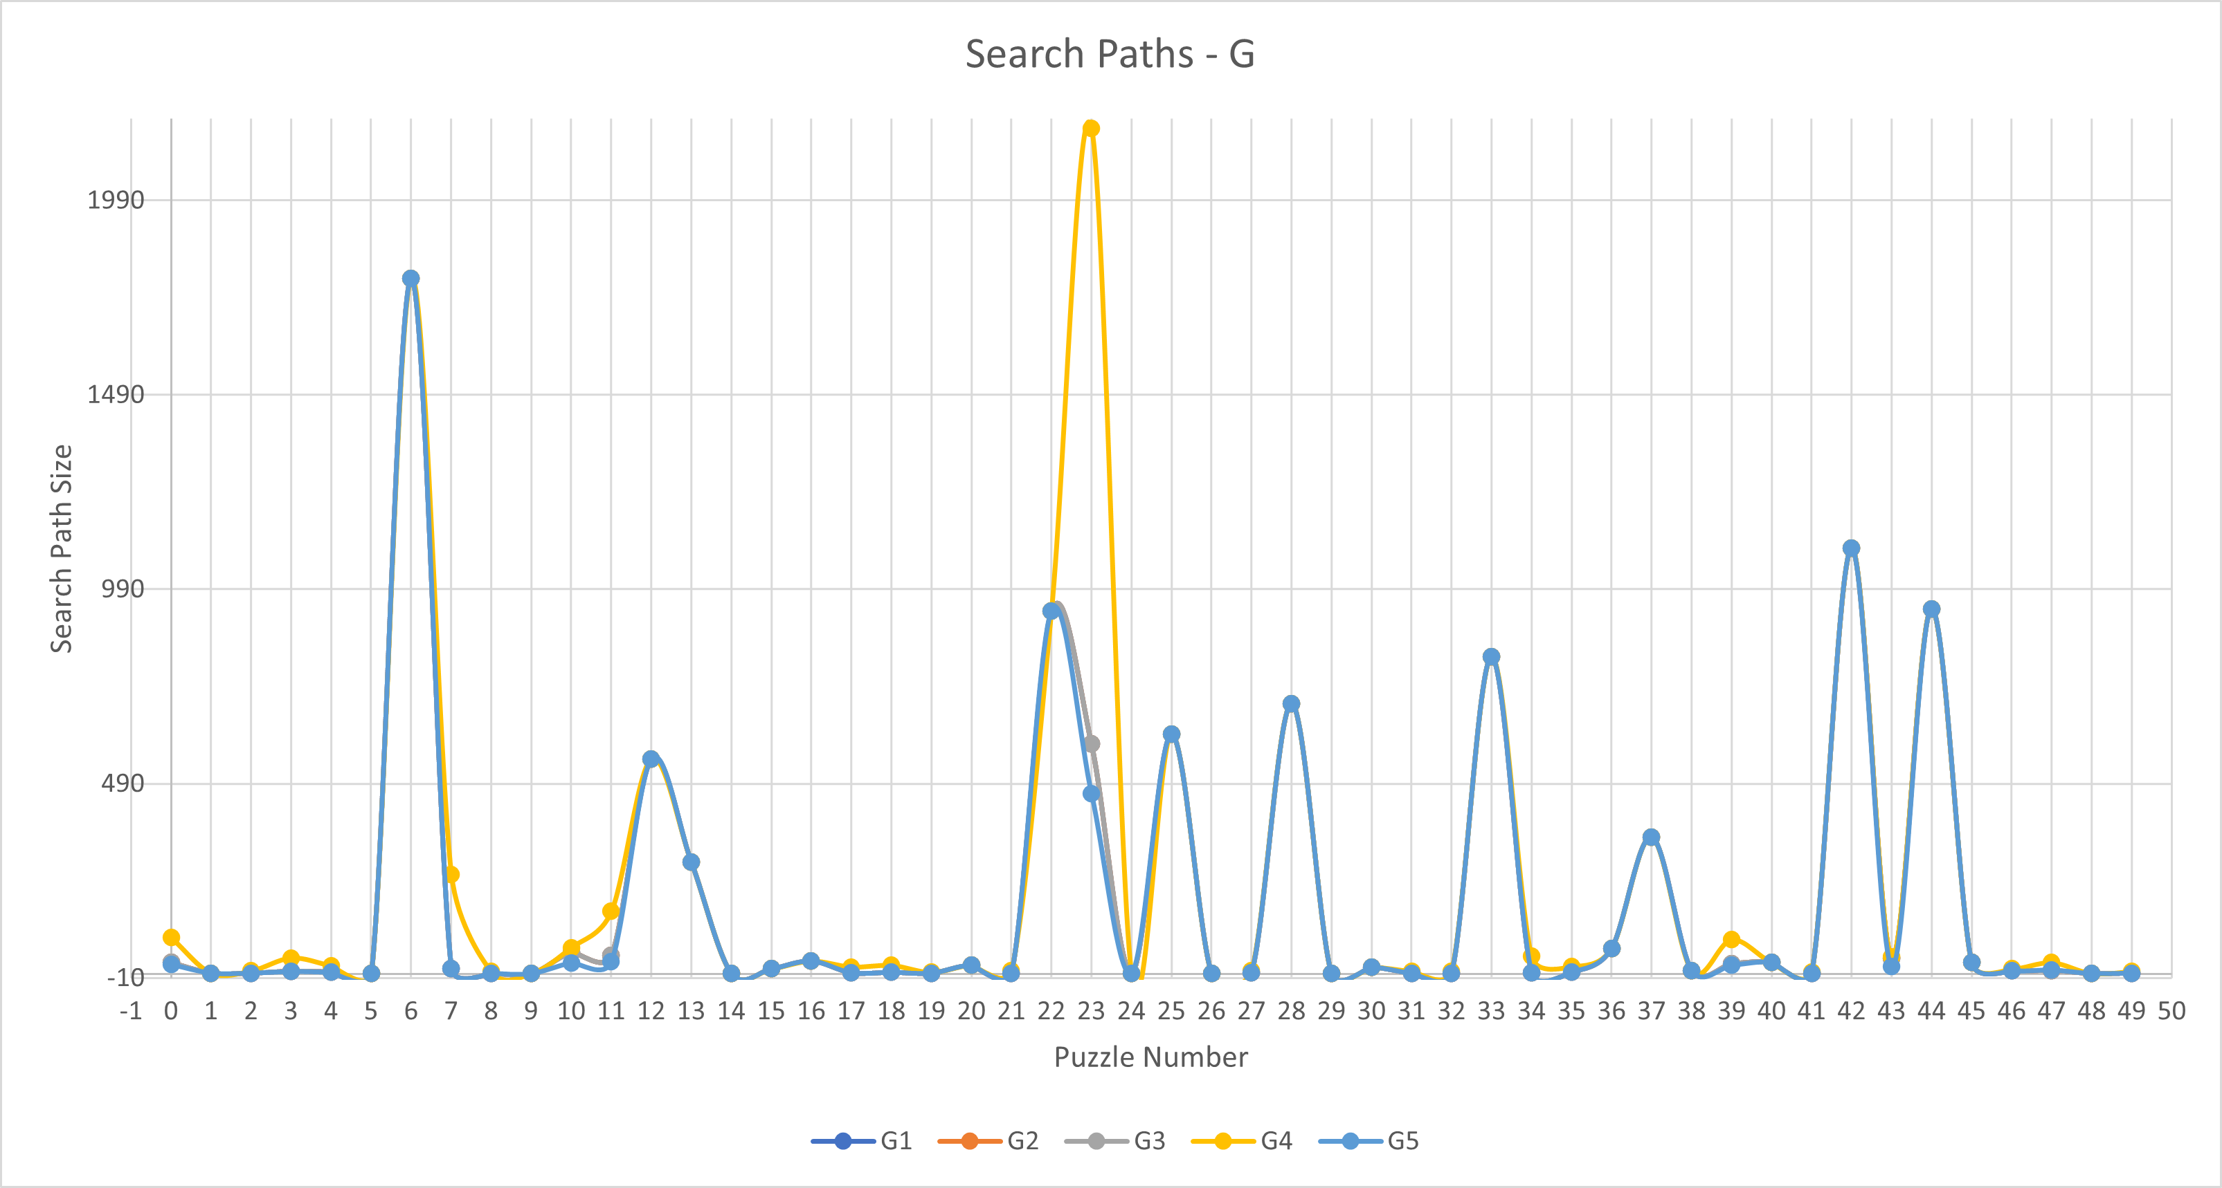
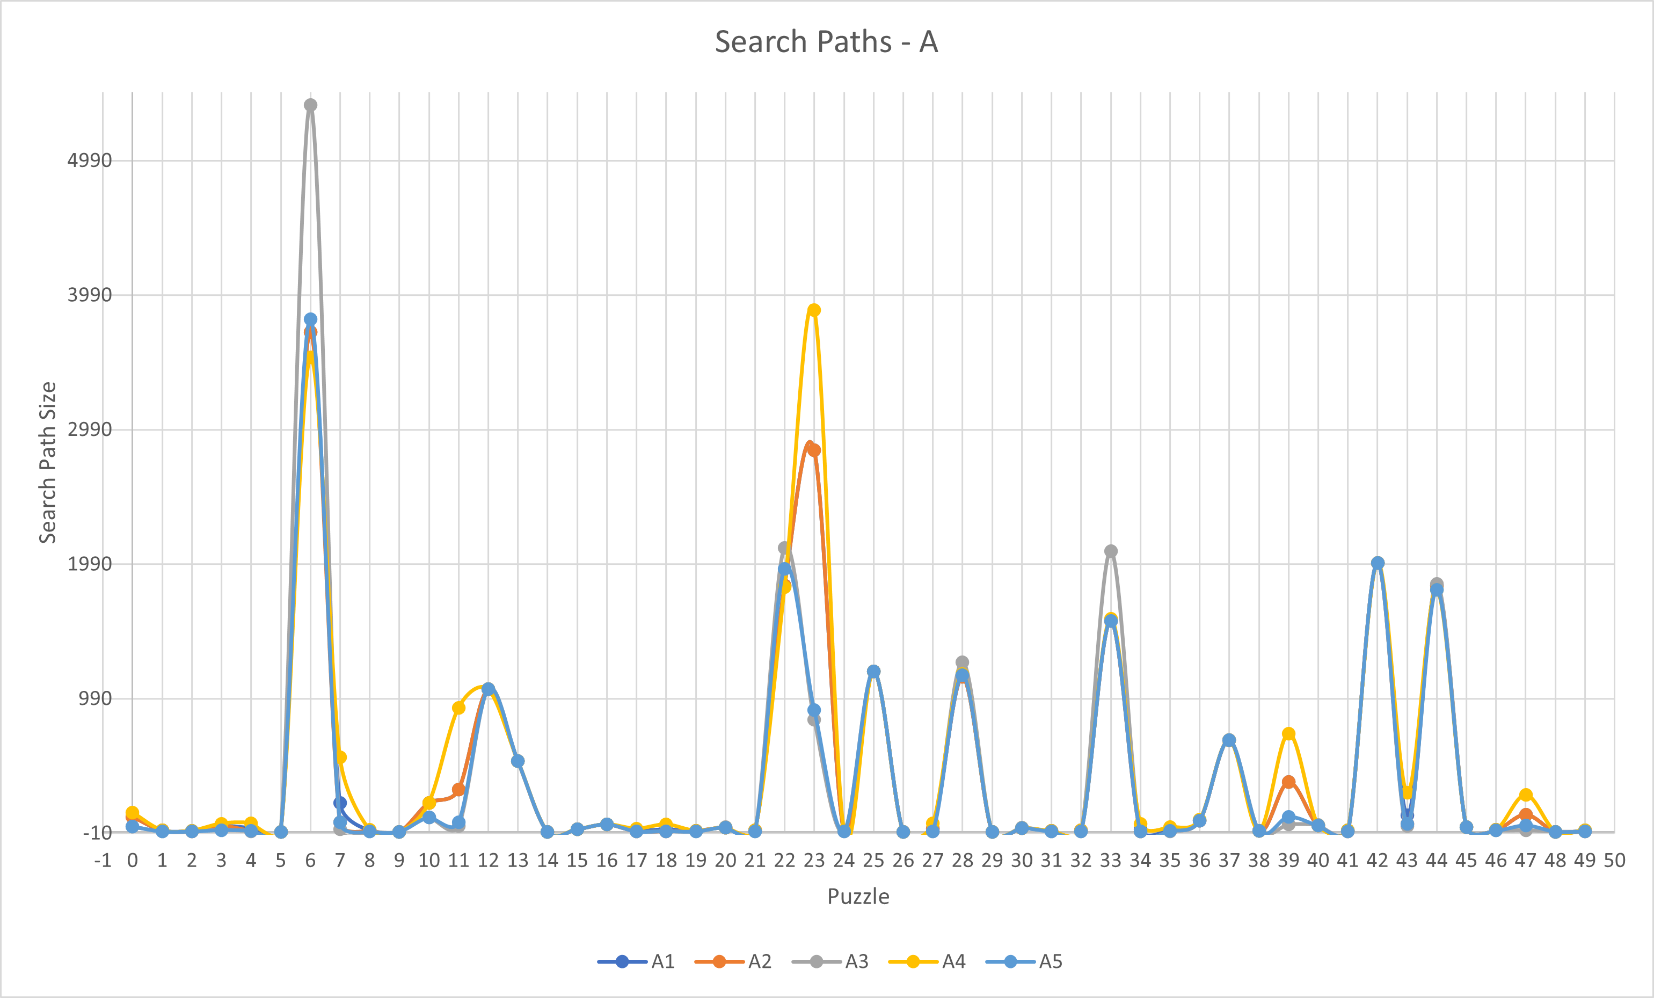
Heuristic Analysis
Heuristic 4: Seems to search the most nodes. This lines up with the results seen with solution times as well.

