Slide 1
MRI Report
Generation
Agent
What We Created
An end-to-end agentic AI system that reads brain MRI scans and automatically generates structured radiology reports — covering Findings, Impression, Recommendations and Confidence — using Claude (Anthropic's large vision-language model).
Dataset Used
BraTS 2020 (Brain Tumor Segmentation) — 369 patient brain MRI volumes in HDF5 format. Each volume contains 4 MRI sequences (FLAIR, T1, T1ce, T2) and expert-labelled tumor masks with 3 regions: necrotic core, edema, and enhancing tumor.
AI-Powered Brain Tumor
Radiology Reporting
Why We Built This
Dataset: BraTS 2020
Radiologists face high workloads and report turnaround delays. This system demonstrates how AI can assist by producing a first-draft report from raw MRI images — reducing manual effort while keeping the radiologist in control for final verification.
Notes:
Introduce: what we built, the BraTS 2020 dataset, and the clinical motivation. Emphasise that radiologists still do final review — AI assists, not replaces.

Slide 2
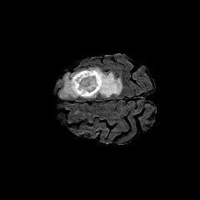
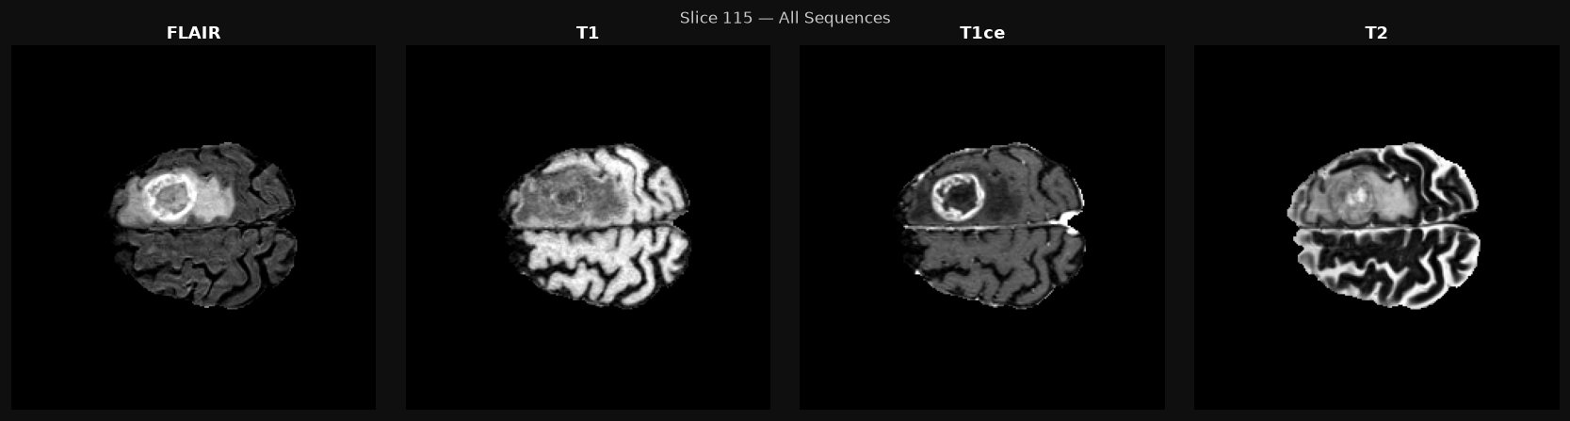
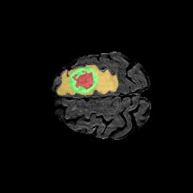
MRI Visualisation — Volume 115 (Glioblastoma WHO Grade 4)
Three views generated by the pipeline for every patient case
FLAIR Slice
All 4 Sequences
GT Tumor Overlay
What it shows:
Side-by-side view of all 4 MRI sequences for the same slice. FLAIR tumor edema bright. T1 anatomy reference. T1ce ring enhancement confirms active tumor / blood-brain barrier breakdown. T2 edema extent. Sending all 4 to Claude gives a far richer diagnostic context than FLAIR alone.
What it shows:
Single FLAIR sequence slice. The bright ring-shaped region in the right frontoparietal area is the tumor. FLAIR suppresses CSF signal, making abnormalities highly visible as bright (hyperintense) regions. This is the primary sequence used for initial lesion detection.
What it shows:
Ground truth tumor mask overlaid on the FLAIR image in colour:
■ Red — necrotic core
■ Yellow/Orange — peritumoral edema
■ Green — enhancing tumor
Used to verify AI predictions against expert labels.
Notes:
Point to each image in turn. The FLAIR shows the tumor clearly. The 4-panel shows why all sequences matter — T1ce confirms ring enhancement which is the key sign of glioblastoma. The overlay shows the ground truth labels we compare against.

Slide 3
Results & Evaluation
20 patient volumes · BraTS 2020 · All 4 MRI sequences · Compared against rule-based baseline
95%
Accuracy
Baseline: 0%
1.00
Precision
Zero false positives
0.97
F1 Score
Recall: 0.95
0.96
Report Quality
12-point clinical rubric
Laterality exact accuracy: 0.25 (AI over-predicts bilateral) · Hallucination risk: 0% flagged
Notes:
Walk through the chart — AI scores 0.95–1.0 across all metrics while baseline scores 0 on everything. Laterality is the weakness — AI tends to say bilateral when it's actually left or right. Mention this honestly as a known limitation and future improvement.

Slide 4
Improvements
Six enhancements made since the progress presentation
01
Real Evaluation Results
04
Baseline Comparison
Actual accuracy, F1, precision, recall and per-case table printed and saved
AI report vs rule-based template displayed side by side in the UI
02
Expert Scoring Panel
05
All 4 MRI Sequences
Radiologist rates reports in-app (1–5 Likert) — scores saved to expert_scores.json
FLAIR · T1 · T1ce · T2 all sent to Claude — not FLAIR only
03
Hallucination Safeguard
06
Visual GT Overlays
Step 4 self-review: Claude checks its own report, flags unsupported claims with risk badge
Tumor mask overlaid on FLAIR in colour: red=necrotic, yellow=edema, green=enhancing
Notes:
List the 6 improvements in 30 seconds then switch to the browser. Open volume_115 — show FLAIR, 4-sequence panel, GT overlay, then AI Report (glioblastoma diagnosis), then Baseline Comparison, then Evaluation tab. Keep demo to 3 minutes.

Slide 5
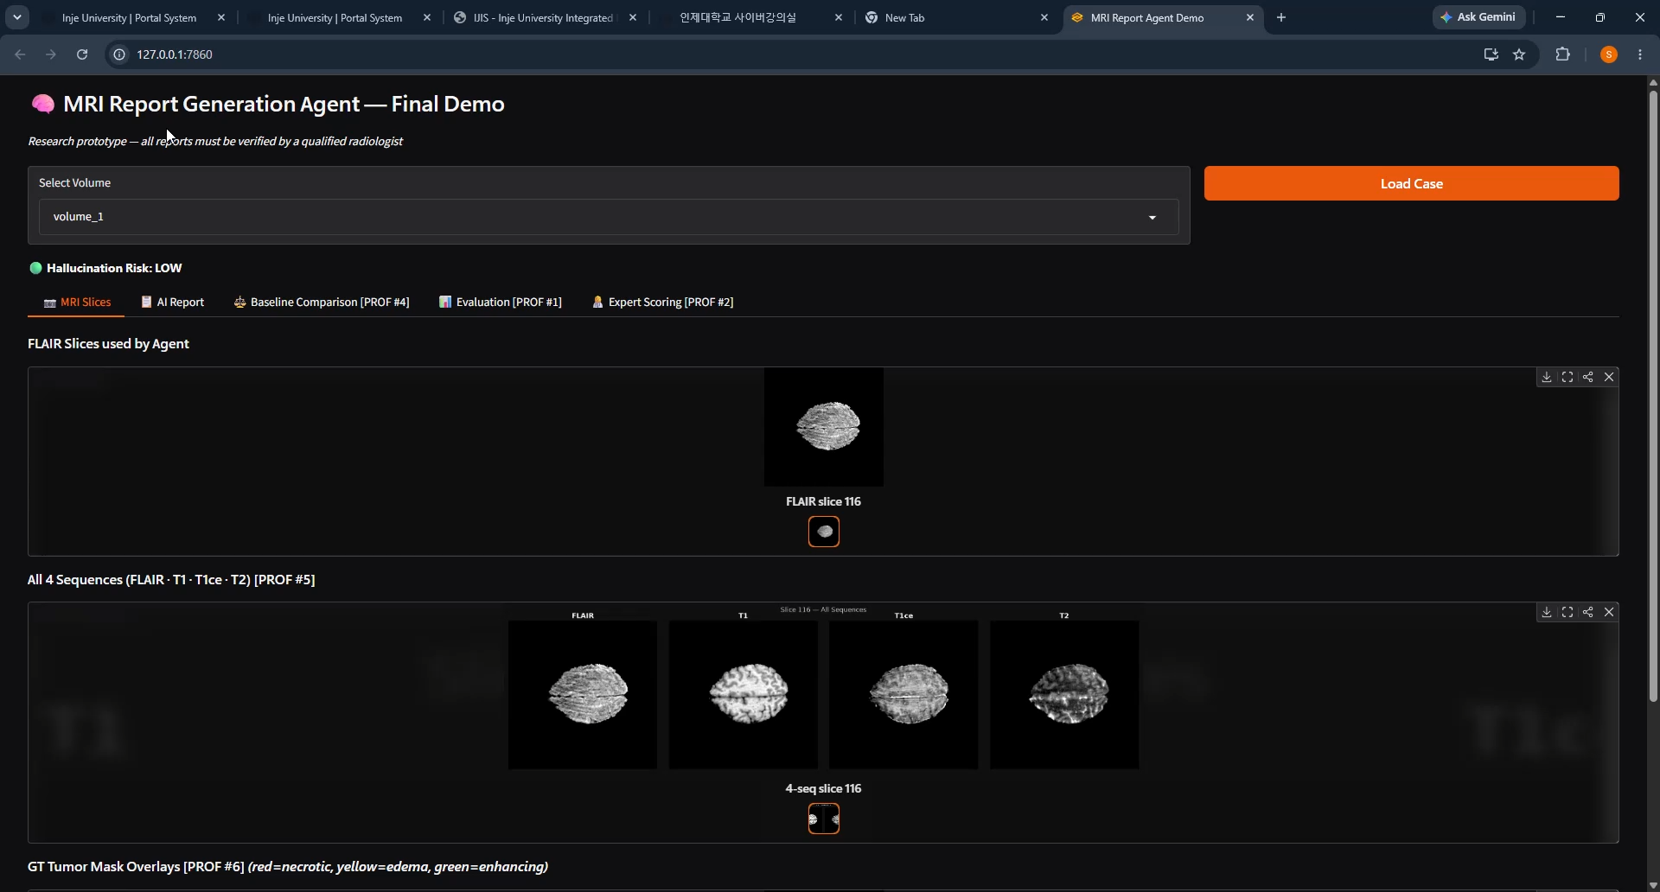
Live Demo
🎬 LIVE DEMO — http://127.0.0.1:7860 · Open volume_114

