Slide 1
Stereognosis protocol
Anton Sobinov
Uchicago Bensmaia Lab, 2021-02-04

Slide 2
Experimental sequence
Preparation
Session file generation
Program initiation
Running
Trial loop
Wrap-up
Data export

Slide 3
Generation of session file
Generates a list of object positions for the session.
Located in App\session_configs
*_session_config.xml – defines what is varied
generate_session.bat – useful script for generation
3D_session_2021.01.28_17.32.36.csv – example session file

Slide 4
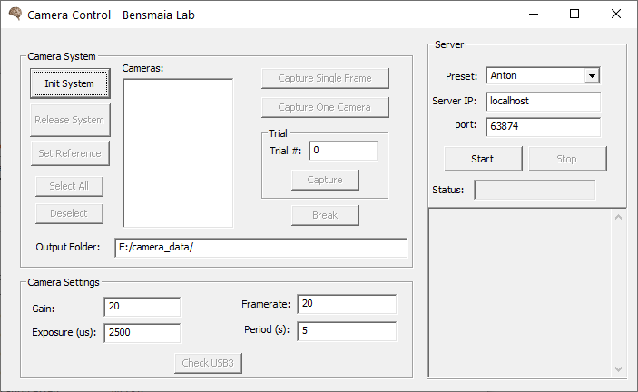
Program initialization – cameras – PC2 & PC3
automatically
detected
1
3
2

Slide 5
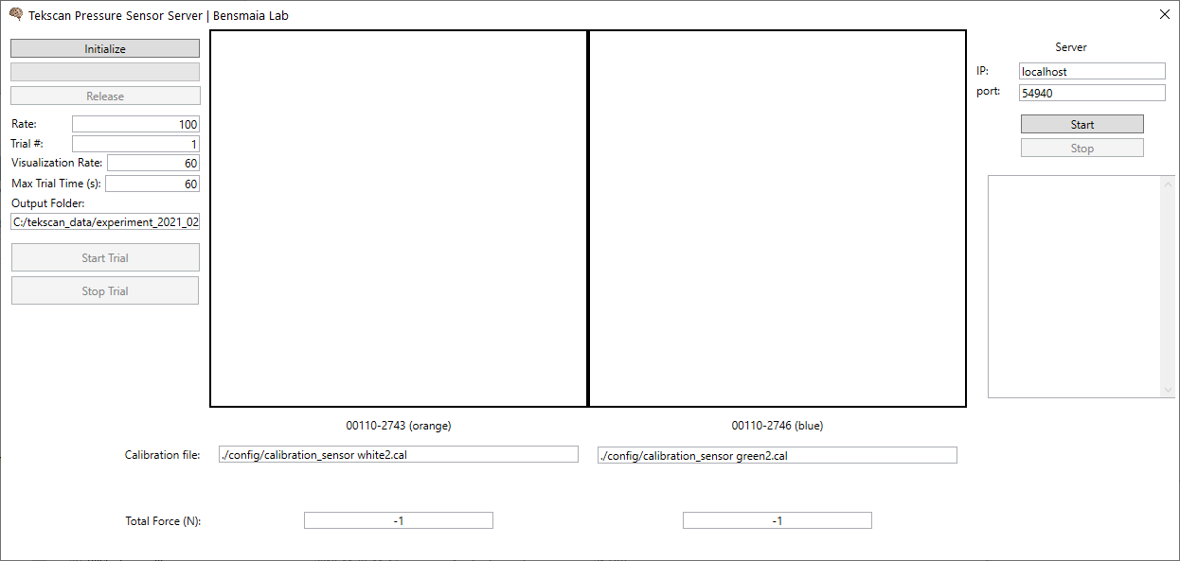
Program initialization – pressure sensors – PC1
1
2

Slide 6
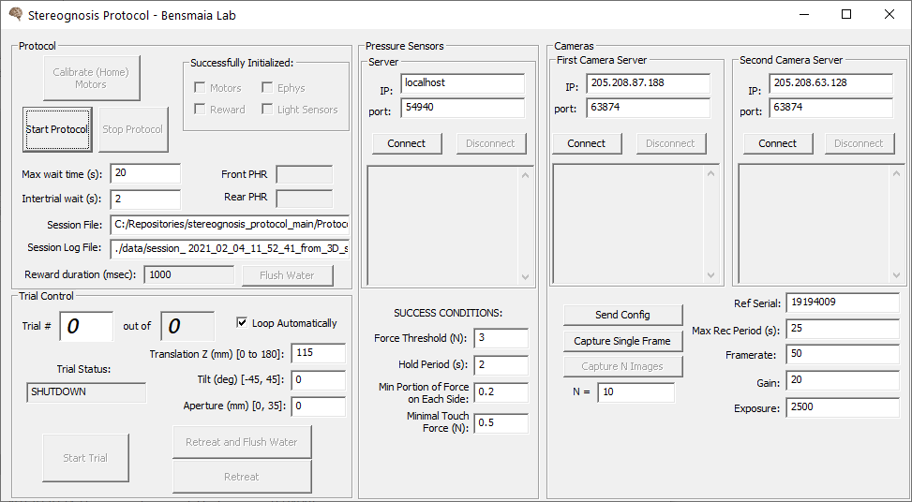
Program initialization – main protocol – PC1
3
move tilt stopper, run and move the stopper away
2
1
4

Slide 7
Program initialization – ephys
Lisa & Charles

Slide 8
Trial loop
Start
Load next trial
When in position signal BEEP
Wait until:
monkey released sensors
both light sensors covered
Start Trial is pressed OR
loop is on and timeout occurs
When light sensors uncovered, start recording
Wait until:
monkey exerts enough pressure over time
timeout
stop Trial or Stop Protocol – will stop looping
Check if trial # or
positions changed
Retreat and then stop recording
Start moving motors
(break if arm lifts off or
sensors feel pressure)
Log and wait for cameras to finish saving
Repeat

Slide 9
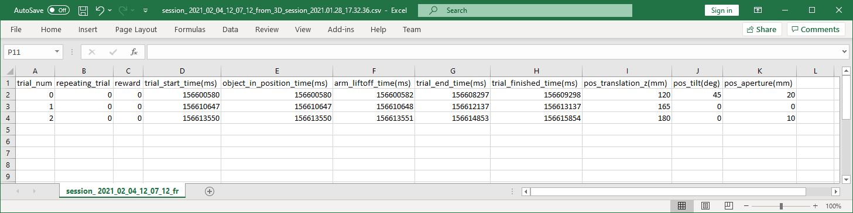
Session log
session_<CURRENT_DATETIME>_from_<SESSION_FILENAME>.csv
E.G.: session_ 2021_02_04_12_07_12_from_3D_session_2021.01.28_17.32.36.csv

Slide 10
Data export
Timestamps will be different
PC2 and PC3:
D:/camera_data/experiment_<DATE> - images
PC1:
C:/tekscan_data/experiment_<DATE> - pressure sensors
App/data/Protocol_<DATE> and session_<DATE> - logs.

Slide 11
Future improvements
Check USB3 shows color of the cord.
Log global events on each sensor internal timeline?
Check USB3 on init system.
Increase rate of pressure sensor recording
Expose light sensor parameters
Increase maximum recording times for sensors
Checkbox to use or not use the light sensors in control
Log of the time when M. pressed on the object for the first time

