Slide 1
S.O.E
Block-B's
Website

Slide 2

School of Engineering, Pokhara University
S.O.E Block-B official Website
Presented By
Guided By
1.Ritik Gurung
2.Bikash GC
3.Sobit Thapa
4.Karan Adhikari
Er. Shiva Ram Dam
Submitted for the partial fulfillment
of
Bachelor Degree
1
Department of Science and technology
June - 2022

Slide 3


Content
Introduction
Objectives
Methodology
ER Diagram
Tools and technologies
Project Implementation
Project Planning
Gantt Chart
Web Site Design & Development
Production Management & Implementation
Outcome Evaluation
Findings and results
Applications
Conclusion
References
S.O.E Block-B website project
S.O.E Block-B website project
June - 2022
2

Slide 4
INTRODUCTION
The students of BEoC (S.O.E) seek to create a sub-family for Block-B of the existing website, https://pu.edu.np/.
So, for the convenience of students and teachers,
We hope to build a better site to serve the community(S.O.E Block-B).
It should easily find information, and accessible to the all visitors.
S.O.E Block-B website project
June - 2022
3

Slide 5
OBJECTIVES
The proposed website will have a clear, intuitive, and easily searchable design so that members of the community and visitors are able to maximize their work.
The site will provide links to the official website and other external sites.
To convey dynamic energy and diversity to all who visit the site.
Therefore, the site will be easy to maintain and easy to update with new content.
S.O.E Block-B website project
June - 2022
4

Slide 6
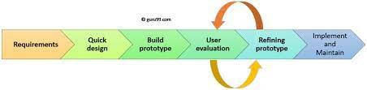
METHODOLOGY
The prototype methodology was selected for the development of our project.
collect requirements that typically include planning and sketching a sample
the quick design of the project is made
the prototype of the project is made
the errors are maintained after the development of the website
S.O.E Block-B website project
June - 2022
5

Slide 7
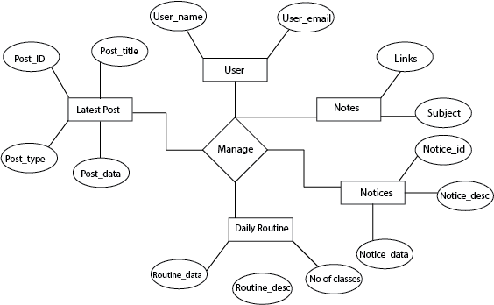
ER-Diagram
S.O.E Block-B website project
June-2022
6

Slide 8
Tools and technologies
HTML
CSS
Visual studio code
JavaScript
SQL
PHP(Laravel framework)
S.O.E Block-B website project
June-2022
7

Slide 9
Project Implementation
Project Planning
Using the insight gained from analysis of the required content for the site,
we plan to select several design that will visually express your core message
from layout and color to type size and style will be made with users in mind
we shall then present the initial concepts to the users to turn the concept into a comprehensive design
The best idea will be chosen for further development.
S.O.E Block-B website project
June-2022
June-2022
8

Slide 10
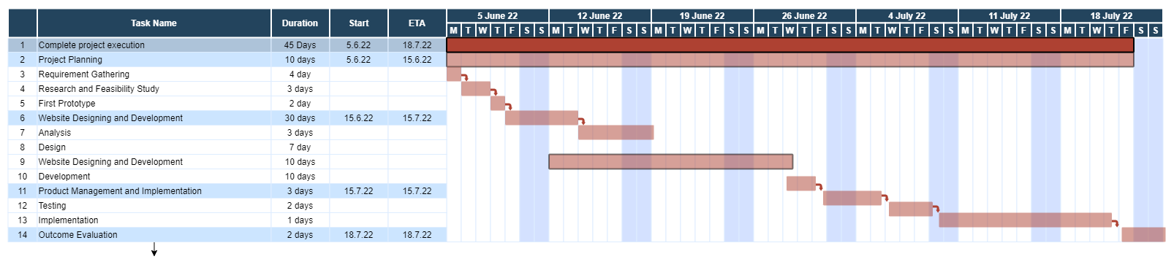
Gantt Chart
S.O.E Block-B website project
June-2022
9

Slide 11
Web Site Design & Development
Once the design is selected and approved, the heavy lifting development work is done next.
At this phase, we examine the details, ensuring that every element works to aid the communication objectives of the project.
The architecture and site map are completed. The CSS are flushed out.
At this stage we will provide:
• Complete website (skeleton) complete
S.O.E Block-B website project
June-2022
10

Slide 12
Production Management & Implementation
At this stage we provide:
• Production proofs for proofing and corrections as needed
• Testing of site for selected browsers, devices (iPhone, Android, Window etc.)
• Accessibility tests
• Training and production management for the finished project
• The finished project, style guide and all documentation
• SEO initial set-up
S.O.E Block-B website project
June-2022
11

Slide 13
Outcome Evaluation
We work with the users to gather feedback, and use this feedback to improve and optimize our website.
Findings and results
Having individual sites for each block saves the time and energy of the visitor.
This website will help the user to sift through news and notices from PU official related to S.O.E Block-B.
S.O.E Block-B website project
S.O.E Block-B website project
June-2022
12

Slide 14
Application
Some of the applications of our website are
It will help find information to organize campus events, athletic events and student events.
On the Home Page the core fundamentals will be displayed.
Our website will provide links related to notes required by the students.
S.O.E Block-B website project
June-2022
13

Slide 15
Conclusion
Based on our analysis , it can be concluded that by creating a website that contains all relivent data that is useful for members of S.O.E Block-B; we can improve their without the need for mindless sifting while searching for informations.
S.O.E Block-B website project
June-2022
14

Slide 16
References
Different websites which are searched and compared are mentioned below.
Official Pokhara University website at https://pu.edu.np/
Official Kathmandu University website at https://ku.edu.np/
Oxford University’s Official website at https://www.ox.ac.uk/
S.O.E Block-B website project
June-2022
15

Slide 17
Thank
You
Peace
Out

