Slide 1

Conclusion

Slide 2

Countries to consider:
This Photo by Unknown Author is licensed under CC BY

Slide 3
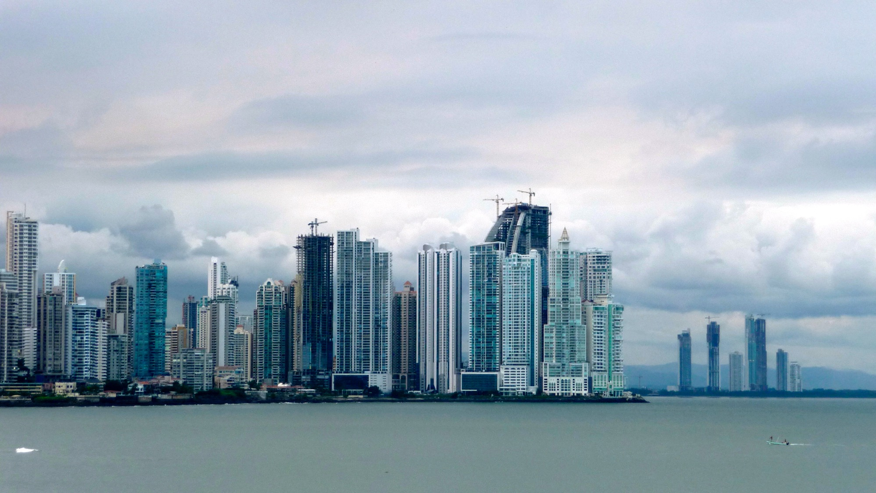
Panama

Slide 4
Factors to Success:
Panama Canal Expansion (2016):
Completed a $5.25 billion expansion in June 2016
Accommodates Neo-Panamax ships (up to 12,000 containers)
Maritime Trade Significance:
Holds 46% of the market share for containers from Northeast Asia to the U.S. East Coast
Connects 160 countries through 144 maritime routes
Economic Impact:
Vital transport and logistical hub
Trade and financial center
Emerging significance in copper mining
Economic Achievements:
GDP growth of 4.7% (2014-2019)
Increased protected land area from 33% to 54%
Carbon-negative country
Significant job creation, reducing poverty from 48.2% (1991) to 12.1% (2019, $6.85 a day, 2017 PPP prices)

Slide 5
Challenges/Risks:
Fiscal Reforms and Challenges:
Medium-term need for fiscal reforms to meet SFRL targets
Reforms include pension, expenditure, and tax adjustments
Economic Risks:
Risks from pension reforms, tax administration inefficiencies, and climate-related shocks
Potential impact from increased frequency and intensity of El Niño events
Labor Market and Growth:
Increased unemployment and informality (2017-2019) due to slowed economic growth
Difficulty in finding competent, English-fluent technical employees
Energy Costs Impact:
Exceptionally high electricity costs
Contribute to higher-than-average unit production costs in Panama

Slide 6
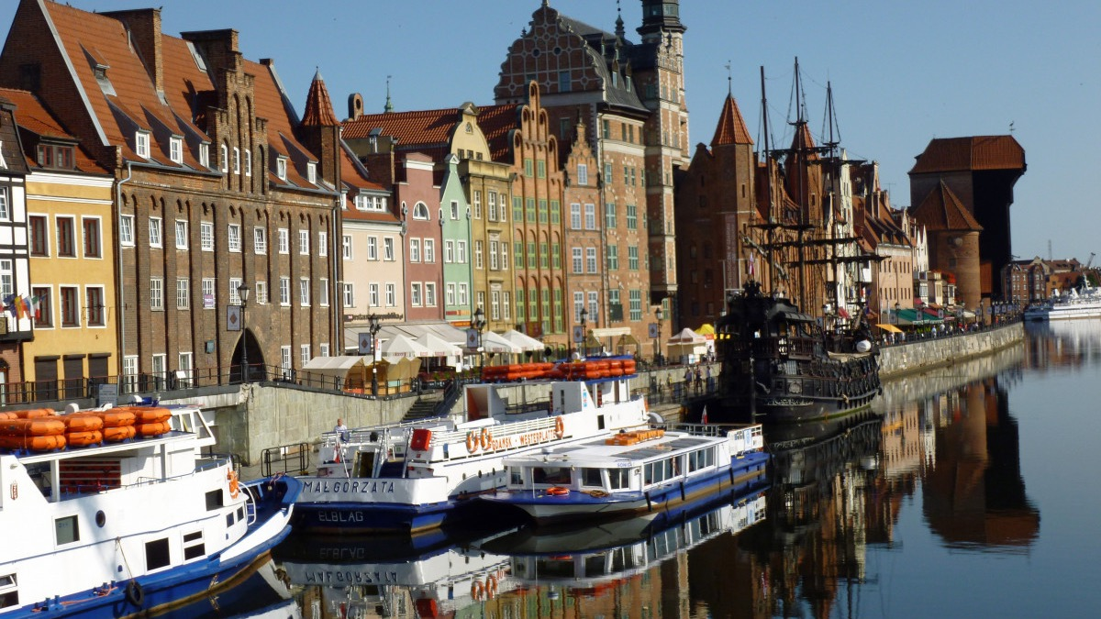
Poland

Slide 7
Factors in success:
European Integration and Norms:
Embracing European integration, Western institutions, and norms
Education Growth:
Expanding education, particularly with a significant number of young people pursuing university studies
Infrastructure Development:
Benefiting from inflows of EU funds for infrastructure development
Business-Friendly Environment:
Enjoying an improved business climate
High ranking in the World Bank's Doing Business report
Financial Sector Strength:
Strong supervision and conservative risk management in the banking sector

Slide 8
Challenges/Risks:
To sustain its upward trajectory towards Western levels of development, Poland must prioritize further reforms in innovation, tertiary education, and tackling population aging.

Slide 9

Thailand

Slide 10
Factors in Success:
ASEAN Leadership:
The second-largest economy in ASEAN, surpassing all but Indonesia
Robust Economic Profile:
Upper middle-income status with a dynamic open economy
GDP Powerhouse:
Noteworthy gross domestic product (GDP) of $529 billion
Consistent Growth:
Achieved a solid 4.1% annual growth in 2018
Export Dynamo:
Thriving as an export-driven economy, with 2018 exports totaling $249.8 billion
Global Export Markets:
Key export destinations include the United States (11.2%) and China (11.9%)
Diverse Exports Portfolio:
Leading in various sectors, with top exports including machinery, electrical equipment, vehicles, rubber, plastics, gems, mineral fuels, meat/seafood preparations, organic chemicals, and cereals

Slide 11
Factors in Success (Continued):
Tourism Impact:
Direct tourist receipts: 12% of GDP
Indirect contributions potentially nearing 20%.
Economic Growth:
Overall: 4.1%
Key sectors: Private consumption +4.6%, total investment +3.8%, export value +7.7%
Economic Resilience:
Current account surplus: 37.7% of GDP
Strategic Infrastructure:
Eastern Economic Corridor (EEC) Act drives $55 billion in investments in high-speed rail, ports, and airports.
Targeted Industries:
Next-gen cars, smart electronics, medical services, wellness tourism, agriculture, biotechnology, food, robotics, aviation, biofuels, and digital technologies.

Slide 12
Challenges/Risks:
Trading Partner Economies:
Economic situations of trading partners impact outcomes
Currency Market Volatility:
Money market fluctuations add an element of uncertainty
Global Policy and Political Uncertainty:
Uncertainty in international economic policies and politics influences the economic landscape

Slide 13
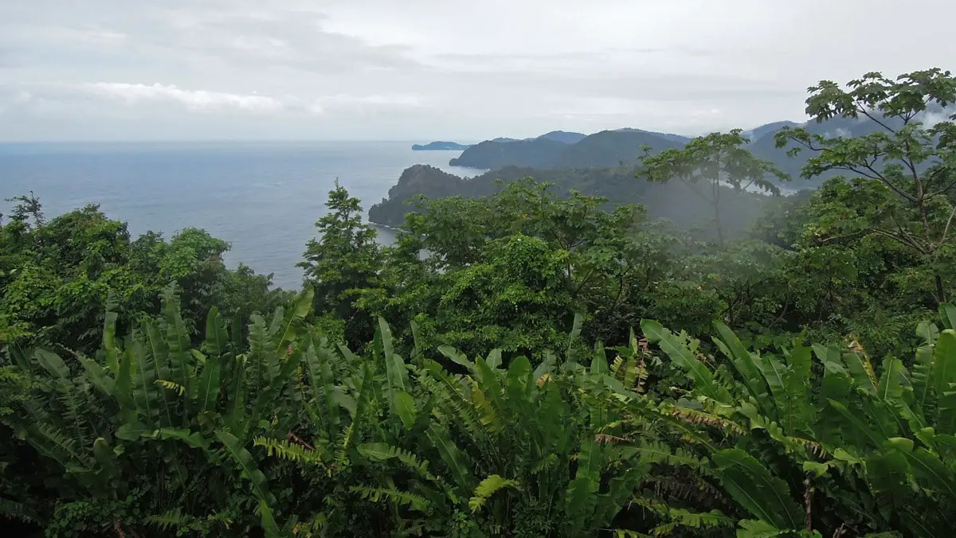
Trinidad and Tobago
This Photo by Unknown Author is licensed under CC BY-NC-ND

Slide 14
Factors to Success:
High-Income Status:
Recognized as a high-income country with one of the highest GNI per capita in Latin America and the Caribbean (US$17,640 in 2015).
Oil and Gas Dependency:
The economy heavily relies on oil and gas production, constituting about 37% of GDP and over 70% of exports (2015 data).
Financial Center Significance:
Emerged as a major financial center in the Caribbean.
Energy Sector Revival:
The commencement of new natural gas projects in late 2017 revived energy output, contributing to improved growth rates.
Fiscal Consolidation Measures (2018):
Implemented fiscal measures in 2018, including the establishment of the Trinidad and Tobago Revenue Authority, adoption of a property tax system, and reductions in fuel subsidies, aimed at fiscal consolidation.
This Photo by Unknown Author is licensed under CC BY-NC-ND

Slide 15
Challenges/Risks:
Energy Price Impact (2016):
The energy sector declined by nearly 10% amid low prices
Economic Consequences:
Job losses and reduced tax revenues.
Foundational Resilience:
Despite challenges, low public debt, strong financial buffers, human capital, and political stability support an expected economic rebound
Fiscal Consolidation Urgency:
Immediate need for fiscal measures to counter emerging imbalances and prevent escalating debt
Policy Imperatives:
Action is required to rationalize expenditure, maintain revenue levels, and address external financial risks
Strategic Priorities:
Enhance business environment, improve public services, and bolster statistical capacity

Slide 16

Countries to avoid:

Slide 17
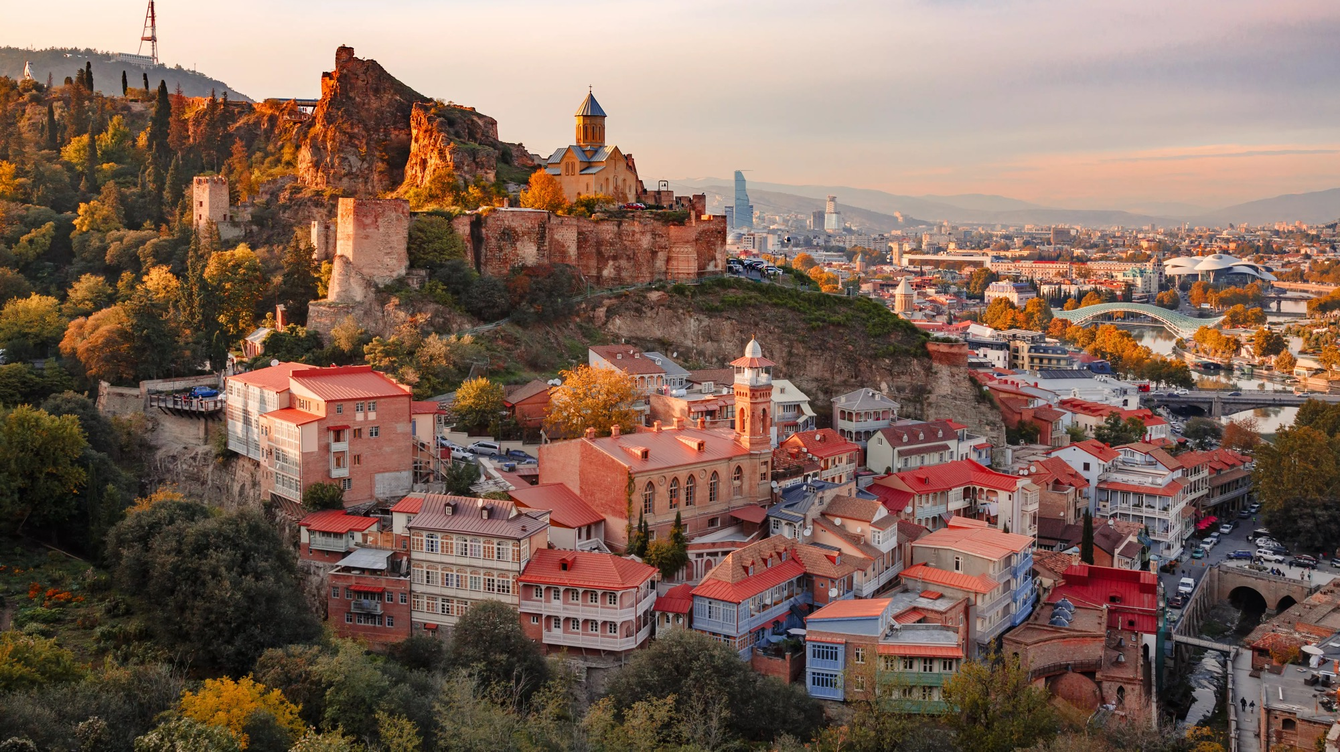
Georgia

Slide 18
Reasons for its problems:
Demographic & Workforce Challenges:
Aging Population
Weak Productivity Growth
1/3 Workers in Low-Productivity Agriculture
Limited Creation of High-Quality Jobs
Poor Learning Outcomes
Serious Skills Mismatch in the Job Market
Workforce Dynamics:
Companies Struggle to Find Skilled Workers
Economic Diversification:
Narrow Export Base
Need for Diversification Beyond Traditional Sectors

Slide 19
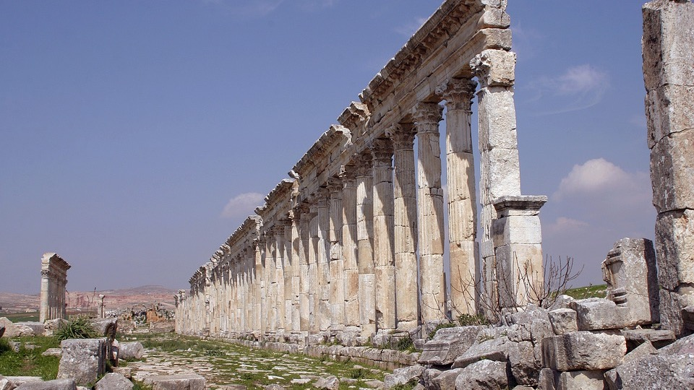
Syria

Slide 20
Reasons for its problems:
Economic Devastation:
Ongoing conflict for over a decade caused immense devastation and economic loss.
More than half of the pre-conflict population (around 21 million) was displaced internally and as refugees.
Economic Contraction:
Syria's GDP shrunk by over half between 2010 and 2020.
World Bank reclassified Syria as a low-income country in 2018.
Impact on Socioeconomic Conditions:
Deteriorating conditions are exacerbated by armed conflict, economic sanctions, drought, and regional economic crises.
Severe depreciation of the local currency leads to inflation, eroding real wages, and increasing poverty.
Infrastructure Challenges:
Critical sectors like health, education, water, and sanitation dramatically worsened.
Soaring commodity prices impact Syria's position as a net food and fuel importer.

Slide 21
Ultimately…

Slide 22

Thailand is the best country

Slide 23
Thailand is the best country!!
Why?
Economic Strength:
The second-largest economy in ASEAN boasts a stable and dynamic economic environment.
Robust gross domestic product (GDP) of $529 billion and consistent annual growth.
Strategic Location and Infrastructure:
Strategic location in Southeast Asia and infrastructure development initiatives, such as the Eastern Economic Corridor (EEC) Act, enhance business prospects.
Innovation Focus:
Commitment to innovation is evident in a diverse range of industries, including next-generation cars, smart electronics, and digital technologies.
Export Opportunities:
Thriving export-dependent economy with key markets like the United States and China, providing ample global trade opportunities.
Tourism Impact:
The tourism sector contributed around 12% of the GDP in 2018, adding an additional dimension to economic strength.
Favorable Business Climate:
Overall favorable business climate with diverse export portfolios and strategic initiatives for sustained growth.

Slide 24
Sources:
Panama
https://www.worldbank.org/en/country/panama/overview
https://www.trade.gov/country-commercial-guides/panama-market-overview
https://www.trade.gov/panama-country-commercial-guide
Poland
https://www.brookings.edu/articles/how-poland-became-europes-growth-champion-insights-from-the-successful-post-socialist-transition/
Thailand
https://th.usembassy.gov/business/getting-started-thailand/why-thailand/
Trinidad and Tobago
https://www.worldbank.org/en/country/trinidadandtobago/overview
Georgia
https://www.worldbank.org/en/country/georgia/overview#:~:text=These%20include%20population%20ageing%2C%20weak,engaged%20in%20low%2Dproductivity%20agriculture.
https://www.imf.org/en/News/Articles/2017/06/12/sp061217-the-challenges-of-building-a-modern-georgian-economy
Syria
https://www.worldbank.org/en/country/syria/overview

