Slide 1





Data Analysis of E-Commerce Platform
Graduation Project 2024

Slide 2


Industry Overview
Amazon, Meesho and Flipkart are major E-Commerce Platform India which have
majority of the Indian Market.
The market share is leaded by Flipkart with 38%, then
Amazon with 35 % and Meesho with 16 %.
Meesho primarily features unbranded products and 95 percent of their products are
unbranded while Flipkart and Amazon both focus branded product as a major share.
In this case study, we try to explore the various sales parameters of Amazon, Meesho
and Flipkart.

Slide 3


Hour-wise Distribution
Primary Data Analysis
The pie chart illustrates the distribution of all orders, categorized
by either the type of seller or the method of order placement, and
further broken down into shipped and canceled orders.
Peak hours can be used as best time
to display advertisements on amazon
platform.

Slide 4





Expedited vs Standard
Secondary Analysis
Volume Vs Revenue
We find although Expedited
order are in larger amount
but the cancellation is more
In Expedited. So We should
increase delivery charges on
expeditated orders.
We observe that Delhi being at 2nd by orders is at 10th when it comes
about revenue. So in such location we can offer more BOGO(Buy one
Get one free) to increase order value or We can offer more discount on
Orders.

Slide 5


Cancellation Analysis
The cancellation rate is decreasing
Year by Year.
J&K and few North-East States are
on top because of delay in delivery
on time because of tough terrain and
also because of lower orders. To decrease
cancellation in these states we have to focus
on reducing Delivery time period.
The tax % is 10 % on cancelled orders while it is only 6%
on non-cancelled orders.

Slide 6



Primary Data Analysis
The Flipkart sales peaks in the month
Of October due to Big-Billion sales and
Diwali Sales.
To minimize logistic losses, we can
initiate the delivery process 8-10 hours
after an order is placed, based on the
average 10-hour cancellation period.
This time frame allows for potential
cancellations while optimizing
operational efficiency.
The peak hours suggest
the best time to display
advertisement
on the Flipkart Platform

Slide 7


Analyzing Trends
Although the initial 3-month order volume is lower
than others, the return rate remains high and cancellation
also remain higher. Return and Cancellation is highest in
October which can be justified due to the fact that it is the
month with highest order to “Big-Billion Sale”.

Slide 8


Primary Data Analysis
This basic analysis shows that the states which tops in Volume wise,
also tops in revenue wise. Also we have found the top 4 product, which are best selling on our platform. We must focus more on reducing the cancellation rate of these product, in order to maintain good reviews.

Slide 9


Analyzing Trends
Although the no order is
Increasing while revenue
is decreasing which suggest decrease in average order value and will need to focus on pricing strategy.
Delivery Rate in Top 5 States
Uttar Pradesh is leading in highest
delivery but lacks in Delivery
rate which suggest to implement
techniques to improve
logistic services in UP and encourage
more shopping in Tamil Nadu
Uttar Pradesh – 67.01%
Tamil Nadu-73.67
Karnataka – 69.33
Maharashtra – 73.90
Andhra Pradesh – 71.92

Slide 10

Comparative Analysis
Peak Months for All Platforms
Flipkart Sales peak during October
due to Festival season as well as
it’s own BIG-BILLION SALE during
October.
Meesho Sales is usually throughout
the year and usually once a quarter
they give discount offers on various
orders
Amazon sales peaks during
June due to Great Indian
Festival Sale and in November
due to Diwali Sales

Slide 11
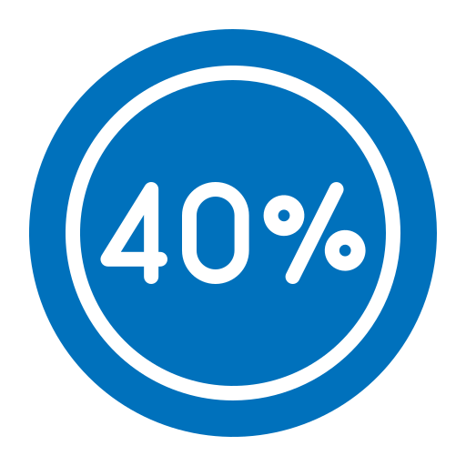
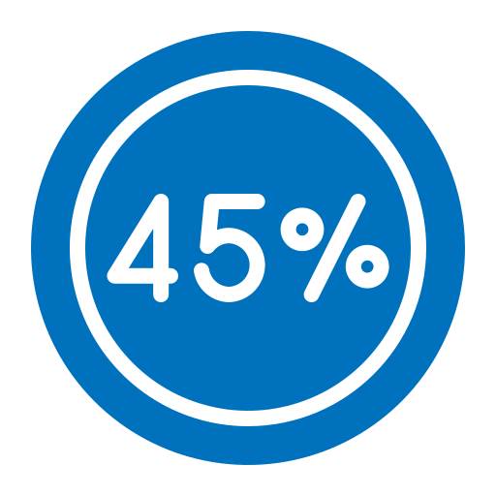
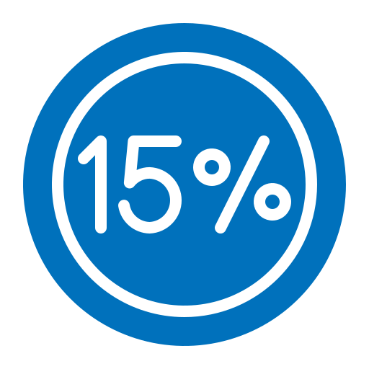
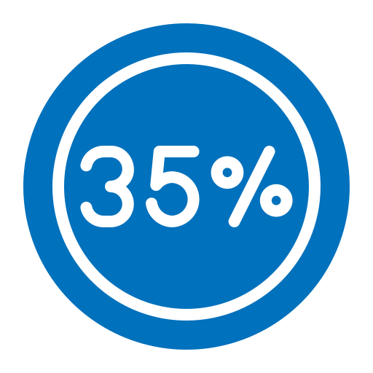

Comparative Analysis
Peak Hours for all the Platform
This suggest best time
to display advertisement.
Other Insights
Cancel product due to high shipping cost.
Cancel their order because they change their mind.
Cancel because they do not agree with return policy.
Cancel product because of long delivery time.
Cancellation rate when order takes place without promotion.
Reference - https://fluentcommerce.com/resources/blog/reduce-cancellation-rates-by-enhancing-customer-satisfaction/

