Slide 1
Fitting Q learning on monkey dyadic data
May 2024

Slide 2
How choice vector should be defined?
Choice vector should be defined based on ‘’what subject has to learn’’ to maximize the reward. Therefore the choice vector is:
When subject received 3 or 4 choice = 1
When subject received 2 or 1, choice = 0

Slide 3
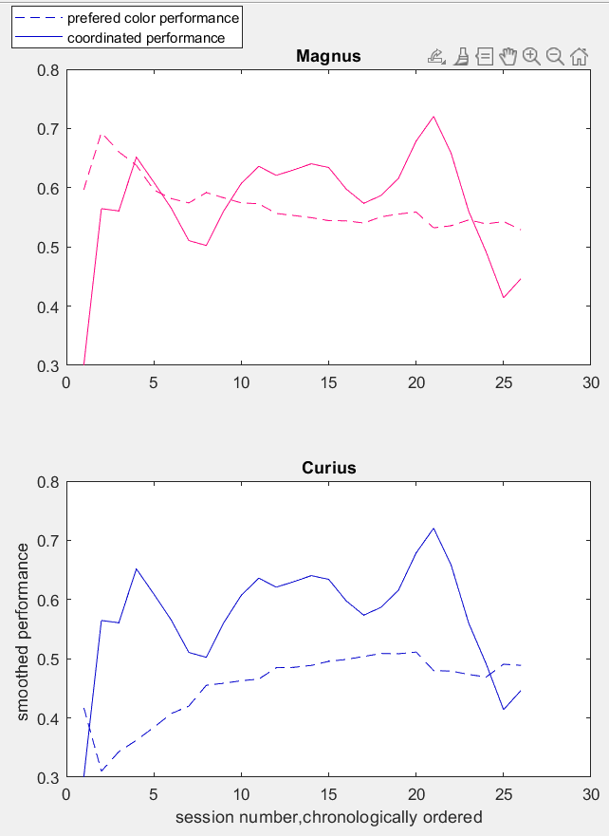
Dynamic of performance for differently defined choice vectors
Magnus compromised for coordination by reducing the choices for preferred color

Slide 4
Q learning: learning by maximizing coordination

Slide 5
Q learning: learning by choosing preferred color

Slide 6
A very beautiful example of learning by coordination, sacrificing preferred color!

Slide 7
Q learning: learning by maximizing coordination

Slide 8
Q learning: learning by choosing preferred color

Slide 9
Conclusion
1) Q learning model is a good fit for sessions that learning is not ‘’saturated’’ that’s why in steady state R2 values are near zero.
2) When the choice vector is defined based on preferred color, for fitted learning rate: there is a negative slope line for curius and positive slope line for magnus, the reason is that magnus compromised for coordination by reducing choosing the preferred color and in this way maximize the reward by coordination.
3) When the choice vector is defined based on coordination, goodness of fit drops because if we assume that WHAT monkey learned is ‘’coordination’’, what to be learnt is the ability to predict the opponent and this happens by TOM and not simple Q learning

