Slide 1
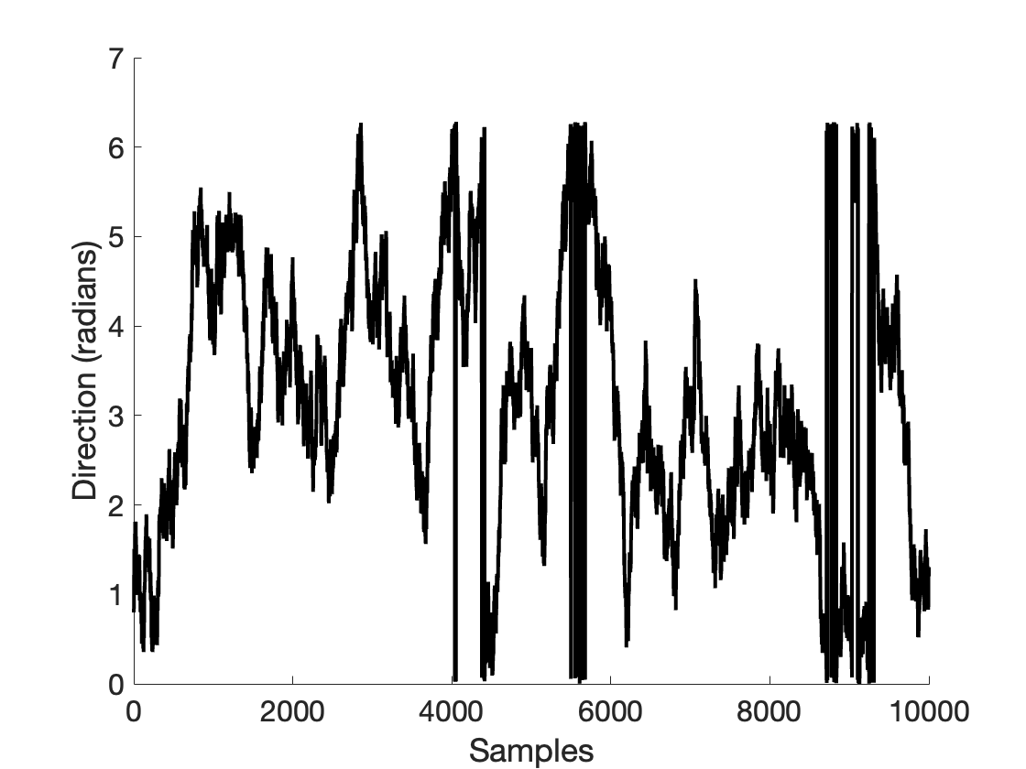
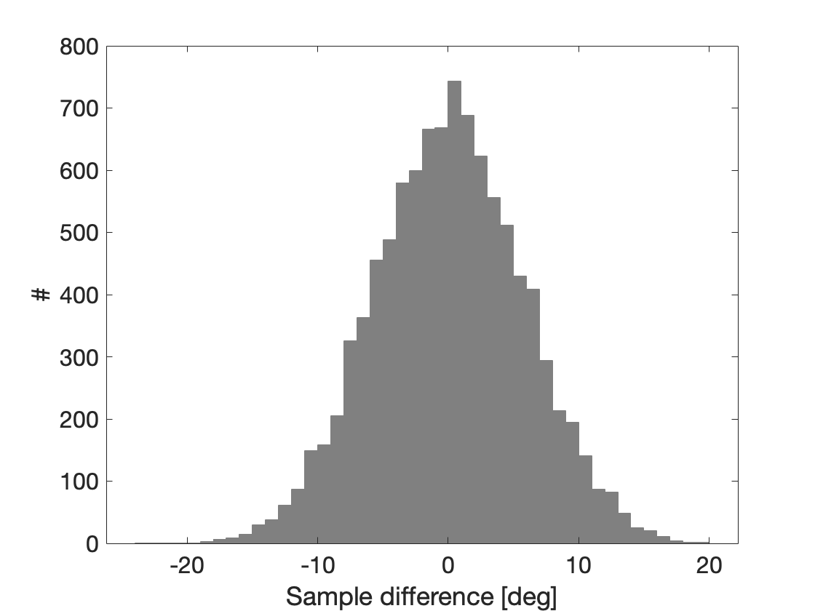
Random walk implementation
% Step size in polar space
polar_step_size = 0.1;
% Initial stimulus direction
stimulus_direction = rand * 2 * pi;
% Update stimulus direction with random step
stimulus_direction(iStep) = stimulus_direction(iStep-1) + randn * polar_step_size;

Slide 2
Subject tracking simulation
if random_subject
% Random subject direction
subject1_direction(step) = pi + nscale*randn;
subject2_direction(step) = pi + nscale*randn;
else
if step > lag
% Subject direction (noisily) lags behind stimulus direction
subject1_direction(step) = stimulus_direction(step-lag) + (nscale*randn);
subject2_direction(step) = stimulus_direction(step-lag/2) + (nscale*randn);
else
subject1_direction(step) = pi + nscale*randn;
subject2_direction(step) = pi + nscale*randn;
end
end

Slide 3
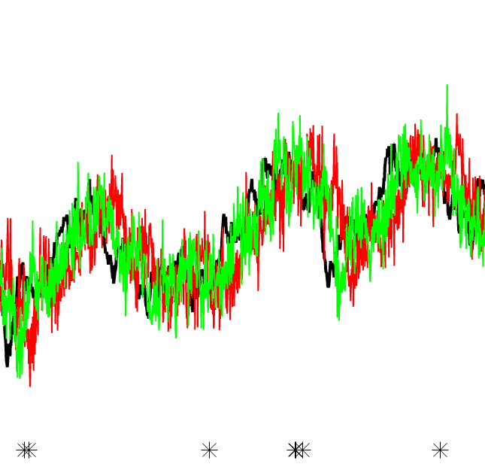
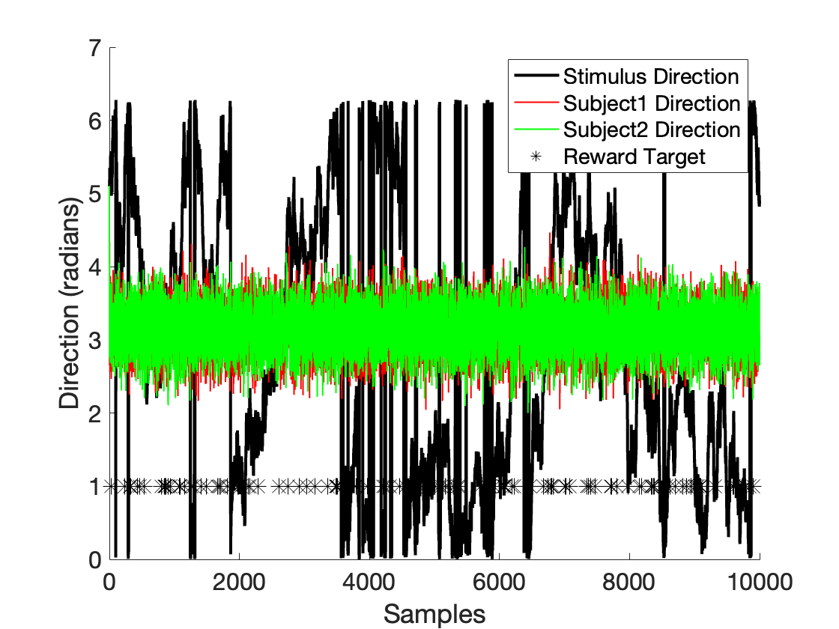
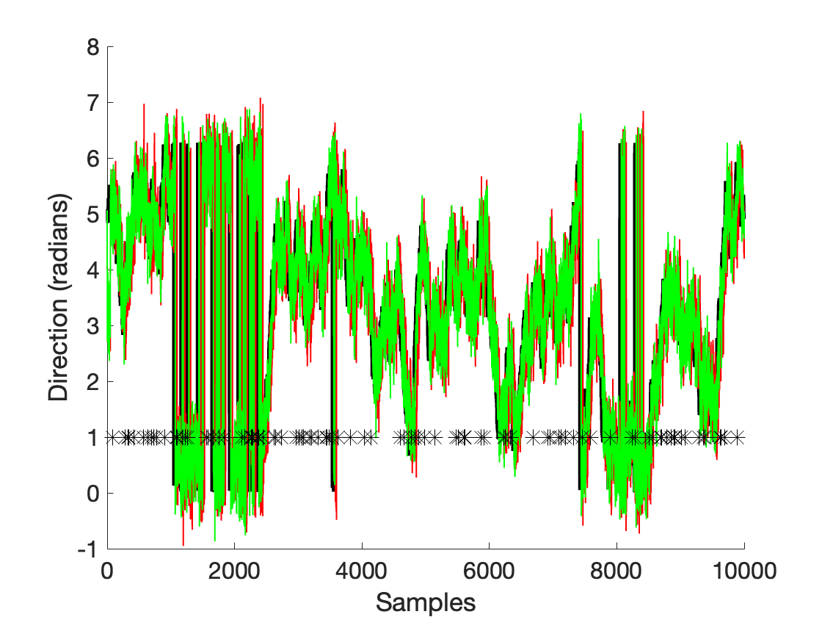
Example simulation
Lag
Lag x2
Random subjects
Tracking subjects

Slide 4
Reward calculation
% Probability of reward target appearance per sample
reward_probability = 0.01;
% Check for reward target appearance at sample
if rand < reward_probability
% Calculate tracking accuracy for each player
% Assign reward to each player
end
Two possible social settings:
Option 1: Equally shared reward (cooperative)
Option 2: Winner- takes-all (competitive)

Slide 5
% Determine reward based on accuracy for dyadic hits (both players hit the target)
if accuracy_subject1 > 0.75 && accuracy_subject2 > 0.75 % Corresponds to fixed 0.5 eccentricity
if strcmp(social_context, 'coop’)
% Cooperative context: Equally shared reward between players
reward1 = mean([accuracy_subject1 accuracy_subject2]) / 2;
reward2 = mean([accuracy_subject1 accuracy_subject2]) / 2;
elseif strcmp(social_context, 'comp’)
% Competitive context: Winner-takes-all if both hit the target
if accuracy_subject1 > accuracy_subject2
reward1 = accuracy_subject1;
reward2 = 0;
else
reward1 = 0;
reward2 = accuracy_subject2;
end
end
else
% No reward otherwise
reward1 = 0;
reward2 = 0;
end
Notes:
Comp: sum of two

Slide 6
Average reward outcome
For each simulation (N = 1e4 for each social condition):
Target-wise reward summed for each player, […]
[…] then averaged across both players.
Statistics (between cooperatice and competitive context):
Median difference of average reward per simulation
Paired Wilxocon-signed rank test

Slide 7
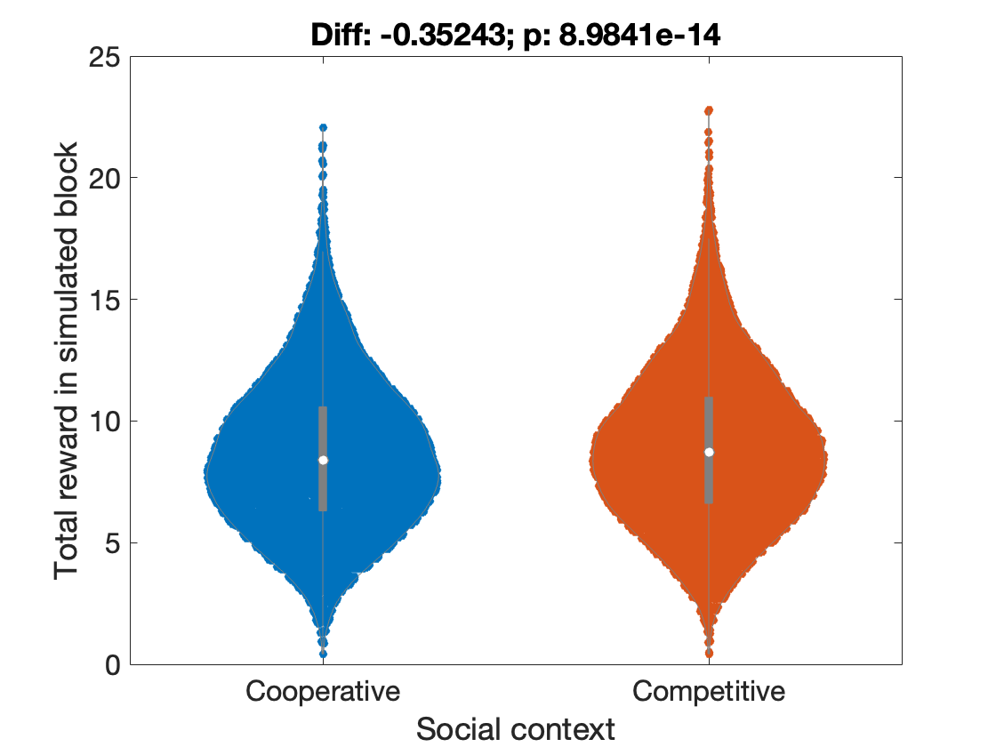
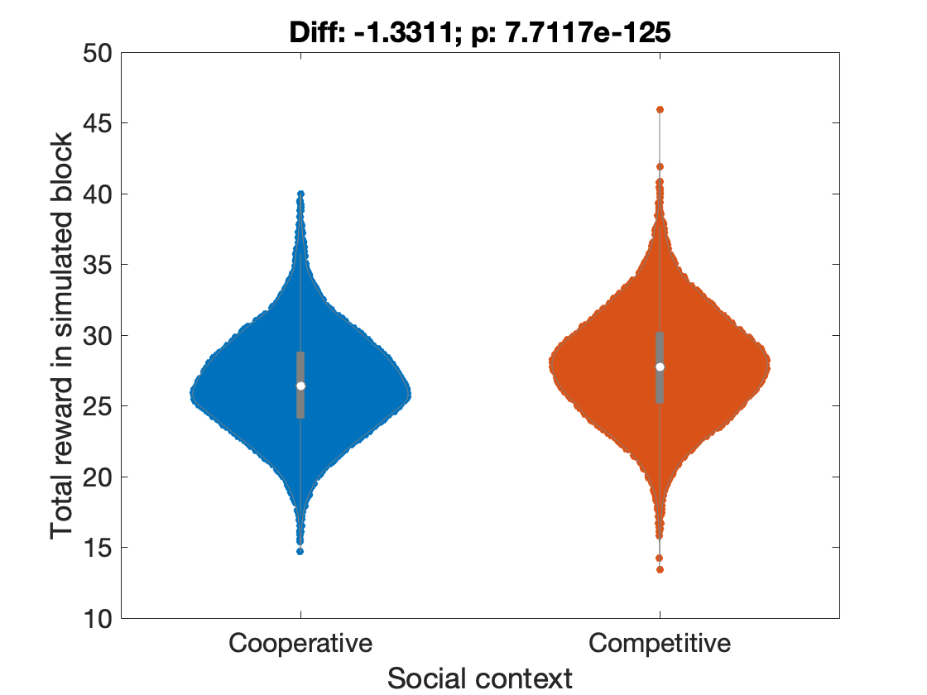
Random subject
Tracking subject
N = 1e4
N = 1e4
N = 1e4
N = 1e4
Small but significant difference between social condition for random and tracking players

