Slide 1
Team Foundation Server
Created by Lesya Klakovych

Slide 2
Agenda
TFS 2013
Application Lifecycle Management with Visual Studio TFS
Work in Team Web Access and Team Explorer
Team Foundation Version Control
Terminology and scenarios
TFVC in work
References

Slide 3
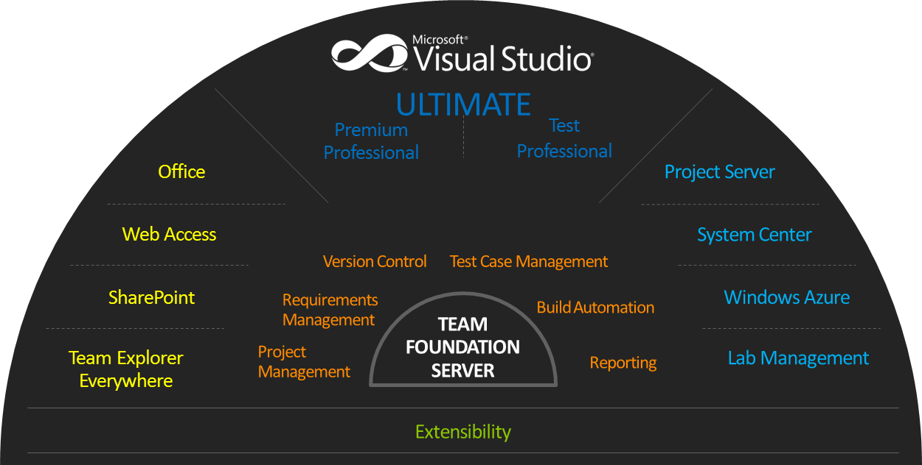
Team Foundation Server

Slide 4
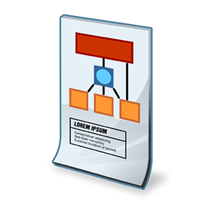


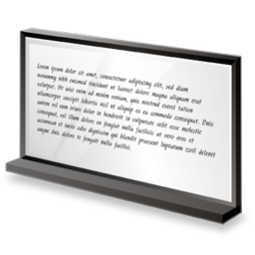

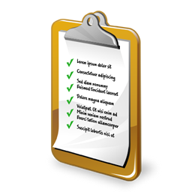



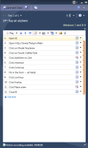

Application Lifecycle Management with Visual Studio TFS
Tasks
Check-in
User Stories
Business
Analyst
Developer
Team Build
Tests
Bug
Build
Tester

Slide 5





Application Lifecycle Management with Visual Studio TFS
 | Set up: Set up TFS, create a team project, and add team member accounts.
 | Code: Share and build your code using Team Foundation version control (TFVC) or Git.
 | Work: Plan projects, track work, collaborate as a team, and report progress.
 | Build: Set up your on-premises build server and define your build processes.
 | Test: Test your application.
Notes:
http://msdn.microsoft.com/en-us/library/fda2bad5.aspx

Slide 6
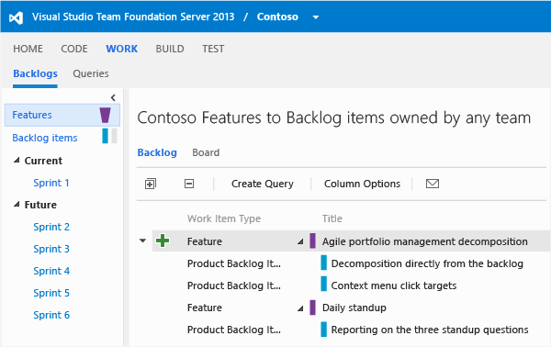
Work in Team Web Access
Planning and tracking the progress of your software development project is simple when you use Team Web Access (TWA).
Launch TWA from a connected project in Visual Studio or from a supported web browser using the following URL:
http:// ServerName :8080/tfs/ CollectionName/ProjectName
You can manage source code, work items, builds, and test efforts here

Slide 7
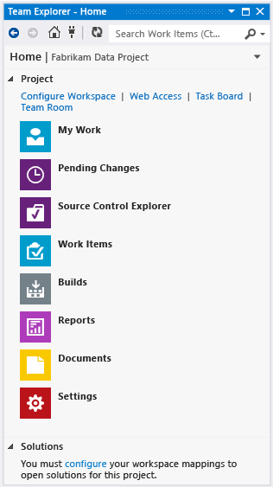
Work in Team Explorer
Team Explorer is used to manage work that is assigned to you, your team, or your team projects, and to coordinate your efforts with other team members to develop a project.
Team Explorer is a plug-in that installs with Visual Studio or Eclipse.
Developers and stakeholders working from different platforms can collaborate effectively using Team Explorer connected to team projects hosted on Visual Studio Online or an on-premises Visual Studio Team Foundation Server (TFS).

Slide 8
Team Foundation Version Control
TFVC is a centralized version control system
TFVC enables two models for your team to make changes:
Server workspaces: Before making changes, team members publicly check out files. Most operations require developers to be connected to the server.
Local workspaces: Each team member takes a copy of the latest version of the codebase with them and works offline as needed. Developers check in their changes and resolve conflicts as necessary.
Notes:
http://msdn.microsoft.com/en-us/library/ms181237.aspx

Slide 9
TFVC: Terminology
Workspaces
Area on local disk where you edit files
Check in / check out
Check out marks the beginning of your edits
Check in commits your changes to the repository
TFS allows shared check out
Changesets
Group of changes that happen when you check in
It works similarly as Label
Shelving
Similar to check in
Changes get stored on the server
Not visible as part of the main project source tree
For the purpose of Park your changes & go ahead
Branching
Used to manage multiple versions of a product
Helps in Release Process (Bug Fixes, Developing new features, Service Packs)

Slide 10
What should go into source control?
Solution files -- *.sln
Project files -- *.csproj, *.vbproj
Source Control Project Metadata (*.vspscc)
Project bindings
Source control configuration
Application config files (*.config)
Source files
Project Binaries dependency references (e.g. Third Party dlls, Components)

Slide 11
What should not go in source control?
Solution user option files (*.suo)
Local user customizations
Project user option files (*.user)
Local user customizations
WebInfo files (*.webinfo)
Build outputs
/bin/debug
/bin/release
/obj

Slide 12







Scenarios
Shelving
Set aside pending changes without checkin
Optionally revert to unmodified files
Restore shelved changes by “unshelving”
Unshelve other user’s changes
Power of task branching with less overhead
Switch Tasks
Backup
Work-In-Progress
Checkpoint
Work-In-Progress
Developer
Share
Work-In-Progress
Perform a Code Review

Slide 13
Branching Scenarios
No Branching
Everyone works from the same code
Branch for Release
Stabilization in order to prepare for a release
Branch for Maintenance
Maintenance of a previous build/release
Service pack development
Branch for Feature
Branch from the Trunk to develop a new feature (such as a new module in isolation)
Merge back into the Trunk when feature is done
Branch for Multiple Teams
Branches for multiple teams working on a set of features

Slide 14
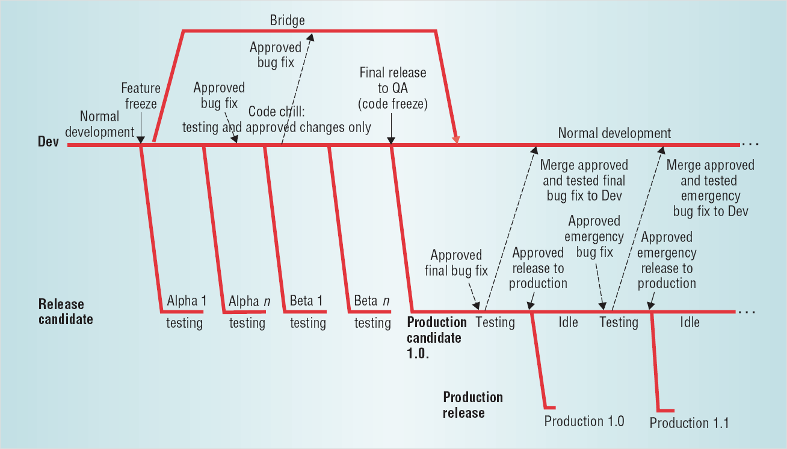
Branching and Merging
Source: http://downloads.seapine.com/pub/papers/SCMBranchingModels.pdf

Slide 15
TFVC in work
1) Add TFS to the list of recognized servers 2) Set up Team Foundation Version Control on your dev machine
3) Add your code to version control
4) Work in Solution Explorer
5) Review personal backlog and prepare tasks to begin work
6) Check in the changes
7) Resolve conflicts
8) Merge changes in merge tool
9) Compare and edit a file in your workspace with a file on the server in Diff window 10) Manage Changesets
11) Request and provide code review

Slide 16
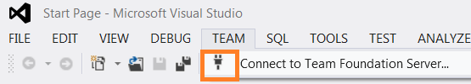
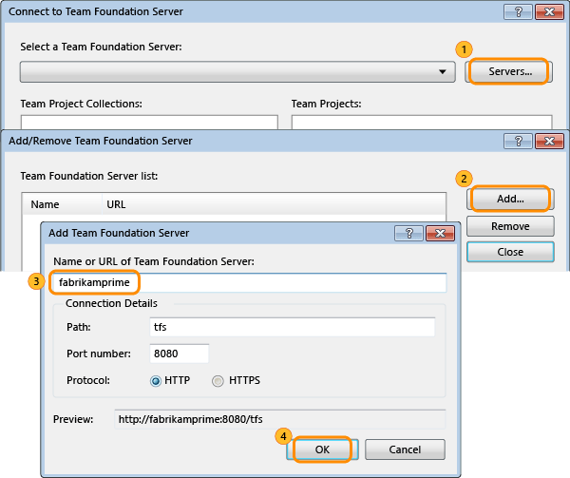
1) Add TFS to the list of recognized servers

Slide 17
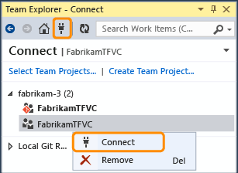
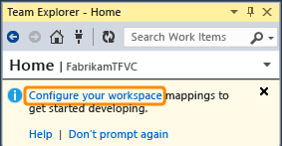
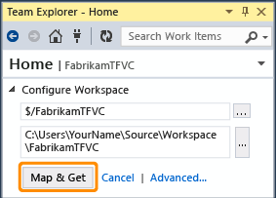
2) Set up Team Foundation Version Control on your dev machine
Connect to the team project
To set up TFVC on your dev machine, you just need to create a workspace and then add your code.
Map the team project to a folder on your dev machine.
Map the workspace and get your code.

Slide 18
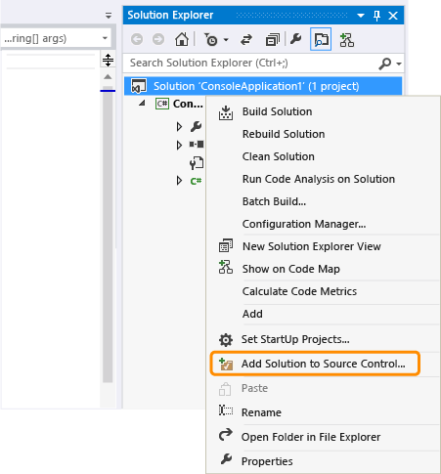
3) Add your code to version control
Put an existing solution under version control
Move your solution into your workspace folder (for example: c:\Users\YourName\Source\Workspaces\YourTeamProject\Main\
Or add your solution to source control
After that - check in your changes (Keyboard: Ctrl + 0,P)

Slide 19
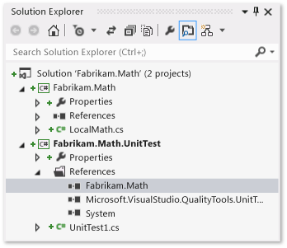
4) Work in Solution Explorer
After opening solution, open the solution explorer
When you open and modify a file from the solution explorer,
the file is automatically checked out for you.
Icons appear to indicate:
files you have not changed
files you have checked out
files you have added to the
solution

Slide 20
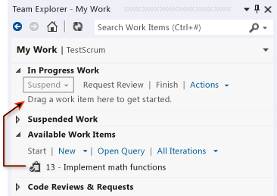
5) Review personal backlog and prepare tasks to begin work
You can use My Work to:
Track your work against work items
Suspend and later resume your work (including file changes, associated work items, and Visual Studio state such as window positions and breakpoints)
Request a code review

Slide 21
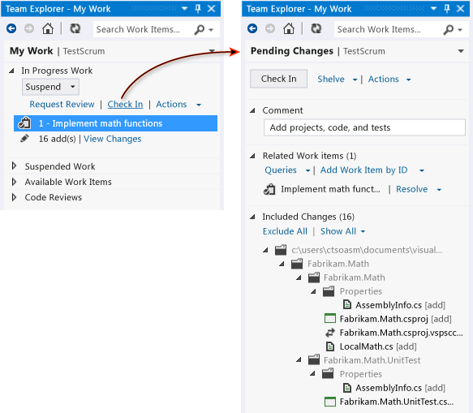
6) Check in the changes
Review the contents of the Pending Changes page to make sure that:
All relevant changes are listed in Included Changes
All relevant work items are listed in Related Work Items.
Specify a Comment to help your team understand the purpose of these changes
Choose Check In.
Notes:
http://msdn.microsoft.com/en-us/library/vstudio/bb385990.aspx

Slide 22
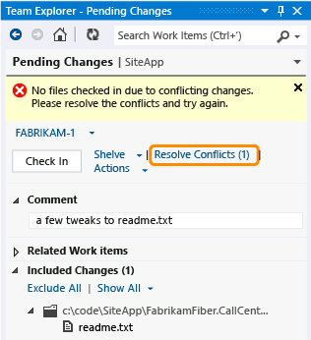
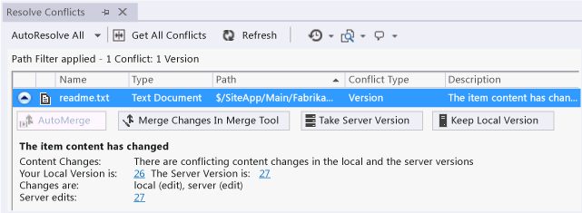
7) Resolve conflicts
Use the Resolve Conflicts window to resolve conflicts that are blocking you.
Notes:
http://msdn.microsoft.com/en-us/library/vstudio/ms181432.aspx

Slide 23
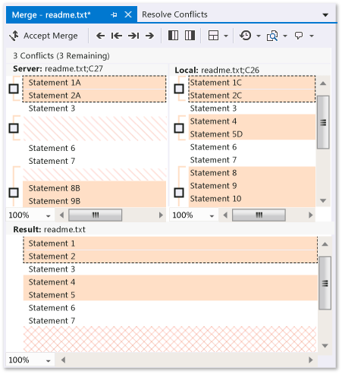
8) Merge changes in merge tool
When a conflict is caused by conflicting content changes - use Merge Changes in Merge Tool.
The outcome of your work to resolve the conflict is shown in the Results pane.

Slide 24
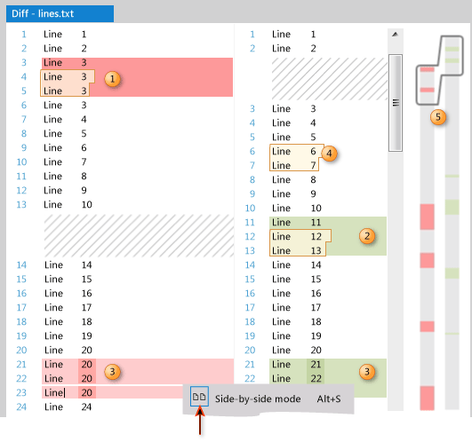
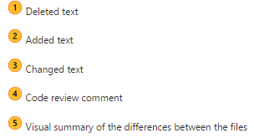
9) Compare and edit a file in your workspace with a file on the server in Diff window
On the Pending Changes page, locate the file. In the shortcut menu for this file:
Choose Compare with Workspace Version to see what changes you have made to the version you checked out.
Choose Compare with Latest Version to see how the changes you have made compare to the latest version of the file on your TFS.
The Diff window appears. You can continue to make changes to the file in this window.

Slide 25
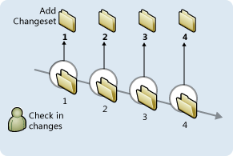
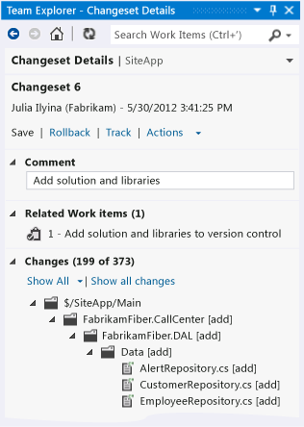
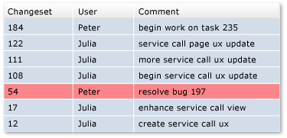
10) Manage Changesets
When you check in your changes, they are stored on the server as a changeset.
Changesets contain the history of each item in version control.
View details for changesets from the History window
Roll back changesets

Slide 26
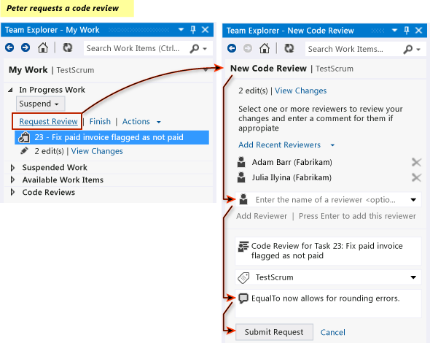
11) Request and provide code review

Slide 27
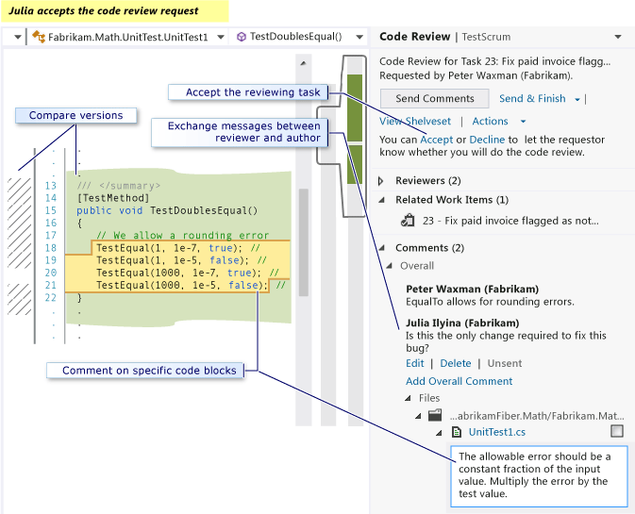
11) Request and provide code review

Slide 28
References: Compilation – Automating & Debugging Builds
Run, monitor and manage builds using an enhanced interface
Run, Monitor, and Manage Builds
Define gated check-in build processes that support multiple check-ins
Define a Gated Check-In Build Process to Validate Changes.
Run native and third-party framework unit tests in your build process
Run Tests in Your Build Process.
Debug your build process more easily
View diagnostic logs from within the build results window.
Find duplicate code
Finding Duplicate Code by using Code Clone Detection.

Slide 29
References: Team Work- Effective Development & Collaboration
Track tasks and boost productivity using an enhanced interface
Organize upcoming, on-going and suspended work while increasing transparency and reducing the impact of interruptions. Day in the Life of an ALM Developer: Write New Code for a User Story.
Work more efficiently in a version-controlled codebase
Organize your work, reduce the impact of interruptions and manage shelvesets and changesets. Develop Your App in a Version-Controlled Codebase.
Initiate and Track Code Review Requests and Responses
Day in the Life of an ALM Developer: Suspend Work, Fix a Bug, and Conduct a Code Review.
Perform unit testing by using as part of your workflow
Running Unit Tests with Test Explorer.
Work offline
Work in local workspaces either inside or outside of Visual Studio. Decide Between Using a Local or a Server Workspace.

