Slide 1


Slide 2
How to Clean Data with
SQL, Python, and R
Presented by Sam Howard, Abhishek Roy & Brianna Noland

Slide 3


Slide 4
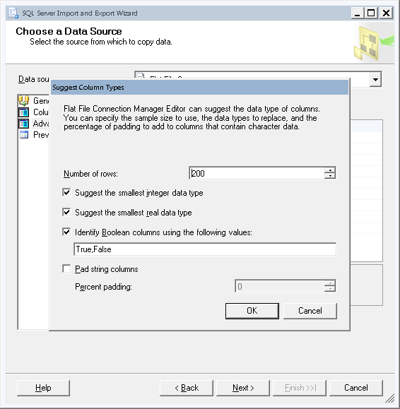
SQL Import Wizard
Helps with a lot of initial cleaning
Use as many rows as possible/viable

Slide 5
Strengths / Weaknesses
Easy to view data
Prebuilt functions allow replication over server
Lacks flexibility
You might not always have control

Slide 6
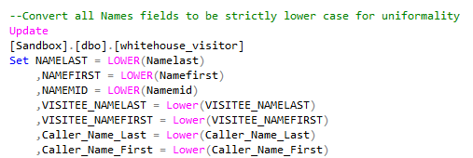
Case Conversion
Often no system impact
Readability

Slide 7
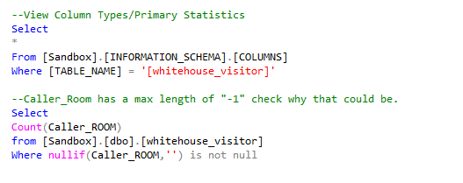
Use Schema for discovery
Data types
Column length

Slide 8
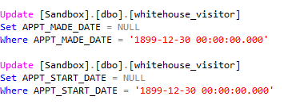
Be careful of “Base Dates”
Looks like date
Varies by platform
Useless data

Slide 9
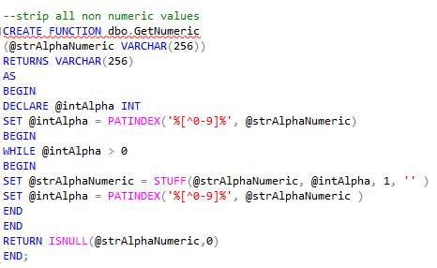
Functions
Removing all non numerics from a field
Phone numbers, weights, etc

Slide 10
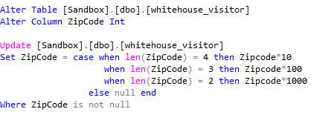
Int vs String
Adding trailing zeros to an int requires multiplication
Adding leading zeroes requires conversion

Slide 11


Slide 12
More power to the “pandas”
Start with looking at a high level data structure
Review the structure of the data
What are the different data types
Mix of numeric and characters
Do we need to convert character to numeric or vice versa
View the underlying data in each column to see the distribution and levels of data
In case of categorical variables check for levels which do not make sense and need to be combined or removed
In case of numeric or continuous variables check for outliers

Slide 13


Slide 14
A “Pretty Good” Process
Look at a sample of data
Ensure text is in standard format
Check for any obvious issues
Review data types of columns
Determine if any need to be changed (i.e. strings to factors, dates, etc)
View a summary of the data
Check for and drop empty columns and those with all NAs, or review of data types that should be changed
Check for outliers
Plot and remove or correct as appropriate
Check for missing values
Remove or correct as appropriate

Slide 15

Questions?

