Slide 1

Deep Learning
Jan 26 2018
Notes:
We will start the session with talking about what deep learning is and then right away jump into building our first artificial neural network. After that we would get into the meat of how deep learning works, we will talk very high level theory so that we are comfortable applying deep learning techniques

Slide 2
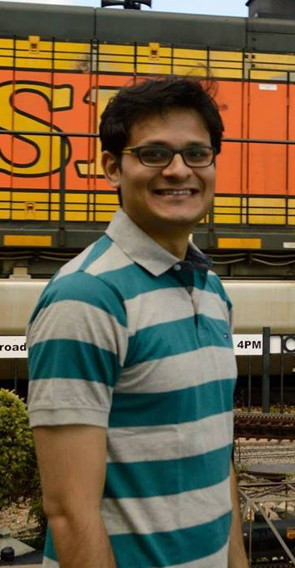


About Me
Advanced Analytics Consultant , Slalom
Co-Founder of Social Data Science
Crowd-sourced Data Science for Nonprofits
https://www.linkedin.com/in/abhishekkroy
https://github.com/nonchalantroy
@AbhishhekRoy

Slide 3
Introduction to Deep Learning
What is Deep Learning?
Involves stacking little algorithms called artificial neurons to solve problems.
Various Examples – Machine Vision – Biology Example- NLP – Voice Recognition
Notes:
Vision began – 543 m years ago
Once trilobites had vision – they could see at a distance, they could see mates, they could see food, they could see predators.
Hubel – Wisel – Cat Visual System – Single neurons in the primary visual cortex that gets the first signals from the eyes.
How vision works in mammals brain – Primary visual cortex receiving signal from our eyes do very simple computation, just detecting the orientation of edges. They in turn pass information up to later centers in the brain where those edges are combined into slightly complex features like corners. Then in turn it sends information to other neurons which processes information like table, chair, faces etc.
So this is the architecture with layers that can identify complex representation hierarchically.
Artificial neural networks that can learn from data

Slide 4
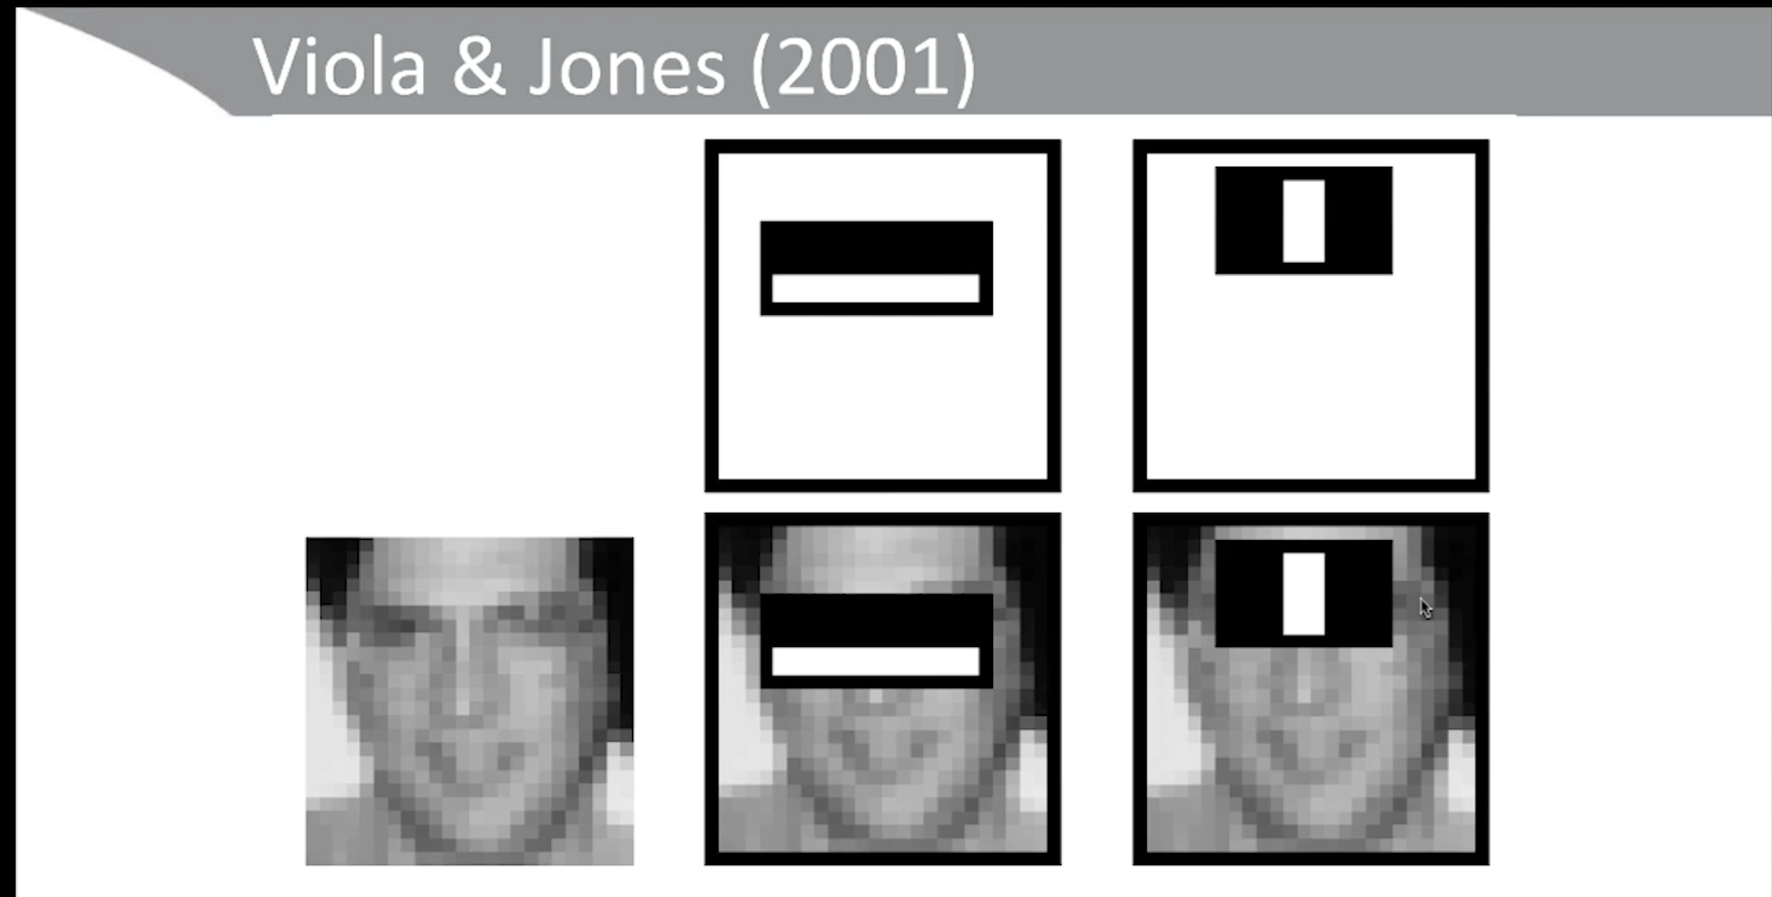
Notes:
This approach of feature engineering was commercialized by digital cameras which would recognize faces and automatically focus on them.
You spend a vast majority of time engineering features in machine learning as opposed to building the statistical models using those engineered features is best exemplified from paper from Viola and Jones – Identify pictures using rectangular images and then use them to find change in contrast of images.

Slide 5
Machine Learning vs. Deep Learning
Feature Engineering
Model Building
Machine Learning
Feature Engineering
Model Building
Deep Learning
Notes:
In deep learning we use stacked ANN to do feature engineering for us and we spend more time on model building.They made inroads into voice recognition, image recognition, machine vision, machine translation
AI – Tasks that could be easily described formally – like a game of checkers or chess = Board, how pieces move, config. of how game terminates – created as representations
Then came machine learning – where humans collect and identify features and then a machine learning algorithm can learn how to infer whether the patient has disease or not.
But we human beings learn concepts from raw data. For instance we can learn by looking at a few examples of how a boat looks like and even process half of the information to identify an object. Match one to one.
The word deep in deep learning refers to the idea of learning the hierarchy of concepts directly from raw data.
Deep Learning – Representation Learning – Automated Feature Engineering

Slide 6
Factors that make Deep Learning Different
Less work on pre processed abstractions – Deep learning algorithms can learn from
the data instead of relying on very clean processed and feature rich data set. Deep learning
algorithms can work directly on pixel data – no preprocessing required.
Design of a network topology – Instead of working on feature engineering, data scientists have
To try different combinations of layers, parameters to get to the answer. You can also take the
Brute force approach by running large compute clusters.
High computation power needed – Deep Learning training process requires thousand core GPUs
to perform billions of math vector operations.
Interpretability remains an issue -
High level neural network libraries – Caffe, Deeplearning4j,MXNet, Tensorflow and Theano.
Notes:
At highest conceptual level deep learning is no different from supervised machine learning

Slide 7
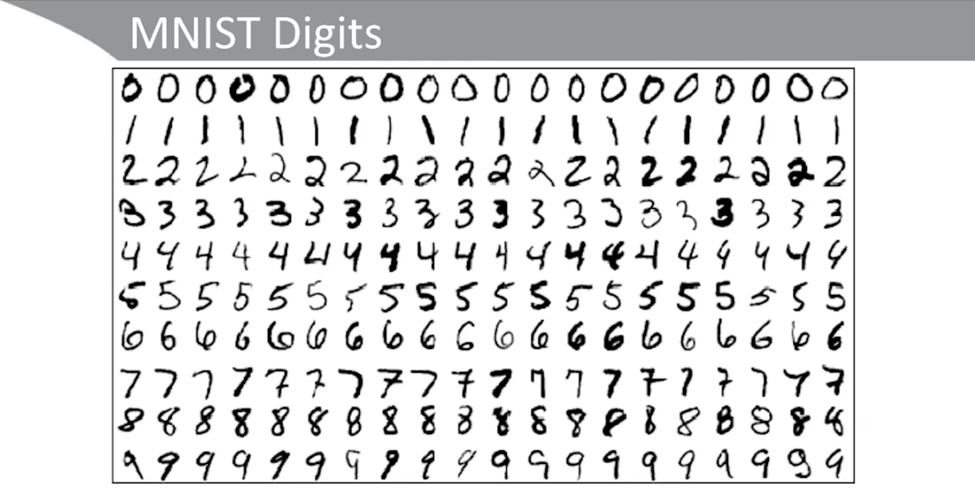

Slide 8
Classic Machine Vision Problem- MNIST Digits
5
60k digits to train on
10k digits to test on
Handwritten by US Census bureau and students
Used for a study to read zip codes on mailing envelopers
Square image – 28 * 28 = 784 pixels
Notes:
Zeros represent the white areas and the other area says darkness.
Convert them into one dimensional array by flattening them and then recode the darkness from 0:255 to 0:1(single point precision float numbers)
Post that we would do one hot encoding for the ten different digits
This is a sequential model because each neural network feeds into one another.
Dense hidden Parameters = 784 * 64 + 64
Dense output Parameters = 64 * 10 + 10
SGD – stochastic gradient descent
Lr – learning rate
One run over the data is an epoch
By chance the success rate could be 10%
So we have to train the model for longer and as it runs the neural network gets the data again, each time it gets better and better from 10% to 34%. This means that this network is slowly learning to identify the handwritten digits
Lets now run with 200 epochs.

Slide 9
Our first Shallow Neural Network
0
1
2
3
4
783
Input Layer
. . . .
Hidden Layer - 64 neurons
0
1
2
9
Output Layer
. . .
Notes:
Keras – high level library for doing this work
We will flatten the image - into an array of 783 pixels for each image.
The neural network we would build will have 784 inputs – This will be the input layer
Hidden Layer – Dense or Fully connected hidden layer – all the neurons in the hidden layer are connected to all the neurons above and all the neurons below the layer.Any given layer is connected to all the 784 neurons of input layer and is outputting to all the 10 neurons in the output layer. There is an optimal numbers for any given problem. We will have 64 neurons in our hidden layer.
The higher level neurons can create more complex and non linear abstractions than the lower level neurons.
Stochastic Gradient Descent

Slide 10
Convolutional Networks - ConvNets
Machine Vision
Used in object recognition of self driving cars
Face recognition in facebook
More efficient, have much better accuracy

Slide 11
Recurrent Neural Networks - RNNs
Used with data that come in sequence
NLP
Financial and econometric data

Slide 12
Deep Reinforcement Learning
It is given feedback on its performance
Google Deep Minds Network – Defeated the champion of the board game GO

Slide 13
Generative Adversarial Network(GANs)
Adept at creating complex images sufficiently realistic that you can think only a human can create it.

Slide 14
Essential Theory – Neural Units
Axon
0/1
Cell
0/1
0/1
Dendrites
0/1
Biological Neuron
Artificial Neuron-Perceptron
Notes:
Changes in the charge of the body of the neuron or dendrites over a certain threshold fires up the Axon which carries that information away from the cell.
Artificial neuron have binary inputs(0 or 1) and binary output(0 or 1) and each input can have different weights in deciding the output. After that I set a threshold for the output to fire.
Summation(wi,xi) >= threshold
Once we start having more layers, we will have more abstraction. First layer would look for edges, then shapes and then faces or house etc.

Slide 15
Neural Units
X1
X2
Y
1
X3
1st
2nd
3rd
4th
0
Abstraction
Sig(w.x+b) = z
Notes:
A unit is the basic building block of the neural network.
Units are organized in layers, with each layer containing one or more units. The last layer is referred as the output layer and in between layers are called hidden layers.
Once we start having more layers, we will have more abstraction. First layer would look for edges, then shapes and then faces or house etc. More than 2 layers are called deep networks.
Microsoft Research Asia has more than 1000 layers. For simple tasks we wont need more than 12 layers.
Binary outputs makes it difficult to fix issues in the network because even a tiny change can fire up that threshold. This is where we should ideally have away to get a gradual change instead of an abrupt jump.
That is why we use the sigmoid function(an example of an activation function), Sig(w.x+b) = z
They can take any value from zero to one so we can learn more slowly and gradually. So we can make small changes in the network without worrying about the abrupt changes in the output.

Slide 16
Activation Functions
Types of neurons or in deep learning parlance, activation functions –
Perceptron
Sigmoid – 1/1+ e^-x – value from 0 to 1
Tanh – similar to sigmoid but have value -1 to 1 - = tanh(wx+b)
Relu – rectified linear unit – does not input value below zero but has no maximum – max(0,wx+b) – most efficient. More commonly used as a hidden unit in recent times because it leads to large and consistent gradients and is useful in gradient based learnings
Notes:
When an activation function is non linear, a two layer neural network can approximate any function
Continuously differentiable function allows for gradients to be computed and gradient based methods be used for finding the parameters that minimize
our loss function over the data.
A function whose range is finite leads to more stable performance.
Are symmetric around the origin and behave like identify functions near the origin (f(x) = x)

Slide 17
Machine Learning vs. Deep Learning
Feature Engineering
Model Building
Machine Learning
Feature Engineering
Model Building
Deep Learning
Notes:
You spend a vast majority of time engineering features in machine learning as opposed to building the statistical models using those engineered features is best exemplified from paper from Viola and Jones – Identify pictures using rectangular images and then use them to find change in contrast of images.
In deep learning we use stacked ANN to do feature engineering for us and we spend more time on model building.They made inroads into voice recognition, image recognition, machine vision, machine translation
AI – Tasks that could be easily described formally – like a game of checkers or chess = Board, how pieces move, config. of how game terminates – created as representations
Then came machine learning – where humans collect and identify features and then a machine learning algorithm can learn how to infer whether the patient has disease or not.
But we human beings learn concepts from raw data. For instance we can learn by looking at a few examples of how a boat looks like and even process half of the information to identify an object. Match one to one.
The word deep in deep learning refers to the idea of learning the hierarchy of concepts directly from raw data.
Deep Learning – Representation Learning – Automated Feature Engineering

Slide 18
Cost Functions
Quantify output we are getting from a neuron to what we want from a neuron
Quadratic Cost Function = C = summation(y-a)^2/n – Also known as MSE – Learning
Happens very slowly so with a lot of neurons it becomes too slow for the network to learn
Cross Entropy – Higher the difference, faster it learns when we take a derivative of this cross entropy value. Two types –
Binary Cross Entropy
Notes:
Quantify when our neurons are wrong. Also known as loss function

Slide 19
Gradient Descent and Back Propagation
C
0
P(weight or bias between neurons)
Notes:
Keep lowering the p until the Cost is really low.
Gradient Descent – the way to minimise the cost function, if you make the learning rate too large you might miss the minimum
Back propagation – leverages chain rule to have gradient descent pass through the entire neural network. The error back propagates through the network and then tries through the new samples until the costs become too small and we start giving right prediction.

Slide 20
Output Layer(Softmax)
Takes any weighting of confidence and gives us back a probability score
exp(yi)/ sigma(y1..yi)
Notes:
We started the lesson by building a very basic neural network and since then we have learned quite a bit about how neural network works
Softmax layer – Typically used as an output layer for multi classification tasks in conjunction with the Cross Entropy Loss function. It normalizes the output of previous layer so
That they sum up to one.

Slide 21
Lets recap what we have learned so far
We have figured out how to do calculations within the neuron
We pass “z” through an activation function
Different types of layers
More the number of layers, higher the abstraction
Inorder to learn, we need to know how wrong we are, so we use cost/loss function
To minimize the cost function, we use gradient descent
We use backpropagation to back propagate our gradient descent through the network
We learnt different layer types as well
Notes:
We started the lesson by building a very basic neural network and since then we have learned quite a bit about how neural network works
Softmax layer – Typically used as an output layer for multi classification tasks in conjunction with the Cross Entropy Loss function. It normalizes the output of previous layer so
That they sum up to one.

Slide 22
Initialization
The network eventually as it learns figures out what weights and biases should be used.
How to identify the right weights and biases for our network we should start with?
Notes:
Zeros?
Non zero values?
Uniform distribution
Normal distribution
Xavier Glorot - Uniform and Normal

Slide 23
Overfitting
Overfitting is an issue we will face a lot as we add more parameters in to our network.
So we need to have safeguard against that –
L1/L2 Regularization
Dropout
Expand
Notes:
L1/L2 Reg – Weight/kernel reg, bias reg, activity reg
Expand – rotate, expand, add noise image
There is no dropout during validation

Slide 24
More Layers
Max Pooling
Flatten
Convolutional
Notes:
Flatten is usually used when we move from a convolutional layer to a dense layer

Slide 25
Batch Normalization
No need to worry about initialization parameters
Has a regularizing effect
Avoid covariate shift and avoids saturation in the network

Slide 26
Lets work a little bit on our intermediate network now

Slide 27
Convolutional Neural Network
Any network that has a convolutional layer
Very similar to max pooling layer sliding over the surface
A convolutional neuron has a height,width and depth
It passes through the image at a speed we call stride length
These convolutional neurons/kernels/filters sliding over the image starts to represent a
Single type/aspect of the image(corner,angle,orientation etc.)
Convolutional layers lose the sense of location or are space invariant
Way more efficient than dense network(we need less parameters to learn than dense)

Slide 28
Lenet-5(Commercialized zip code reader)
Notes:
Developed by yann lecun and his team in 1998
Has a couple of convolutional layers that feed into a dense layer

Slide 29
Leading Deep Learning Libraries
 | Caffe | Torch | Theano | Tensorflow
language | Python, C++ | Lua | Python | Python,Java,C,Go
Pre-trained models | ModelZoo | ModelZoo | Lasagne | Inception, others
Parallel GPUs;data model | Yes | Yes Yes | Yes | Yes Yes
Source code | Readable | Readable
For RNNs |  |  | Good | Best
High level APIs |  |  | Keras | Keras, TFLearn

Slide 30
Improving Performance of a neural network
Get Above Chance Learning
Layers
Initialization
Cost
Avoid Overfitting
Learning Rate
Epochs
Regularization
Batch Size
Automation

Slide 31
Sources
Michael Nielsen’s Online Textbook – neuralnetworksanddeeplearning.com
Deeplearningbook.org

Slide 32
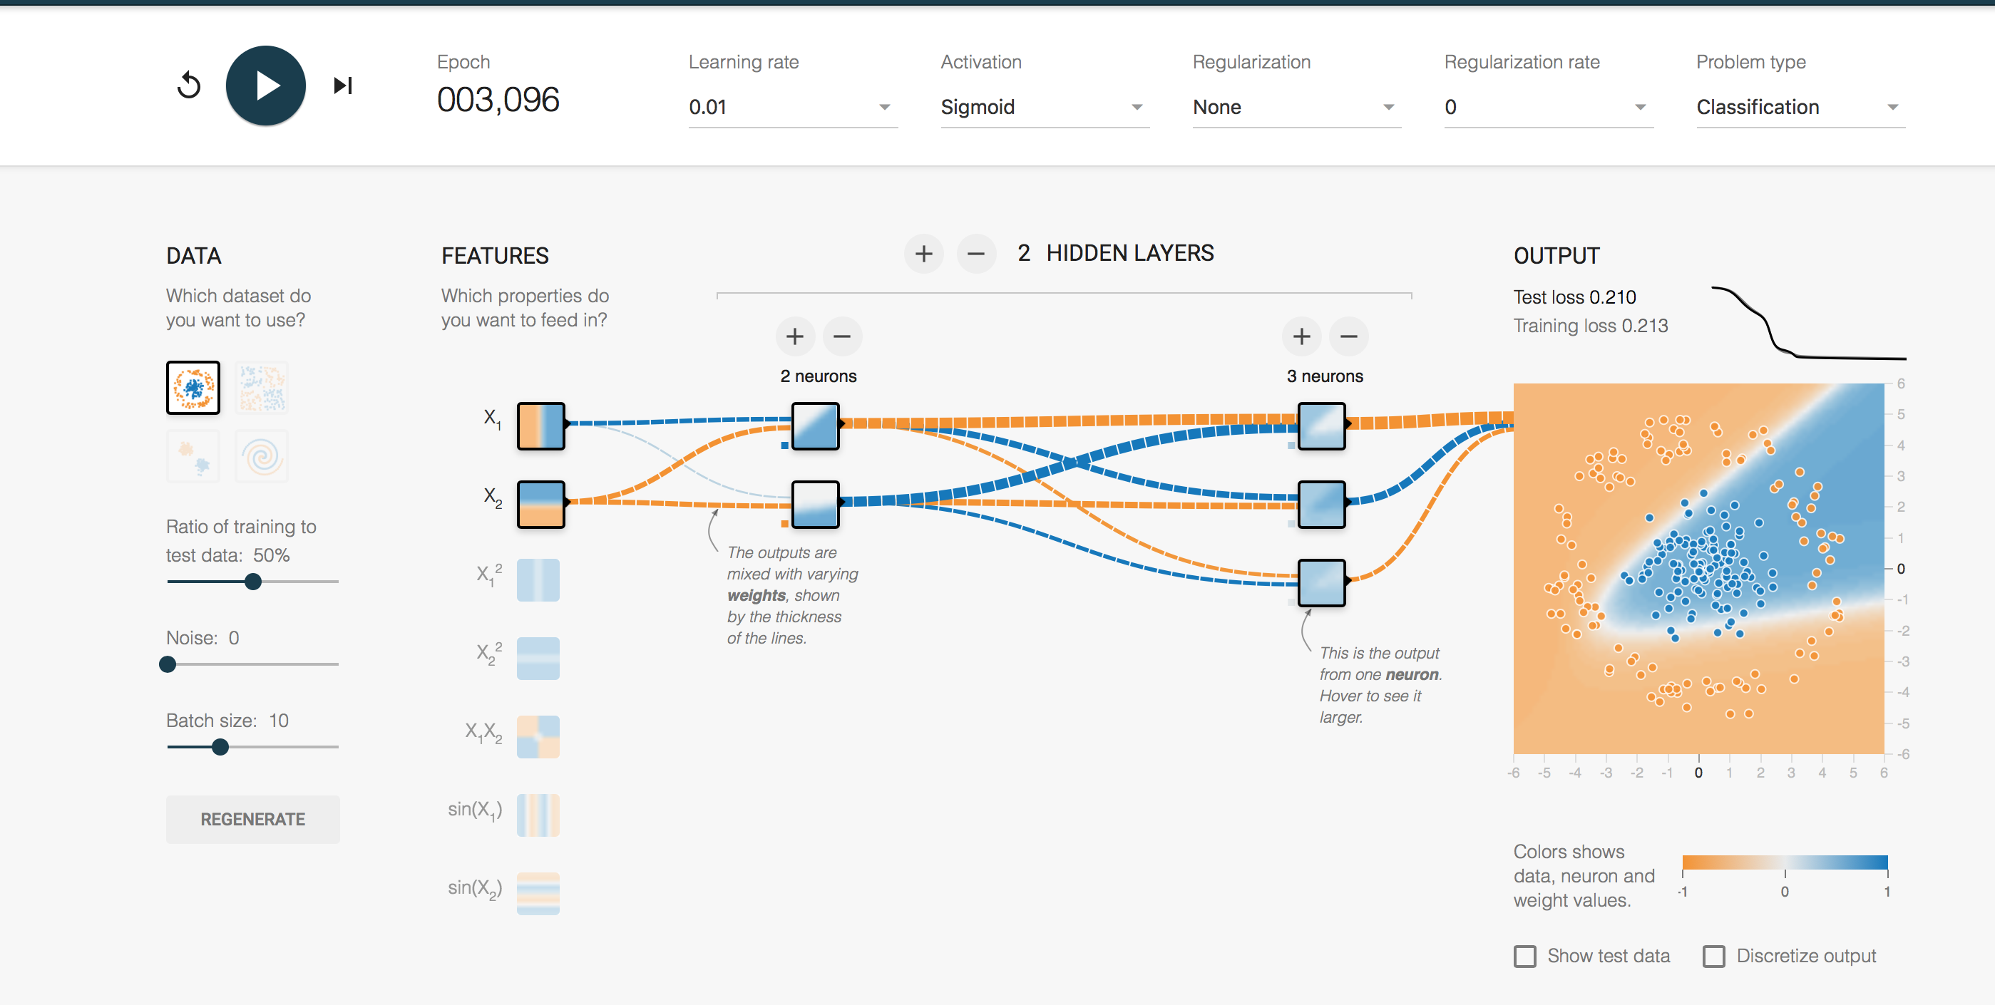
Tensorflow Playground
http://playground.tensorflow.org
Notes:
Keras is a (Batteries included) high-level neural network library that, among many other things, wraps an API similar to scikit-learn's around the Theano or TensorFlow backends.
Keras is a high-level neural network library created by François Chollet at Google.
Keras needs labels to be one hot encoded.
But Keras is a neural network library. As such, while the number of features/classes in your data provide constraints, you can determine all the other aspects of model structure: number of layers, size of layers, the nature of the connections between the layers, etc. (And if that didn't make sense, Keras is a great way to experiment with it!)
Training neural networks often involves the concept of "mini-batching", which means showing the network a subset of the data, adjusting the weights, and then showing it another subset of the data. When the network has seen all the data once, that's called an "epoch". Tuning the mini-batch/epoch strategy is a somewhat problem-specific issue, but in this case we'll just use a mini-batch of 1. That makes it effectively good old stochastic gradient descent, i.e. the data is shown to the network one flower at a time, and the weights adjusted immediately.
evaluate() returns the loss function and any other metrics we asked for when we compiled the model. In our case, we asked for accuracy
And it does hint at one of the dangers of neural networks: overfitting. We've been careful here to hold out a test set and measure performance with that, but it's a small set, and 99% accuracy seems awfully high to me, so I wouldn't be surprised if there was some overfitting going on. You could work on that by adding dropout (which is built into Keras). That's the neural network equivalent of the regularization our logistic regression classifier uses.

