Slide 1

February 6th, 2016

Slide 2

Agenda
Social Data Science Meetup Format
Future Data Sets of Interest
Ways to Get Involved With Social Data Science
Other Community Events
Appending Geolocation with Python
Accessing bridgethegap Github Repo
Small Group Mingle

Slide 3

MeetUp Format
Learn by Example
See a real example
Play with actual code & data
Small Group Mingle
Questions & Ideas
Networking
Scheduling
University of St Thomas
Monthly

Slide 4
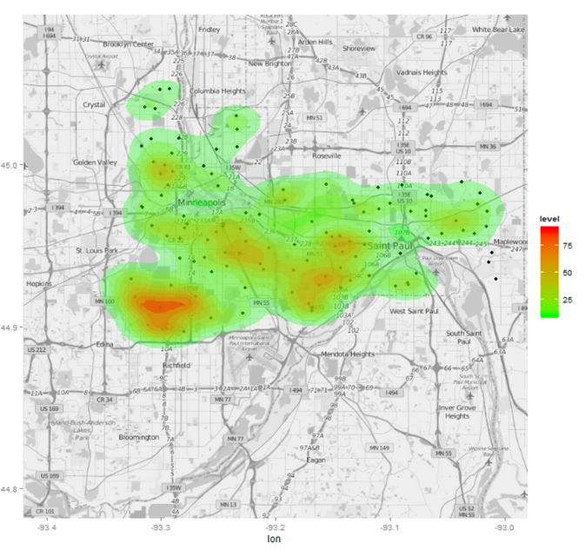
Future of Data
Minnesota Education Data
Continued Analysis
More Data Appends & Requests
More Data Cleansing
Open Data Up for Universities
University of St Thomas
University of Minnesota
University of Minnesota Duluth
Mankato State University

Slide 5

Future of Data
Minnesota Water Quality
Water Quality is a Public Concern
What Data is Available?
What Questions Can We Answer?
Possible Tie-in with IoT Fuse
Build a Data Collection Device
Collect Data
Analyze

Slide 6
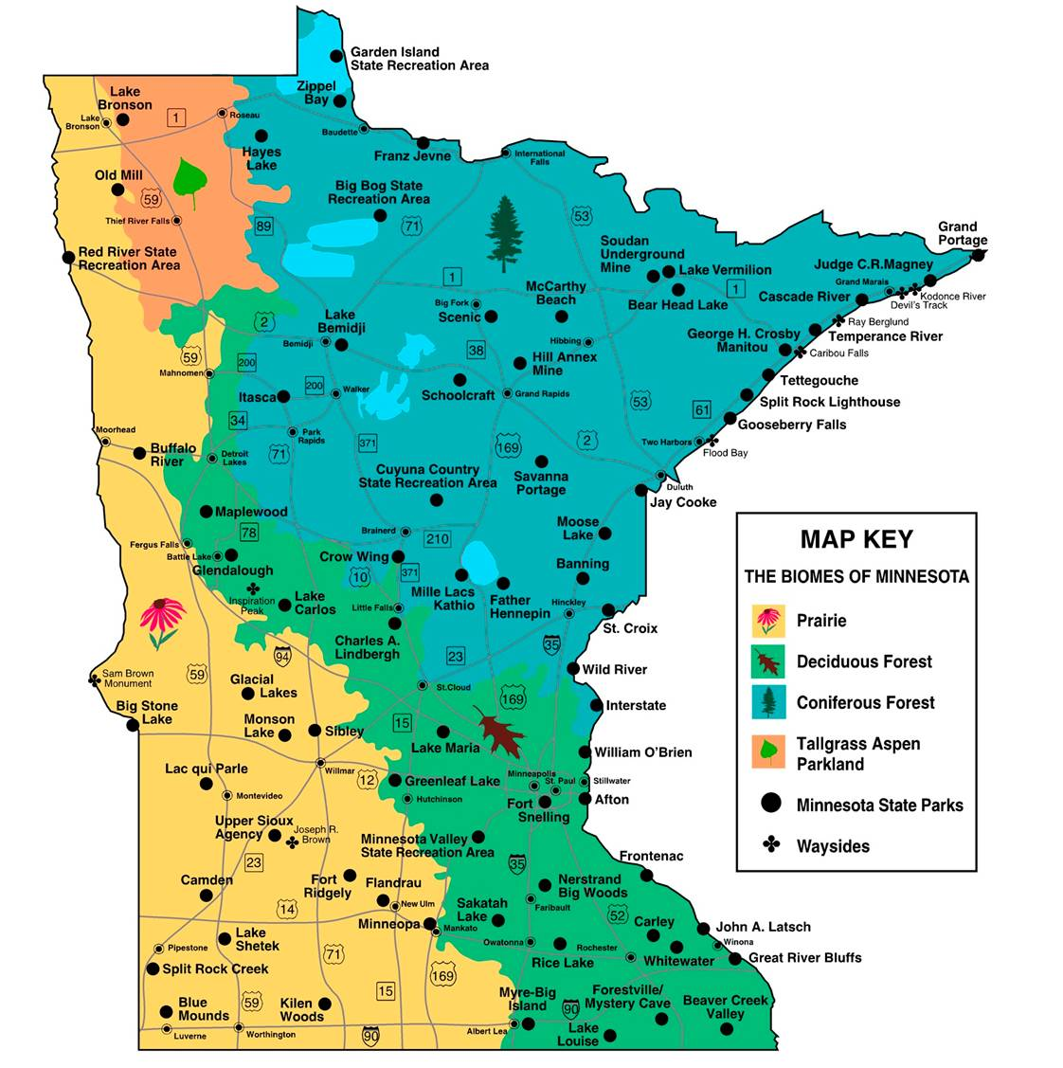
Future of Data
Minnesota Parks Data?
Twin Cities Public Transportation
Something Else?

Slide 7
Get Involved
Website Content
Make us professional!
Twitter Account Admin
Get us exposure!
Project Management
Help keep us organized!

Slide 8

Other Community Events
Open Twin Cities
“Community brings people together to solve problems using the tools of technology in the shared geography of the place in which we all live.”
http://www.hennepin.us/geocode

Slide 9
Other Community Events
Other conferences?
Contests?
Jobs?

Slide 10

Appending Geolocation
with
John Hogue | February 6th, 2016

Slide 11



About Me
Data Scientist at General Mills
Supporting Marketing
CoFounder of Social Data Science
Crowd-sourced Data Science for Nonprofits
https://www.linkedin.com/in/johnhogue
https://github.com/dreyco676
@dreyco676

Slide 12
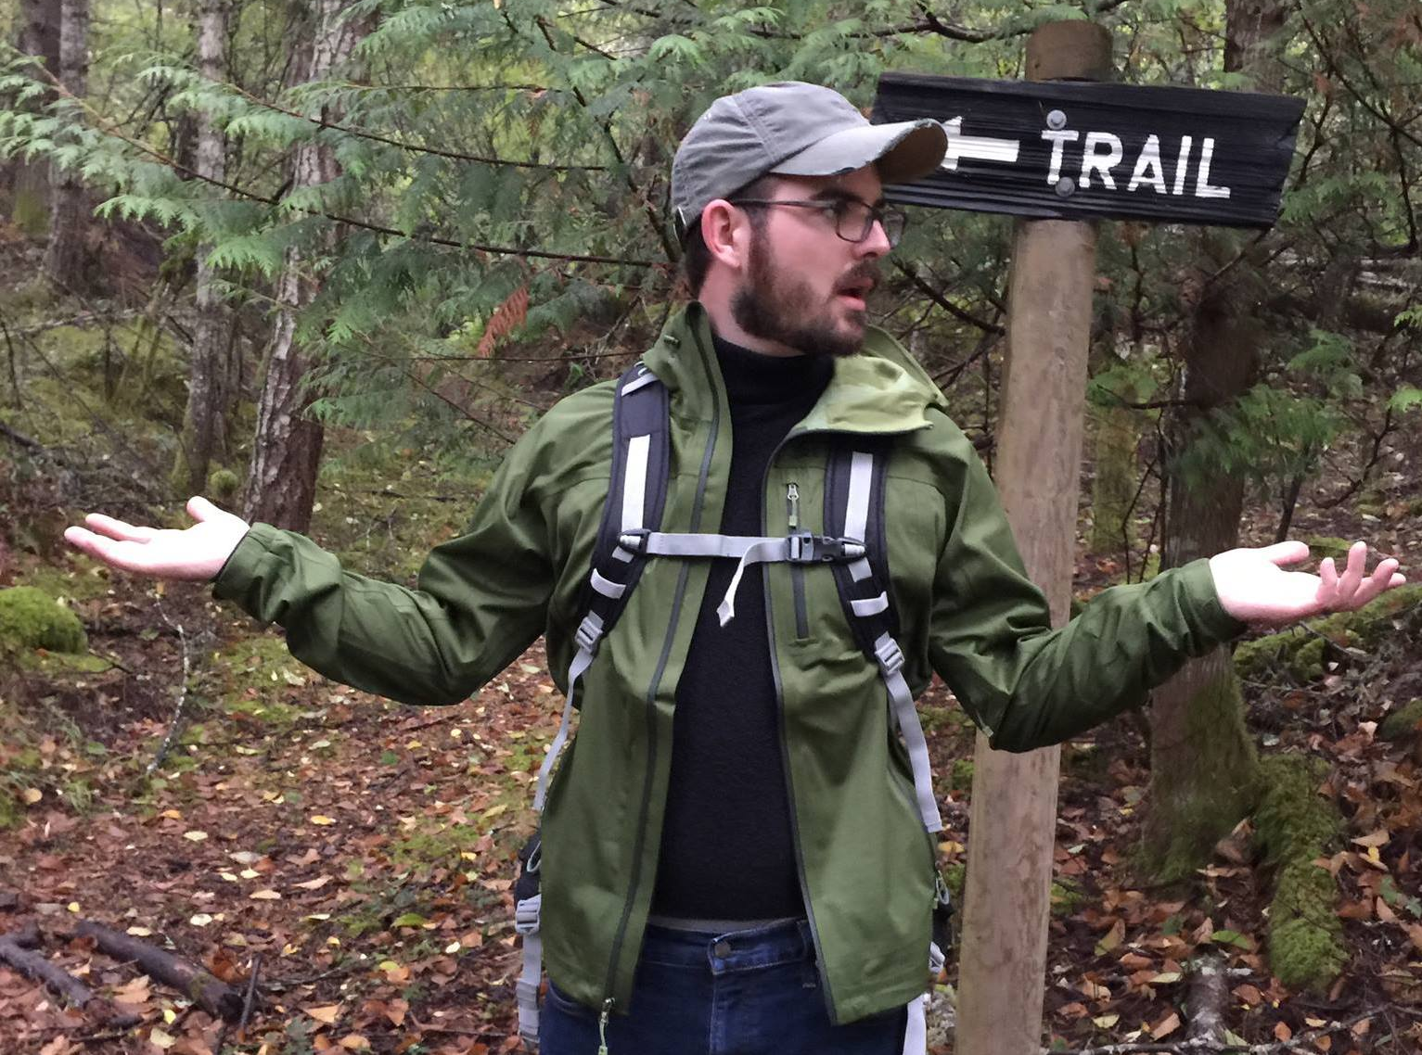
About Me (caveats)
Data Appends are only a part of my job
- Code written for readability
Not optimization
- I don’t know everything ☺
- But that’s ok

Slide 13
Agenda
- Why Append Data?
- Why Geolocation?
Python
Loading Data
Cleaning Data
Google Maps API
Parsing Addresses
- Where to go from here?
Minnesota
School
Example

Slide 14

Why Append Data?
+
=
Good
Good
Better?

Slide 15
Why Append Data
Break Data Silos
Don’t miss the big picture
Find Something Novel
So much data so little time!
Factor in additional variables
Create detailed, accurate insights
Better?

Slide 16


Slide 17
Why Geolocation?
Append Other Data
Census
American Community Survey
Crime Data
Etc
Understand Scale of Problem
Cluster
Heatmap
Create call to action!

Slide 18
Why Geolocation?
Append Other Data
Census
American Community Survey
Crime Data
Etc
Understand Scale of Problem
Cluster
Heatmap
Create call to action!

Slide 19
Where to go from here?
Build a Twitter bot!
Retweet only Data Science Posts
Apply feedback of favorites and retweets to the model
Apply to a different application
Classify your support tickets, etc

Slide 20
Where to go from here?
Give it a try yourself! https://github.com/dreyco676/nlp_spark
Need Spark 1.6 Installed
Need Anaconda 2.4.1 (Python 3.4)
NLTK & NLTK Data
Langid
Happy to answer questions & issues

