Slide 1


Demystifying Compiler Unstable Feature Usage and Impacts in the Rust Ecosystem
Chenghao Li^, Yifei Wu^, Wenbo Shen^, Zichen Zhao^, Rui Chang^, Chengwei Liu*, Yang Liu*, Kui Ren^
Zhejiang University^
Nanyang Technological University*
Accepted in ICSE’24
Presenter: Chenghao Li
Mail: loancold.zju.edu.cn

Slide 2
Quick Note
While people study Rust unstable codes and bugs, we decide to look at the compiler itself and the Rust ecosystem.
At most 44% of package versions in Rust ecosystem are affected by compiler unstable features, causing compiling failures for at most 12% of package versions.
We can recover up to 90% of the failure.

Slide 3




Motivation
---- Rust Programming Language
Many large and influential projects choose Rust for its unique design for security and performance.
Rust for Linux
Android
AWS Firecraker
(Virtualization, Serverless)
TiKV
(Key-Value Database)
Zero memory safety vulnerabilities
in Android’s Rust code. 2022
Google Online Security Blog: Memory Safe Languages in Android 13 (googleblog.com)

Slide 4
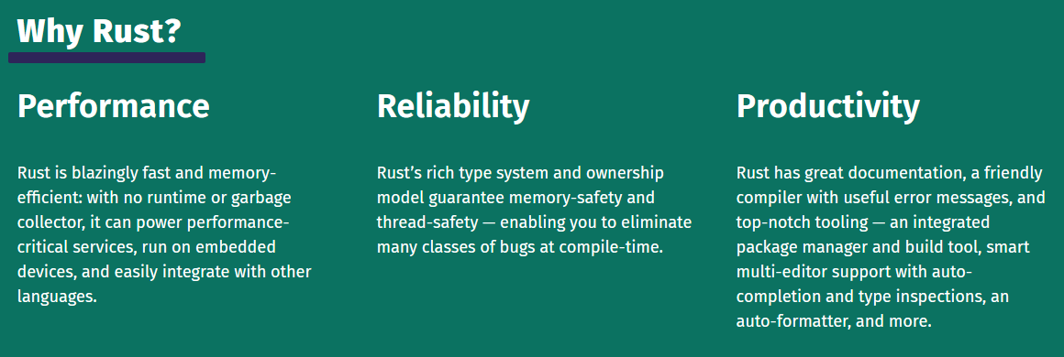



Motivation
---- Rust Programming Language
Rust Compiler
Rust Codes
Rust Binary
Compile-Time Check
Type Safety
Ownership
Is compiler reliable?
Source: Rust Programming Language (rust-lang.org)

Slide 5
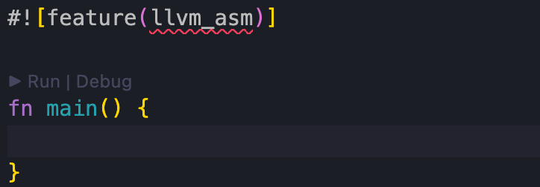
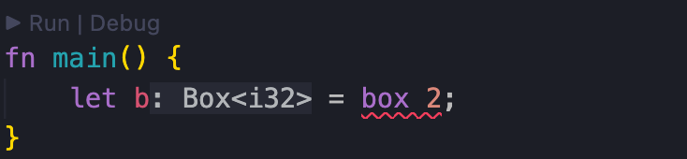
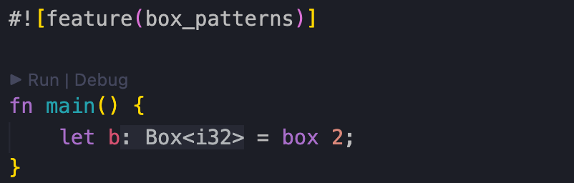
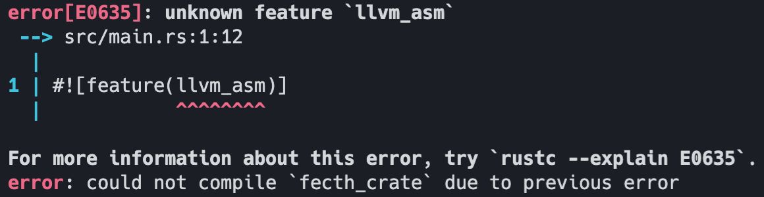
Motivation
---- Rust Unstable Features (RUF)
Rust Unstable Features (RUF) are proposed by the compiler to provide experimental compiler extensions for Rust developers.
Simple RUF Example
RUF may get removed.
All packages depending on the package using removed RUF will receive compilation failure.

Slide 6
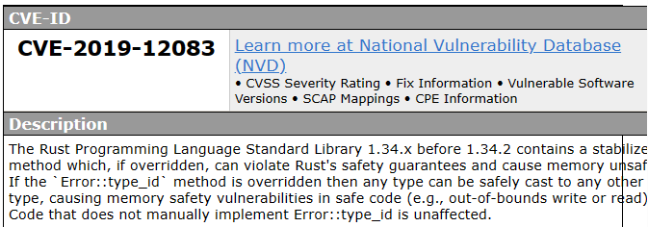
Motivation
---- Rust Unstable Features (RUF)
Bad things about RUF
Even worse: RUF can propagate through dependencies.
Compilation Failure. Removed RUF make packages fail to compile.
Unstable Functionality. ABI may change, functionality may change. It might work wrong…
Unstable Compiler Selection. RUF force developers to use nightly compilers rather than stable ones.
Compilation Failure Propagates. One fail, all fail.
Unstable Functionality Propagates. One unstable, all unstable.
Unstable Compiler Selection Propagates. One nightly, all nightly.
CVE caused by RUF
error_type_id
Tracking issue for stabilizing `Error::type_id` · Issue #60784 · rust-lang/rust (github.com)
CVE - CVE-2019-12083 (mitre.org)

Slide 7
Motivation
---- Research Questions
Bad things about RUF
Even worse: RUF can propagate through dependencies.
Compilation Failure. Removed RUF make packages fail to compile.
Unstable Functionality. ABI may change, functionality may change. It might work wrong…
Unstable Compiler Selection. RUF force developers to use nightly compilers rather than stable ones.
Compilation Failure Propagates. One fail, all fail.
Unstable Functionality Propagates. One unstable, all unstable.
Unstable Compiler Selection Propagates. One nightly, all nightly.
We want to answer research questions (RQ) about RUF.
How do packages use RUF and how are they impacted?
RQ2. RUF Usage
RQ3. RUF Impact
How do RUF evolve with time?
RQ1. RUF Lifetime

Slide 8
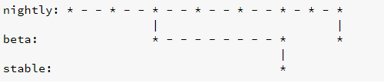
Nightly Rustc
“Enforced Nightly”: Unstable features can only be compiled in Nightly Rustc.
“Hard to fix”: Unstable features are code-level language features. If it breaks, the code breaks. “You should clear everywhere it appears, and fix it.”
Unstable feature is unstable. ABI may change, functionality may change. It might work wrong…
Rust has three types of compiler:
Nightly: Released every night.
Beta: Split Nightly in preparation for being Stable.
Stable
Unstable feature
"The stable releases are made every 6 weeks (with occasional point releases). Beta releases are the version that will appear in the next stable release. Nightly releases are made every night." -- The rustup book

Slide 9
Content List
Motivation
Design and Implementation
RUF Status Extraction
RUF Configuration Extraction
Ecosystem Dependency Resolution
Ecosystem-Scale Study
RQ1. RUF Lifetime
RQ2. RUF Usage
RQ3. RUF Impact
RUF Impact Mitigation

Slide 10
Content List
Motivation
Design and Implementation
RUF Status Extraction
RUF Configuration Extraction
Ecosystem Dependency Resolution
Ecosystem-Scale Study
RQ1. RUF Lifetime
RQ2. RUF Usage
RQ3. RUF Impact
RUF Impact Mitigation

Slide 11
Design
RUF Status Parsing
RUF Status
Rust Compiler
(All Release Versions)
……
RUF Status Extraction
Stable
RQ1. RUF Lifetime
Abnormal RUF Status
Transition Detection
Active
Remove
Minimal Configuration Extraction
Compilation Data-flow
Interception
Semantic Identification
of RUF Configuration
RQ2. RUF Usage
Package
Source Code
RUF Configuration
RUF Configuration Extraction
Ecosystem Dependency Resolution
RQ3. RUF Impact
Virtual Environment
Configuration
Dependency
Resolution
Package DB
Ecosystem
Dependency Graph
Ecosystem-scale
Study
RUF Impact
RUF Impact Mitigation

Slide 12
Design and Impl
RUF Status
Rust Compiler
(All Release Versions)
……
RUF Status Extraction
Stable
RQ1. RUF Lifetime
Active
Remove
RQ2. RUF Usage
RUF Configuration Extraction
Package
Source Code
RUF Configuration
RQ3. RUF Impact
Ecosystem Dependency Resolution
Package DB
Ecosystem
Dependency Graph
Ecosystem-scale
Study
RUF Impact
RUF Impact Mitigation

Slide 13

Design and Impl
---- Ecosystem Dependency Resolution
RUF Status Parsing
RUF Status
Rust Compiler
(All Release Versions)
……
RUF Status Extraction
Stable
RQ1. RUF Lifetime
Abnormal RUF Status
Transition Detection
Active
Remove
How do RUF evolve with time?
RQ1. RUF Lifetime
RUF Status varies in different compiler versions.
We need to track RUF status to get RUF lifetime, especially those that behave abnormally.
Stable
v1.36.0
Unknown
Active/Unstable
Remove
v1.41.0

Slide 14
Design and Impl
---- Ecosystem Dependency Resolution
RUF Status Parsing
RUF Status
Rust Compiler
(All Release Versions)
……
RUF Status Extraction
Stable
RQ1. RUF Lifetime
Abnormal RUF Status
Transition Detection
Active
Remove
RUF Status Extraction Challenges
We extend tidy and use regular expressions to help parse the RUF definition.
Scattered RUF Definition.
Frequently Changed Definition Syntax.
("([a-zA-Z0-9]+?)", .+,(Active|Accepted|Removed))
((active|accepted|removed),([a-zA-Z0-9]+?),.+)
Existing Tool: tidy in Rust compiler. But it supports partial compiler version and RUF definition.
We cannot modify compiler codes as the compiler architecture frequently changes.

Slide 15
Design and Impl
RUF Status
Rust Compiler
(All Release Versions)
……
RUF Status Extraction
Stable
RQ1. RUF Lifetime
Active
Remove
RQ2. RUF Usage
RUF Configuration Extraction
Package
Source Code
RUF Configuration
RQ3. RUF Impact
Ecosystem Dependency Resolution
Package DB
Ecosystem
Dependency Graph
Ecosystem-scale
Study
RUF Impact
RUF Impact Mitigation

Slide 16
Design and Impl
RUF Status
Rust Compiler
(All Release Versions)
……
RUF Status Extraction
Stable
RQ1. RUF Lifetime
Active
Remove
RQ2. RUF Usage
RUF Configuration Extraction
Package
Source Code
RUF Configuration
RQ3. RUF Impact
Ecosystem Dependency Resolution
Package DB
Ecosystem
Dependency Graph
Ecosystem-scale
Study
RUF Impact
RUF Impact Mitigation

Slide 17
Design
RUF Status Parsing
RUF Status
Rust Compiler
(All Release Versions)
……
RUF Status Extraction
Stable
RQ1. RUF Lifetime
Abnormal RUF Status
Transition Detection
Active
Remove
Minimal Configuration Extraction
Compilation Data-flow
Interception
Semantic Identification
of RUF Configuration
RQ2. RUF Usage
Package
Source Code
RUF Configuration
RUF Configuration Extraction
Ecosystem Dependency Resolution
RQ3. RUF Impact
Virtual Environment
Configuration
Dependency
Resolution
Package DB
Ecosystem
Dependency Graph
Ecosystem-scale
Study
RUF Impact
RUF Impact Mitigation

Slide 18
Design
RUF Status Parsing
RUF Status
Rust Compiler
(All Release Versions)
……
RUF Status Extraction
Stable
RQ1. RUF Lifetime
Abnormal RUF Status
Transition Detection
Active
Remove
Minimal Configuration Extraction
Compilation Data-flow
Interception
Semantic Identification
of RUF Configuration
RQ2. RUF Usage
Package
Source Code
RUF Configuration
RUF Configuration Extraction
Ecosystem Dependency Resolution
RQ3. RUF Impact
Virtual Environment
Configuration
Dependency
Resolution
Package DB
Ecosystem
Dependency Graph
Ecosystem-scale
Study
RUF Impact
RUF Impact Mitigation

Slide 19
Design and Impl
---- Ecosystem Dependency Resolution
RUF Status
Minimal Configuration Extraction
Compilation Data-flow
Interception
Semantic Identification
of RUF Configuration
RQ2. RUF Usage
Package
Source Code
RUF Configuration
RUF Configuration Extraction
RUF Impact
Can be Complex
Configuration Predicates
RUF
#![feature(box_syntax)]
fn main() {
let x = box 1;
}
#![cfg_attr(compiler_flag, feature(ruf))]
#![cfg_attr(target_os = "linux",
feature(llvm_asm))]
#![cfg_attr(feature = "pf", feature(box_syntax))]
RUF Usage Example
RUF Configuration Example
Can we just compile the package and get RUF usage?

Slide 20
Design and Impl
---- Ecosystem Dependency Resolution
RUF Status
Minimal Configuration Extraction
Compilation Data-flow
Interception
Semantic Identification
of RUF Configuration
RQ2. RUF Usage
Package
Source Code
RUF Configuration
RUF Configuration Extraction
RUF Impact
Minimal Compilation
How?
We exclude package configurations and source codes.
We intercept the data flow to directly start parsing RUF configurations, by modifying the compiler.
Why?
Complete compilation may fail.
It takes unbearable time.
We need to create user-defined compilation configurations and environment.

Slide 21

Design and Impl
---- Ecosystem Dependency Resolution
RUF Status
Minimal Configuration Extraction
Compilation Data-flow
Interception
Semantic Identification
of RUF Configuration
RQ2. RUF Usage
Package
Source Code
RUF Configuration
RUF Configuration Extraction
RUF Impact
RUF Usage Processing Steps
When are RUF enabled?
ALL(ANY(A,B),C)
Version | Predicates | RUF
V1 | AC | RUF1
V1 | BC | RUF1
V2 | D | RUF2
[AC, BC]
$v\underset{→}{AC}RUF$ or $v\underset{→}{BC}RUF$
Version v enables RUF when A and C are satisfied.

Slide 22
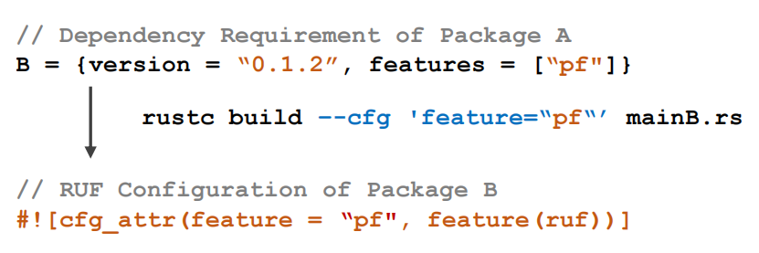
Design and Impl
---- Ecosystem Dependency Resolution
RUF Status
Minimal Configuration Extraction
Compilation Data-flow
Interception
Semantic Identification
of RUF Configuration
RQ2. RUF Usage
Package
Source Code
RUF Configuration
RUF Configuration Extraction
RUF Impact
An Extra Step
Why?
RUF Configurations are formatted as strings.
To determine whether the RUF are enabled or propagate, we need to identify the semantics of RUF configurations.

Slide 23




Design and Impl
---- Ecosystem Dependency Resolution
RUF Status
Minimal Configuration Extraction
Compilation Data-flow
Interception
Semantic Identification
of RUF Configuration
RQ2. RUF Usage
Package
Source Code
RUF Configuration
RUF Configuration Extraction
RUF Impact
An Extra Step
$$dep$$
Rust Doc
$δ\left(dep,A\right)$ returns TRUE if dep satisfies RUF config A
Semantics Gap: Corpus Function
compiler flags
RUF Configuration
Dependency
$v\underset{→}{AC}RUF$
$$dep$$
$$config$$
92% configurations can be successfully identified.

Slide 24
Design and Impl
RUF Status
Rust Compiler
(All Release Versions)
……
RUF Status Extraction
Stable
RQ1. RUF Lifetime
Active
Remove
RQ2. RUF Usage
RUF Configuration Extraction
Package
Source Code
RUF Configuration
RQ3. RUF Impact
Ecosystem Dependency Resolution
Package DB
Ecosystem
Dependency Graph
Ecosystem-scale
Study
RUF Impact
RUF Impact Mitigation

Slide 25
Design and Impl
RUF Status
Rust Compiler
(All Release Versions)
……
RUF Status Extraction
Stable
RQ1. RUF Lifetime
Active
Remove
RQ2. RUF Usage
RUF Configuration Extraction
Package
Source Code
RUF Configuration
RQ3. RUF Impact
Ecosystem Dependency Resolution
Package DB
Ecosystem
Dependency Graph
Ecosystem-scale
Study
RUF Impact
RUF Impact Mitigation

Slide 26
Design
RUF Status Parsing
RUF Status
Rust Compiler
(All Release Versions)
……
RUF Status Extraction
Stable
RQ1. RUF Lifetime
Abnormal RUF Status
Transition Detection
Active
Remove
Minimal Configuration Extraction
Compilation Data-flow
Interception
Semantic Identification
of RUF Configuration
RQ2. RUF Usage
Package
Source Code
RUF Configuration
RUF Configuration Extraction
Ecosystem Dependency Resolution
RQ3. RUF Impact
Virtual Environment
Configuration
Dependency
Resolution
Package DB
Ecosystem
Dependency Graph
Ecosystem-scale
Study
RUF Impact
RUF Impact Mitigation

Slide 27
Design
RUF Status Parsing
RUF Status
Rust Compiler
(All Release Versions)
……
RUF Status Extraction
Stable
RQ1. RUF Lifetime
Abnormal RUF Status
Transition Detection
Active
Remove
Minimal Configuration Extraction
Compilation Data-flow
Interception
Semantic Identification
of RUF Configuration
RQ2. RUF Usage
Package
Source Code
RUF Configuration
RUF Configuration Extraction
Ecosystem Dependency Resolution
RQ3. RUF Impact
Virtual Environment
Configuration
Dependency
Resolution
Package DB
Ecosystem
Dependency Graph
Ecosystem-scale
Study
RUF Impact
RUF Impact Mitigation

Slide 28

Design and Impl
---- Ecosystem Dependency Resolution
Ecosystem Dependency Resolution
Virtual Environment
Configuration
Dependency
Resolution
RQ3. RUF Impact
Package DB
Ecosystem
Dependency Graph
RUF Impact
$v_{A}\underset{→}{dep}v_{B}$ and $v_{B}\underset{→}{dep}v_{C}$, so $v_{A}\underset{→}{dep}v_{c}$?
B
A
C
v1.2.0
1.0.0

Slide 29
Design and Impl
---- Ecosystem Dependency Resolution
Ecosystem Dependency Resolution
Virtual Environment
Configuration
Dependency
Resolution
RQ3. RUF Impact
Package DB
Ecosystem
Dependency Graph
RUF Impact
$v_{A}\underset{→}{dep}v_{B}$ and $v_{B}\underset{→}{dep}v_{C}$, so $v_{A}\underset{→}{dep}v_{c}$?
=1.1.0
B
C
A
C
v1.2.0
1.0.0

Slide 30

Design and Impl
---- Ecosystem Dependency Resolution
Ecosystem Dependency Resolution
Virtual Environment
Configuration
Dependency
Resolution
RQ3. RUF Impact
Package DB
Ecosystem
Dependency Graph
RUF Impact
$v_{A}\underset{→}{dep}v_{B}$ and $v_{B}\underset{→}{dep}v_{C}$, so $v_{A}\underset{→}{dep}v_{c}$?
=1.1.0
Every package version needs a separate dependency resolution!
B
C
v1.1.0
A
Merge
C
v1.1.0
Scalability Problem:
Sampling?
Assume $v_{A}\underset{→}{dep}v_{c}$?
Simulate the resolution process?
1.0.0

Slide 31
Design and Impl
---- Ecosystem Dependency Resolution
Ecosystem Dependency Resolution
Virtual Environment
Configuration
Dependency
Resolution
RQ3. RUF Impact
Package DB
Ecosystem
Dependency Graph
RUF Impact
Find Workspace
May not find
Lock Index
Single Thread
Parse Dependency Requirements
Core Resolver
May not satisfy
Update Index
I/O Intense
Strip Useless Info
NP Hard
Reconstruct Graph
I/O Intense
Done

Slide 32
Design and Impl
---- Ecosystem Dependency Resolution
Ecosystem Dependency Resolution
Virtual Environment
Configuration
Dependency
Resolution
RQ3. RUF Impact
Package DB
Ecosystem
Dependency Graph
RUF Impact
Virtual Environment Configuration
Dep, Workspace, Env requirements, etc
Virtual Environment
Core Resolver
Update Index
I/O Intense
Strip Useless Info
NP Hard
Reconstruct Graph
I/O Intense
Done

Slide 33
Design and Impl
---- Ecosystem Dependency Resolution
Ecosystem Dependency Resolution
Virtual Environment
Configuration
Dependency
Resolution
RQ3. RUF Impact
Package DB
Ecosystem
Dependency Graph
RUF Impact
Virtual Environment Configuration
Dep, Workspace, Env requirements, etc
Virtual Environment
Core Resolver
Dependency Resolution
Local Index Redirection, Parallel Resolution
Other specific requirements
Flexibility, RUF-Specific Requirements

Slide 34
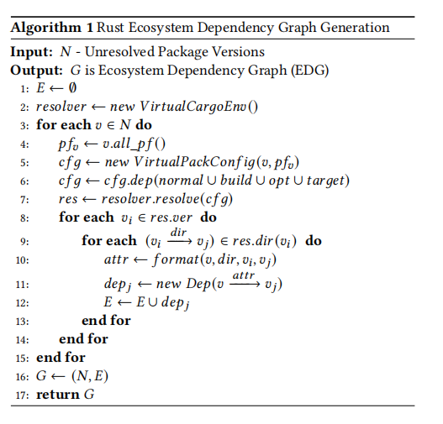
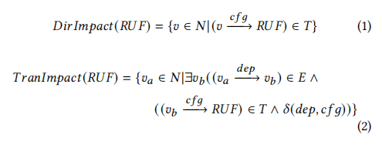
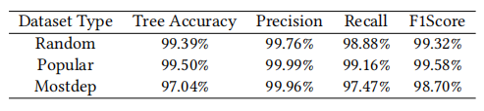
Design and Impl
---- Ecosystem Dependency Resolution
Ecosystem Dependency Resolution
Virtual Environment
Configuration
Dependency
Resolution
RQ3. RUF Impact
Package DB
Ecosystem
Dependency Graph
RUF Impact
Accuracy Evaluation

Slide 35
Design and Impl
RUF Status
Rust Compiler
(All Release Versions)
……
RUF Status Extraction
Stable
RQ1. RUF Lifetime
Active
Remove
RQ2. RUF Usage
RUF Configuration Extraction
Package
Source Code
RUF Configuration
RQ3. RUF Impact
Ecosystem Dependency Resolution
Package DB
Ecosystem
Dependency Graph
Ecosystem-scale
Study
RUF Impact
RUF Impact Mitigation

Slide 36
Design
RUF Status Parsing
RUF Status
Rust Compiler
(All Release Versions)
……
RUF Status Extraction
Stable
RQ1. RUF Lifetime
Abnormal RUF Status
Transition Detection
Active
Remove
Minimal Configuration Extraction
Compilation Data-flow
Interception
Semantic Identification
of RUF Configuration
RQ2. RUF Usage
Package
Source Code
RUF Configuration
RUF Configuration Extraction
Ecosystem Dependency Resolution
RQ3. RUF Impact
Virtual Environment
Configuration
Dependency
Resolution
Package DB
Ecosystem
Dependency Graph
Ecosystem-scale
Study
RUF Impact
RUF Impact Mitigation

Slide 37
Design
RUF Status
Rust Compiler
(All Release Versions)
……
Stable
RQ1. RUF Lifetime
Active
Remove
RQ2. RUF Usage
Package
Source Code
RUF Configuration
RQ3. RUF Impact
Package DB
Ecosystem-scale
Study
RUF Impact
RUF Impact Mitigation

Slide 38
Content List
Motivation
Design and Implementation
RUF Status Extraction
RUF Configuration Extraction
Ecosystem Dependency Resolution
Ecosystem-Scale Study
RQ1. RUF Lifetime
RQ2. RUF Usage
RQ3. RUF Impact
RUF Impact Mitigation

Slide 39
Ecosystem-Scale Analysis (RQs)
Experiment Results:
Tracking RUF status in every minor version of the Rust compiler from v1.0.0 (2015-05-15) to v1.63.0 (2022-08-11)
Crates | Versions | Transitive Dependencies | Resolve Error Versions | Yanked Versions
62870(90.66%) | 479,201(81%) | 139,525,225 | 10623 | 20169

Slide 40
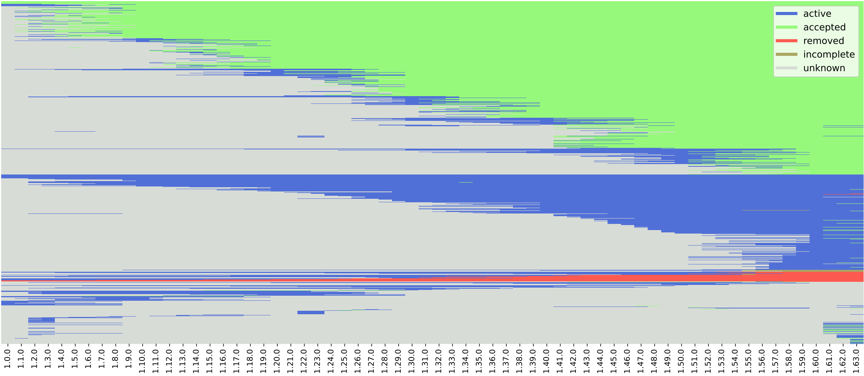
Ecosystem-Scale Study
---- RQ1. RUF Lifetime
We extract RUF status in every compiler version
1.0.0 (2015-05-15) -> 1.63.0 (2022-08-11)

Slide 41
Ecosystem-Scale Study
---- RQ1. RUF Lifetime
Horizontal line indicates one RUF lifetime through different compiler versions.
We extract RUF status in every compiler version
1.0.0 (2015-05-15) -> 1.63.0 (2022-08-11)

Slide 42
Ecosystem-Scale Study
---- RQ1. RUF Lifetime
Vertical line indicates all RUF status in the same compiler version.
We extract RUF status in every compiler version
1.0.0 (2015-05-15) -> 1.63.0 (2022-08-11)

Slide 43
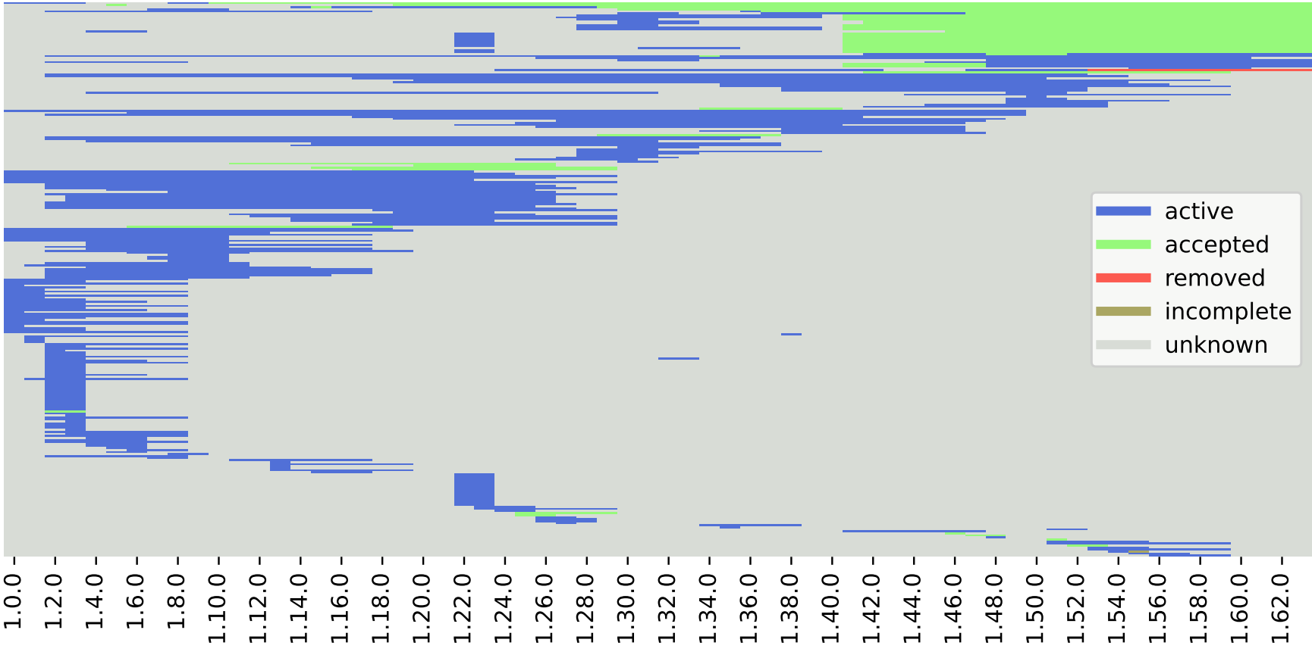
Ecosystem-Scale Study
---- RQ1. RUF Lifetime
Abnormal RUF Lifetime
1.0.0 (2015-05-15) -> 1.63.0 (2022-08-11)

Slide 44
Ecosystem-Scale Study
---- RQ1. RUF Lifetime
Abnormal Patterns
Abnormal RUF Lifetime
1.0.0 (2015-05-15) -> 1.63.0 (2022-08-11)

Slide 45



Ecosystem-Scale Study
---- RQ1. RUF Lifetime
Unknown
Stable
Unknown
Stable feature became unknown
Break functionalities
Active/Unstable
Stable
Active/Unstable
Stable feature became unstable
Bug/CVE
Active/Unstable
Unknown
Active/Unstable
Re-active feature
Functionality changes?
Finding-1: We observe 277/1,875 (15%) abnormal RUF status transitions, which are mainly caused by abandoned development or bugs.
Finding-2: We find that half of RUF (47%) are not stabilized in the latest version of the Rust compiler. Even worse, stabilized RUF can also introduce vulnerabilities to the package (cve:error_type_id), which indicates that stabilized RUF are not totally safe for developers.

Slide 46
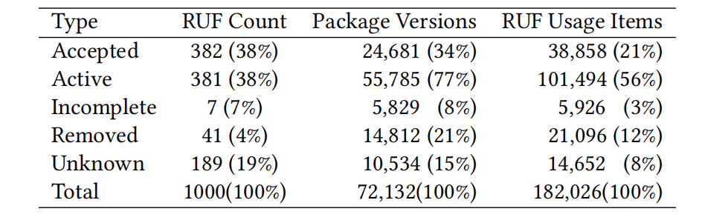
Ecosystem-Scale Study
---- RQ2. RUF Usage
RUF Usage
2015-05-15 -> 2022-08-11
Stable
Finding-3: 72,132 (12%) package versions in the Rust ecosystem are using RUF, and 90% of package versions among them are still using unstabilized RUF. AOSP, Linux, Firefox code repo contain RUF, too.

Slide 47
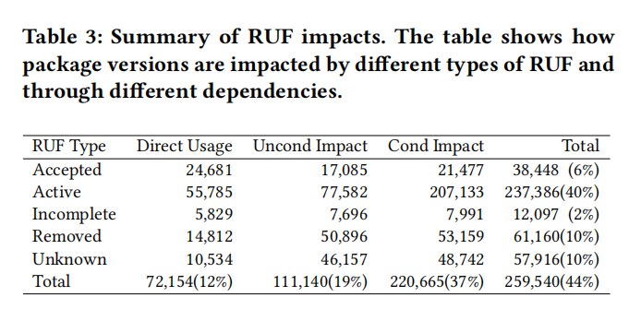
Ecosystem-Scale Study
---- RQ3. RUF Impact
req1
B
C
req1
RUF
A
C
req3
RUF
req2

Slide 48
Ecosystem-Scale Study
---- RQ3. RUF Impact
req1
B
C
req1
RUF
Direct Usage
A
C
req3
RUF
req2

Slide 49
Ecosystem-Scale Study
---- RQ3. RUF Impact
req1
B
C
req1
RUF
Uncond Impact
A
C
req3
RUF
req2

Slide 50
Ecosystem-Scale Study
---- RQ3. RUF Impact
req1
B
C
req1
RUF
Cond Impact
A
C
req3
RUF
req2
Not Match

Slide 51
Ecosystem-Scale Study
---- RQ3. RUF Impact
Finding-4: RUF can impact 259,540 (44%) package versions. Removed RUF can cause at most 70,913 (12%) versions to suffer from compilation failure.

Slide 52
Ecosystem-Scale Study
---- RQ3. RUF Impact
Finding-5: One of the super-spreaders (redox_syscall-0.1.57) makes 41,750 Rust package versions in the ecosystem fail to compile, accounting for 90% of unconditionally impacted versions by unknown RUF.

Slide 53
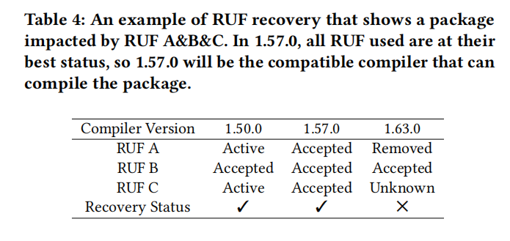
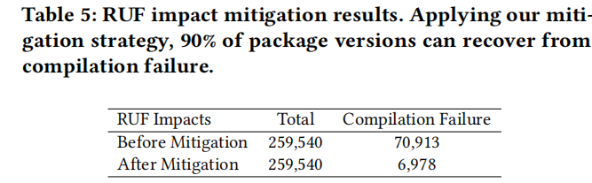
RUF Impact Mitigation
RUF Lifetime
RUF Usage
RUF Impact
Mitigation Results: Our proposed RUF impact mitigation technique can recover up to 90% of failure package versions.

Slide 54
Summary
RUF Status Parsing
RUF Status
Rust Compiler
(All Release Versions)
……
RUF Status Extraction
Stable
RQ1. RUF Lifetime
Abnormal RUF Status
Transition Detection
Active
Remove
Minimal Configuration Extraction
Compilation Data-flow
Interception
Semantic Identification
of RUF Configuration
RQ2. RUF Usage
Package
Source Code
RUF Configuration
RUF Configuration Extraction
Ecosystem Dependency Resolution
RQ3. RUF Impact
Virtual Environment
Configuration
Dependency
Resolution
Package DB
Ecosystem
Dependency Graph
Ecosystem-scale
Study
RUF Impact
RUF Impact Mitigation

Slide 55
Summary
Look back at the Rust
RUF are good, but still need improvement.
Rust Ecosystem is very centralized. This can be a bad thing.
Summary
We prose several novel techniques and conduct the first in-depth study to analyze RUF usage and its impacts on the Rust ecosystem.
44% of package versions are affected by RUF, causing compiling failures for at most 12% of package versions, up to 90% of them can be mitigated by our tools.
Our study discovers many useful findings of Rust.

Slide 56
Demystifying Compiler Unstable Feature Usage and Impacts in the Rust Ecosystem
Chenghao Li^, Yifei Wu^, Wenbo Shen^, Zichen Zhao^, Rui Chang^, Chengwei Liu*, Yang Liu*, Kui Ren^
Zhejiang University^
Nanyang Technological University*
Accepted in ICSE’24
Presenter: Chenghao Li
Mail: loancold.zju.edu.cn
Website: https://sites.google.com/view/ruf-study/home
Github: https://github.com/ZJU-SEC/Cargo-Ecosystem-Monitor
Zenodo: https://zenodo.org/doi/10.5281/zenodo.8289375

