Slide 1


Introduction
Naïve SE 2020
李程浩 180110304
This full name of this project is called “Naïve Search Engine” which focuses on search related information by queries given by users. Users are provided with a simple website and when they enter the queries they want to search, and the website returns 10 most relevant websites that satisfy the queries. The websites are limited in HITSZ and contents are all in Chinese.
The whole project uses library including Lucene, Requests, BeautifulSoup, Tomcat, IKAnalyzer, and Servlet. The related programming language is JAVA, Python and HTML.

Slide 2
Crawler
Crawler
Requests
Scan
Page
Page
Next Page
Link
Link
Website
Website
Website
Website
Website
Website
Beautiful Soup
Local FIle

Slide 3
Indexing
Initialize Lucene
Title
Set IKAnalyzer
Create Fields for files
Url
Indexing
Content
Read Local FIles
Create Fields for files
Index

Slide 4

Servlet
Index
Init()
Ger Search Results()
Start
Query
Query
doPost()
Return
hello.htm
Dynamic Website
Servlet
User

Slide 5
Evaluation
Queries | Precision Count | P.S
党建 | 5
社团活动 | 4
奖学金 | 4 | only 4 returns
化学 | 1 | linked to "自动化学院“
疫情防控 | 5
百年校庆 | 5
社会实践 | 5
新年晚会 | 4 | only 4 returns
话剧 | 2 | only 2 returns
论文发表 | 5
副书记 | 5
计算机科学与技术学院 | 5
暑期实践 | 5
讲座 | 5
心理健康 | 5
开学 | 4
考试安排 | 5
如何去哈工大深圳 | 0
哈工大深圳教学好吗？ | 2
哈工大深圳校历 | 0
Precision@5
Response Time
Queries | Response time(ms)
化学 | 18
话剧 | 8
社团活动 | 9
哈工大深圳 | 12
计算机科学与技术学院 | 18
生物科学 | 14

Slide 6
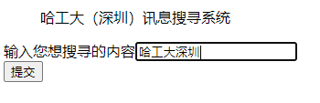
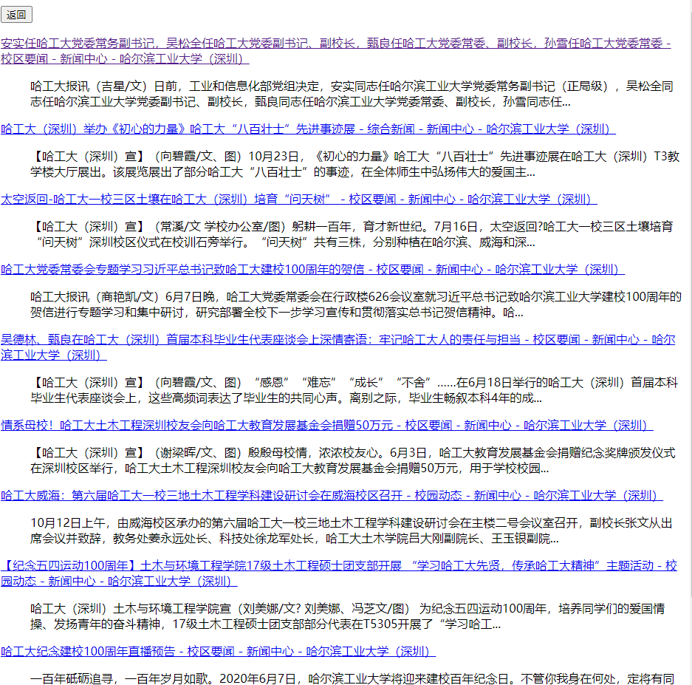

Running Example
Start Website
Search Results
Hyperlink

