Slide 1
Group Informatics Focused Social Network Analysis Workshop
LASI, 2016

Slide 2
Process
Workshop Plan Information at
http://sociallycompute.io
Look for this to be updated with what **actually** happened over the next few days
What Happened
Day 1: The Warning about SNA for Learning Analytics. Connecting theory and Trace Data
Day 2: Working with SNA Tools and Examples
Day 3: Applying SNA Tools to Participant Data

Slide 3
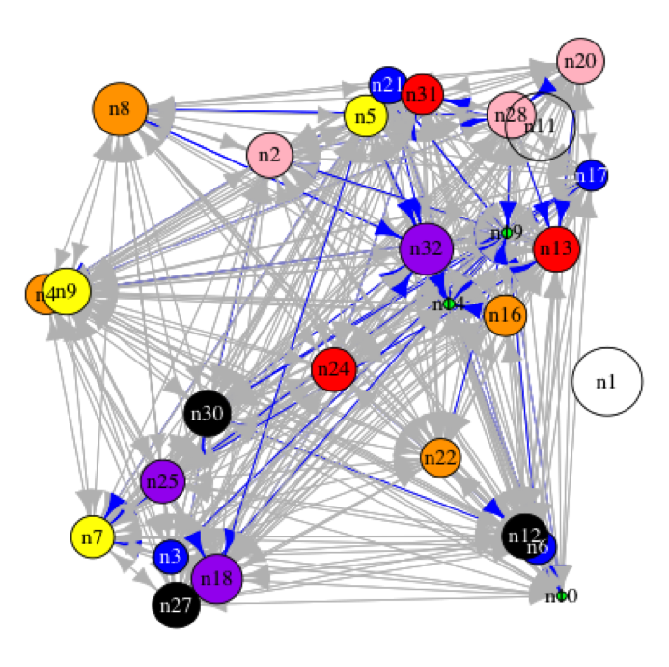
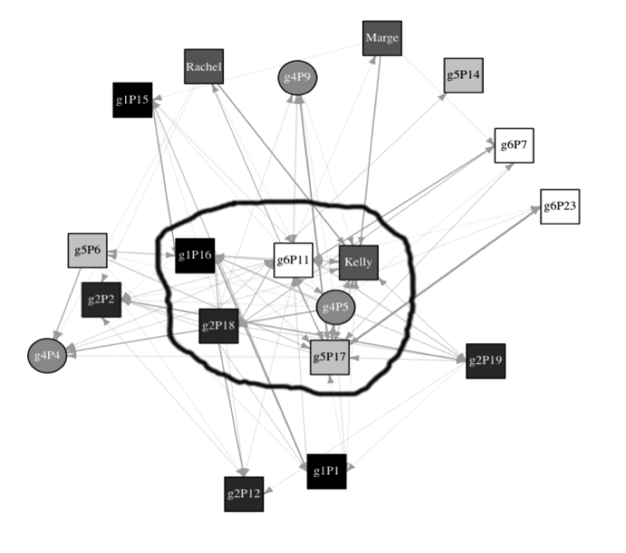
Group Informatics: The Social Network Analysis Part & Impact
Leadership
Coordination
Knowledge Construction
Information Diffusion
Discourse
Negotiation
Knowledge Transfer

Slide 4
Group Informatics: An Ontology and Methodological Approach

Slide 5
What Does Group Informatics Draw From?
Theory: Selection is Context Driven
Data: Electronic Trace Data
Unit of Analysis: The Interaction
Methods Woven Together:
Grounded theory
Content analysis
Network analysis
Computational linguistics
Group informatics is the
systematic application of social network and set theory oriented methods** for analysis of online, human trace data,
skepticism about the reality presented by analysis of raw trace data, and
the integration of other, context relevant social computational methods and approaches,
in concert with established and emerging qualitative approaches
to produce reliable and repeatable science in the study on online phenomena.

Slide 6
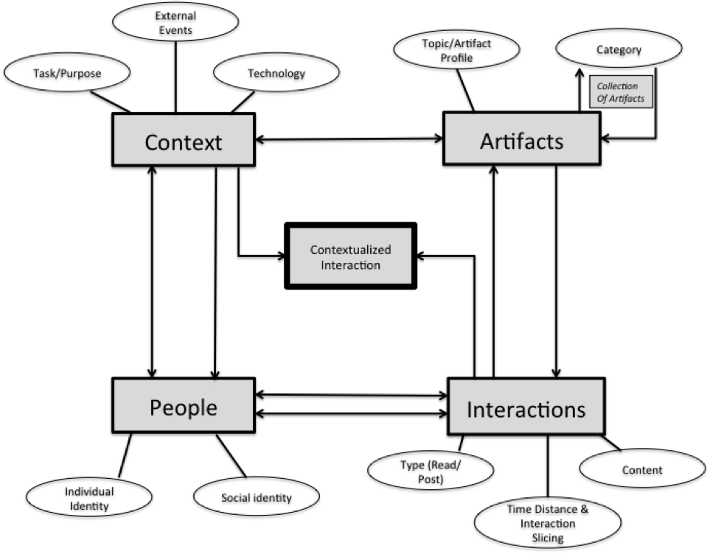
Group Informatics Ontology

Slide 8
Critical Things We Skipped
Data carpentry
The Process of weighting networks from participant data sources

Slide 9

Socratic Rank: Eliciting questions in online discussion forums

Slide 10
About the Data
Moodle discussion forum data across all courses at a University over 2.5 years (2012 – Oct. 2014).
Number of posters: 23 134
Number of posts: 431 734

Slide 11
Assumptions and Aims
One way of engaging and learning is asking questions.
People whose contributions elicit questions from others play important roles in discussion.
Q: In these discussions, who are people that elicit many replies to their posts that contain questions?
Q: Who are people that elicit replies that contain questions, from people who are also quite good are eliciting questions?

Slide 12
Process
Load a tree of posts.
Remove post nodes that are not questions.
Remove posts that reply to one’s own posts.
[n: 70317]
Build a social network where the vertices are posters and directed edges indicate the number of question posts from one user to another.
Determine SocraticRank of users (Eigenvectors of question-elicitation)
Visualize graphs: top question-elicitors in network.

Slide 13
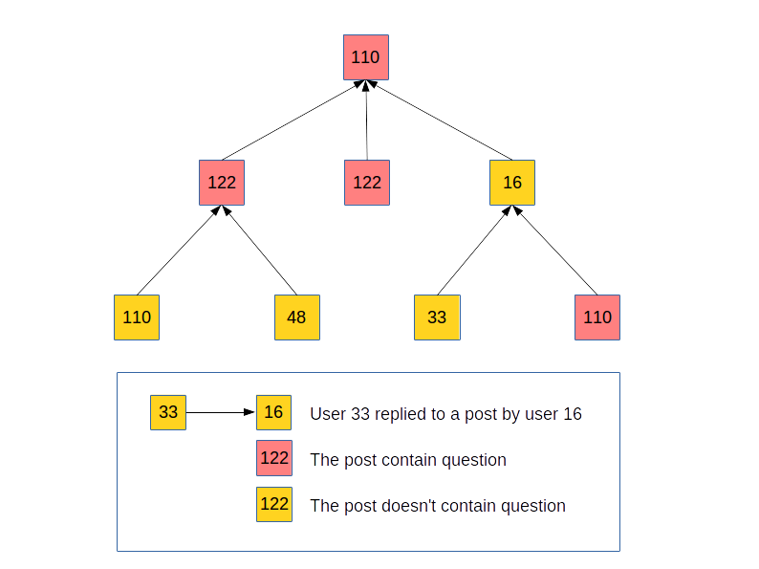

Slide 14


Slide 15
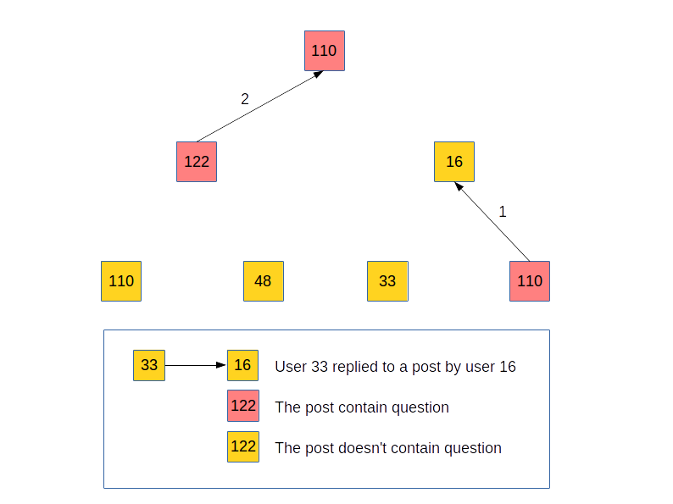

Slide 16
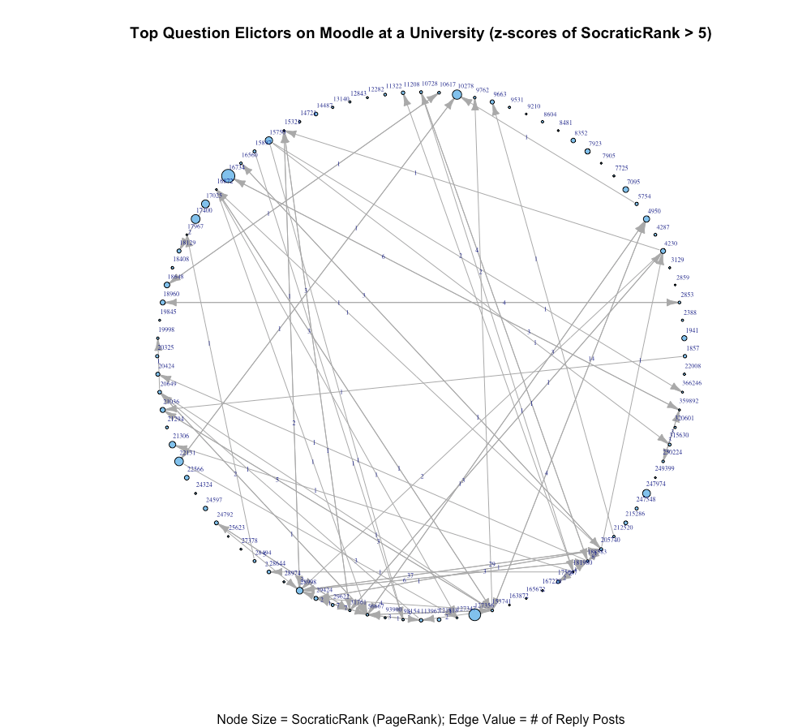
Number of nodes in medium rank graph (>5): 92

Slide 17
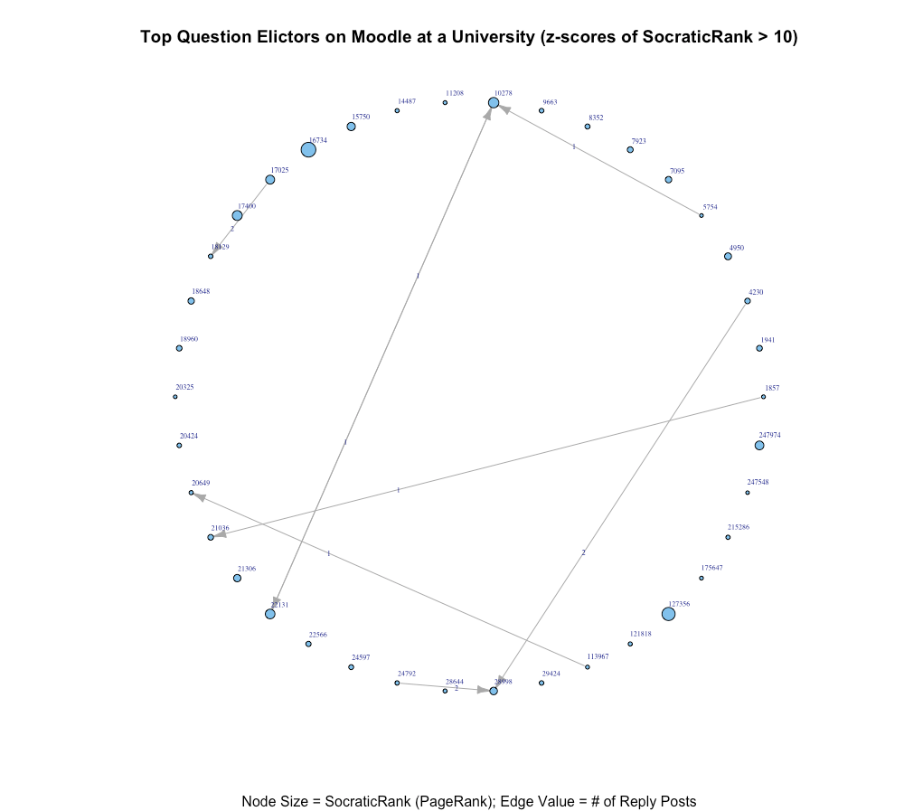
Number of nodes in high rank graph (>10): 38

Slide 18
Socratic Rank Team
Will Riley - Slalom Consulting
Amin Alhashim – University of Wisconsin
Christian Fischer – University of Michigan
Drew Paulin – UC Berkeley

Slide 19
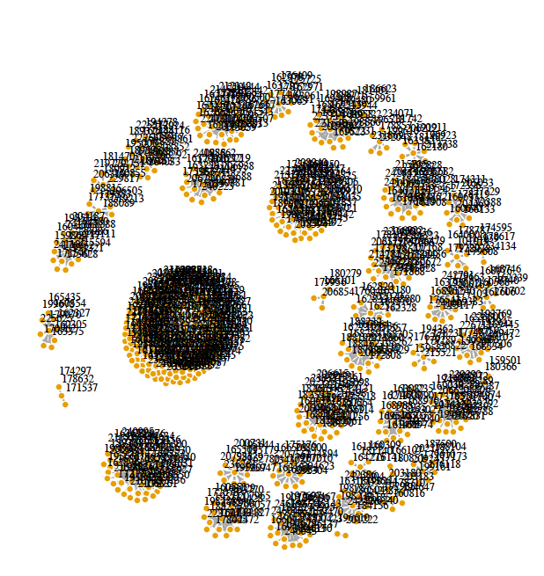
An example of One (Large) Student Course

Slide 20
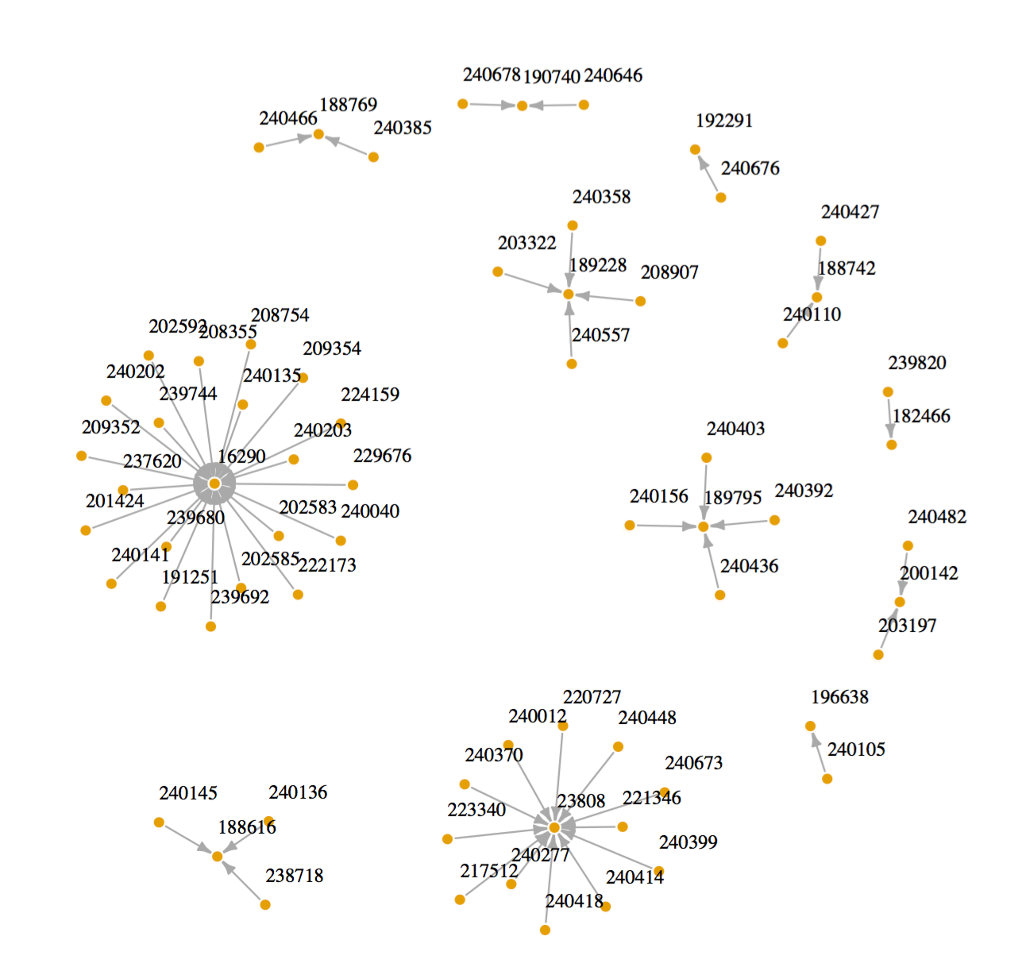
An example of another (Smaller) Student Course

Slide 21
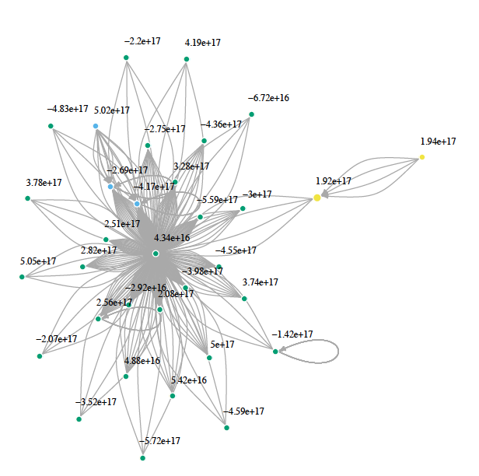
A Second University

