Slide 1
Connecting Theory to Social Technology Platforms: A Framework for Measuring Influence in Context
Sean P. Goggins, Ph.D
Eva Petakovic

Slide 2
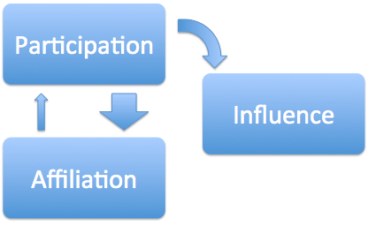
Influence (A Specific Construct)
Theoretical Components of Influence (adoption of new behaviors)
Punishment, Reward, Belonging/Conformity, Communication/Rhetoric
Affiliation – How big is my audience? Who listens?
Participation – What do I say; to what extent do people interact with me?
Three Examples
Facebook
Twitter
GitHub

Slide 3
Approaching Influence ‘Abstractions first’
Data-driven single-platform vs theory-driven multi-platform approach
How do GitHub/Twitter/Facebook/Future social technology fulfill construct x similarly or differently?
Better understanding of the functions of social media as a whole with respect to influence

Slide 4
Contd. ?
Common considerations for examining diverse social technology platforms
Empirical results commonly shaped by the social technology platform being studied
Learning about influence in social media by examining relationships among platforms when evaluated by the same grounded theory
Notes:
A theory-driven framework synthesized from 3 years of past research on social technologies (FB, TW, GH)
Long-term view of guiding future social science research using Big Social Data
Connecting levels of analysis from the empirical study of influence to electronic trace data
Argue for more focus on the abstractions of influence: participation and affiliation
What is done here: outlining a relationship between social media technology platforms, individual goals for participation, and emergent small groups
It’s easy for theory and data not to match up…
GH
Site for highly fluid, distributed, socially engaging work
Most empirical results are shaped by properties of some specific platform being studied- this is why we want a cross-platform emphasis
Roadmap:
Challenge- finding common things to consider when examining individual social technology platforms (why?) long-term goal for coherence within the field
interactions of many kinds
What we need-We need more grounding in social theory than what we have right now
How we do this-synthesize lit related to influence for each soc tec platform, distill own past research
Influence across social technology contexts and platforms

Slide 5
A Social Technology Influence Matrix

Slide 6
Levelism
Levels
Abstraction
Organization (ontological commitments)
Explanation (epistemological commitments)
Gradients of Abstraction
Avoid pitfalls in working with leveled data
Align organization of data with with what you are trying to explain in order to avoid hidden epistemological commitments
Align Digital and Analogue Data (Derive organization of traces from social science analysis)
Notes:
The ‘ground’- we use philosophical theory of Levelism, which makes the relationship between epistemological and ontological abstraction apparent & supports coherent theory development related to influence in social techs
Levelism is a branch of philosophy concerned with how levels of abstraction (LoA’s) are applied in scientific inquiry. There are two main categories of abstraction, Levels of organization (LoO’s), which make ontological commitments; and levels of explanation (LoE’s), which make epistemological commitments. The construct of gradients of abstraction (GoA’s) are applied to suggest levels of greater or lesser abstraction, with all the components of the higher levels composed of the more granular, lower levels. Levelism foregrounds the connection between the data aggregated through variables (discrete or analog) in observables (data that can be captured) (Floridi, 2008) in scientific inquiry.
Our purpose in introducing the philosophical notion of levelism is to point out that wrestling with how to make social sense of discrete, electronic trace data is a category of problem long reasoned about more abstractly in the foundational scientific field of philosophy. How we make sense of behaviors and identify patterns of influence can then be grounded in established modes of reasoning about variables, observables and abstractions in science; and we can avoid well-known pitfalls in logical reasoning about leveled data.
Let us briefly unpack levelism in the context of explaining communication oriented influence in social technologies (see (Floridi, 2008) for a thorough logical explication of levelism). Influence is classified as a LoE. We use traces of interaction to explain influencing behaviors in social technology; to build models and develop theory. The trace data available from the 3 social technologies we focus on here each come to us in a concrete, fine-grained form; often with millions of rows. This data is too granular for us to derive findings from directly, so we must therefore create abstractions.
Levelism posits that if the LoO’s we define by aggregating trace data are not clearly aligned with the discrete and analogue data we collect, as well as the LoE’s we are focused on, we inevitably make hidden epistemological commitments. An example of such an epistemological commitment might be to suggest that the identification of clusters or flow abstractions derived from the traces of behavior in each of the 3 social technologies described here constitute measures of influence. To do so would be to assert that the LoA of a cluster, and the LoO of constituent subgroups of behavior correspond with influence; the ontology of “cluster” in this case makes an ontological commitment to defining the structure of abstractions, and has a powerful effect on our epistemic commitments to questions of influence. In this case we conflate abstraction and organization of data (computationally derived clusters and flows) with the construct of influence, which is what we are trying to explain.
To explain influence (our LoE) across social technologies, we suggest a corresponding need for LoO’s specific to the electronic trace data, practices and purposes for participation in each social technology. To measure and instrument influence across technologies, we will define GoA’s for each that share an LoA at some appropriate, high level. In the next sections, we address these specifics one social technology at a time, and then describe a shared abstraction afterwards Discrete data has a finite number of possible values. In the analysis of influence, trace data is discrete. Analogue data has an indeterminate number of values. In the analysis of influence, qualitative observations we make in a reflexive analysis of the data would be considered analog (Floridi, 2008; Saab & Riss, 2011).
Recall – LoO is an ontological abstraction, and LoE is an epistemological abstraction.

Slide 7
Levels of Organization in Social Technologies
Facebook
Twitter
GitHub

Slide 8
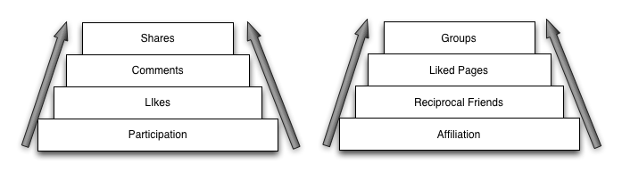
Levels of Organization on Facebook
Gradients of abstraction

Slide 9
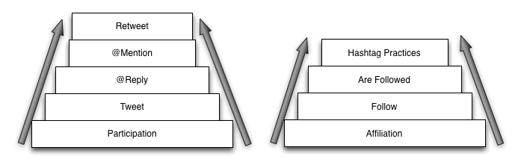
Twitter LoO
Gradients of abstraction
Notes:
Update: Twitter lists -> affiliation

Slide 10
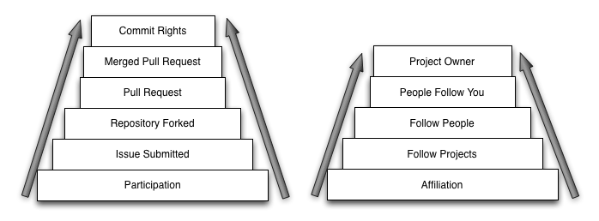
GitHub LoO
Gradients of abstraction

Slide 11
Thank You

