Slide 1
Social Network Analysis Focused Research Process
Sean P. Goggins, Ph.D

Slide 2
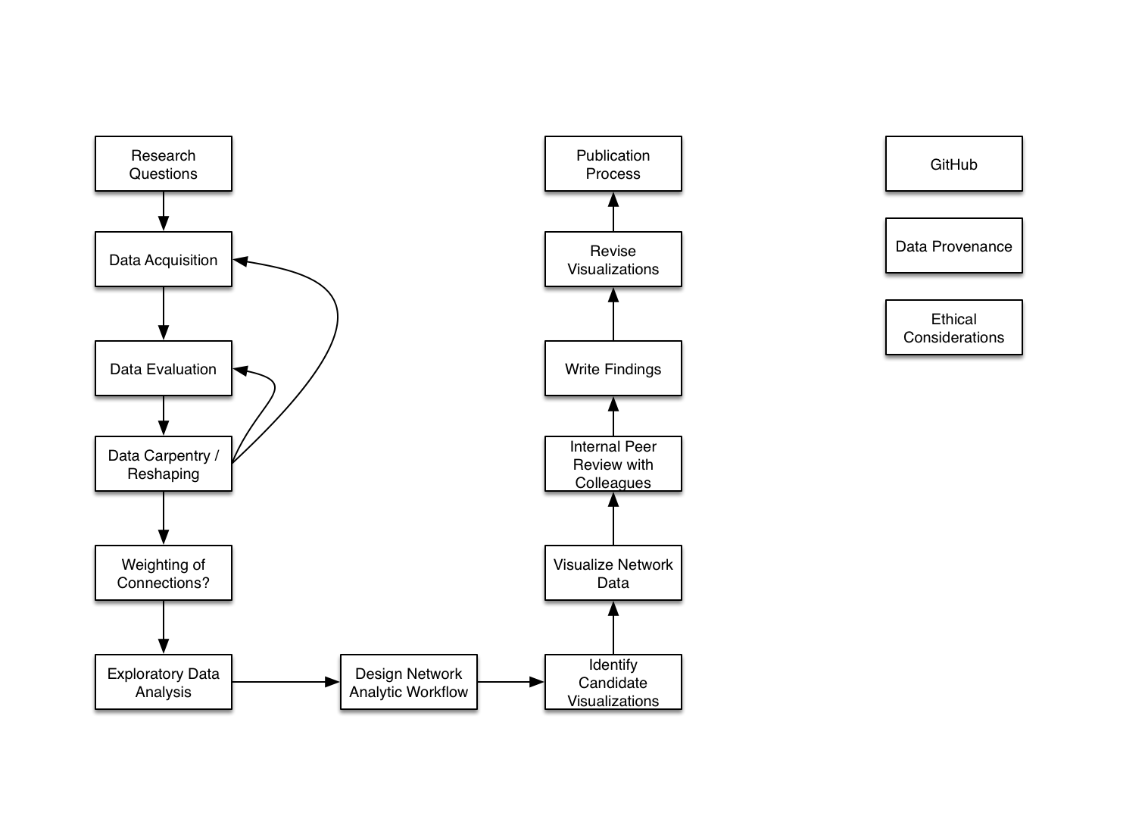
High Level Overview

Slide 3
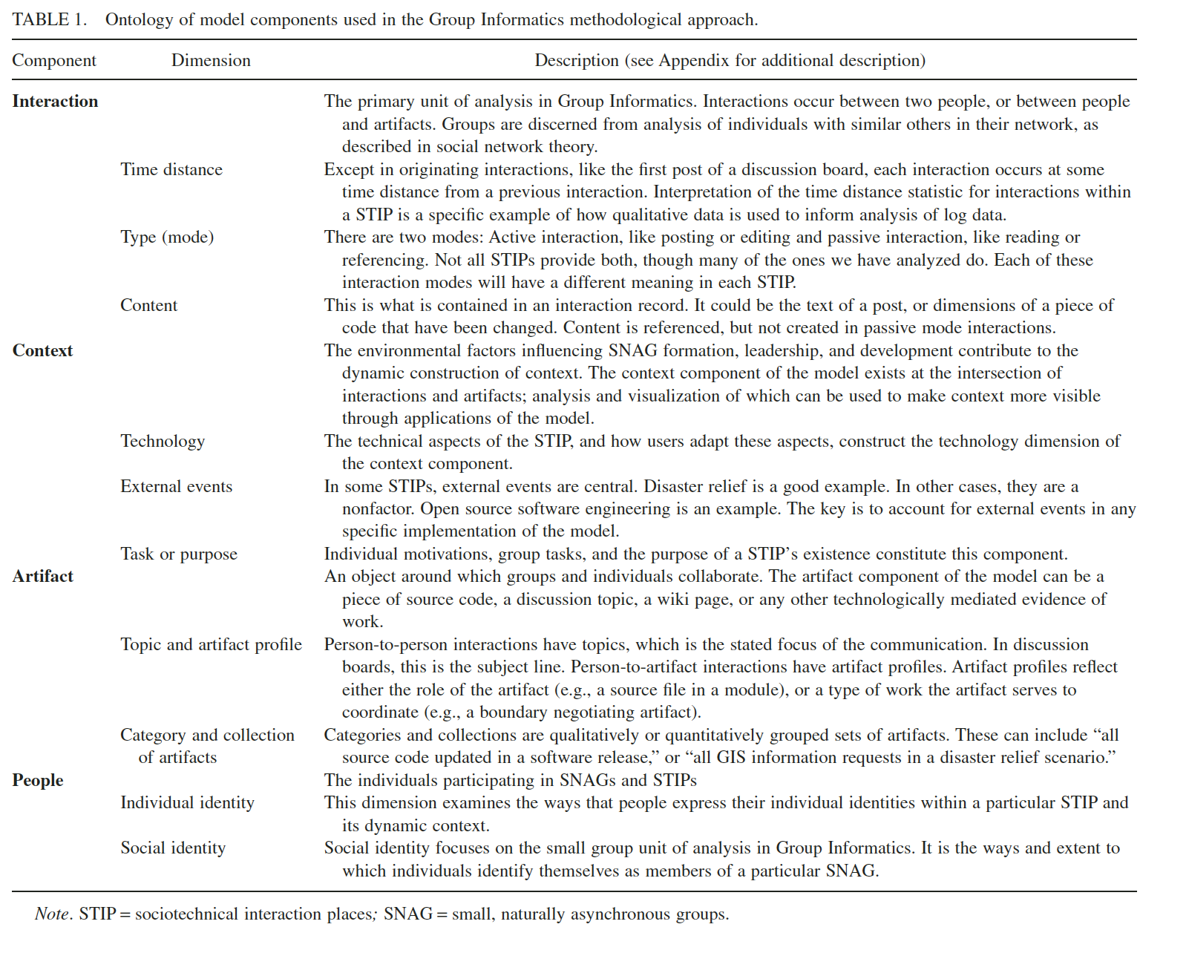
Weighting Questions

Slide 5
Thank You

