Slide 1

Interest

Slide 2
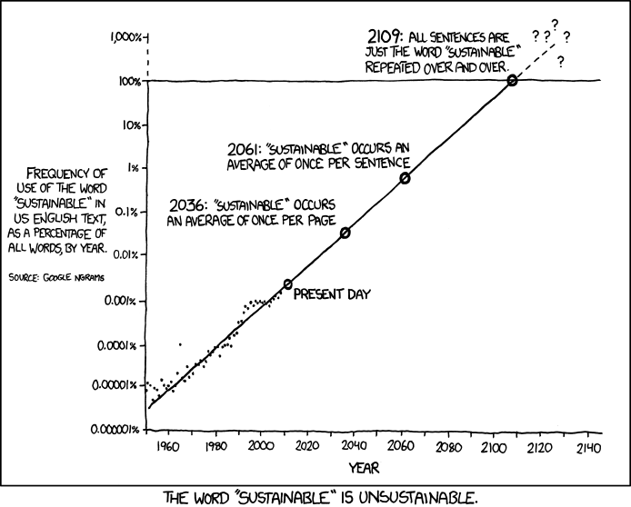

Slide 3
….
How complex is the data?
Not very
Is it presenting the data well?
+ Witty, easy on the eyes, gets the point across
Lacks individual statistics about data points

Slide 4
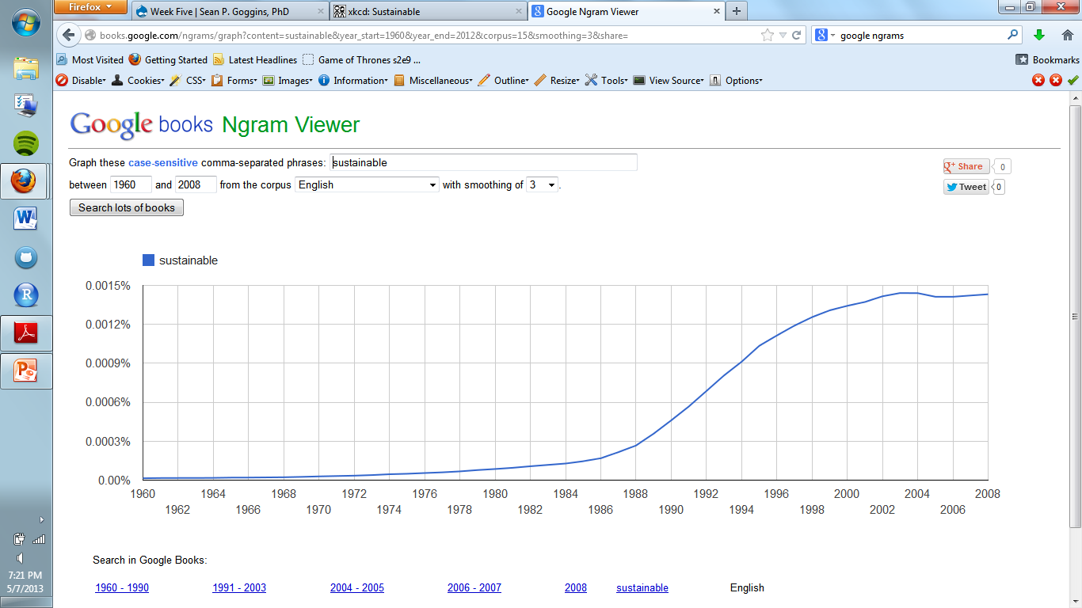

Slide 5
Sources
www.xkcd.com/1007
Google ngrams

