Slide 1
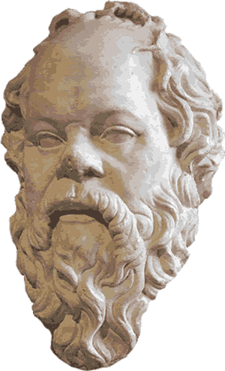
Socratic Rank: Eliciting questions in online discussion forums

Slide 2
About the Data
Moodle discussion forum data across all courses at a University over 2.5 years (2012 – Oct. 2014).
Number of posters: 23 134
Number of posts: 431 734

Slide 3
Assumptions and Aims
One way of engaging and learning is asking questions.
People whose contributions elicit questions from others play important roles in discussion.
Q: In these discussions, who are people that elicit many replies to their posts that contain questions?
Q: Who are people that elicit replies that contain questions, from people who are also quite good are eliciting questions?

Slide 4
Process
Load a tree of posts.
Remove post nodes that are not questions.
Remove posts that reply to one’s own posts.
[n: 70317]
Build a social network where the vertices are posters and directed edges indicate the number of question posts from one user to another.
Determine SocraticRank of users (Eigenvectors of question-elicitation)
Visualize graphs: top question-elicitors in network.

Slide 5
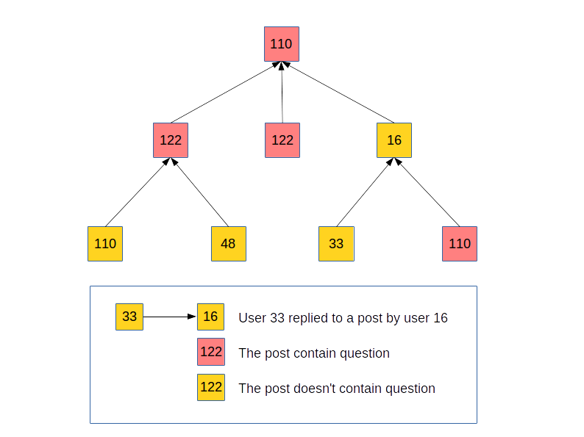

Slide 6


Slide 7
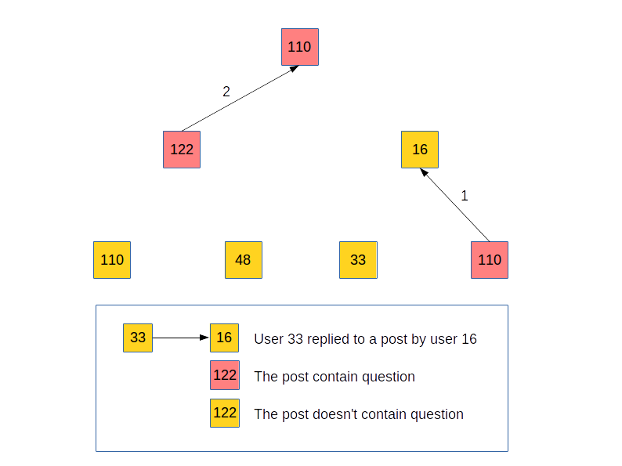

Slide 8
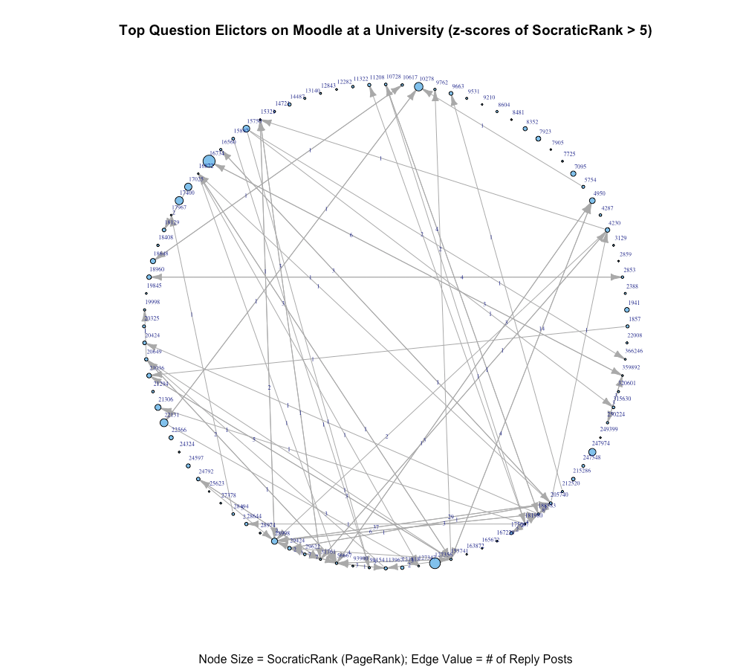
Number of nodes in medium rank graph (>5): 92

Slide 9
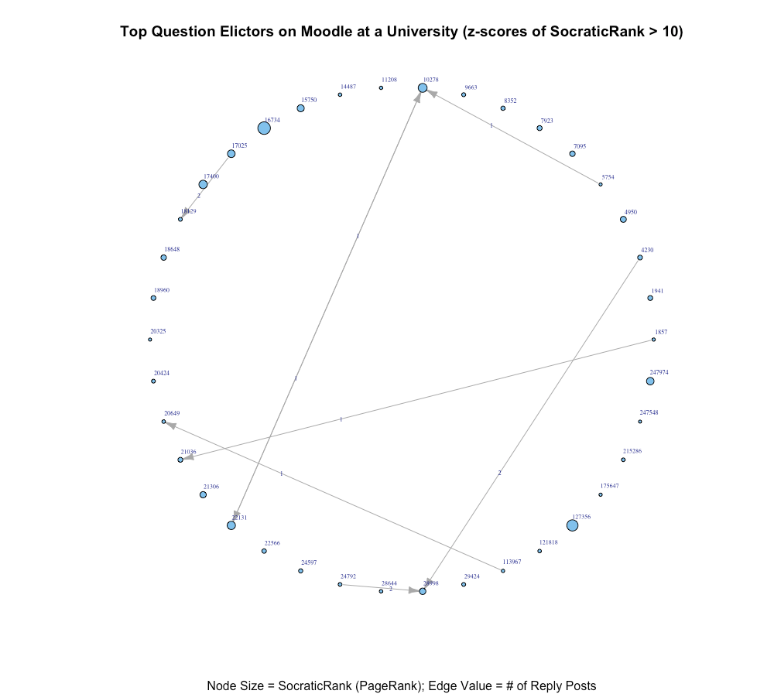
Number of nodes in high rank graph (>10): 38

Slide 10
Team
Will Riley - Slalom Consulting
Amin Alhashim – University of Wisconsin
Christian Fischer – University of Michigan
Drew Paulin – UC Berkeley

