Slide 1

Plant For Planet Data
Angela

Slide 2
Preprocessing
8 projects had no site(Polygons) information dropped
We have 853 sites with complete polygons and 20 with incomplete polygons
Dropped 10 projects with zero trees planted
88-projects had no survival rate ,and 3 with invalid type of survival rates.
70 projects do not have dates when first tree was planted
84 Projects have all this information

Slide 3
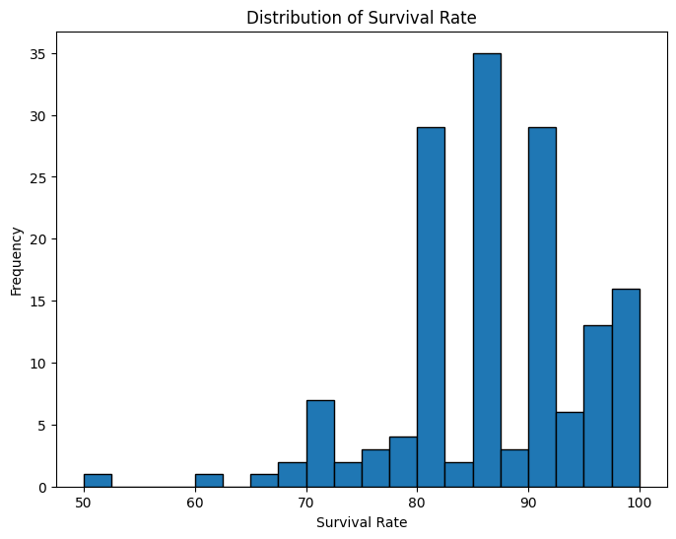
EDA

Slide 4
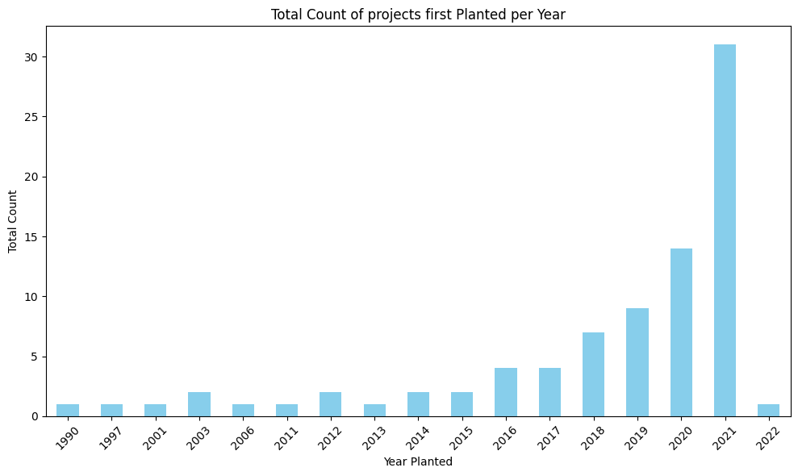
EDA

Slide 5
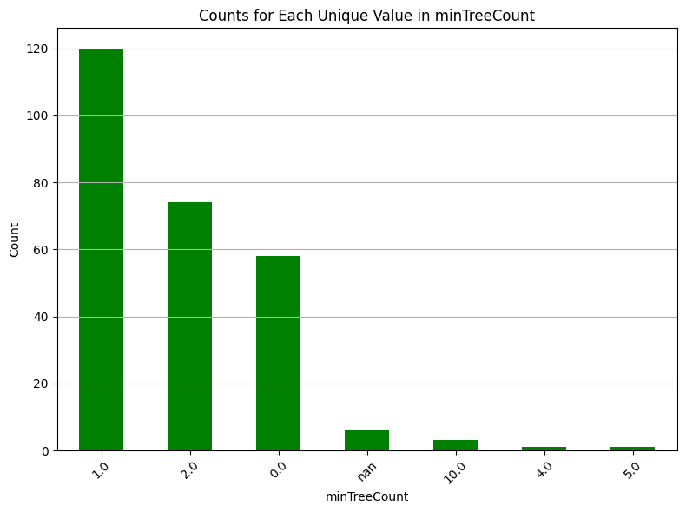
EDA

Slide 6
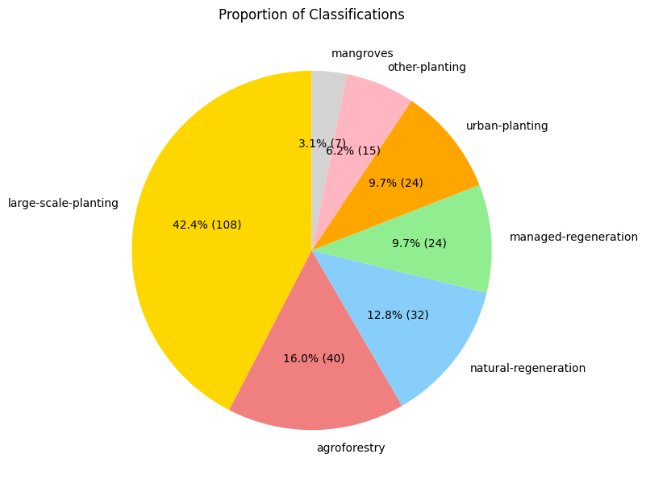
EDA

Slide 7
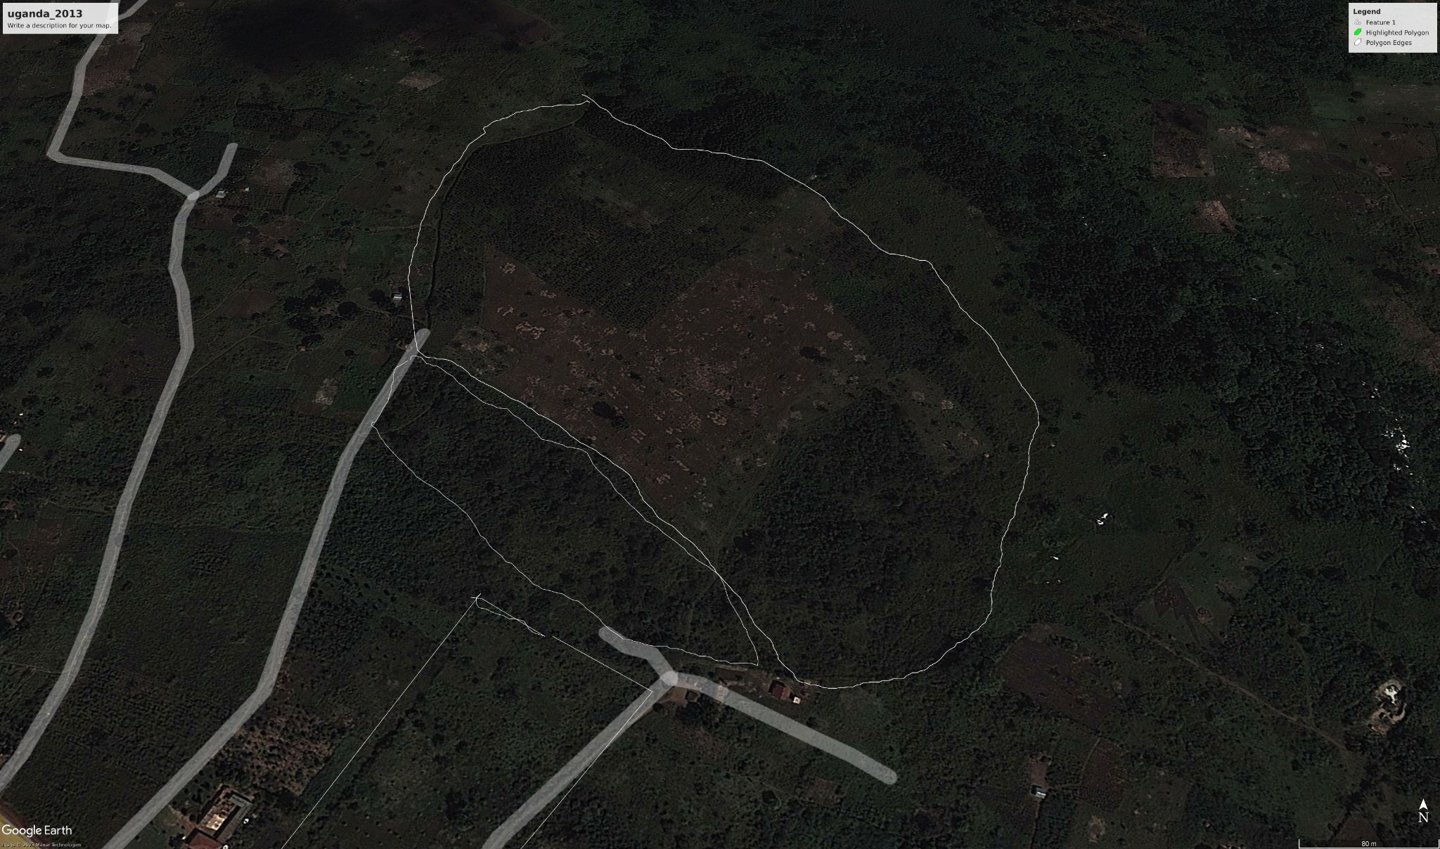
Data

Slide 8
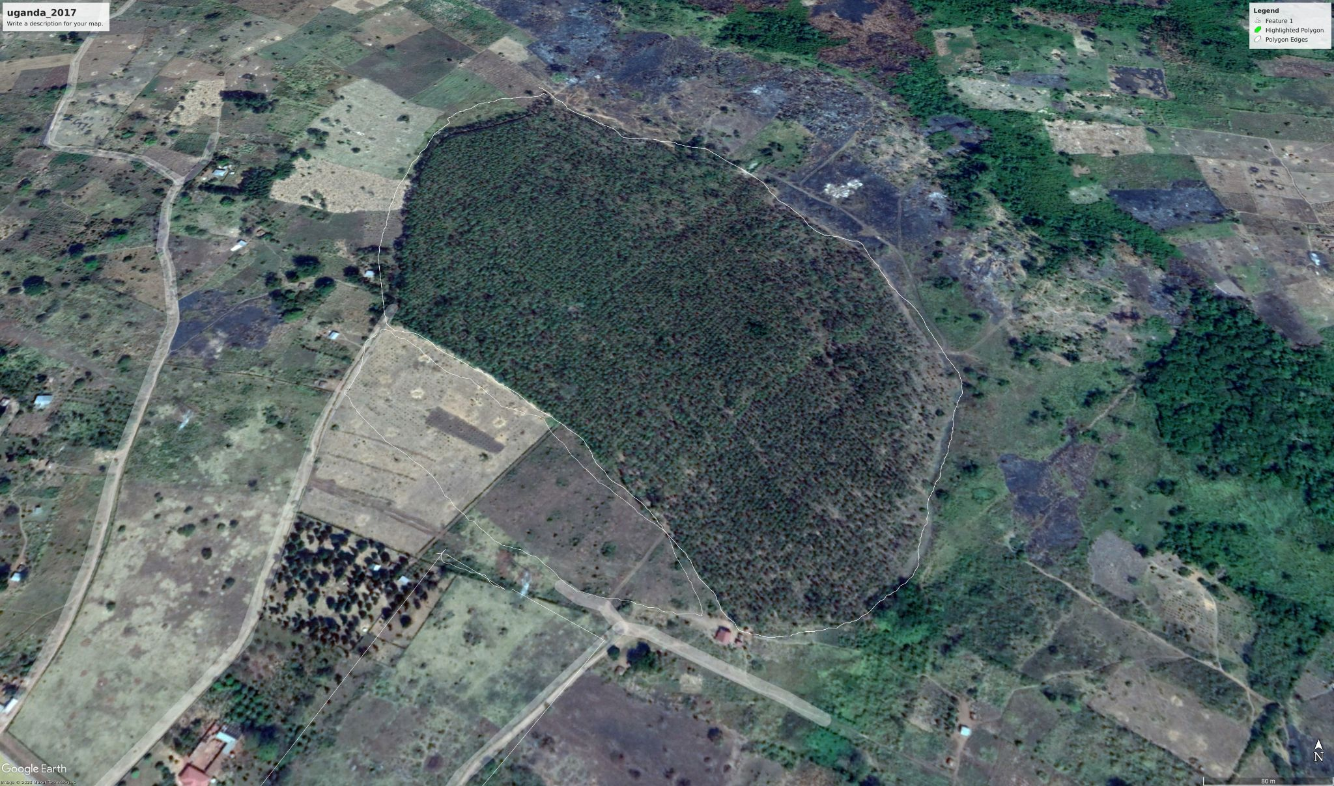
Data

Slide 9
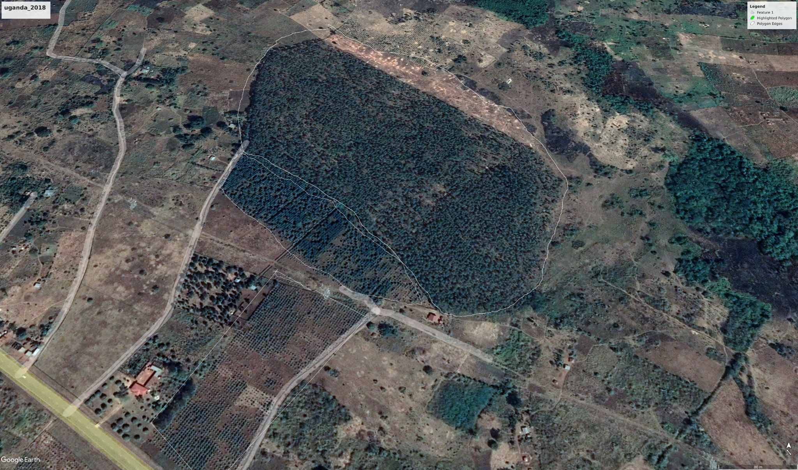
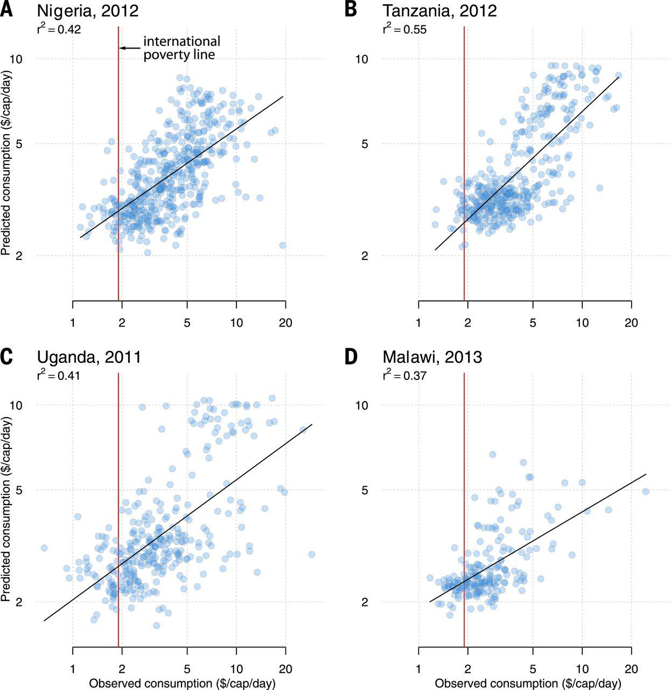
Data
hows the relationship between the predicted and measured consumption

Slide 10
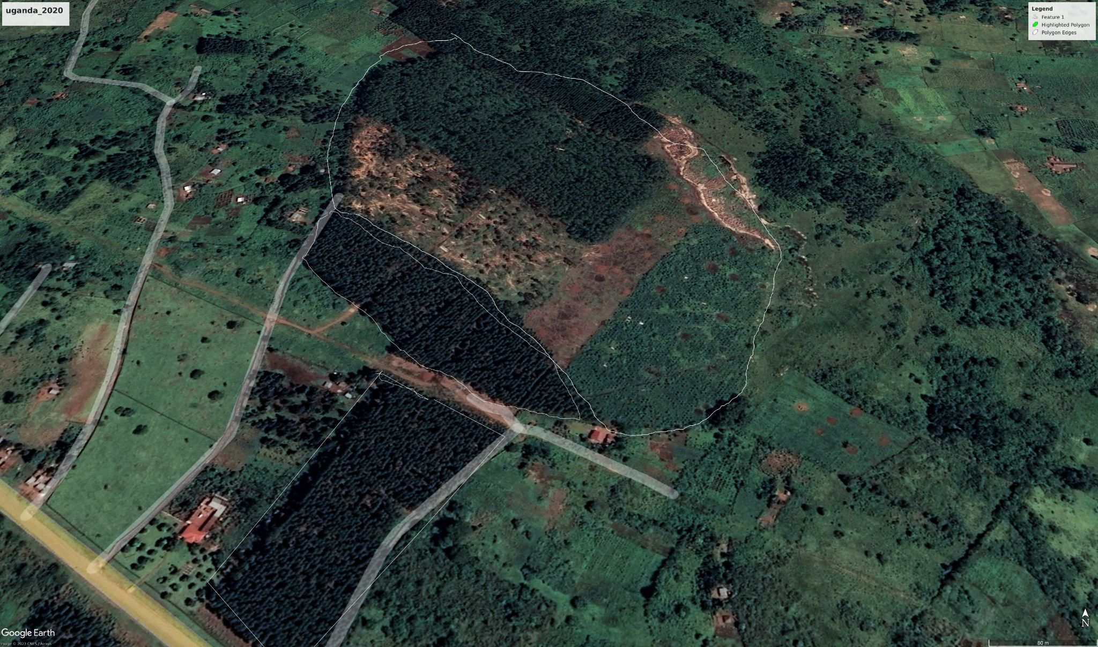
Data

Slide 11
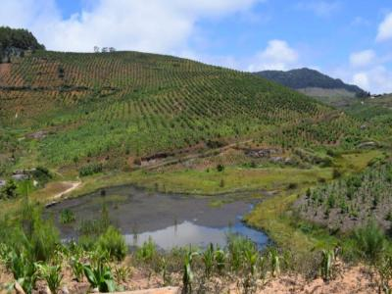
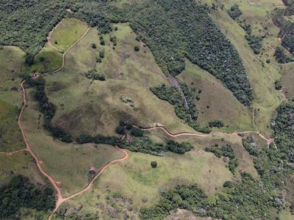
Image From Plant for Planet

Slide 12
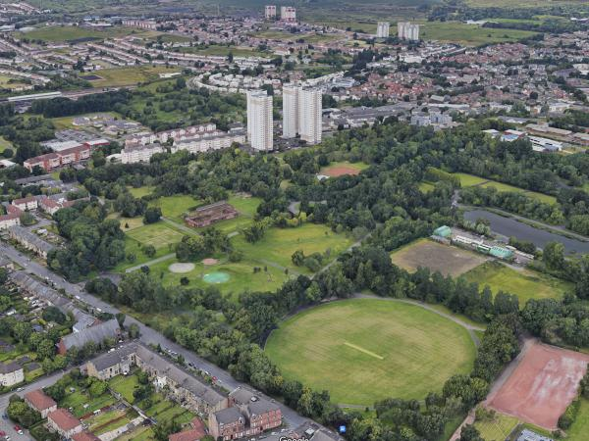
Plant for planet

Slide 13
Thank You :)

