Slide 1
Porting the SFTE Reference Handbook into the 21st Century
Nathan Cook

Slide 2
Table of Contents
0. Introduction
1. What it was
2. What it is
3. What it shall be

Slide 3
0. Introduction

Slide 4
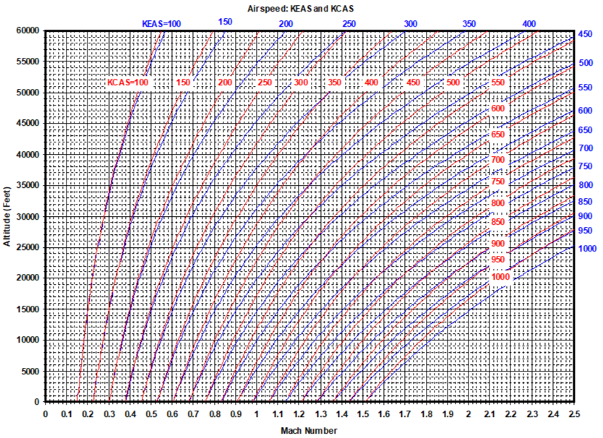
0.1 Situation: You Need a Mach/Altitude Chart
What do you do?
Recreate tools from scratch
Import/scan pictures
Recreate pictures with digital drawings
Mach-Altitude-Airspeed Plot

Slide 5
0.2 What If Instead You Had…
The highest quality VECTOR (zoomable) graphics
Reproducible examples in multiple languages and formats
Universally available content

Slide 6
1. What it was

Slide 7
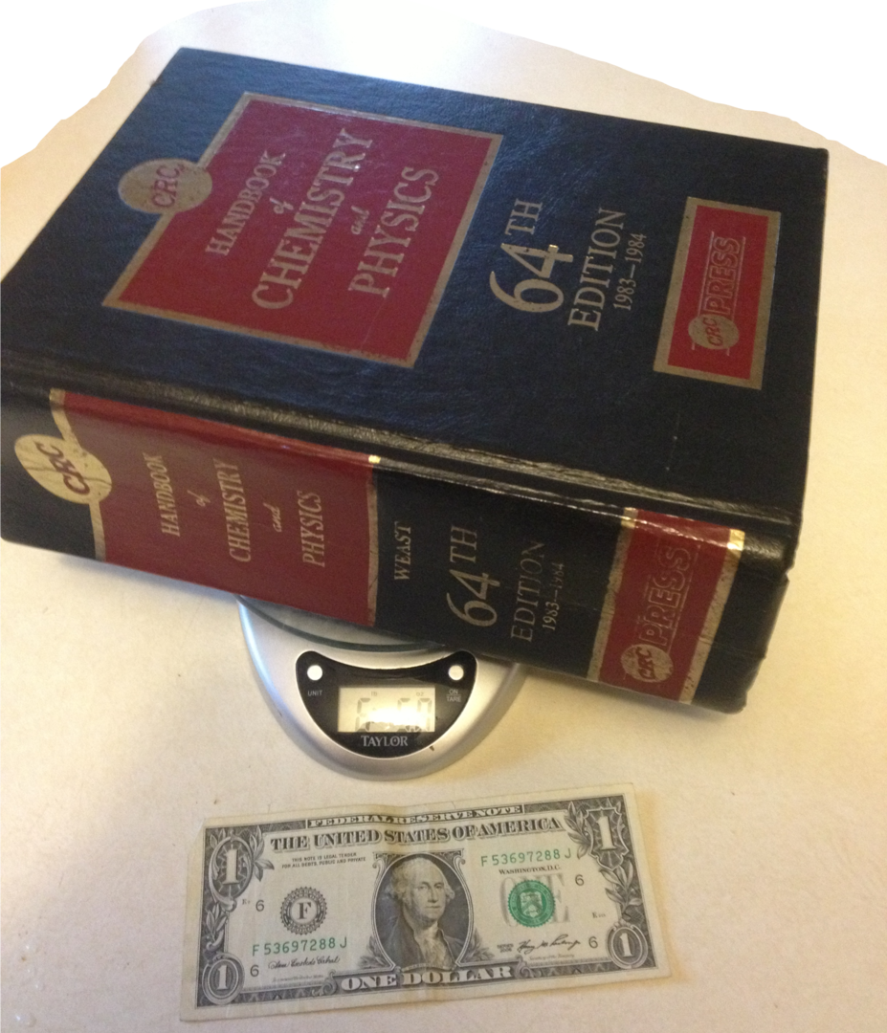
1.1 Handbook History
A book…
…that fit in your hand (debatable…see CRC)
Quick reference for common facts/figures
The CRC: One of the most famous “handbooks” in history

Slide 8
1.2 SFTE Handbook
2001: First edition
2013: Most recent major revision
2019: 2 Addenda
Source - Microsoft Word® - Microsoft Publisher®
Production - PDF - Hardcopy
Issues
Images of various format, resolution, and quality
Maintenance
Life cycle costs
Closed v open architecture
No clear procedure for amendments and revisions

Slide 9
2. What it is

Slide 10
2.1 “port”
/pôrt/
verb
verb: port; 3rd person present: ports; past tense: ported; past participle: ported; gerund or present participle: porting
COMPUTING
transfer (software) from one system or machine to another.
“the software can be ported to an IBM RS/6000”

Slide 11
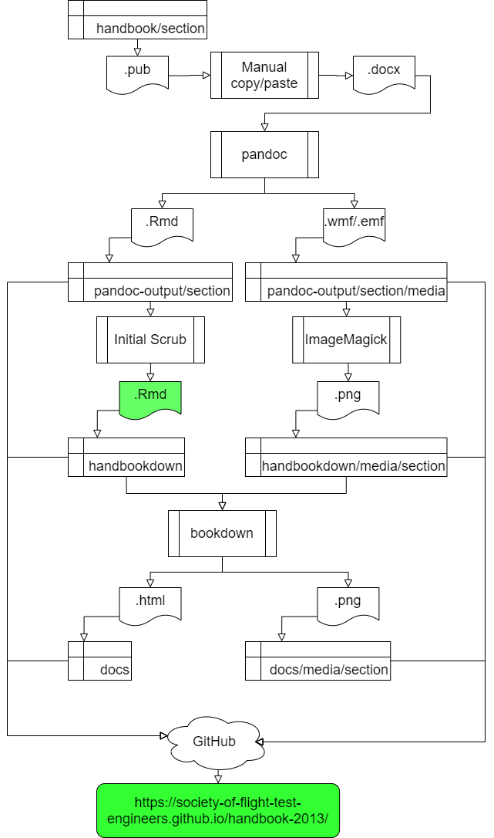
2.2 Porting the Handbook
Source
Unicode Text (Rmarkdown)
Production
HTML
Handbook Port Process

Slide 12

2.3.1 GitHub Demo
Required Tools
git
R
bookdown
text editor
command line
web browser
GitHub account
Optional Tools
An Integrated Development Environment such as…
VS Code
RStudio
https://github.com/Society-of-Flight-Test-Engineers/handbook-2013

Slide 13
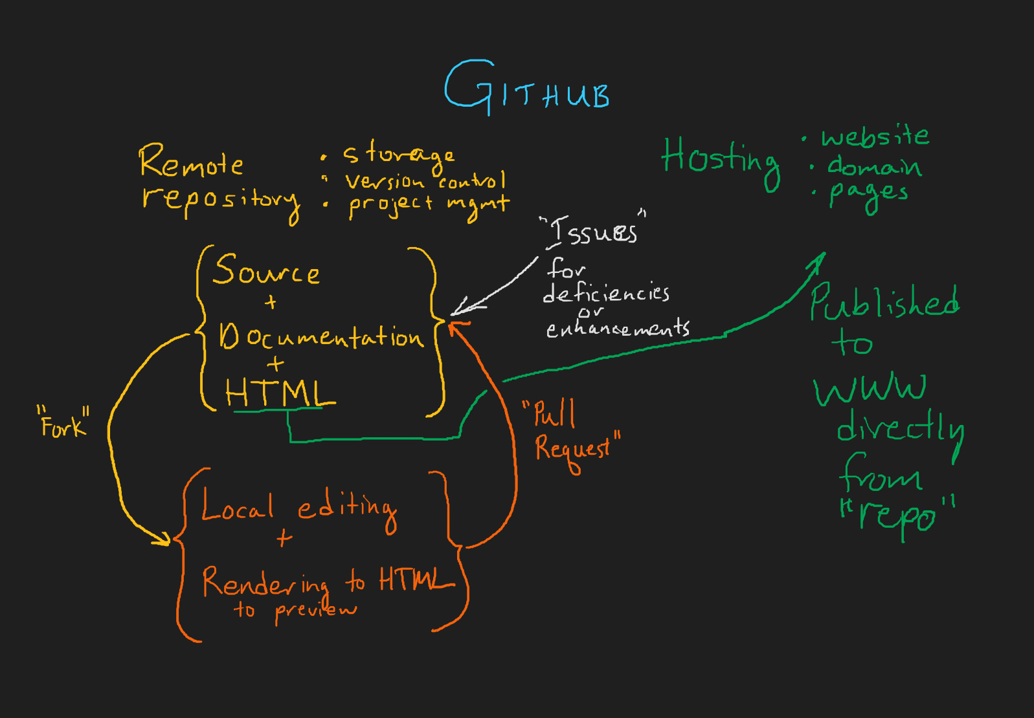
2.3.2 GitHub concept map

Slide 14
3. What it shall be

Slide 15
3.1 Phases
Now: Complete HTML
Next: Complete PDF
Next²:
Code to…
generate every plot
implement every function
Dynamic Handbook with…
interactive visualizations
interactive calculations
Next³: “Refactor” entirely → Handbook 2.0
A means of organizing and making accessible FTE knowledge, practices, and standards

Slide 16
Summary
There’s a lot to know
Modern tools allow for
more ready access
engagement with knowledge
reproducibility
fine-grained version control
Things of value require cultivation
growth environment
weeding
pruning
support
attention

Slide 17
References
CRC Image By NE Ent - Own work, CC BY-SA 3.0, https://commons.wikimedia.org/w/index.php?curid=24352142 GitHub Logo, https://github.com/logos

