Slide 1
Porting the SFTE Reference Handbook into the 21st Century
Nathan Cook

Slide 2
Table of Contents
0. Introduction
1. What it was
2. What it is
3. What it shall be

Slide 3
0. Introduction

Slide 4
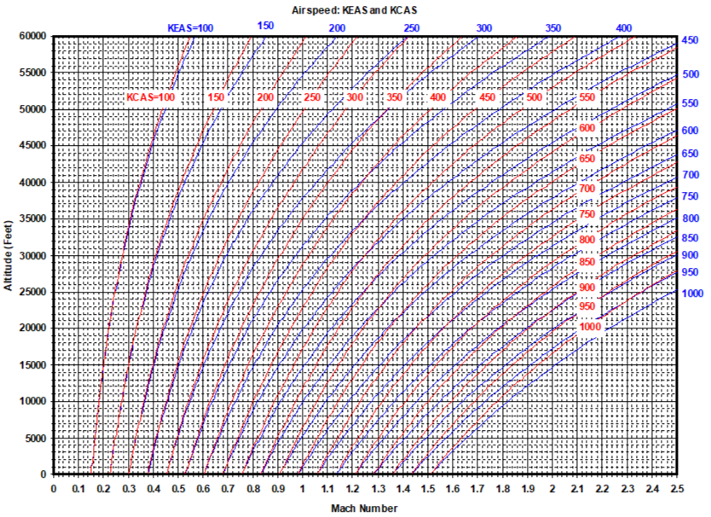
0.1 Situation: You Need a Mach/Altitude Chart
What do you do?
Recreate tools from scratch
Import/scan pictures
Recreate pictures with digital drawings
Mach-Altitude-Airspeed Plot

Slide 5
0.2 What If Instead You Had…
The highest quality VECTOR (zoomable) graphics
Reproducible examples in multiple languages and formats
Universally available content

Slide 6
1. What it was

Slide 7
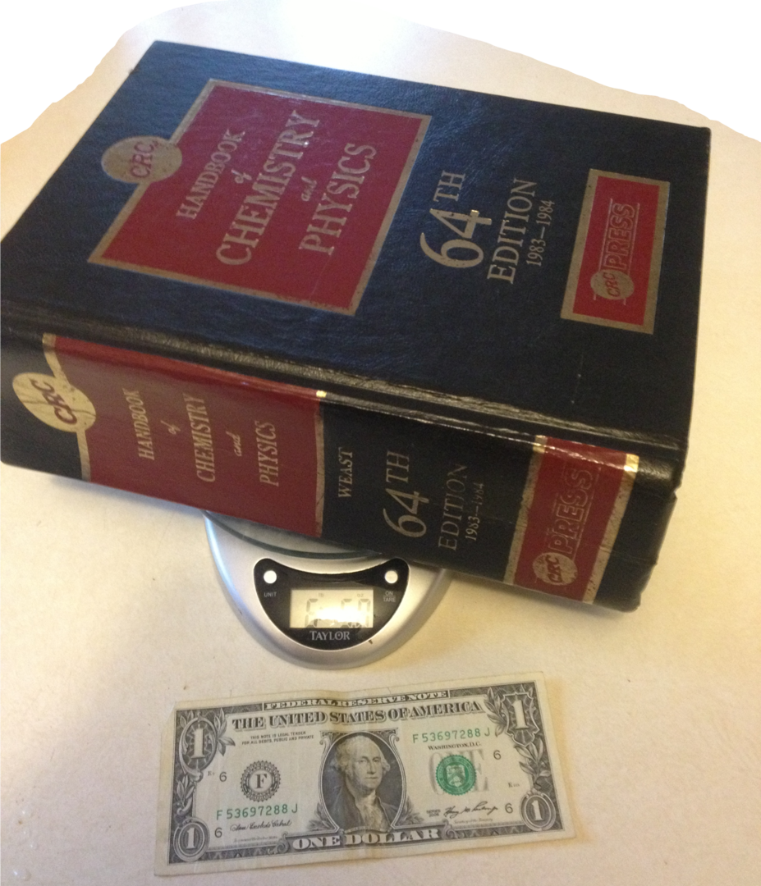
1.1 Handbook History
A book…
…that fit in your hand (debatable…see CRC)
Quick reference for common facts/figures
The CRC: One of the most famous “handbooks” in history

Slide 8
1.2 SFTE Handbook
2001: First edition
2013: Most recent major revision
2019: 2 Addenda
Source - Microsoft Word® - Microsoft Publisher®
Production - PDF - Hardcopy
Issues
Images of various format, resolution, and quality
Maintenance
Life cycle costs
Closed v open architecture
No clear procedure for amendments and revisions

Slide 9
2. What it is

Slide 10
2.1 “port”
/pôrt/
verb
verb: port; 3rd person present: ports; past tense: ported; past participle: ported; gerund or present participle: porting
COMPUTING
transfer (software) from one system or machine to another.
“the software can be ported to an IBM RS/6000”

Slide 11
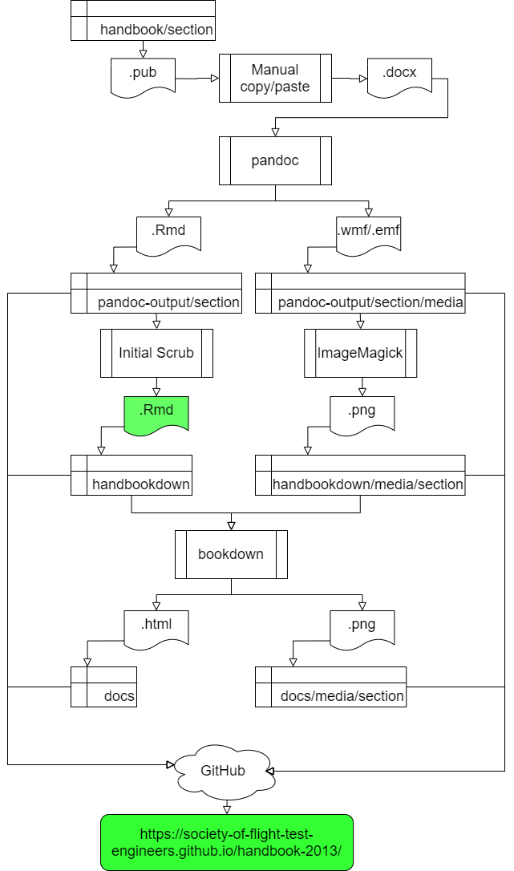
2.2 Porting the Handbook
Source
Unicode Text (Rmarkdown)
Production
HTML
Handbook Port Process

Slide 12
2.3.1 GitHub Demo
Required Tools
git
R
bookdown
text editor
command line
web browser
GitHub account
Optional Tools
An Integrated Development Environment such as…
VS Code
RStudio

Slide 13
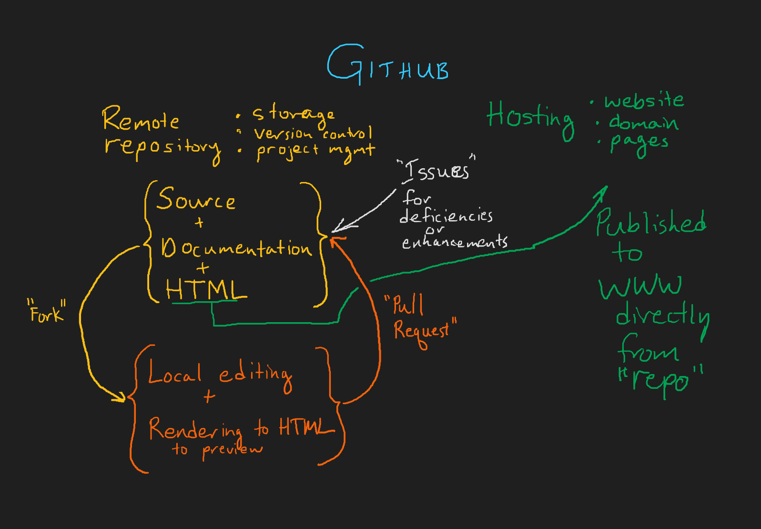

Slide 14
3. What it shall be

Slide 15
3.1 Phases
Now: Complete HTML
Next: Complete PDF
Next²:
Code to…
generate every plot
implement every function
Dynamic Handbook with…
interactive visualizations
interactive calculations
Next³: “Refactor” entirely → Handbook 2.0
A means of organizing and making accessible FTE knowledge, practices, and standards

Slide 16
Summary
There’s a lot to know
Modern tools allow for
more ready access
engagement with knowledge
reproducibility
fine-grained version control
Things of value require cultivation
growth environment
weeding
pruning
support
attention

Slide 17
References
CRC Image By NE Ent - Own work, CC BY-SA 3.0, https://commons.wikimedia.org/w/index.php?curid=24352142

