Slide 1
getsocietypress.org
Free · Open Source · Built by genealogists for genealogists

Slide 2
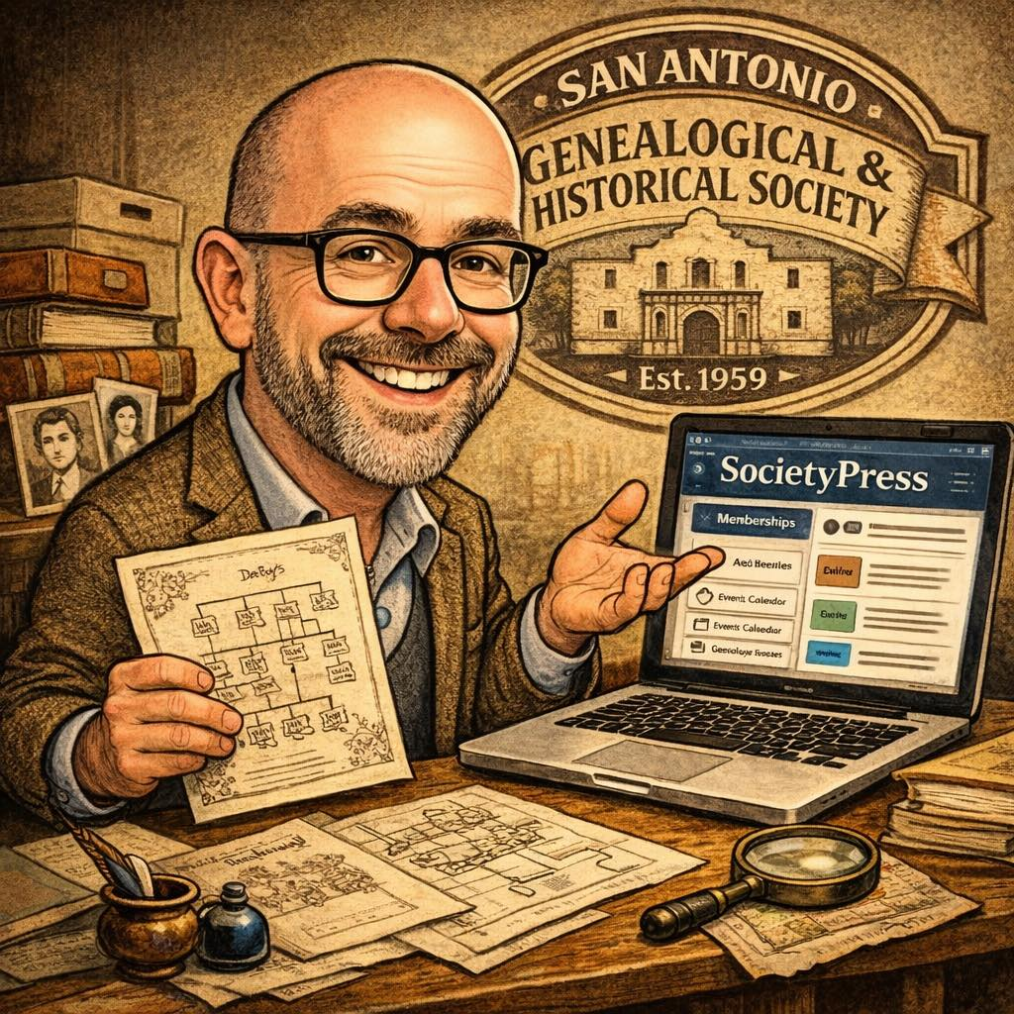
It made me mad.
So, I did something.
S
SocietyPress
Charles W. Stricklin
Education Committee Chair
San Antonio Genealogical & Historical Society
RootsTech 2027

Slide 3
“Someone spent hours walking those rows, brushing lichen off sandstone markers, squinting at half-legible dates…”
And almost no one
outside that society
can find it.
That data exists.
It is accurate.
It is extremely valuable.
It lives on someone’s laptop.
In a proprietary platform.
In a spreadsheet nobody can find.
S
SocietyPress
getsocietypress.org
Free · Open Source · Built by genealogists for genealogists

Slide 4
Meet Harold.
Retired history teacher. Bismarck, North Dakota.
Society secretary for 11 years.
Got voluntold into running the website.
📋
💻
🤝
Knows spreadsheets
Never heard “plugin”
used non-electrically
Keeps the society
running anyway
S
Harold is not a caricature. He is a portrait. Half the people in this room are Harold. The other half know Harold.
SociyPress
getsocietypress.org
Free · Open Source · Built by genealogists for genealogists

Slide 5
The 800-lb gorilla
170+
May 2027
$500/yr
$2,400
societies on ENS
ENS Classic sunset
(maybe sooner)
typical ENS-R cost
for a mid-size society
migration cost
for a small site
The kicker: ENS-R is almost certainly WordPress under the hood —
rebranded, locked down, and charged hundreds a year for the privilege.
Help desk tickets handled by overseas contractors. Password resets. Minutiae.
Your members’ dues money, gone.
getsocietypress.org
Free · Open Source · Built by genealogists for genealogists

Slide 6
The math is brutal.
A typical society: 150 members × $30/year dues = $4,500 in annual revenue
ENS-R
SocietyPress
$500
per year to ENS-R
+ $2,400 migration
= 11% of all revenue
just to keep the site on
$0
per year, forever
+ $10/mo hosting
= $120/year total
more money for preserving records
S
SocietyPress
getsocietypress.org
Free · Open Source · Built by genealogists for genealogists

Slide 7
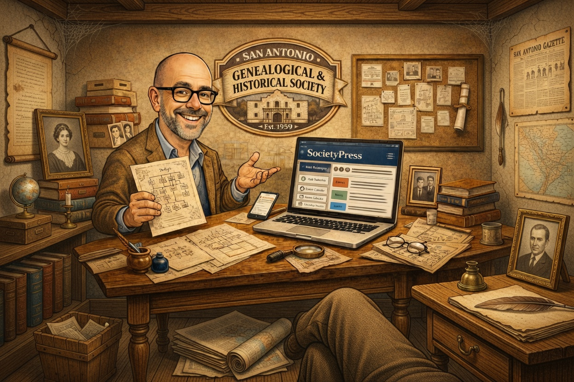
I got mad.
So I did something.
I volunteered as assistant to our 3rd VP and webmaster at SAGHS. I saw it firsthand: huge societies hire their own staff. Everyone else has aging volunteers, computer-phobic members, and a vendor collecting rent.
I watched money that should preserve history
disappear into a help ticket queue.
getsocietypress.org
Free · Open Source · Built by genealogists for genealogists

Slide 8
What it is.
S
SocietyPress
🔌 A WordPress plugin + theme
🆓 100% free. GPL licensed.
One file. Install, activate, done. No external dependencies.
Not freemium. Not “free tier.” Not “free but we sell your data.” Free.
🏠 Self-hosted — you own everything
👴 Built for Harold
Your data, your server, your site. Move hosts anytime. No vendor lock-in.
WordPress is completely hidden. Harold never needs to know it’s there.
S
SocietyPress
getsocietypress.org
Free · Open Source · Built by genealogists for genealogists

Slide 9
What it isn’t.
Honest expectations matter.
✕
✕
✕
Not a hosted service
Not a family tree app
Not finished
You need your own WordPress hosting.
$5–$15/month. Easy to get.
It’s a society management platform.
GEDCOM is for trees. This is for running your society.
Version 1. Built by one person.
It grows with your feedback.
The migration path exists: 86+ EasyNetSites column mappings. Direct CSV import. You don’t migrate alone.
S
SocietyPress
getsocietypress.org
Free · Open Source · Built by genealogists for genealogists

Slide 10
A complete society platform.
👥
📅
📚
📰
Membership management
Events & registration
Library catalog
Newsletter archive
🔎
💌
🏪
💰
Genealogical records
Blast email
Member store
Donations & campaigns
🙋
🗳️
🔒
🌐
Volunteer system
Voting & elections
Encrypted member data
Page builder
16 toggle-able modules · 35 genealogical record types · one install file · zero subscription fees
S
SocietyPress
getsocietypress.org
Free · Open Source · Built by genealogists for genealogists

Slide 11
Why not just use…
Wix / Squarespace
Wild Apricot
ENS-R
SocietyPress
✗ No membership mgmt
✗ Monthly fees $48–$230+
✗ $250–$700+/year
✓ Free forever
✗ No library catalog
✗ Built for any nonprofit
✗ $2,400 migration
✓ Built for this community
✗ No genealogical records
✗ No genealogy tools
✗ Vendor lock-in
✓ 35 record types
✗ Built for everyone =
built for no one
✗ You’re renting your
own member data
✗ Probably WordPress
in a trench coat
✓ You own everything
S
SocietyPress
getsocietypress.org
Free · Open Source · Built by genealogists for genealogists

Slide 12
Change doesn’t have to be scary.
1
You don’t have to decide today.
ENS Classic runs until May 2027 — maybe longer, maybe not. You have time to evaluate.
2
The migration path is already built.
86+ ENS column mappings. Direct CSV import. Your member data moves with you.
3
You don’t migrate alone.
Community, documentation, and a live demo you can poke at before committing to anything.
4
The downside is zero.
Try it. If it’s not right, you’ve lost nothing. If it is — you keep $500+/year. Forever.
S
SocietyPress
getsocietypress.org
Free · Open Source · Built by genealogists for genealogists

Slide 13
Three things. Right now.
1
2
3
Visit the site
Tell your board
Get involved
getsocietypress.org
demo.getsocietypress.org
Poke around. Try the demo.
Especially if you’re running ENS Classic.
The clock is ticking.
They need to know this option exists.
This is community software.
Your feedback shapes the next version.
Your society’s needs matter.
getsocietypress.org

Slide 14

S
SocietyPress
Free
Open Source
Built by genealogists for genealogists
getsocietypress.org · demo.getsocietypress.org
Charles W. Stricklin · Education Committee Chair, SAGHS

