Slide 1
Client Browser
Display, Tablet, etc.
Client Browser
Display, Tablet, etc.
OpenBAS
OpenBAS Application
Server
openBAS API
sMAP
Archiver
Broker
Metadata
Store
sMAP
TimeSeries
Store
sMAP Services
sMAP Drivers
Optional
Remote
Store
Net ctrl
Net lite
Net tstat

Slide 2
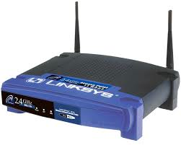
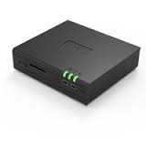
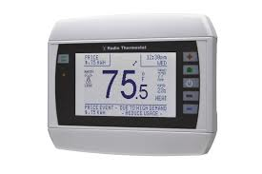
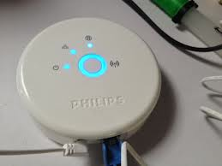
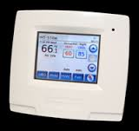


WAN
LAN
WLAN
net ctrl
LoWPAN
wifi tstat
OpenBAS
net lite
net lite
net tstat

Slide 3
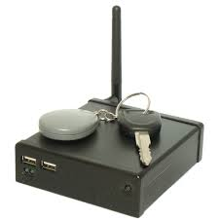
WAN/LAN
OpenBAS
net ctrl
WLAN
LAN
wifi tstat
LoWPAN
net lite
net lite
net tstat

