Slide 1
Client Browser
Display, Tablet, etc.
Client Browser
Display, Tablet, etc.
OpenBAS
OpenBAS Application
Server
openBAS API
sMAP
Archiver
Broker
Metadata
Store
sMAP
TimeSeries
Store
sMAP Services
sMAP Drivers
Optional
Remote
Store
Net ctrl
Net lite
Net tstat

Slide 2
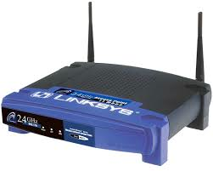
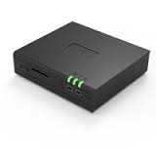
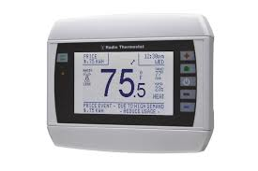
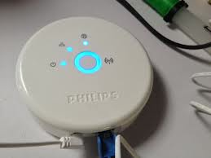
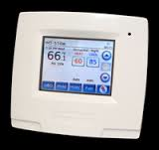


WAN
LAN
WLAN
LoWPAN

Slide 3
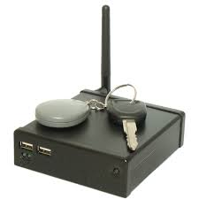
WAN/LAN
LAN
WLAN
LoWPAN

