Slide 1

POTENTIAL TO GO TO COLLEGE ANALYSIS
Done by:-
AMRITA SODHI [n01513240]
KARAN PUNJABI [n01514624]
REMYA RAJ [n01513680]
ROKEYA khatun [n01548033]
SAI SANJU REDDY PURAM [n01515886]

Slide 2

DATA SOURCE
Dataset: Go To College Dataset
The data we are using is “Go To College Dataset” taken from : Kaggle
The data provided is focused on high school conditions in Indonesia and includes several variables related to the students' background and their continuation to college.
Dataset is collected by the Ministry of Education in Indonesia, to increase the number of students attending college.

Slide 3
CHARACTERSTICS OF THE DATASET
Number of Attributes: 10
Number of Instances: 1000
Missing Values: N/A

Slide 4
ATTRIBUTE DESCRIPTION
type_school: indicates the type of high school attended by the student (vocational or academic)
school_accreditation: indicates the accreditation level of the high school (A, B, or C)
gender: indicates the gender of the student (male or female)
interest: indicates the level of interest of the student in continuing their education in college
residence: indicates the location of the student's residence (urban, rural, etc.)
parent_age: indicates the age of the student's parent
parent_salary: indicates the monthly salary of the student's parent in Indonesian rupiah
house_area: indicates the size of the student's house in square meters
average_grades: indicates the student's high school grades, with a maximum score of 100
parent_was_in_college: indicates whether the student's parent attended college
in_college: indicates whether the student actually continued their education in college.

Slide 5

TOOLS USED
HDFS
Zeppelin Notebook
Hive
HBase

Slide 6
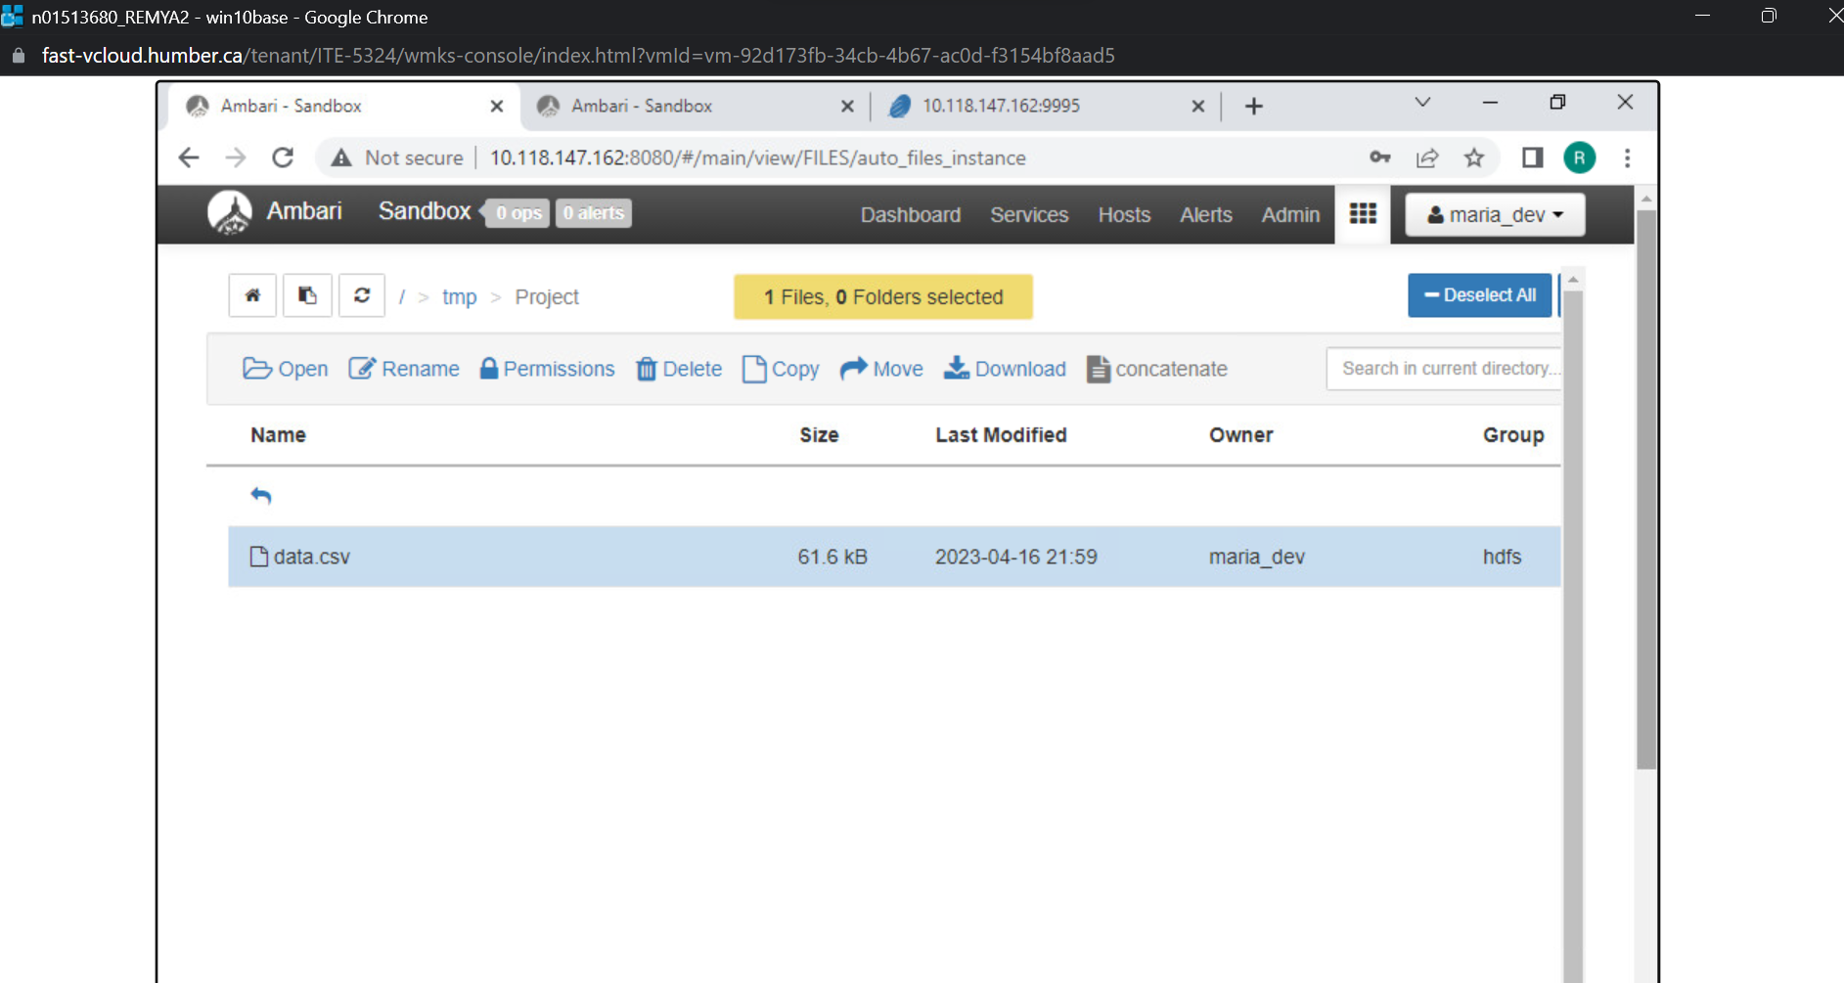
UPLOADING DATASET TO HDFS

Slide 7
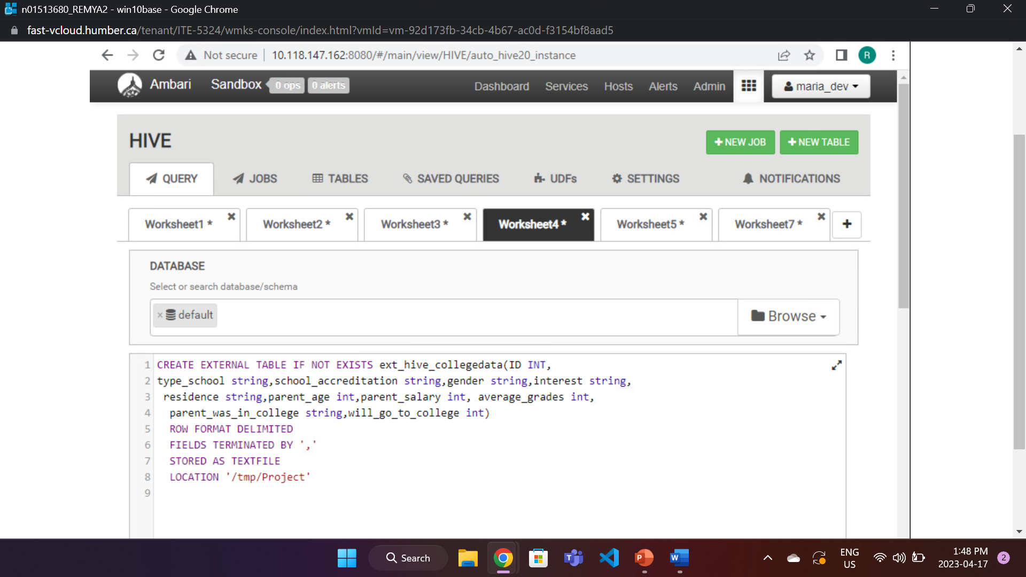
LOADING DATA FROM CSV

Slide 8
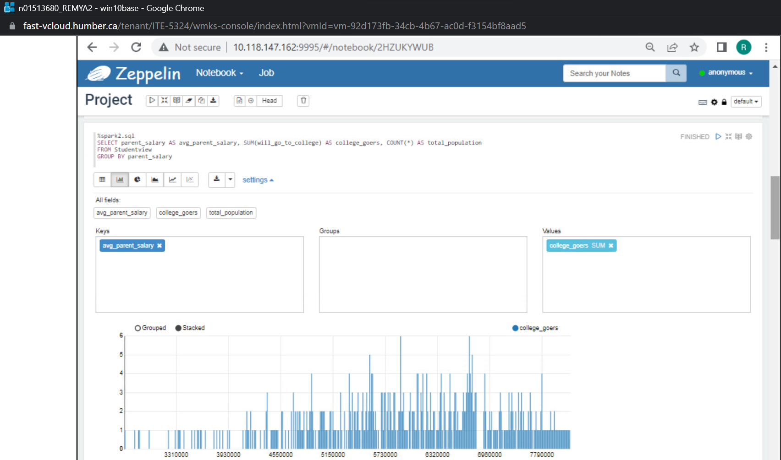
GO TO COLLEGE ANALYSIS: BASED ON PARENT SALARY
Based on the analysis, it appears that students with parents who have an average salary have more chance to attend college. Specifically, the majority of college-goers have parents whose salary falls within the range of 5330000 to 6750000.

Slide 9
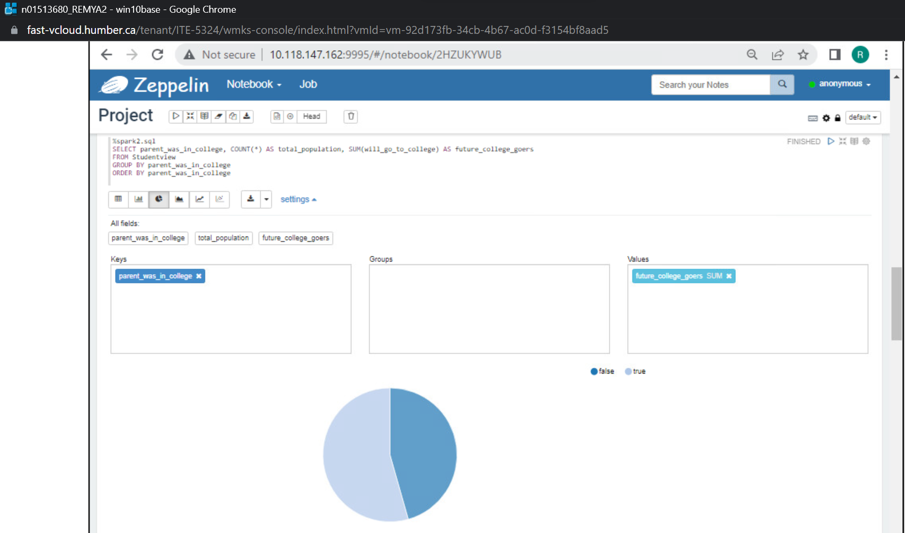
GO TO COLLEGE ANALYSIS: PARENT WAS IN COLLEGE OR NOT
Based on the analysis, it appears that having parents who attended school increases the likelihood of a student attending college. However, it appears that the difference is relatively small, with 56.5% of students with college-educated parents attending college compared to 47.5% of students with non-college-educated parents attending college.

Slide 10
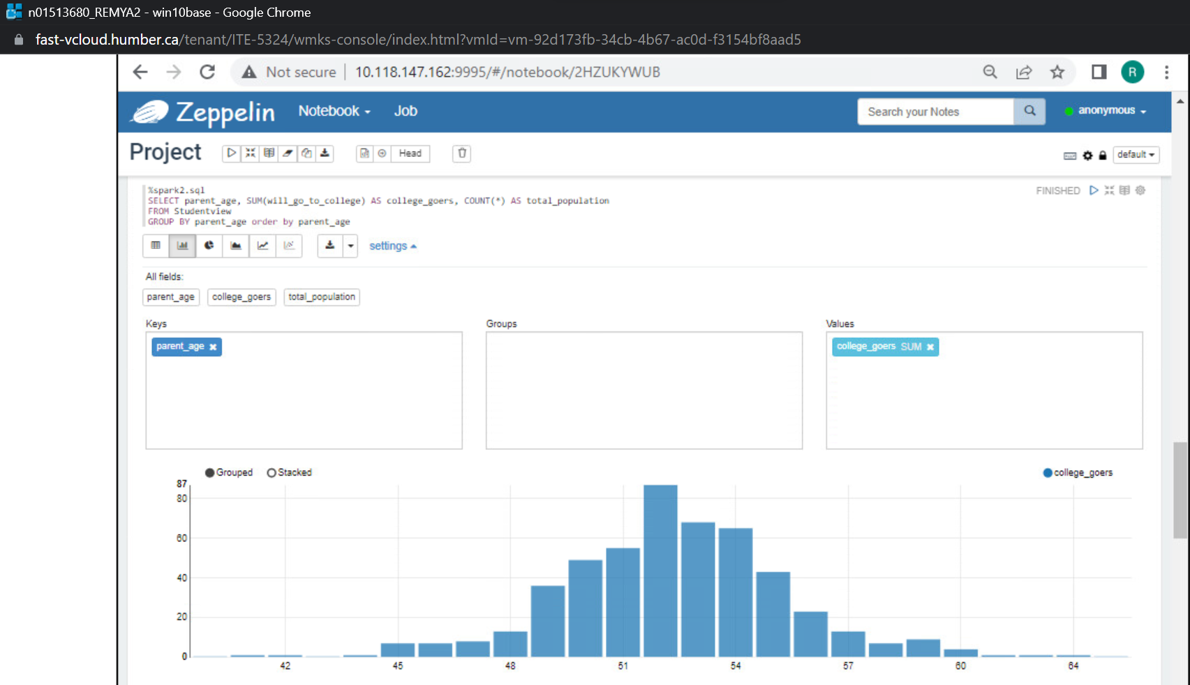
GO TO COLLEGE ANALYSIS: PARENT AGE
Based on the analysis, it appears that there may be a correlation between a student's likelihood of attending college and their parent's age. Specifically, the majority of college-going students have parents whose age falls within the range of 49 and 56.

Slide 11
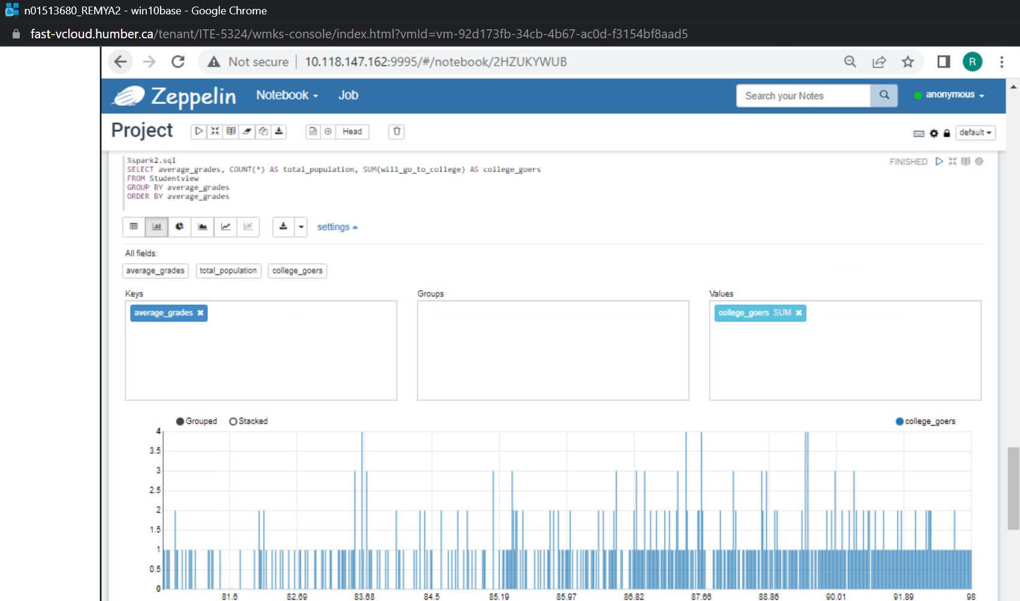
GO TO COLLEGE ANALYSIS: AVERAGE GRADES
Based on the analysis, it appears that there is a strong correlation between a student's academic performance and their likelihood of attending college.

Slide 12
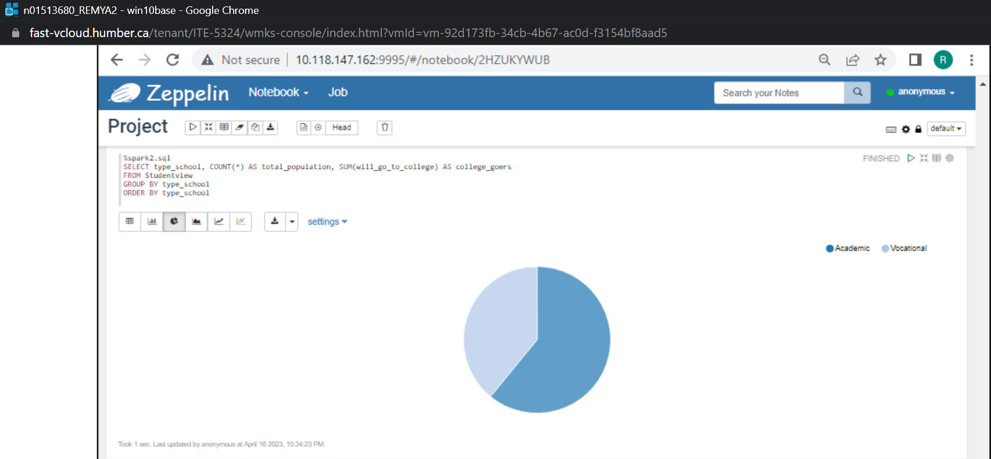
GO TO COLLEGE ANALYSIS: SCHOOL TYPE
Based on the analysis, it appears that the type of school a student attends may be a significant factor in determining their likelihood of attending college. Specifically, students who attend academic schools are more likely to go to college than those who attend vocational schools.

Slide 13
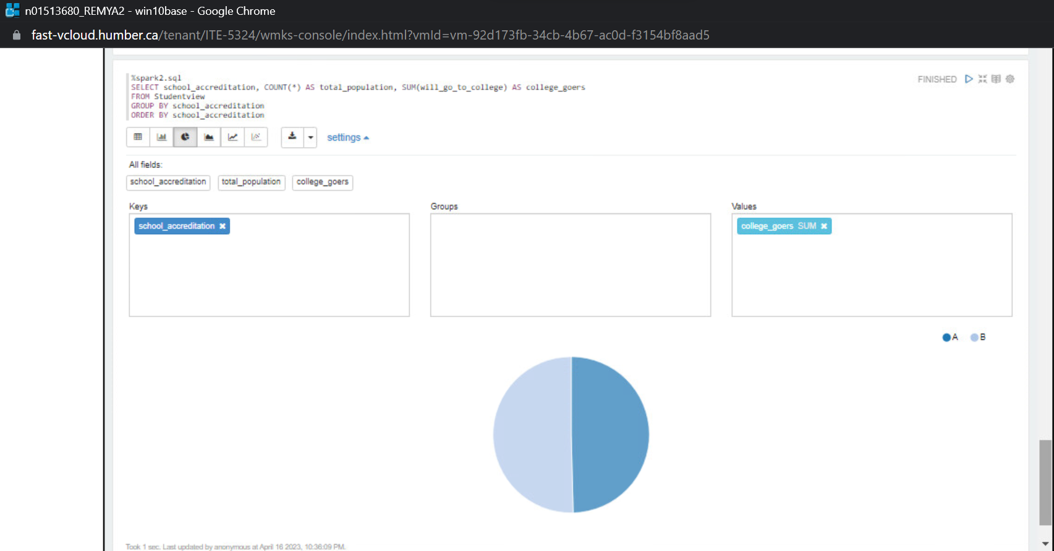
GO TO COLLEGE ANALYSIS: SCHOOL ACCREDITATION
Based on the analysis, there does not appear to be a significant difference in college attendance rates between students who attend accredited schools and those who do not. Specifically, out of 481 students who attended an accredited school, 248 will be going to college, while out of 519 students who attended a non-accredited school, 252 will be going to college.

Slide 14
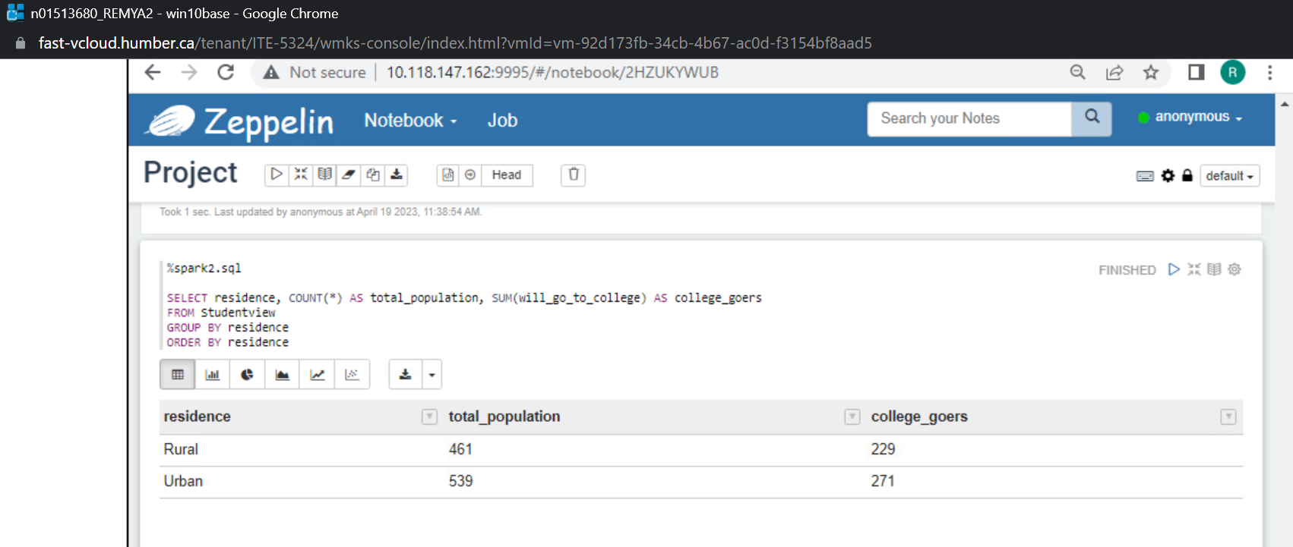
GO TO COLLEGE ANALYSIS: RESIDENCE
Based on the analysis, it appears that there is a relatively small difference in college attendance rates between students from rural and urban areas. Specifically, out of 461 students from rural areas, 229 attended college, while out of 539 students from urban areas, 271 attended college.

Slide 15
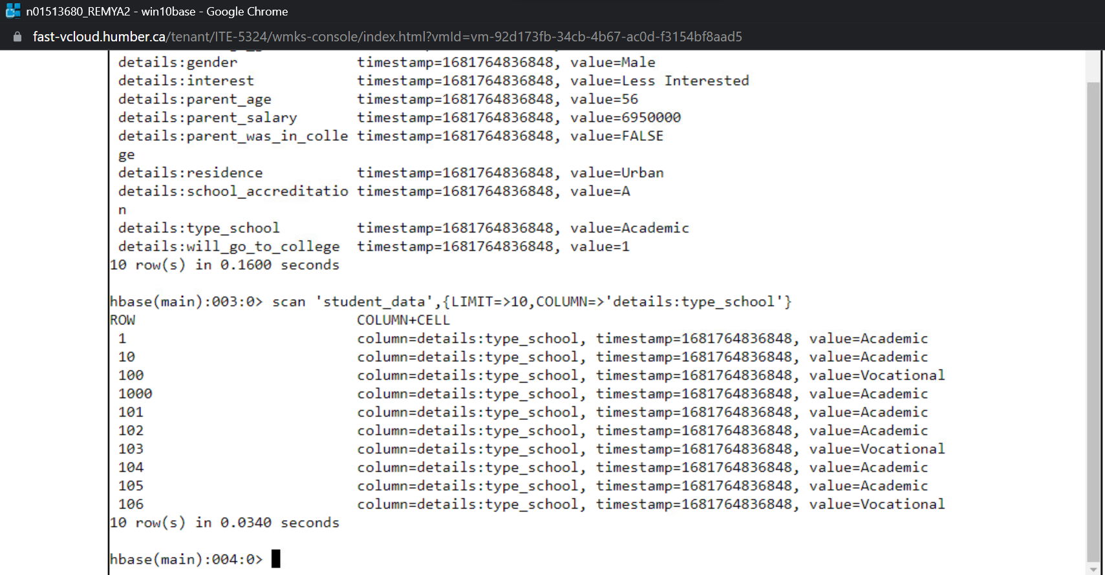
HBase: FILTERING OUT THE COLUMN TYPE_SCHOOL ( ONLY FIRST 10 RECORDS)

Slide 16
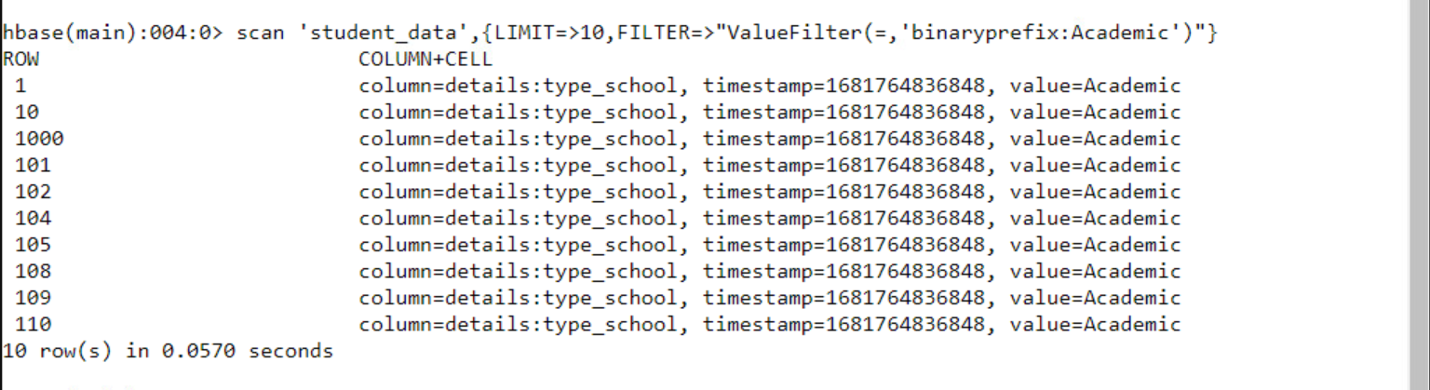
HBase: FILTERING OUT THE STUDENTS ATTENDED ACADEMIC SCHOOL ( ONLY FIRST 10 RECORDS)

Slide 17
CONCLUSION
Analysis done on categorical data indicates that students who come from an academic school, urban area and whose parents have attended college are more inclined to pursue higher education.
The analysis conducted on numerical data indicates that there is a higher probability for students with good academic grades and parents with high income to attend college.

Slide 18

THANK YOU!!

