Slide 1
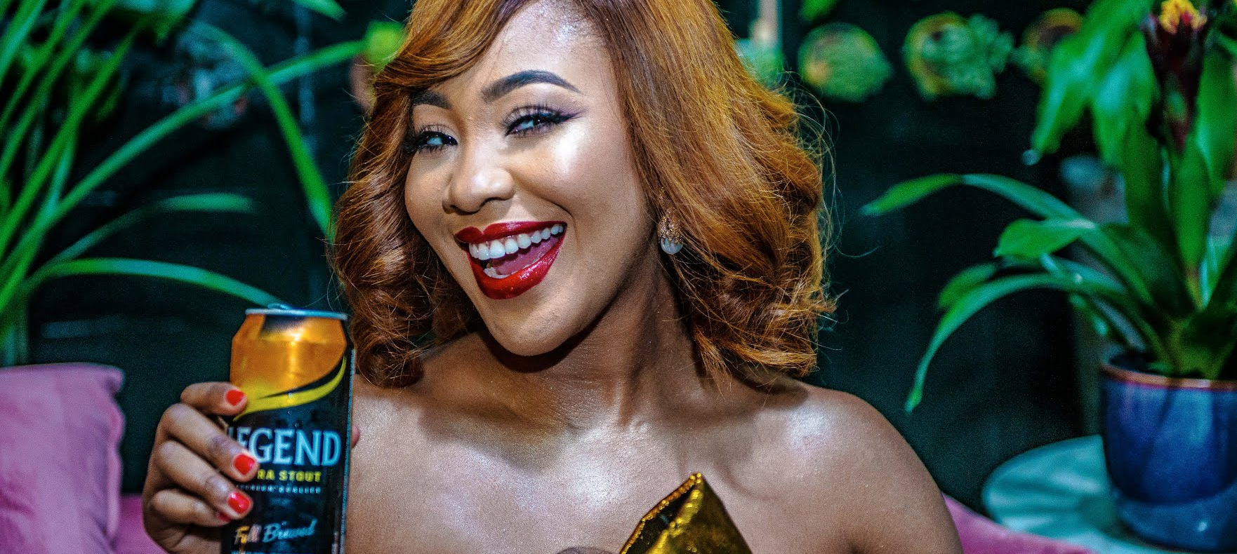
BRAND AMBASSADOR
EXPLOITATION PLAN

Slide 2
Beautiful
About Us
Introduction
consectetur arcu bibendum at varius vel pharetra al diam fermentum posuere urna nec tincidunt suscipit adipiscing bibendum est ultricies integer quis quisque
Minimal
Relax and let us bring the style to you.

Slide 3



DIGITAL
OBJECTIVES
01. Service
02. Service
03. Service
consectetur arcu bibendum varius pharetra fermentum posuere urna nec tincidunt at suscipit adipiscing bibenduma est
consectetur arcu bibendum varius pharetra fermentum posuere urna nec tincidunt at suscipit adipiscing bibenduma est
consectetur arcu bibendum varius pharetra fermentum posuere urna nec tincidunt at suscipit adipiscing bibenduma est

Slide 4
Fashion is very important. It is life enhancing and, like everything that gives pleasure, it is worth doing well.
Beautiful
About Us
More About Us
Minimal
Tips
consectetur arcu bibendum at
varius vel pharetra fermentum
posuere urna tincidunt suscipit

Slide 5

About Price
Our Subscription Plan
Minimal
$12.50 /month
Benefit
consectetur arcu bibendum at
varius vel pharetra fermentum
posuere urna nec tincidunt at
suscipit adipiscing
consectetur arcu bibendum at varius vel pharetra fermentum posuere urna anec tincidunt suscipit adipiscing bibenduma est ultricies integer quis lorem
Beautiful

Slide 6
01.
Minimal
We would have Erica prepare different cocktails, with Legend Stout being the main ingredient. There would be persons included in the show to judge the mix and guess the ingredients.
RATIONALE
02.
Services We
Provide
Content would be prerecorded and deployed weekly for a period of 1month. To optimize engagement, consumers would name the cocktail and winners would be randomly selected.
03.
Selected consumers would be given the opportunity to join her in two of the shows, to be a part of the jury.

Slide 7
01.
Minimal
We would have Erica on set with her friends or colleaue for each episode.
RATIONALE
02.
Services We
Provide
Content deployed would include consumer engagement.
03.
Selected consumers would be given the opportunity to join her in show to ask their questions.

Slide 8
01.
Minimal
We would have Erica on set with her friends or colleaue for each episode.
RATIONALE
02.
Services We
Provide
Consumers would be given an opportunity to show their creativity
03.
Selected consumers would be given the opportunity to join her in show to ask their questions.

Slide 9
THANK YOU

