Slide 1
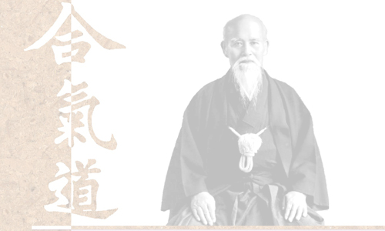
Secrets of the FRP Masters
The why and how of
Functional Reactive Programming

Slide 2
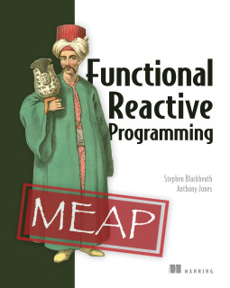
Stephen Blackheath
Manning Publications

Slide 3
Why FRP?
Composable event handling

Slide 4
Why FRP?
Composable event handling
Compositional event handling
(mathematically provable)

Slide 5
Why FRP?
Composable event handling
Compositional event handling
(mathematically provable)
Complete language for stateful logic

Slide 6
Benefits
Complexity scales linearly
with program size
=> Fewer bugs

Slide 7
How does it work?
Program = data flow
Logic
+
State
Inputs
Outputs

Slide 8
Two data types
Cell
a value that changes over time
e.g. time
space ship position
= state

Slide 9
Two data types
Stream
a stream of discrete events
e.g. mouse click
timer expires
= state change

Slide 10
Composing
6 ways to combine cells + streams
map/lift
merge
snapshot
filter
sample
switch
And that's it.

Slide 11
And...
Continuous time model

