Slide 1
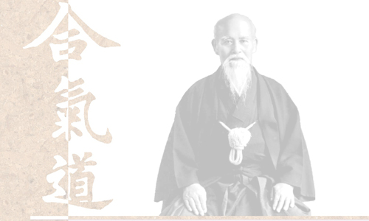
The why and how of
Functional Reactive Programming

Slide 2

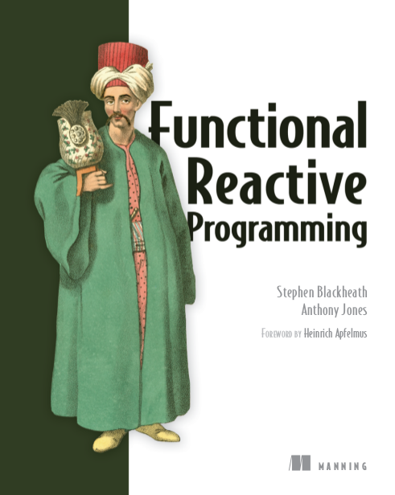
Stephen Blackheath
author...
Manning Publications

Slide 3
Topics
~ 1 hour
+ questions
Why FRP?
How it works:
Video game example
Advanced:
‘Remote values’ example
FRP implementation:
C++/Javascript memory management

Slide 4
Why FRP?
Callbacks
Composable event handling

Slide 5
Why FRP?
Callbacks
Composable event handling
Compositional event handling
(mathematically provable)

Slide 6
Why FRP?
Callbacks
Composable event handling
Compositional event handling
(mathematically provable)
Complete EDSL for stateful logic
(Embedded Domain Specific Language)

Slide 7
Why compositionality?
Callbacks
Complexity scales linearly
with program size
=> Fewer bugs

Slide 8
FRP is good for...
Complex data flow
Multi-variable state machines
Anywhere where callbacks are used
User interfaces
Video games
Industrial

Slide 9
FRP is good for...
Complex data flow
Multi-variable state machines
Anywhere where callbacks are used
User interfaces
Video games
Industrial

Slide 10
How does it work?
Program = data flow
Logic
+
State
Inputs
Outputs

Slide 11
How does it work?
Logic + State = composable unit
Logic
+
State
Logic
+
State
Inputs
Outputs
Logic
+
State
Logic
+
State

Slide 12
Video game example

Slide 13
Video game example (Java/Sodium)
Inputs
Outputs
time
scene
Logic
+
State
sClick
sGameOver

Slide 14
Video game example - code
https://github.com/SodiumFRP/demo-ftack

Slide 15
Two data types – Cell | Stream
Cell
a value that changes over time
e.g. time, scene
stack, block position
= state

Slide 16
Two data types – Cell | Stream
Stream
a stream of discrete events
e.g. mouse click
game over
= state change

Slide 17
Video game example
Cell
Cell
time
scene
Logic
+
State
sGameOver
sClick
Stream
Stream

Slide 18
Composing
6 ways to compose cells & streams
map/lift
merge
snapshot
filter
sample
switch
And that's it.

Slide 19
Co-ordinate system
z
x
y

Slide 20
map example
time
scene
map
sClick
sGameOver
A block whose position is a function of time

Slide 21
Continuous time model
“Rasterization”
of time
Model
Time
Frames

Slide 22
lift example
time
scene
lift
stack
sClick
sGameOver
Combine block with current stack

Slide 23
snapshot example
time
scene
lift
stack
sClick
sGameOver
snapshot
On click, snapshot current scene

Slide 24
Remote values example
FRP represents event-based logic functionally
=>
FP = meta-language for event-based logic

Slide 25
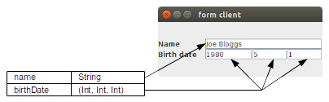
Remote values example

Slide 26
Remote values example
public abstract class Value<A> {
public abstract ValueOutput<A>
construct(Stream<A> sWrite);
}
public class ValueOutput<A> {
public ValueOutput(..) { .. }
public final Cell<Optional<A>> value;
public final Listener cleanup;
}

Slide 27
Remote values: Impedance mismatch
Database
Value<Date> vBirthDate
UI
Value<Integer> vYear
Value<Integer> vMonth
Value<Integer> vDay

Slide 28
Remote values example
Read vYear :-
  Get current vBirthDate
  Return the year
Write vYear :-
  Get current vBirthDate
  Modify the year
  Write modified vBirthDate

Slide 29
Remote values:‘lens’ method
class Value<A> {
...
public final <B> Value<B> lens(
Lambda1<A, B> getter,
Lambda2<A, B, A> setter);
}
Value<Integer> vYear = vBirthDate.lens(
d -> d.year,
(dt, y) -> dt.setYear(y)
);

Slide 30
Remote values:‘lens’ method
public final <B> Value<B> lens(
Lambda1<A, B> getter,
Lambda2<A, B, A> setter) {
Value<A> va = this;
return new Value<B>() {
public ValueOutput<B>
construct(Stream<B> sWriteB) {
...
}
};
}

Slide 31
Remote values: Output of lens
StreamLoop<A> sWriteA = ...
ValueOutput<A> out = va.construct(sWriteA);
Cell<Optional<A>> oa = out.value;
return new ValueOutput<B>(
oa.map(oa_ ->
oa_.isPresent()
? Optional.of(getter.apply(oa_.get()))
: Optional.empty()),
out.cleanup);

Slide 32
Remote values: Input of lens
StreamLoop<A> sWriteA = new StreamLoop<>();
ValueOutput<A> out = va.construct(sWriteA);
sWriteA.loop(Stream.filterOptional(
sWriteB.snapshot(oa, (wb, oa_) ->
oa_.isPresent()
? Optional.of(setter.apply(oa_.get(), wb))
: Optional.empty()
)));

Slide 33
FRP Implementation: C++
Sodium is implementation of FRP
Sodium uses callbacks internally
FRP memory management is automatic

Slide 34
Java: with finalizers
sa
Stream<A> sa = …
Stream<B> sb = sa.map(f);
sb
Listener
registered
GC!
sa
Listener
de-registered

Slide 35
FRP Implementation
Java: uses finalizers
But C++ we use reference counting pointers
PROBLEM: Cycles

Slide 36
Memory management w/smart ptrs
1
Represent “depends-on” relationship with smart ptrs
sa
reversed
sb

Slide 37
Memory management w/smart ptrs
2
Use plain pointers for callbacks
sa
sb
user

Slide 38
Memory management w/o finalizers
3
De-register callbacks on destruct
sa
sb

Slide 39
Memory management w/o finalizers
4
Detect cycles using cycle-detection algorithm
sc
sa
sd
sb

Slide 40
Memory management w/smart ptrs
5
Need to declare Sodium objects referenced by closures, so they can be tracked
Replicate
[...]
auto ca = ...;
auto cb = ...;
auto csw = csw_str.map(
lambda([ca, cb] (std::string s) {
return s == "ca" ? ca : cb;
}, {ca.ref(), cb.ref()}));

Slide 41
Questions

