Slide 1
Data science HW3
Department of Computer Science
National Tsing Hua University (NTHU)
Hsinchu, Taiwan
Date: April 13th, 2021
TA Email: tfg10232338@gmail.com

Slide 2
HW3
Description
How to submit and choose predictions
Baseline method
Hints

Slide 3

Kaggle
HW3 will be held on Kaggle
Please register a Kaggle account first
A platform of
Machine learning competition
Sharing dataset
https://zh.wikipedia.org/wiki/Kaggle

Slide 4
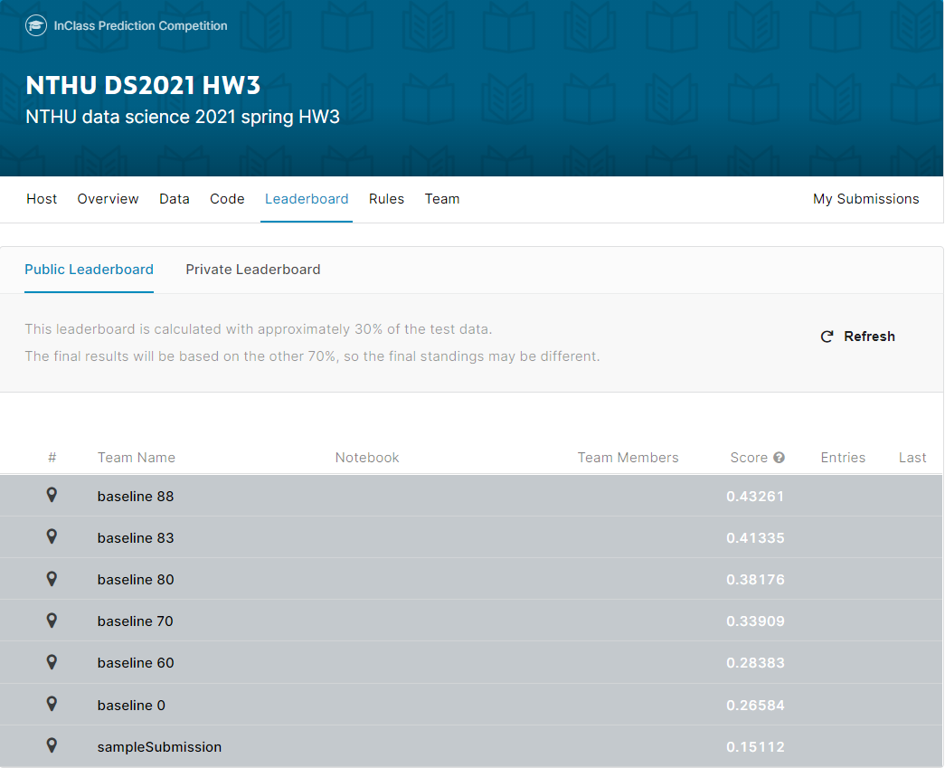
HW3
HW3 Kaggle link
https://www.kaggle.com/t/8257d4321c074ef1b587535c2c775883
Deadline: 2021/05/11 23:59 (4 weeks)
We will use the result on Kaggle to score this homework
No need to hand in any files on iLMS
Remember to fill your Kaggle name in the google form https://docs.google.com/spreadsheets/d/1cg-BPX6gKrcEXLbWzhnxKsYkZNGXXfPN6n7JZHlvN_U/edit?usp=sharing

Slide 5
Problem description
Supervised binary classification problem
Given a data set
Training set with label
Testing set without
You need to predict the labels of testing data

Slide 6
Dataset description
The dataset is transformed from real weather observations dataset
16 numeric features, 5 nominal features, 1 label
Numeric feature are nonlinear transformed
About 20% data become missing value
Our dataset label is ‘Weather’

Slide 7
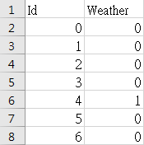
Output format
For each testing instance, there is a unique id
Output your prediction to csv file with the following format and submit to kaggle Remember to output the first line
Id, Weather
Id1, Weather 1
Id2, Weather 2
…

Slide 8
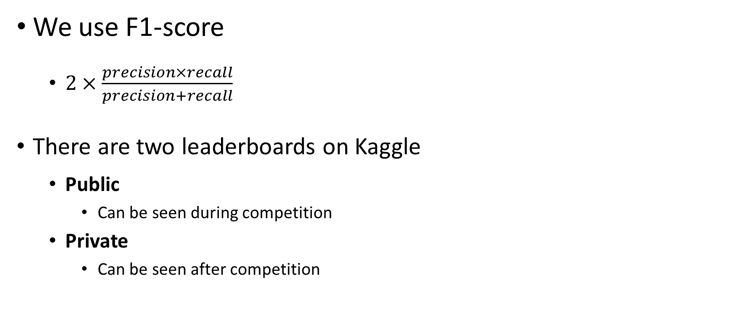
Evaluation
We use F1-score
$2×\frac{precision×recall}{precision+recall}$
There are two leaderboards on Kaggle
Public
Can be seen during competition
Private
Can be seen after competition

Slide 9
Public and Private leaderboard
Public (Can be seen during competition)
30% testing data
For reference
Private (Can be seen after competition)
the other 70%
Use this result for final scoring
30%
Public score
Testing
data
70%
Private score

Slide 10
Scoring
Use private leaderboard result for final scoring
Baseline scores
We will score according to given 7 baseline scores
 | Public | Private
Baseline 90 | 0.43261 | 0.42595
Baseline 85 | 0.41335 | 0.42502
Baseline 80 | 0.38176 | 0.38108
Baseline 70 | 0.33909 | 0.35150
Baseline 60 | 0.28220 | 0.28336
Baseline 0 | 0.26584 | 0.25060

Slide 11
Scoring
Baseline 0
Baseline 60
Baseline 70
Baseline 80
Baseline 83
Baseline 88
Top 20% : 100
20%~80%: 92
Others: 88
0
60
70
80
85
You will get 0, if your private score is between baseline 0 and baseline 60
You will get 60, if your private score is between baseline 60 and baseline 70
You will get 70, if your private score is between baseline 70 and baseline 80
And so on

Slide 12
Scoring
Baseline scores
There are benchmarks on the leaderboard for reference

Slide 13
Other rules
You can submit 15 times per day
You can choose 4 predictions for final scoring
Kaggle will use the best one to be your final result

Slide 14
How to submit and choose predictions

Slide 15
How to submit
Click ‘Submit Predictions’ button on the navigation bar

Slide 16
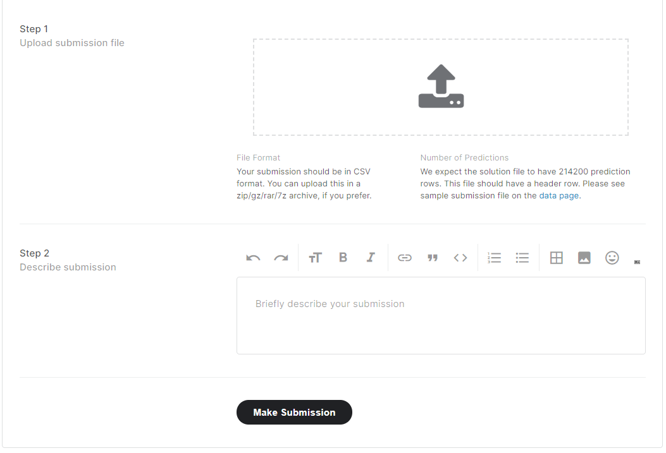
How to submit
Upload your answer csv file here
You can write some description about the answer csv file
Click to submit

Slide 17
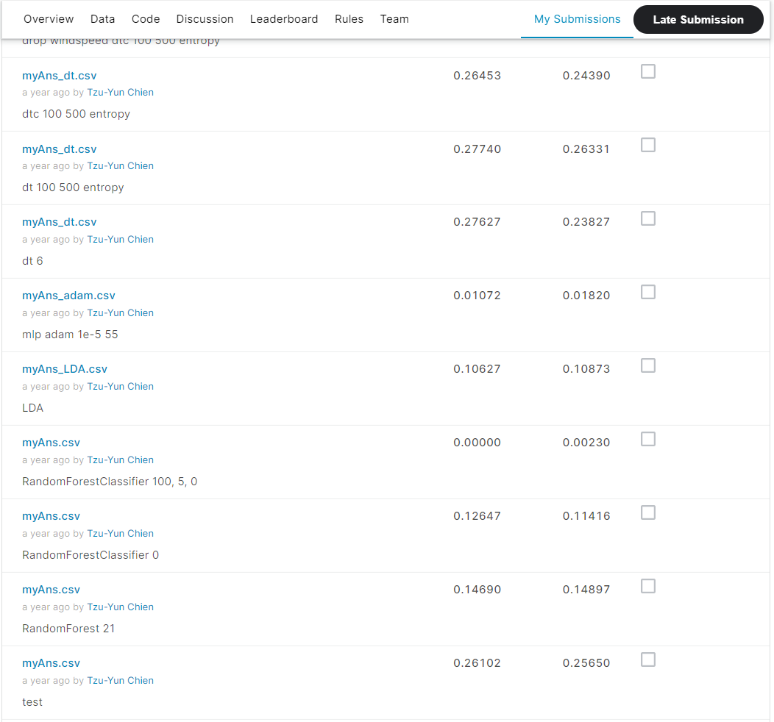
Choose predictions for final scoring
You can see all your submissions in ‘My Submissions’
Remember to choose 4 predictions before the deadline

Slide 18
Baseline method

Slide 19
Baseline method
We provide a simple baseline method code for your reference
Baseline 0
The steps in baseline are as below
Read training/testing data
Drop columns which are not numeric features
Fill missing value
Train a decision tree classifier
Output prediction

Slide 20
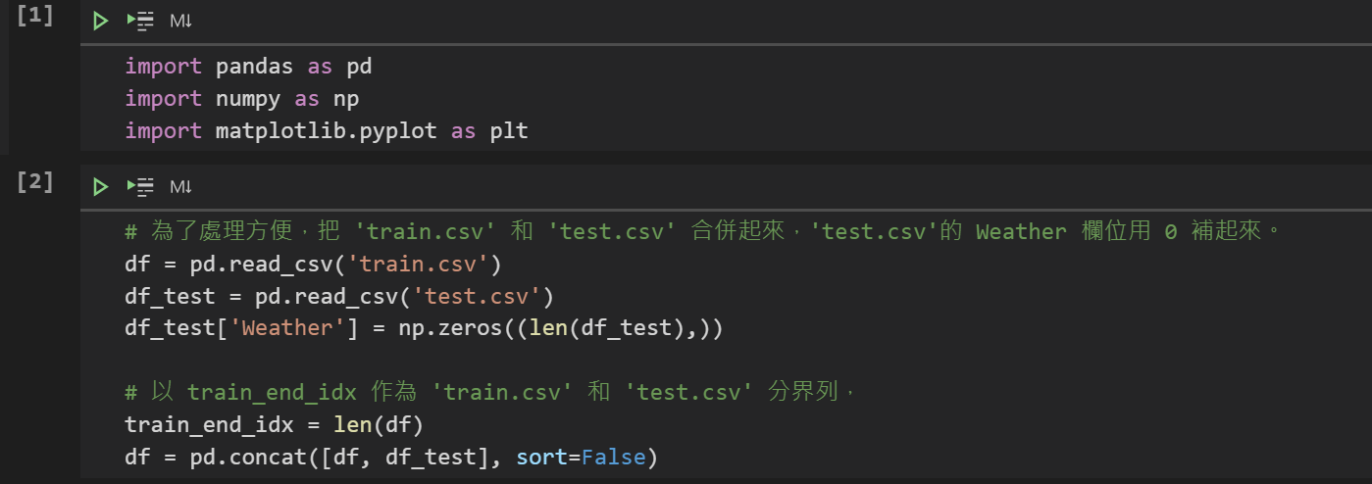
Baseline 0 method
Read training/testing data

Slide 21
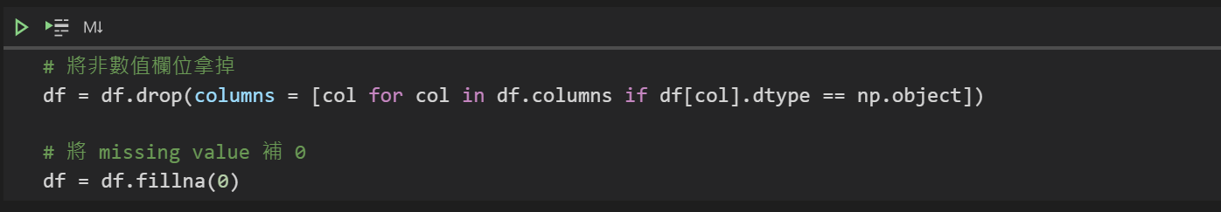
Baseline 0 method
Drop columns which are not numeric features
Fill missing value

Slide 22
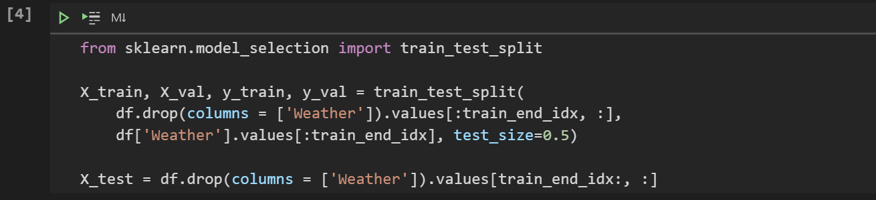
Baseline 0 method
train.csv
test.csv
X_train
X_val
X_test
train_end_id
Split dataset

Slide 23
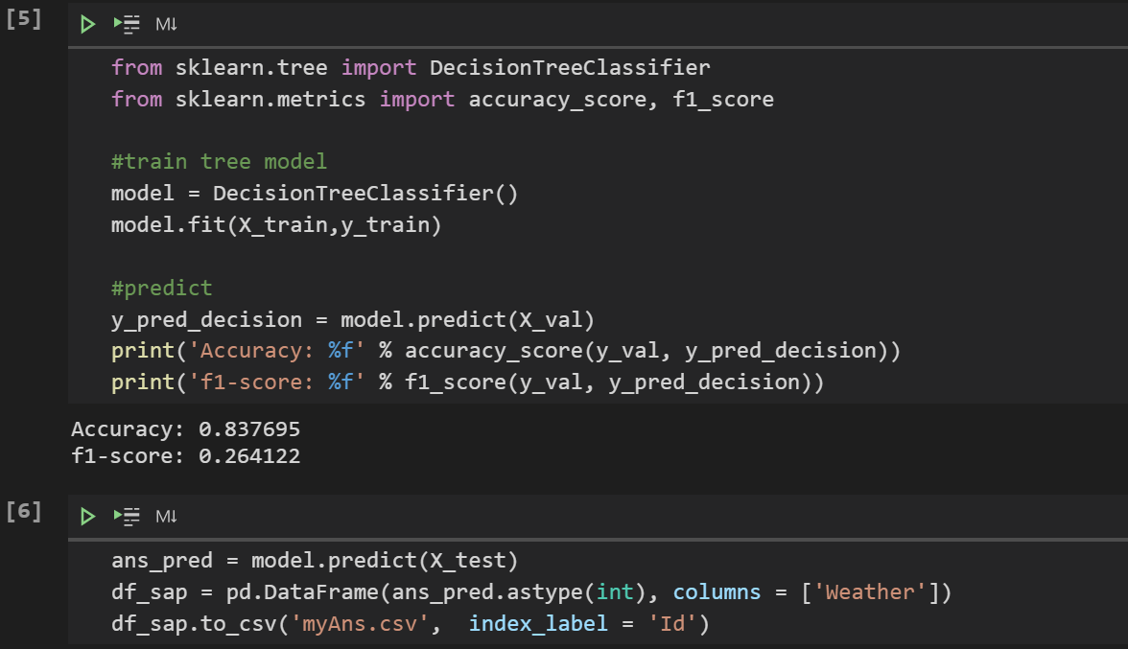
Baseline 0 method
Train a decision tree classifier and output prediction

Slide 24
Hints

Slide 25
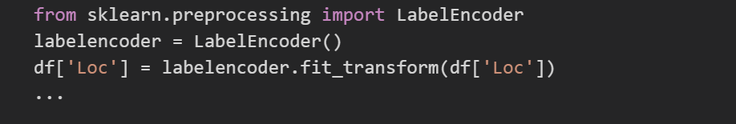
Hints
You can try to encode features in object type
Some features in object type may contain important information

Slide 26
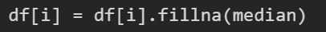
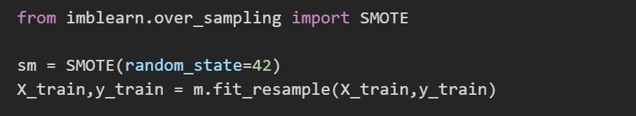
Hints
Fillna with median in numeric features instead of 0
Deal with data imbalance
Complete these may achieve the same or higher effect as the baseline 60

Slide 27
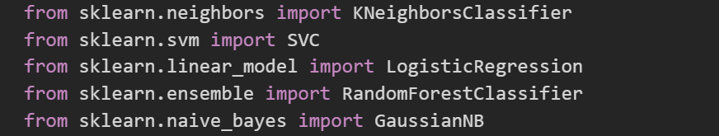
Hints
Try different models
KNN, SVM, Logistic Regression, Random Forest ...
Finetune the model may achieve higher effect than the baseline 70 and 80

Slide 28
Hints
More techniques for better performance
Feature selection
Normalization
Dimension reduction (PCA, TSNE)
Try other different models
…
We use private leaderboard as the final score
Use public score to choose your model is dangerous
It’s better to perform validation

Slide 29
Packages you may use
Scikit-learn
https://scikit-learn.org/stable/index.html
Pandas
https://pandas.pydata.org/pandas-docs/stable/
Imbalance learn (for over sampling and down sampling)
https://imbalanced-learn.readthedocs.io/en/stable/

